Slide 1
Environmental Data Analysis with MatLab
Lecture 8:
Solving Generalized Least Squares Problems

Slide 2
SYLLABUS
Lecture 01 Using MatLab
Lecture 02 Looking At Data
Lecture 03 Probability and Measurement Error
Lecture 04 Multivariate Distributions
Lecture 05 Linear Models
Lecture 06 The Principle of Least Squares
Lecture 07 Prior Information
Lecture 08 Solving Generalized Least Squares Problems
Lecture 09 Fourier Series
Lecture 10 Complex Fourier Series
Lecture 11 Lessons Learned from the Fourier Transform
Lecture 12 Power Spectra
Lecture 13 Filter Theory
Lecture 14 Applications of Filters
Lecture 15 Factor Analysis
Lecture 16 Orthogonal functions
Lecture 17 Covariance and Autocorrelation
Lecture 18 Cross-correlation
Lecture 19 Smoothing, Correlation and Spectra
Lecture 20 Coherence; Tapering and Spectral Analysis
Lecture 21 Interpolation
Lecture 22 Hypothesis testing
Lecture 23 Hypothesis Testing continued; F-Tests
Lecture 24 Confidence Limits of Spectra, Bootstraps

Slide 3
purpose of the lecture
use prior information to solve exemplary problems
Notes:
This lecture mostly consists of examples. You might consider using MatLab during the lecture, to solve some
of the exemplary problems in real-time.

Slide 4
review of last lecture

Slide 5
failure-proof least-squares
add information to the problem that guarantees that matrices like [G^{T}G] are never singular
such information is called
prior information
Notes:
Remind the students that least squares fails when the data do not uniquely specify the solution.
Mathematically, this corresponds to [G^{T}G] being singular.

Slide 6
examples of prior information
soil has density will be around 1500 kg/m³
give or take 500 or so
chemical components sum to 100%
pollutant transport is subject to the diffusion equation
water in rivers always flows downhill
Notes:
If, during the last lecture, the class came up with more examples, mention them here.

Slide 7
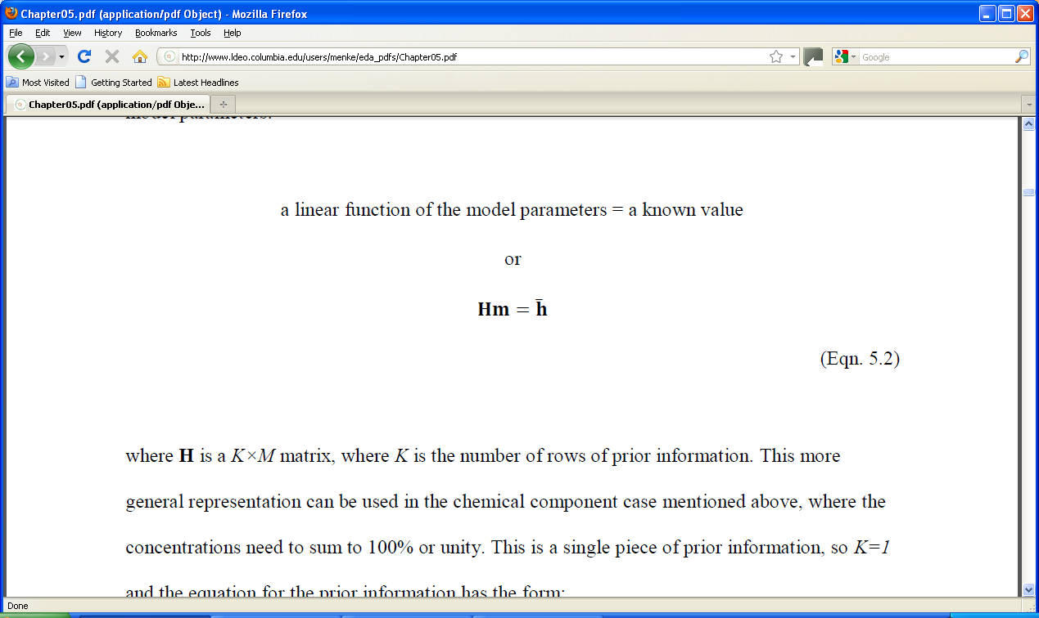
linear prior information
with covariance C_{h}
Notes:
Emphasize that the covariance matrix represents the quality of the prior information.
Is it inaccurate or accurate?

Slide 8
simplest example model parameters near known values
Hm = h with
H=I
h = [10, 20]^{T}
C_{h}=
m₁ = 10 ± 5
m₂ = 20 ± 5
m₁ and m₂ uncorrelated
5² | 0
0 | 5²
Notes:
Use a pointer to show that the known values of (10, 20) wind up in h and the confidence limits of (5,5) wind up in C_{h}.

Slide 9
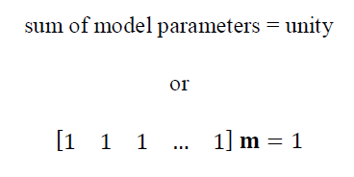
another example relevant to chemical constituents
H
h
Notes:
Mention that the matrix H has only one row. Multiplying m by it just sums the elements of m.

Slide 10
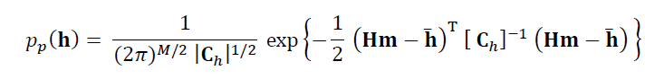
use Normal p.d.f. to represent prior information
Notes:
Mention that this is the standard form of a multivariate Normal distribution. It has mean, h-bar, and covariance, C_{h}.

Slide 11

Normal p.d.f. defines an
“error in prior information”
individual
errors weighted by their certainty
Notes:
Mention that the error is zero when the prior information equation, Hm=h-bar, is satisfied exactly.
Mention that variance is a measure of the width of the p.d.f, so that 1/variance is a measure of it narrowness, that is, its certainty.

Slide 12
now suppose that we observe some data:
d = d^{obs}
with covariance C_{d}
Notes:
Emphasize that the covariance matrix, Cd, represents the quality of the data,
that is, whether it is accurate or inaccurate.

Slide 13
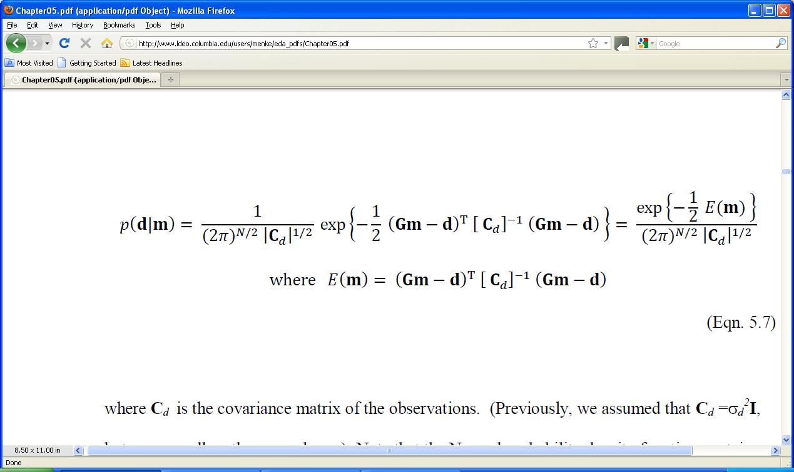
represent the observations with a
Normal p.d.f.
p(d) =
observations
mean of data predicted by the model
Notes:
This is just a standard Normal p.d.f. with the mean set to Gm and the variance to C_{d}.

Slide 14
this Normal p.d.f. defines an
“error in data”
prediction error
weighted by its certainty
Notes:
Mention that this is almost the least-squares error of Chapter 4, except that now each component error is weighted by its certainty.

Slide 15
Generalized Principle of Least Squares the best m^{est} is the one that minimizes the total error with respect to m justified by Bayes Theorem in the last lecture
Notes:
Only differences from ordinary least squares are 1) the error depends on both the prediction error and the error in the prior information. 2) all component errors are weighted by their certainty - the more certain, the more weight that they are given.

Slide 16
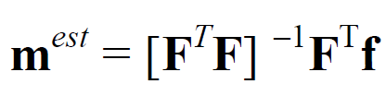
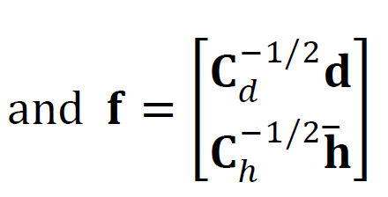
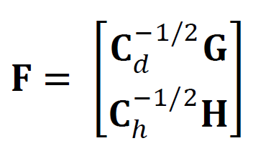
generalized least squares solution
pattern same as ordinary least squares …
… but with more complicated matrices
Notes:
The solution has been arranged to look as much like ordinary least squares as possible.
Some students may not have ever encountered the square root of a matrix, C.
In this lecture, however, we will always assume that the matrix C is diagonal, so that
its square root is just the square root of its diagonal elements.
So you might review show on the board that when you multiply a diaginal matrix by itself,
you just square its diagonal elements.

Slide 17
(new material)
How to use the
Generalized Least Squares Equations

Slide 18
Generalized least squares is equivalent to solving
F m = f by ordinary least squares
=
C_{d}^{-½}G
C_{h}^{-½}H
C_{d}^{-½}d
C_{h}^{-½}h
m

Slide 19
uncorrelated, uniform variance case
C_{d} = σ_{d}² I
C_{h} = σ_{h}² I
=
σ_{d}⁻¹G
σ_{h}⁻¹H
σ_{d}⁻¹d
σ_{h}⁻¹h
m
Notes:
You might show on the board how the general form reduces to this simpler one.

Slide 20
top part data equation weighted by its certainty
=
σ_{d}⁻¹G
σ_{h}⁻¹H
σ_{d}⁻¹d
σ_{h}⁻¹h
m
σ_{d}⁻¹ { Gm=d }
data equation
certainty of measurement
Notes:
The top part is just the data equation, weighted by its certainty.

Slide 21
bottom part prior information equation weighted by its certainty
=
σ_{d}⁻¹G
σ_{h}⁻¹H
σ_{d}⁻¹d
σ_{h}⁻¹h
m
σ_{h}⁻¹ { Hm=h }
prior information equation
certainty of prior information
Notes:
The bottom part is just the prior information equation, weighted by its certainty.

Slide 22
example no prior information but data equation weighted by its certainty
σ_{d1}⁻¹G₁₁ | σ_{d1}⁻¹G₁₂ | … | σ_{d1}⁻¹G_{1M}
σ_{d2}⁻¹G₂₁ | σ_{d2}⁻¹G₂₂ | … | σ_{d2}⁻¹G_{2M}
… | … | … | …
σ_{dN}⁻¹G_{N1} | σ_{dN}⁻¹G_{N2} | … | σ_{dN}⁻¹G_{NM}
σ_{d1}⁻¹d₁
σ_{d2}⁻¹d₂
…
σ_{dN}⁻¹d_{N}
=
m
called “weighted least squares”
Notes:
When there is no prior information, the top part (from 2 lides back) is the only part.

Slide 23
straight line fit no prior information but data equation weighted by its certainty
fit
data with low variance
data with high variance
Notes:
In this example, the left half of the data has large variance, and the right half has small variance.
The straight-line fit (green line ) more closely fits the right hand data.

Slide 24
straight line fit no prior information but data equation weighted by its certainty
fit
data with low variance
data with high variance
Notes:
In this example, the right half of the data has large variance, and the left half has small variance.
The straight-line fit (green line ) more closely fits the left hand data.

Slide 25
another example prior information that the model parameters are small m≈0
H=I h=0 assume uncorrelated with uniform variances
C_{d} = σ_{d}² I
C_{h} = σ_{h}² I
Notes:
There are many cases where a list of model parameters fluctuate around zero.
For example, suppose that the model parameters represent the amount of deposition
(when they are positive) and erosion (when they are negative) at different locations
along a river bed.
In these cases, a solution that is near zero is almost always better than a solution
that wildly fluctuating, in an Occam’s razor sense.

Slide 26
Fm=h
m =
σ_{d}⁻¹G
σ_{h}⁻¹I
σ_{d}⁻¹d
σ_{h}⁻¹0
[F^{T}F]⁻¹F^{T}m=f
m=[G^{T}G + ε²I]⁻¹G^{T}d with ε= σ_{d}/σ_{m}
Notes:
Work through the math on the board, step by step.

Slide 27
called “damped least squares”
m=[G^{T}G + ε²I]⁻¹G^{T}d with ε= σ_{d}/σ_{m}
ε=0: minimize the prediction error
ε→∞: minimize the size of the model parameters
0<ε<∞: minimize a combination of the two
Notes:
The small ε case occurs when σ_{d}<<σ_{m}, that is, the data are much more certain than is the prior information.
That case corresponds to the ordinary least squares solution.
The large ε case occurs when σ_{d}>>σ_{m}, that is, prior information is much more certain than the data.
That case simply returns the prior values of the model parameters – zero.

Slide 28
advantages: really easy to code mest = (G’*G+(e^2)*eye(M))\(G’*d); always works
m=[G^{T}G + ε²I]⁻¹G^{T}d with ε= σ_{d}/σ_{m}
disadvantages:
often need to determine ε empirically
prior information that the model parameters are small not always sensible
Notes:
Mention that the eye(M) function retuirns an M×M identify matrix

Slide 29
smoothness as prior information
Notes:
We almost always have some intuitive idea about how smooth a curve should be.
Have the class think about air temperature during the course of the day.
How smooth is it?

Slide 30
model parameters represent the values of a function m(x) at equally spaced increments along the x-axis
Notes:
Mention that this process cannot capture all the nuances of m(x).
The increments much be chosen small enough so as not to miss significant features in m(x).

Slide 31
function approximated by its values at a sequence of x’s
m_{i}
m_{i+1}
m(x)
x
x_{i}
x_{i+1}
Δx
m(x) → m=[m₁, m₂, m₃, …, m_{M}]^{T}
Notes:
The column-vector, m, is called a “time series”.
This lingo makes the most sense when the independent variable, x, corresponds to time.
However, the term is often used even when x refers to position or some more abstract quantity.

Slide 32
rough function has large second derivative a smooth function is one that is not rough a smooth function has a small second derivative
Notes:
Emphasize that the intuitive quantity, “smoothness”, has been replaced
by a more precisely defined mathematical one. Whether it precisely captures
the intuitive notion of smoothness is debatable.

Slide 33
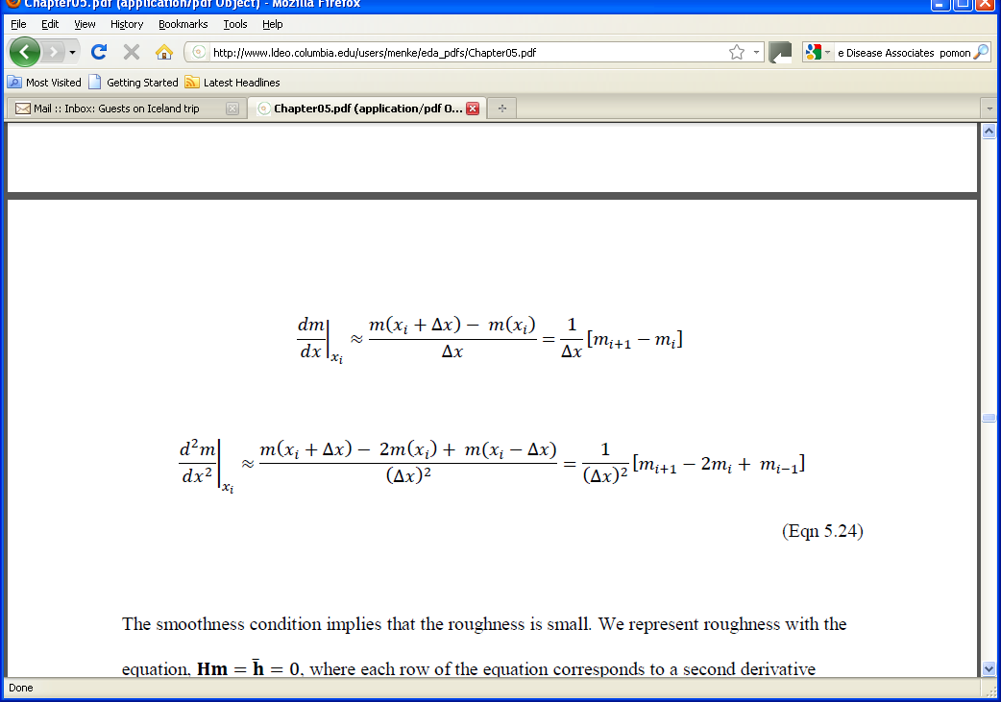
approximate expressions for second derivative
Notes:
This derivation uses the definition of the derivative (sans the limit) that one often sees in an elementary calculus course.
These formula are often referred to as ‘finite difference’ approximations to the derivative.

Slide 34
m(x)
x
x_{i}
i-th row of H: (Δx)⁻² [ 0, 0, 0, … 0, 1, -2, 1, 0, …. 0, 0, 0]
2nd derivative at x_{i}
column i
Notes:
Emphasize that it takes 3 points to calculate the 2nd derivative – the central point and one on each side.
The is going to be a problem at the ends, because there is no point to the left of the first model parameter,
and no point to the right of the last.

Slide 35
what to do about m₁ and m_{M}? not enough points for 2nd derivative two possibilities no prior information for m₁ and m_{M} or prior information about flatness
(first derivative)

Slide 36
m(x)
x
x₁
first row of H: (Δx)⁻¹ [ -1, 1, 0, … 0]
1st derivative at x₁
Notes:
First derivative requires only 2 points.

Slide 37
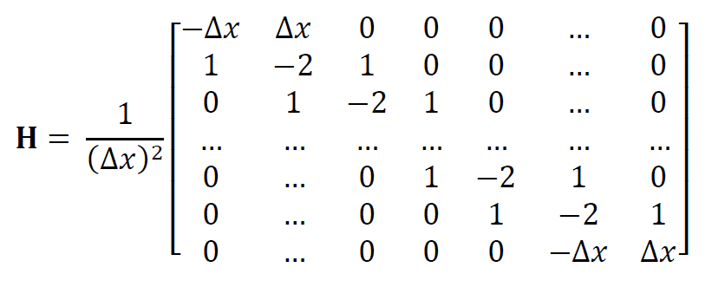
“smooth interior” / “flat ends” version of Hm=h
h=0
Notes:
This matrix is square. Given M model parameters, one can form M-2 second derivatives of the interior points and
2 first derivatives at the end points.

Slide 38
example problem:
to fill in the missing model parameters so that
the resulting curve is smooth
m = d
x
Notes:
This might be though of as a type of interpolation (although the term “interpolation” is usually reserved for the
case where the resulting curve passes exactly through the observed data, whereas in this case, it will only pass
near them).

Slide 39
the model parameters, m an ordered list of all model parameters
m₁
m₂
m₃
m₄
m₅
m₆
m₇
m=
Notes:
The model parameters is the whole time-series

Slide 40
the data, d just the model parameters that were measured
d₃
d₅
d₆
m₃
m₅
m₆
d=
=
Notes:
The data are the known values of the time-series.

Slide 41
data equation
Gm=d
m₁
m₂
m₃
m₄
m₅
m₆
m₇
0 | 0 | 1 | 0 | 0 | 0 | 0
0 | 0 | 0 | 0 | 1 | 0 | 0
 |  |  | …
0 | 0 | 0 | 0 | 0 | 1 | 0
=
d₃
d₅
d₇
data kernel “associates” a measured model parameter with an unknown model parameter
data are just model parameters that have been observed
Notes:
Multiply out the first row, to show that it yields m₃=d₃.

Slide 42
The prior information equation, Hm=h
“smooth interior” / “flat ends”
h=0
Notes:
This is the same matrix as was shown a few slides earlier. Now it is put to use.

Slide 43
put them together into the
Generalized Least Squares equation
F =
σ_{d}⁻¹G
σ_{h}⁻¹H
f =
σ_{d}⁻¹d
0
choose σ_{d}/σ_{m} to be << 1
data takes precedence over prior information
Notes:
Remind the class that the top row is the data equation weighted by its certainty, and that
the bottom row is the prior information equation weighted by its certainty. In the gap-filling
problem, we give precedence to the data, and so assume that the data are much more
certain than the prior information of smoothness.

Slide 44
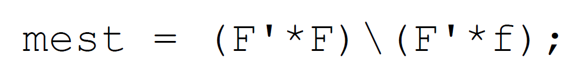
the solution using MatLab
Notes:
Remind the class of the meaning of the back-slash operator.

Slide 45
graph of the solution
solution passes close to data
solution is smooth
m = d
x
Notes:
The estimated model parameters form a smooth curve that satisfies the data to a high degree of approximation.
(Actually, the error is negligibly small).

Slide 46
Two MatLab issues
Issue 1: matrices like G and F can be quite big, but contain mostly zeros.
Solution 1: Use “sparse matrices” which don’t store the zeros
Issue 2: matrices like G^{T}G and F^{T}F are not as sparse as G and F
Solution 2: Solve equation by a method, such as “biconjugate gradients” that doesn’t require the calculation of G^{T}G and F^{T}F
Notes:
Emphasize that this is a practical discussion that is relevant when solving large (and hence interesting)
least squares problems.

Slide 47
Using “sparse matrices” which don’t store the zeros:
N=200000;
M=100000;
F=spalloc(N,M,3*M);
creates a 200000× 100000 matrix that can hold up to 300000 non-zero elements.
“sparse allocate”
note that an ordinary matrix would have 20,000,000,000 elements
Notes:
You might flash back to the G and H for the gap-filling problem, and examine how sparse
they are. The fraction N/(NM) of the elements of G are non-zero. The fraction 3M/(M²) of
the elements of H are non-zero. Note that these fractions decrease rapidly as N and M increase.

Slide 48
Once allocated, sparse matrices are used just like ordinary matrices …
… they just consume less memory.
Notes:
Except for the initial allocation, the operation of sparse matrices are completely transparent in MatLab.

Slide 49
Issue 2: Use biconjugate gradient solver to avoid calculating G^{T}G and F^{T}F
Suppose that we want to solve F^{T}F m = F^{T}f
The standard way would be:
mest = (F’F)\(F’f);
but that requires that we compute F’F
Notes:
This is a little complicated, but necessary if the students want to tackle large least-squares problems.

Slide 50
a “biconjugate gradient” solver requires only that we be able to multiply a vector, v, by G^{T}G, where the solver supplies the vector, v.
so we have to calculate y=G^{T}G v
the trick is to calculate t=Gv first,
and then calculate y=G’t
this is done in a Matlab function, afun()

Slide 51
function y = afun(v,transp_flag)
global F;
t = F*v;
y = F'*t;
return
ignore this variable; its never used

Slide 52
the bicg()solver is passed a “handle” to this function
so, the new way of solving the generalized inverse problem is:
clear F;
global F;
…
mest=bicg(@afun,F'*f,1e-10,3*L);
put at the top of the MatLab script
for “biconjugate”
“handle” to the function

Slide 53
maximum number of iterations
tolerance
mest=bicg(@afun,F'*f,1e-10,Niter);
for “biconjugate”
r.h.s of equation F^{T}Fm=F^{T}f
“handle” to the multiply function
The solution is by iterative improvement of an initial guess. The iterations stop when the tolerance falls beneath the specified level (good) or, regardless, when the maximum number of iterations is reached (bad).

Slide 54
example of a large problem
fill in the missing model parameters
that represents a 2D function m(x,y)
so that
the function passes through measured data points
m(x_{i},y_{i}) = d_{i}
and
the function satisfies the diffusion equation
d²m/dx² + d²m/dy² = 0

Slide 55
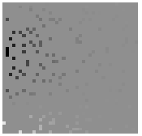

A) observed, d_{i}^{obs}=m(x_{i}, y_{i})
B) predicted, m(x,y)
y
y
x
x
(see text for details on how its done)
Notes:
The image is 41×41, so there are 1681 model parameters. The matrix, H, is 1681×1681 and has
2.8 million elements. So this relatively “small” problem benefits significantly from the use of sparse
matrices.

