Slide 1
Environmental Data Analysis with MatLab
Lecture 10:
Complex Fourier Series
Notes:
Today’s lecture is pretty dry – a switch from Fourier Series using sines and cosines to Fourier Series using complex exponentials. Warn the class about this! It’s necessary, though, because the switch substantially simplifies many of the formulas in spectral analysis.

Slide 2
SYLLABUS
Lecture 01 Using MatLab
Lecture 02 Looking At Data
Lecture 03 Probability and Measurement Error
Lecture 04 Multivariate Distributions
Lecture 05 Linear Models
Lecture 06 The Principle of Least Squares
Lecture 07 Prior Information
Lecture 08 Solving Generalized Least Squares Problems
Lecture 09 Fourier Series
Lecture 10 Complex Fourier Series
Lecture 11 Lessons Learned from the Fourier Transform
Lecture 12 Power Spectra
Lecture 13 Filter Theory
Lecture 14 Applications of Filters
Lecture 15 Factor Analysis
Lecture 16 Orthogonal functions
Lecture 17 Covariance and Autocorrelation
Lecture 18 Cross-correlation
Lecture 19 Smoothing, Correlation and Spectra
Lecture 20 Coherence; Tapering and Spectral Analysis
Lecture 21 Interpolation
Lecture 22 Hypothesis testing
Lecture 23 Hypothesis Testing continued; F-Tests
Lecture 24 Confidence Limits of Spectra, Bootstraps
Notes:
Today’s lecture is pretty dry – a switch from Fourier Series using sines and cosines to Fourier Series using complex exponentials. Warn the class about this! It’s necessary, though, because the switch substantially simplifies many of the formulas in spectral analysis.

Slide 3
purpose of the lecture
switch from Fourier Series containing
sines and cosines
to Fourier Series containing
complex exponentials
Notes:
Emphasize the underlying ideas are the same, only the mathematical implementation is different.

Slide 4
purpose of the lecture
switch from Fourier Series containing
sin(ωt) and cos(ωt)
to
Fourier series containing
exp(-iωt) and exp(+iωt)
Notes:
This lecture really does nothing else.

Slide 5
review of complex numbers

Slide 6
imaginary unit i such that i² = -1
Notes:
Mention that there is nothing profound about “i”. It’s really just a bookkeeping device.

Slide 7
complex number a = a_{r} + i a_{i}
imaginary part
real part
Notes:
The imaginary part is whatever multiplies i.

Slide 8
adding complex numbers a = a_{r} + i a_{i} b = b_{r} + i b_{i} c = a+b = (a_{r} + i a_{i} )+ (b_{r} + i b_{i} ) =
(a_{r} + b_{r} )+ i(a_{i} +b_{i} )
c_{r}
c_{i}
… just add real and imaginary parts, separately
Notes:
Addition is simple.

Slide 9
subtracting complex numbers a = a_{r} + i a_{i} b = b_{r} + i b_{i} c = a-b = (a_{r} + i a_{i} )-(b_{r} + i b_{i} ) =
(a_{r} - b_{r} )+ i(a_{i} - b_{i} )
c_{r}
c_{i}
… just subtract real and imaginary parts, separately
Notes:
So is subtraction.

Slide 10
multiplying complex numbers a = a_{r} + i a_{i} b = b_{r} + i b_{i} c = ab = (a_{r} + i a_{i} )(b_{r} + i b_{i} ) =
= a_{r} b_{r} + i a_{r} b_{i} + i a_{i} b_{r} + i² a_{i} b_{i} =
(a_{r} b_{r} - a_{i} b_{i} )+ i(a_{r} b_{i} + a_{i} b_{r} )
c_{r}
c_{i}
… like multiplying polynomials
Notes:
But multiplication is more complicated because the real and imaginary parts of the input “mix”. We do not review division here, because we won’t ever need it, but it’s even worse.

Slide 11
complex conjugate, a* a = a_{r} + i a_{i} a* = a_{r} - i a_{i}
Notes:
Note that if you add a complex number and its complex conjugate, you cancel the imaginary parts, so the result is purely real.
If you subtract them, you cancel the real parts, and the result is purely imaginary.

Slide 12
absolute value, |a |
|a | = [ a_{r}² + a_{i}² ]^{½} note
|a |² = a* a
Notes:
You might derive the last rule on the board, by expanding a* a = (a_{r}-ia_{i})(a_{r}+ia_{i}) = ….

Slide 13
Euler’s Formula exp(iz) = cos(z) + i sin(z)
… where does that come from ???
Notes:
You should check that everyone knows about the function exp(), and realizes that exp(x) is synonymous with e^{x}.

Slide 14
start from the Taylor series expansions exp(x) = 1 + x + x²/2 + x³/6 + x⁴/24 + … cos(x) = 1 + 0 - x²/2 + 0 + x⁴/24 + … sin(x) = 0 + x + 0 - x³/6 +0 + …
Notes:
Point out that, up to signs, the terms in exp(x) match either the corresponding term in cos(x) or in sin(x).

Slide 15
exp(x) substitute in x=iz exp(x) = 1 + x + x²/2 + x³/6 + x⁴/24 + … exp(iz) = 1 + iz - z²/2 - iz³/6 + z⁴/24 + …
Notes:
Point out that (iz)² is equal to –z², and that (iz)⁴ is equal to z⁴.

Slide 16
cos(x) substitute in x=z cos(x) = 1 + 0 - x²/2 + 0 + x⁴/24 + … cos(z) = 1 + 0 - z²/2 + 0 + z⁴/24 + …

Slide 17
sin(x) substitute in x=z and multiply by i sin(x) = 0 + x + 0 - x³/6 +0 + … i sin(z) = 0 + iz + 0 - iz³/6 +0 + …
Notes:
Mention that you must multiply every term in the r.h.s. by i.

Slide 18
add cos(z) and i sin(z) cos(z) = 1 + 0 - z²/2 + 0 + z⁴/24 + …
+ i sin(z) = 0 + iz + 0 - iz³/6 +0 + …
= cos(z) + i sin(z) = 1 + iz - z²/2 - iz³/6 + z⁴/24 + … compare with results for exp(iz) exp(iz) = 1 + iz - z²/2 - iz³/6 + z⁴/24 + … they’re equal!
Notes:
You might want to flash back 3 slides for the exp() result.

Slide 19
note that since exp(iz) = cos(z) + i sin(z) then
|exp(iz) |= cos²(z) + sin² (z) = 1
Notes:
Mention that sin²(z) plus cos² (z) is unity, for any value of z.

Slide 20
any complex number can be written z = r exp(iθ) where r = |z | and θ=tan⁻¹(z_{i}/z_{r})
Notes:
You might derive this results on the board.
Equate z=zr + zi with z = r exp(iθ) = r cos(θ)+i r sin(θ)
and solve for r and θ in terms of zr and zi.
Equating real and imaginary parts selarately yields z_{r} = r cos(θ) and z_{i} = r sin(θ).
Squaring the two equations and adding yields r² [cos² (θ)+sin² (θ)]= r² = z_{r}²+z_{i}² or r=|z|.
Dividing the two equations yields tan(θ)=z_{i}/z_{r}.

Slide 21
MatLab handles complex numbers completely transparently a = 2 + 3*i; b = 4 + 6*i; c = a+b; works just fine
Notes:
In MatLab, complex arithmetic is no harder than ordinary arithmetic.

Slide 22
Warning! accidentally resetting i to something other than i is so easy i=100;
(and then you get nonsense) so execute a clear i; at the top of your script if you plan to use i
Notes:
In MatLab, you can redefine the value of any constant variable. Thus you could set pi=3, though doing it accidentally is harder.

Slide 23
or use the alternate notation a = complex(2,3); b = complex(4,6); c = a+b; which is safer
Notes:
Here a=complex(2,3) is equivalent to a =2+3*i;

Slide 24
end of review

Slide 25
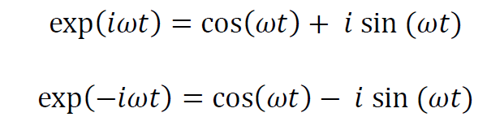
Euler’s Formulas complex exponentials can be written as sines and cosines
Notes:
Show that the second follows from the first by replacing ω with –ω and using cos(–ω)=cos(ω) and sin(–ω)=-sin(ω)

Slide 26
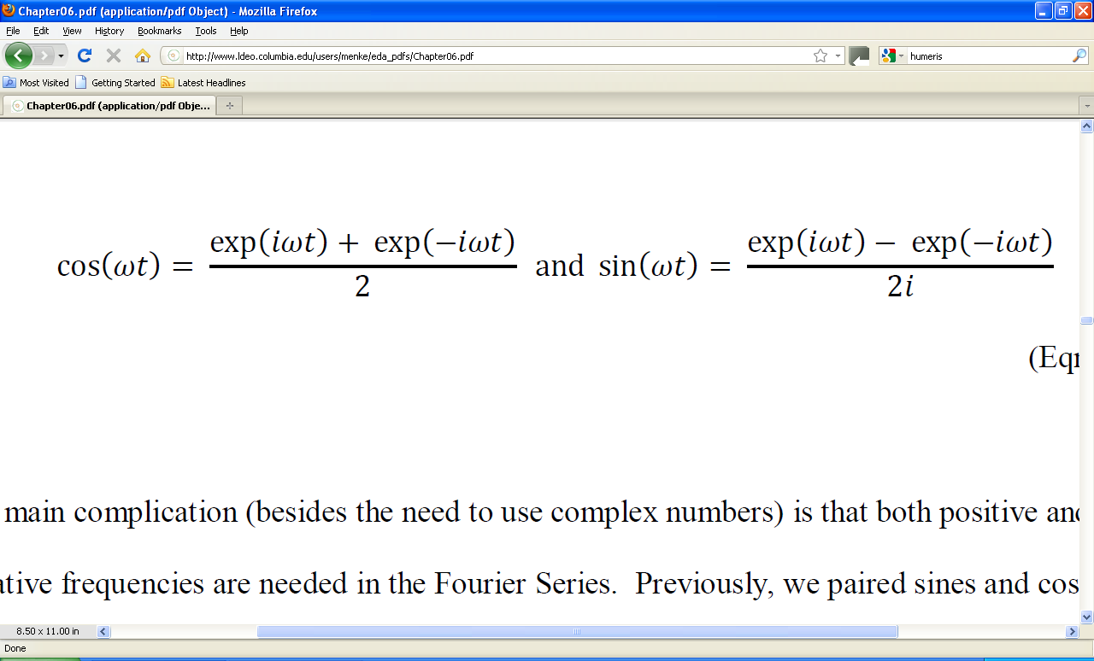
or reverse them sine and cosines can be written as complex exponentials
Notes:
These are just the previous two equations, solved for sin() and cos().

Slide 27
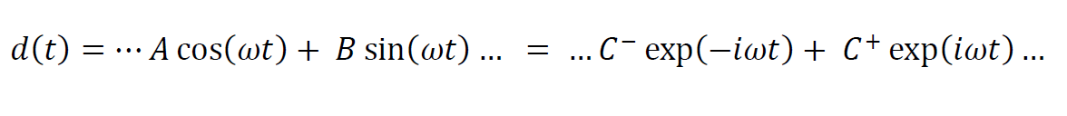
so a Fourier Series alternatively can be written as a sum of sines and cosines or a sum of complex exponentials
Notes:
Remind the class that the purpose of this lecture is to develop Fourier Series that contain complex exponentials.

Slide 28
paired terms
sines and cosines of the same frequency, ω, are paired
and
positive and negative complex exponentials of the frequencies, ω, are paired
… so as to be able to represent a time-shifted sinusoid

Slide 29
A and B and C⁻ and C⁺ must be related

Slide 30
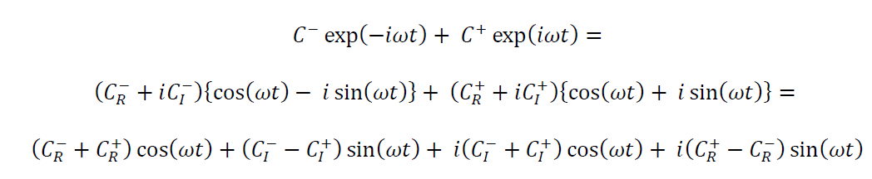
A
B
=0
implies
C _{I}⁻ = -C_{I}⁺
=0
implies
C_{R} ⁺ = C_{R}⁻
Notes:
Here we have replaced the complex exponentials in the first line with their sines and cosines equivalents.
For this to match Acos(ωt)+Bsin(ωt) it must have zero imaginary part, so the last two terms must be zero.

Slide 31
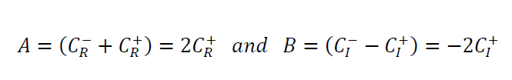
summary
C_{r} is an even function of frequency
C_{i} is an odd function of frequency
coefficients at corresponding positive and negatives are complex conjugates
C(-ω) = C*(ω)
Notes:
The symmetry is the more important result, and is illustrated in the next slide.

Slide 32
ω
illustration of symmetry of
C_{r}
C_{i}
Notes:
Real part is symmetric. Imaginary part is antisymmetric.

Slide 33
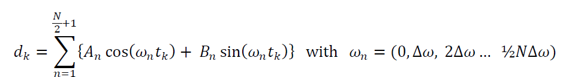
old-style Fourier Series
non-negative frequencies only
from
0 to ω_{ny}

Slide 34
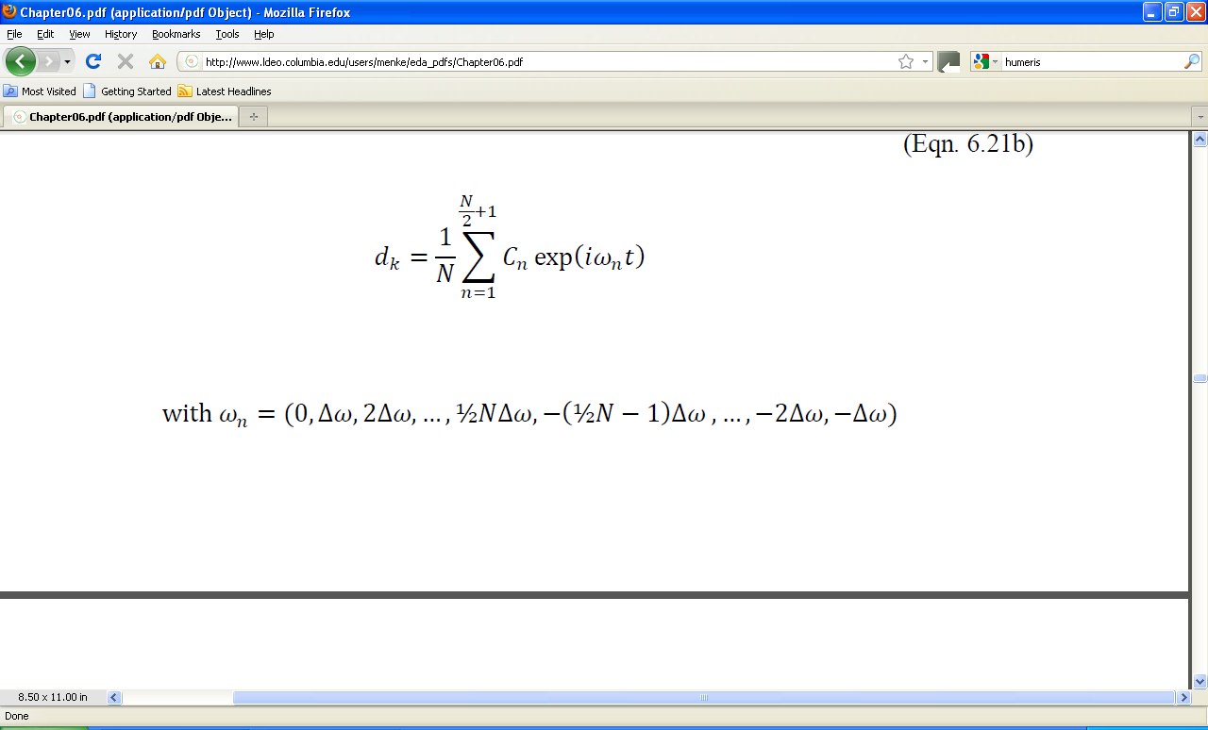
new-style Fourier Series or “Inverse Discrete Fourier Transform”
added for compatibility with MatLab
non-negative
frequencies
negative
frequencies
Notes:
The factor of (1/N) is added to match MatLab’s ifft() function.

Slide 35
why the weird ordering of frequencies?
ω_{n} = ( 0, Δω, 2Δω, …,½N Δω, -(½N -1) Δω, …, -2 Δω, -Δω )
same as
ω_{n} = ( 0, Δω, 2Δω, …,½N Δω, (½N +1) Δω, …, (N-1)Δω, NΔω )
non-negative
frequencies
negative
frequencies
non-negative frequencies up to Nyquist
non-negativefrequencies above the Nyquist
Notes:
This result “puts aliasing to work”.

Slide 36
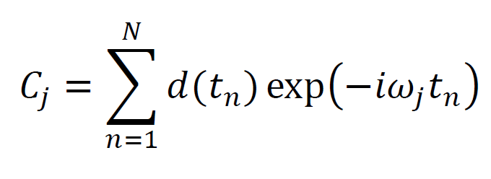
least-squares solution for the Fourier coefficients, C_{n} or “Discrete Fourier Transform”
… derivation requires complex version of least-squares. See text of details …

Slide 37
MatLab
Fourier Coefficients C_{j} from time series d_{n} c = fft(d);
vector of N data
vector of N complex Fourier coefficients

Slide 38
MatLab time series d_{n} from Fourier Coefficients C_{j} d = ifft(c);
vector of N complex Fourier coefficients
vector of N data

Slide 39
standard setup
M=N;
tmax=Dt*(N-1);
t=Dt*[0:N-1]';
fmax=1/(2.0*Dt);
df=fmax/(N/2);
f=df*[0:N/2,-N/2+1:-1]';
Nf=N/2+1;
dw=2*pi*df;
w=dw*[0:N/2,-N/2+1:-1]';
Nw=Nf;

Slide 40
standard setup
M=N;
tmax=Dt*(N-1);
t=Dt*[0:N-1]';
fmax=1/(2.0*Dt);
df=fmax/(N/2);
f=df*[0:N/2,-N/2+1:-1]';
Nf=N/2+1;
dw=2*pi*df;
w=dw*[0:N/2,-N/2+1:-1]';
Nw=Nf;
same number M of Fourier Coefficients as number N of data

Slide 41
standard setup
M=N;
tmax=Dt*(N-1);
t=Dt*[0:N-1]';
fmax=1/(2.0*Dt);
df=fmax/(N/2);
f=df*[0:N/2,-N/2+1:-1]';
Nf=N/2+1;
dw=2*pi*df;
w=dw*[0:N/2,-N/2+1:-1]';
Nw=Nf;
maximum time, for N data sampled at Dt

Slide 42
standard setup
M=N;
tmax=Dt*(N-1);
t=Dt*[0:N-1]';
fmax=1/(2.0*Dt);
df=fmax/(N/2);
f=df*[0:N/2,-N/2+1:-1]';
Nf=N/2+1;
dw=2*pi*df;
w=dw*[0:N/2,-N/2+1:-1]';
Nw=Nf;
time column-vector

Slide 43
standard setup
M=N;
tmax=Dt*(N-1);
t=Dt*[0:N-1]';
fmax=1/(2.0*Dt);
df=fmax/(N/2);
f=df*[0:N/2,-N/2+1:-1]';
Nf=N/2+1;
dw=2*pi*df;
w=dw*[0:N/2,-N/2+1:-1]';
Nw=Nf;
Nyquist frequency, f_{ny}

Slide 44
standard setup
M=N;
tmax=Dt*(N-1);
t=Dt*[0:N-1]';
fmax=1/(2.0*Dt);
df=fmax/(N/2);
f=df*[0:N/2,-N/2+1:-1]';
Nf=N/2+1;
dw=2*pi*df;
w=dw*[0:N/2,-N/2+1:-1]';
Nw=Nf;
frequency sampling, Δf

Slide 45
standard setup
M=N;
tmax=Dt*(N-1);
t=Dt*[0:N-1]';
fmax=1/(2.0*Dt);
df=fmax/(N/2);
f=df*[0:N/2,-N/2+1:-1]';
Nf=N/2+1;
dw=2*pi*df;
w=dw*[0:N/2,-N/2+1:-1]';
Nw=Nf;
frequency column- vector

Slide 46
standard setup
M=N;
tmax=Dt*(N-1);
t=Dt*[0:N-1]';
fmax=1/(2.0*Dt);
df=fmax/(N/2);
f=df*[0:N/2,-N/2+1:-1]';
Nf=N/2+1;
dw=2*pi*df;
w=dw*[0:N/2,-N/2+1:-1]';
Nw=Nf;
number of frequencies between 0 and Nyquist

Slide 47
standard setup
M=N;
tmax=Dt*(N-1);
t=Dt*[0:N-1]';
fmax=1/(2.0*Dt);
df=fmax/(N/2);
f=df*[0:N/2,-N/2+1:-1]';
Nf=N/2+1;
dw=2*pi*df;
w=dw*[0:N/2,-N/2+1:-1]';
Nw=Nf;
angular frequency sampling, Δω

Slide 48
standard setup
M=N;
tmax=Dt*(N-1);
t=Dt*[0:N-1]';
fmax=1/(2.0*Dt);
df=fmax/(N/2);
f=df*[0:N/2,-N/2+1:-1]';
Nf=N/2+1;
dw=2*pi*df;
w=dw*[0:N/2,-N/2+1:-1]';
Nw=Nf;
angular frequency column- vector

Slide 49
standard setup
M=N;
tmax=Dt*(N-1);
t=Dt*[0:N-1]';
fmax=1/(2.0*Dt);
df=fmax/(N/2);
f=df*[0:N/2,-N/2+1:-1]';
Nf=N/2+1;
dw=2*pi*df;
w=dw*[0:N/2,-N/2+1:-1]';
Nw=Nf;
number of angular frequencies between 0 and Nyquist

Slide 50
Computing Power Spectral Density
% compute Fourier coefficients
mest = fft(d);
% compute amplitude spectral density
s=abs(mest(1:Nw));
% compute power spectral density
s2=s^2;

Slide 51
Spectral Density
% compute Fourier coefficients
mest = fft(d);
% compute amplitude spectral density
s=abs(mest(1:Nw));
% compute power spectral density
s2=s^2;
note that negative frequencies are discarded
since they are redundant

Slide 52
Why The Switch to Complex?
One function, exp(), is better than two, cos() & sin()
exp() is algebraically simpler than cos() & sin(), e.g.
exp(a) / exp(b) = exp( a – b)
which substantially simplifies formulas
Tradition – that’s the way everyone does it! Or more importantly, that’s the way MatLab does it.
Notes:
The sine & cosine form is equivalent to the complex exponential form, so whatever you can do with one, you can do with the other. However, if you choose to work with the sine & cosine form, you will be, in effect, be explicitly manipulating the real and imaginary parts of complex numbers whenever you have to deal with A’s and B’s. In contrast, if you choose to work with complex exponentials, the algebra of complex arithmetic hides the real and imaginary parts of the complex numbers from you.

