Slide 1
Environmental Data Analysis with MatLab
Lecture 13:
Filter Theory
Notes:
Today’s lecture is develops the fundamental ideas of filter theory.

Slide 2
SYLLABUS
Lecture 01 Using MatLab
Lecture 02 Looking At Data
Lecture 03 Probability and Measurement Error
Lecture 04 Multivariate Distributions
Lecture 05 Linear Models
Lecture 06 The Principle of Least Squares
Lecture 07 Prior Information
Lecture 08 Solving Generalized Least Squares Problems
Lecture 09 Fourier Series
Lecture 10 Complex Fourier Series
Lecture 11 Lessons Learned from the Fourier Transform
Lecture 12 Power Spectral Density
Lecture 13 Filter Theory
Lecture 14 Applications of Filters
Lecture 15 Factor Analysis
Lecture 16 Orthogonal functions
Lecture 17 Covariance and Autocorrelation
Lecture 18 Cross-correlation
Lecture 19 Smoothing, Correlation and Spectra
Lecture 20 Coherence; Tapering and Spectral Analysis
Lecture 21 Interpolation
Lecture 22 Hypothesis testing
Lecture 23 Hypothesis Testing continued; F-Tests
Lecture 24 Confidence Limits of Spectra, Bootstraps

Slide 3
purpose of the lecture
develop the
Linear Filter
as a way to describe the way past events influence present-time observations
Notes:
You should mention that although it has a special name and a special interpretation, the Linear Filter
is just a special case of the Linear Model. All the tools that we have developed for solving linear problems
can be applied to it.

Slide 4
sometimes, no past history is needed
Thermometer measuring temperature θ(t)
Flame with time-varying heat h(t)
Flame instantaneously heats the thermometer
Thermometer retains no heat
θ(t) ∝ h(t)
Notes:
We will use the functions θ(t) and h(t) throughout the chapter. In the generic sense, h(t) is the “input” and “θ(t)” is the output
of the linear filter problem.

Slide 5
this idea described as a linear model
θ₁= g ₁ h ₁
. . .
θ₁₀= g ₁ h ₁₀
θ₁₁= g ₁ h₁₁
θ₁₂= g ₁ h ₁₂
. . .
θ_{N}= g ₁ h _{N}
where g ₁ is a constant
Notes:
Emphasize that only one proportionality factor, g₁, is involved.

Slide 6
But sometimes, past history is needed
Thermometer measuring temperature θ(t)
Steel plate
Flame with time-varying heat h(t)
Heats takes time to seep through plate
Plate retains heat
θ(t=t’) ∝ history of h(t) for time t<t’
Notes:
Emphasize the proportionality is used in the usual sense: doubling the input, h(t), doubles the output, θ(t).

Slide 7
But sometimes, past history is needed
Thermometer measuring temperature θ(t)
Steel plate
“causal”: only past effects present (not future)
Flame with time-varying heat h(t)
Heats takes time to seep through plate
Plate retains heat
θ(t=t’) ∝ history of h(t) for time t<t’
Notes:
Causality is an extremely important concept. In this context, it means that coefficients, g₀, g₋₁, g₋₂, etc are all zero.

Slide 8
this idea described as a linear model
. . .
θ₁₀= g ₁ h ₁₀ + g ₂ h ₉ + g ₃ h ₈ + g ₄ h ₇ + …
θ₁₁= g ₁ h ₁₁ + g ₂ h ₁₀ + g ₃ h ₉ + g ₄ h ₈ + …
θ₁₂= g ₁ h ₁₂ + g ₂ h ₁₁ + g ₃ h ₁₀ + g ₄ h ₉ + …
. . .
where g ₁, g ₂, g ₃, … are constants
called a “filter”
Notes:
You might flash back to the simpler case. 3 slides back, for comparison.
The coefficients g₁, g₂, g₃ … are collectively called a filter.
They are often treated as a time-series in their own right.

Slide 9
Special case: temperature depends only on the time elapsed since the flame was turned on, and not on the experiment as performed on Monday or Wednesday
same shape
  θ(t)
  θ(t)
experiment is “time-shift invariant”
Notes:
Emphasize that the curves (red) are the same, as long as one references them to the right origin, the time
that the flame was turned on.

Slide 10
this idea described as a linear model
. . .
θ₁₀= g ₁ h ₁₀ + g ₂ h ₉ + g ₃ h ₈ + g ₄ h ₇ + …
θ₁₁= g ₁ h ₁₁ + g ₂ h ₁₀ + g ₃ h ₉ + g ₄ h ₈ + …
θ₁₂= g ₁ h ₁₂ + g ₂ h ₁₁ + g ₃ h ₁₀ + g ₄ h ₉ + …
. . .
where g ₁, g ₂, g ₃, … are constants
called a filter
coefficients all the same …
filter is time-shift invariant …
Notes:
Time-shift invariance implies that all the coefficients in the columns are the same. The coefficient g₁
refers to the effect of the “present” heat on the present temperature. The coefficient g₂
refers to the effect of the heat “one time step in the past” on the present temperature.
The coefficient g₂ refers to the effect of the heat “two time steps in the past” on the present temperature.
And etc.
Be sure to say this in words when explaining the equation.

Slide 11
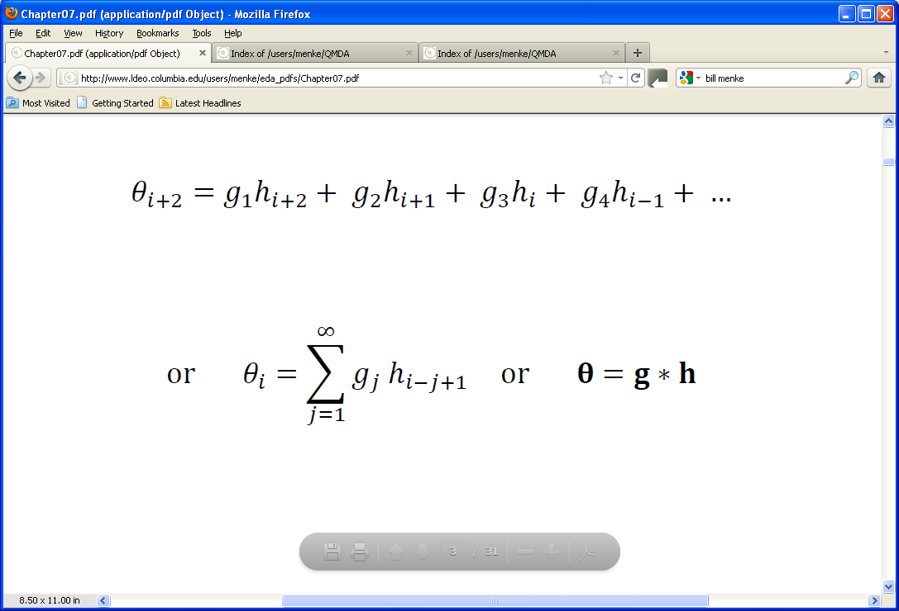
this idea written as a summation
Notes:
You might flash back back three slides to compare with the expanded-out equation.

Slide 12
this idea written as a summation
output
input
filter
“convolution”, not multiplication
Notes:
Emphasize the generic nature of the problem. Lots of different inputs and outputs are related in this way.

Slide 13
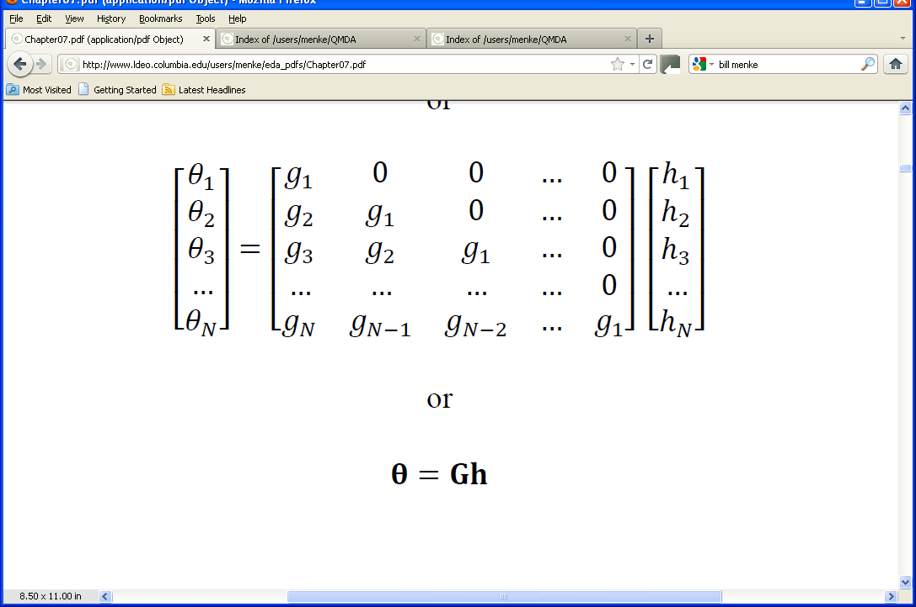
this idea written as matrix equation
filter
output
input
Notes:
You might flash back to three slides and show that this really is the matrix form of the linear equations.

Slide 14
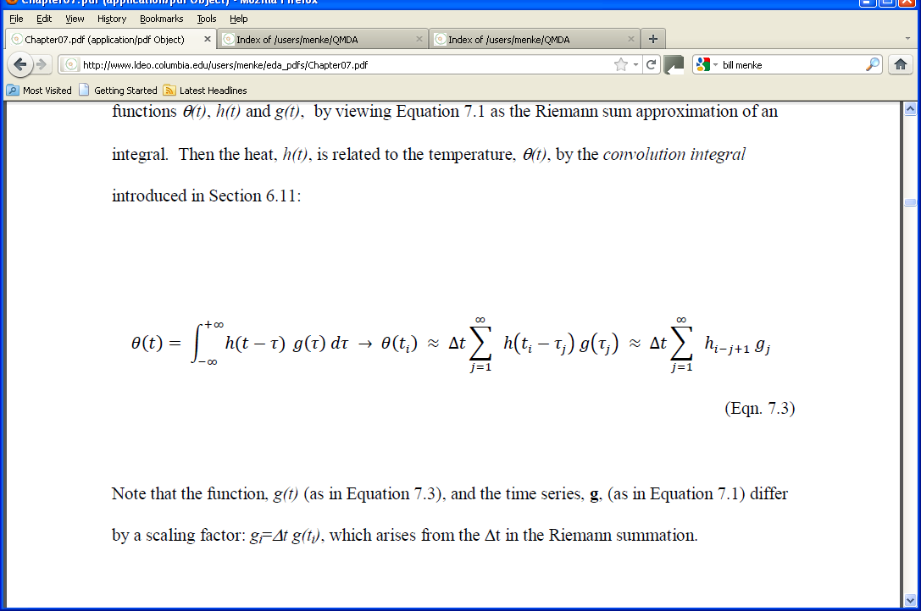
we’ve heard the word “convolution” before in Lecture 11 it’s the name of this integral
Notes:
In lecture 11, we showed that the Fourier Transform of a convolution is the product of the transforms.

Slide 15
but the integral can be approximated as the summation we’ve just seen
Notes:
The is the standard “Riemann Sum” approximation to an integral. Note the extra factor of Δt.

Slide 16
so, mathematically, what we’re doing is
“convolution”

Slide 17
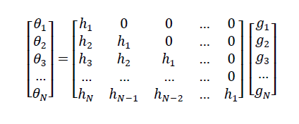
convolutions can be written two ways
. . .
θ₁₀= g ₁ h ₁₀ + g ₂ h ₉ + g ₃ h ₈ + g ₄ h ₇ + …
θ₁₁= g ₁ h ₁₁ + g ₂ h ₁₀ + g ₃ h ₉ + g ₄ h ₈ + …
θ₁₂= g ₁ h ₁₂ + g ₂ h ₁₁ + g ₃ h ₁₀ + g ₄ h ₉ + …
. . .
g inside matrix
h inside matrix
Notes:
You might flash back to the simpler case. 3 slides back, for comparison.
The coefficients g₁, g₂, g₃ … are collectively called a filter.
They are often treated as a time-series in their own right.

Slide 18
implying that the convolution operation is symmetric g*h = h*g
Notes:
The order of convolution is not important.

Slide 19
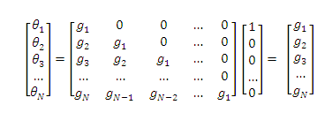
meaning of the filter g suppose the input is a spike h = [1, 0, 0, 0 … 0]^{T} then the output is the filter
output
input
filter
Notes:
This is important for understanding the physical meaning of convolution.

Slide 20
so the filter represents the
“impulse response” of the experiment
Notes:
Sometimes you hear the lingo, “the impulse response of the system” or “… of the physical model”.

Slide 21
A) Input is spike
spike
h(t), W
0
time , t, after impulse
B) Output is impulse response
θ(t), K
0
time , t, after impulse
Notes:
Hypothetical impulse response of the hot plate scenario. A) An impulse (spike) of heat, h, is applied to the bottom of the plate at time, t=0. B) The temperature, θ, of the top surface of the plate first increases, as heat begins to diffuse through plate. It then decreases, as the plate cools.

Slide 22
A)
spike of amplitude, h(t₀)
h(t), W
time, t
t₀
B)
h(t₀)g(t−t₀)
θ(t). K
time, t
t₀
Notes:
This diagram explains what’s going on in a convolution.
The heat, h(t), is viewed as consisting of a sequence of impulses (spikes).
Each spike in heat leads to a smooth impulse response function, as shown in the previous slide.
The temperature, θ(t), is viewed as consisting of a sum of scaled and delayed, impulse responses (dashed curves).
A spike of amplitude, h(t₀) at time, t=t₀, makes a contribution, h(t₀)g(t−t₀), to the overall temperature.
The output is therefore a sum (the sum in the convolution) of many scaled and shifted impulse responses.

Slide 23
example: heat-generating layer
z-axis
observation point
soil
z
z=0
heat-generating layer
soil
Notes:
It could, for instance, be a radioactive layer created by a leak of a radioactive fluid into a permeable soil layer.

Slide 24
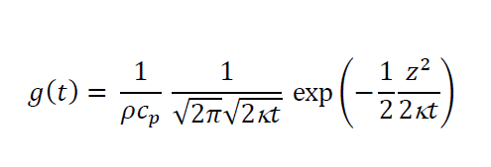
known impulse response
based on known physics of heat transfer
Notes:
Tell the student that this solution was taken from a textbook on heat transfer theory. Its pretty
typical for a scientist to use such a formula, with minimal knowledge of how it was derived. But FYI,
the physics underlying this formula has three central ideas: that heat energy is conserved, that
heat energy content is proportional to temperature; and that heat flows from hot to cold at a
rate that depends on the spatial gradient of the temperature. These three principles can be
combined to get a partial differential equation that describes the flow of heat. The equation
in the slides is the solution to that equation.

Slide 25
known impulse response
distance from center of layer
soil density
1500 kg/m³
soil heat capacity,
800 J/kg-K
soil thermal diffusivity.
1.25×10⁻⁶ m²/s
Notes:
Many formulas have material constants. In this case we assume that we know them exactly. In
reality, we are introducing unquantified (b ut not unquantifyable) noise into the problem by assuming
these values.

Slide 26
A)
Δt g(t)
B)
time t, days
h^{true}(t), W/m²
C)
time t, days
θ ^{true}(t), K
time t, days
Notes:
Impulse response, g(t), of a heat-generating layer. The temperature at the observation point rapidly rises over a period of a few days and then gently decays away over the period of a few months.
B) Hypothetical heat production, h^{true}(t), consisting of a couple of spikes.
C) Corresponding temperature, θ^{true}(t), at 1 m distance from the layer. Note that it is two repeats of the impulse response, one for each spike.

Slide 27
The Method
solve
using least-squares
… well, use damped least square, just in case
Notes:
This is just the linear problem we have seen many times before, so we solve it by least squares.
We add a bit of damping, in case there is missing information.

Slide 28
A)
θ ^{obs}(t), K
B)
time t, days
h^{true}(t), W/m²
C)
time t, days
h^{est}(t) ), W/m²
time t, days
Notes:
A) Synthetic temperature data, θ^{obs}(t), constructed from the true temperature plus a high level of random noise. B) True heat production, h^{true}(t). C). B) Estimated heat production, h^{est}(t), calculated with damped least squares.
The solution is noisy because the heat transfer smooths out short-period flucuations in temperature, making the observations insensitive to them. The solution must then amplify them. Unfortunately, in the process of doing so, it also amplifies onservational noise.

Slide 29
noise in data …
A)
θ ^{obs}(t), K
B)
time t, days
h^{true}(t), W/m²
C)
time t, days
… is amplified
h^{est}(t) ), W/m²
time t, days
Notes:
A) Synthetic temperature data, θ^{obs}(t), constructed from the true temperature plus a high level of random noise. B) True heat production, h^{true}(t). C). B) Estimated heat production, h^{est}(t), calculated with damped least squares.
The solution is noisy because the heat transfer smooths out short-period flucuations in temperature, making the observations insensitive to them. The solution must then amplify them. Unfortunately, in the process of doing so, it also amplifies onservational noise.

Slide 30
Try adding prior information of smoothness
(minimize second derivative)
Notes:
If the heat were being generated by radioactive decay, we would indeed expect that the heat production
would slowly decay away at a rate governed by the half-lives of whatever radioactive isotopes were present.

Slide 31
A)
θ ^{obs}(t), K
B)
time t, days
h^{true}(t), W/m²
C)
time t, days
much less noise
h^{est}(t) ), W/m²
time t, days
Notes:
A) Synthetic temperature data, θ^{obs}(t), constructed from the true temperature plus the same level of ransom noise as in Figure 7.6. B) True heat production, h^{true}(t). C). B) Estimated heat production, h^{est}(t), calculated with generalized least squares using prior information of smoothness.

Slide 32
Tips on filter calculations with MatLab
Notes:
The methods described here are used in the exemplary problems and in the homework.

Slide 33
you should avoid constructing the matrix
G =
because it contains so many redundant elements
Notes:
While g has only N elements, G has about N²/2 of them.

Slide 34
Tip #1 use the conv() function to calculate the convolution q = g * h not the matrix multiplication q=Gh
tmp = conv(g, h);
q=tmp(1:N);
note that we truncate the output of conv(), so that is has the same length, N, as the input time series
Notes:
conv() actually returns 2N-1 elements, the maximum amount that two length-N timeseries can be lagged with respect to the other and still barely overlap. This will be further explored in the next lecture.

Slide 35
Tip #2 use the bicg() solver, together with the function filterrfun() to solve Fq=h by generalized least squares not matrix division h^{est}=(F^{T}F)\(F^{T}q)
it implements the matrix multiplications, G^{T}(Gv), using the timeseries g, and does not ever construct G
filterrfun() is described in the text
Notes:
This technique is usually much faster than a direct solver.

