Slide 1
Environmental Data Analysis with MatLab
Lecture 14:
Applications of Filters
Notes:
Today’s lecture continues developing the idea of a filter, and works through several examples.

Slide 2
SYLLABUS
Lecture 01 Using MatLab
Lecture 02 Looking At Data
Lecture 03 Probability and Measurement Error
Lecture 04 Multivariate Distributions
Lecture 05 Linear Models
Lecture 06 The Principle of Least Squares
Lecture 07 Prior Information
Lecture 08 Solving Generalized Least Squares Problems
Lecture 09 Fourier Series
Lecture 10 Complex Fourier Series
Lecture 11 Lessons Learned from the Fourier Transform
Lecture 12 Power Spectral Density
Lecture 13 Filter Theory
Lecture 14 Applications of Filters
Lecture 15 Factor Analysis
Lecture 16 Orthogonal functions
Lecture 17 Covariance and Autocorrelation
Lecture 18 Cross-correlation
Lecture 19 Smoothing, Correlation and Spectra
Lecture 20 Coherence; Tapering and Spectral Analysis
Lecture 21 Interpolation
Lecture 22 Hypothesis testing
Lecture 23 Hypothesis Testing continued; F-Tests
Lecture 24 Confidence Limits of Spectra, Bootstraps

Slide 3
purpose of the lecture
further develop the idea of the
Linear Filter
and its applications
Notes:
This lecture has three sections, the prediction error filer, the inverse filter and the recursive filter.

Slide 4
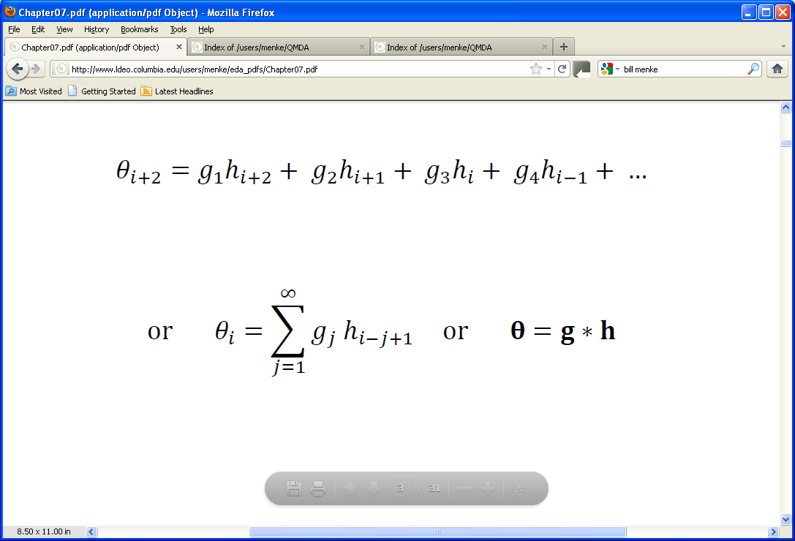
from last lecture present output ∝ past and present values of input
output
input
filter
“convolution”, not multiplication
Notes:
Stress the generic nature of the problem. The present output is linearly proportional
to the past and present values of the input. Lots of different inputs and outputs are related in this way.

Slide 5
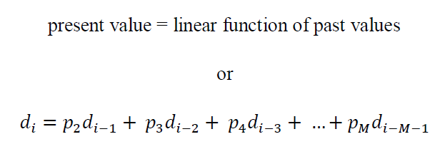
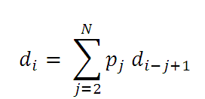
Part 1: Predicting the Present
or
Notes:
The nuance here is that we are using a time series, d, to predict itself.
The present value of d is proportional to its past values.
The coefficients, p, are a kind of filter.
As its stands, this is not quite a convolution, because the summation starts at 2, not 1.
But its close.

Slide 6
Part 1: Predicting the Present
or
very close to a convolution
Notes:
Note that the summation omits the j=1 case.

Slide 7
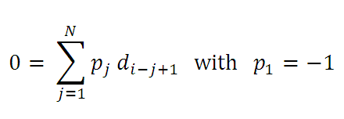
output
input
“prediction error” filter
Notes:
You can make it exactly a convolution by moving d_{i} to the l.h.s. of the equation and by multiplying it
by a filter coefficient p₁ defined to be -1.

Slide 8
strategy for predicting the future
1. take all the data, d, that you have up to today
2. use it to estimate the prediction error filter, p
(use generalized least-squares to solve p*d=0)
3. use the filter, p, and all the data, d, to predict d_{tomorrow}
Notes:
Tomorrow, you can make a new estimate of p that include today’s datum.

Slide 9
application to the Neuse River hydrograph
Notes:
You might remind the class that a hydrograph quantifies stream flow, the amount of water
flowing in a river. This record is about 12 years long. Point out the annual cycle and note that
the spikes correspond to storms.

Slide 10
here’s the best fit filter, p
prediction error filter, p(t)
time t, days
Notes:
This filter was computed with generalized least squares, with the prior information that p₁=-1 being very certain.

Slide 11
here’s the best fit filter, p
in this case, only the first few coefficients are large
prediction error filter, p(t)
what’s that?
time t, days
Notes:
Although the filter, p, was given 100 coefficients, only the first two or three are large. This suggest that the
predictable part of stream flow can be quantified with just a 2-3 of days of data, that is, whether the stream
is rising or falling, and if so, at what rate. The little peak at ~42 days suggest some value in knowing what
was happening then. In two of the homeworks we will explore the degree to which this feature
improves the prediction and the degree to which that improvement (if any) is statistically significant.

Slide 12
importance of the prediction error
since one is using least squares, the equation
0=p*d
is not solved exactly
the prediction error, e=p*d
tells you what aspects of the data cannot be predicted on the basis of past behavior
Notes:
Ask the class to think about what aspects of steam flow might not be predictable.

Slide 13
A)
discharge, d(t)
time t, days
B)
prediction error, e(t)
time t, days
Notes:
This is an enlargement of the first year of data.

Slide 14
A)
discharge, d(t)
time t, days
B)
the error is small
many spikes are at times when discharge increases
the error is spiky
prediction error, e(t)
time t, days
Notes:
Point out that the scale on the to graphs are the same.
Ask the class to guess what the spikes correspond to. They are storms. Without the
addition of new water, the river flow subsides in a very predictable way.
Only the storms are unpredictable.

Slide 15
Part 2: Inverse Filters
Can a convolution be undone?
if θ = g * h
is there another filter g^{inv} for which
h = g^{inv} * θ
?
Notes:
It very useful to be able to remove the effect of a filter
simply by applying another filter.
But first, a digression … let’s do a convolution by hand in order
to gain some insight into its structure.

Slide 16
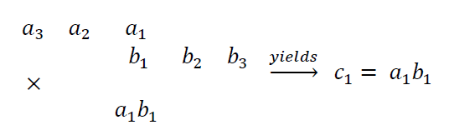
convolution c=a*b by hand: step 1 for simplicity, suppose a and b are of length 3
write a backward in time
write b forward in time
overlap the ends by one, and multiply. That gives c₁

Slide 17
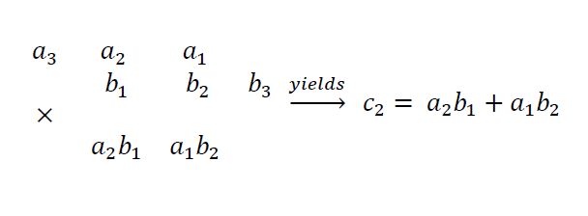
convolution c=a*b by hand: step 2
slide a right one place
multiply and add. That gives c₂

Slide 18
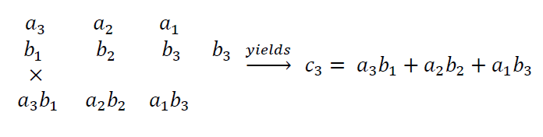
convolution c=a*b by hand: step 3
slide a right another place
multiply and add. That gives c₃

Slide 19
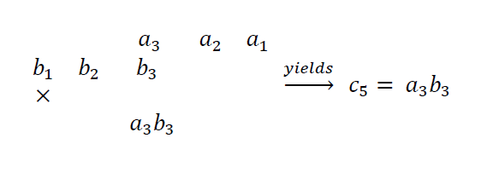
convolution c=a*b by hand: keep going
Multiply. That gives c₅

Slide 20
an important observation
this is the same pattern that we obtain when we
multiply polynomials
Notes:
You might review polynomial multiplication on the board.

Slide 21
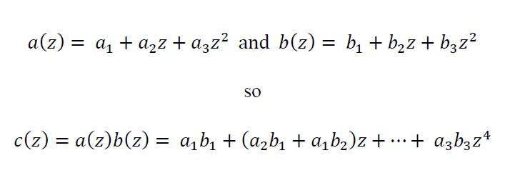
Notes:
You might work this one out on the board.
Do it by finding all the pairs that yield a particular power of z.
Lots of ways to get z².
Only one way to get z⁰ or z⁴.

Slide 22
z-transform turn a filter into a polynomial
g = [g₁, g₂, g₃, … g_{N}]^{T}
g(z) = g₁ + g₂ z + g₃ z² + … g_{N} z^{N-1}
Notes:
Just use the g’s as coefficients of the powers of z.

Slide 23
inverse z-transform turn a polynomial into a filer
g(z) = g₁ + g₂ z + g₃ z² + … g_{N} z^{N-1}
g = [g₁, g₂, g₃, … g_{N}]^{T}
Notes:
Just extract the coefficients.

Slide 24
why would we want to do this?
because we know a lot about polynomials
Notes:
You might ask the class what the most important thing that they know about polynomials.

Slide 25
the fundamental theorem of algebra
a polynomial of n-th order has exactly n roots
and thus can be factored into the product of
n factors
Notes:
Answer: The so-called fundamental theorem of algebra, that is, that a n-th order polynomial
has exactly n roots.

Slide 26
the fundamental theorem of algebra
a polynomial of n-th order has exactly n-roots
and can be factored into the product of n factors
largest power, z^{n}
solutions to g(z)=0
g(z) ∝ (z-r₁) (z-r₂) … (z-r_{n})
Notes:
Answer: The so-called fundamental theorem of algebra, that is, that a n-th order polynomial
has exactly n roots.

Slide 27
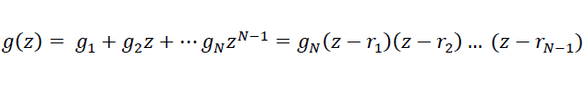
in the case of a polynomial constructed from a length-N filter, g
where r₁, r₂, … r_{N-1} are the roots
Notes:
A filter of length N correspond to an N-1 order polynomial.
This polynomial has N-1 roots and so can be written as the product of N-1 factors.

Slide 28
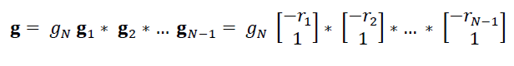
so, the filter g is equivalent a “cascade” of
N-1 length-2 filters
Notes:
If high-order polynomial can be represented as the product of many 1-st order factors,
then a long filter can be represented as the convolution of man length-2 filters.

Slide 29
now let’s try to find the inverse of a length-2 filter the filter that undoes convolution by
[-r_{i}, 1]^{T} is … ? the function that undoes multiplication by z-r_{i} is1 /(z-r_{i})
z-transform
Notes:
If we can solve the length-2 problem, we can solve a larger one using a cascade.

Slide 30
problem:
1/(z-r_{i}) is not a polynomial solution: compute its Taylor series
Notes:
Review a Taylor series here, if necessary.

Slide 31
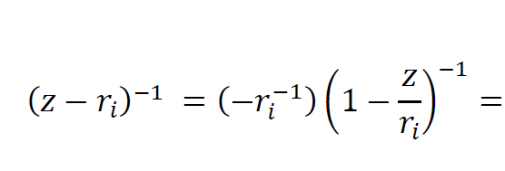
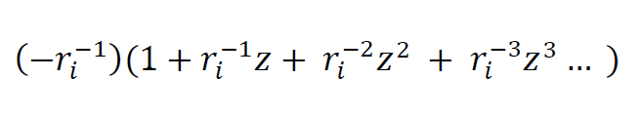
Taylor series
Notes:
You might show on the board the Taylor series for 1/(1-x), which is 1+x+x²+x³+…

Slide 32
Taylor series
contains all powers of z
Notes:
So this is a “infinitely long” or “infinitely high order” polynomial.

Slide 33
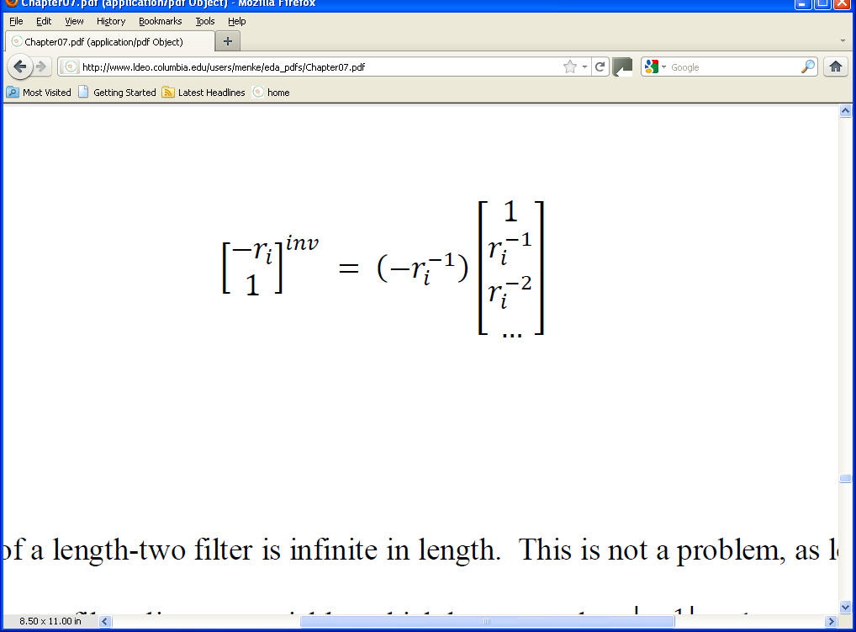
so the filter that undoes convolution by
[-r_{i}, 1]^{T} is …
an indefinitely long filter
Notes:
Likewise, the corresponding filter is indefinitely long.
It’s only useful if the coefficients rapidly fall off.

Slide 34
this filter will only be useful if its coefficients fall off
this happens when |r_{i}|⁻¹ > 1
or
|r_{i}| < 1
must decrease
Notes:
Condition for the coefficients decreasing.

Slide 35
this filter will only be useful if its coefficients fall off
this happens when |r_{i}|⁻¹ < 1
or
|r_{i}| > 1
must decrease
the root, r_{i}, must lie outside the “unit circle”
Notes:
A filter that has this property is said to be “minimum phase”.

Slide 36
the inverse filter for a length-N filter g step 1: find roots of g(z) step 2: check that roots are inside the unit circle step 3: construct inverse filter associated with each root step 4: convolve them all together

Slide 37
example
construct inverse filter of:
g_{j}
element j
Notes:
This is just a hypothetical example.

Slide 38
only hard part of the process is finding the roots of a polynomial
% find roots of g
r = roots(flipud(g));
fortunately, MatLab does this easily

Slide 39
g_{j}
element j
g_{j}^{inv}
element j
[g^{inv}*g]_{j}
element j
Notes:
Fig. 7.10. A filter, g, its inverse filter, g^{inv}, and the convolution of the two, g^{inv}*g.

Slide 40
short time series
g_{j}
element j
long timeseries
g_{j}^{inv}
element j
spike
[g^{inv}*g]_{j}
element j
Notes:
The inverse filter is in general infinitely long. But in most cases, as above,
can be adequately approximated with a longish, but finite filter.

Slide 41
Part 3: Recursive Filters
a way to make approximate a long filter
with
two short ones
Notes:
Recursive filters are also called IIR filters, where IIR stands for “Infinite Impulse Response”.

Slide 42
in the standard filtering formula
we compute the output θ₁, θ₂, θ₃, … in sequence
but without using our knowledge of
θ₁ when we compute θ₂
or θ₂ when we compute θ₃
etc
Notes:
This is the generic nature of the problem. Lots of different inputs and outputs are related in this way.

Slide 43
that’s wasted information
Notes:
So let’s put it to work

Slide 44
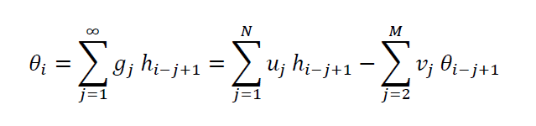
suppose we tried to put the information to work, as follows
here we’ve introduced two new filters, u and v

Slide 45
new but conventional filter, u
conventional filter, g
filter v that acts on already computed values of θ

Slide 46
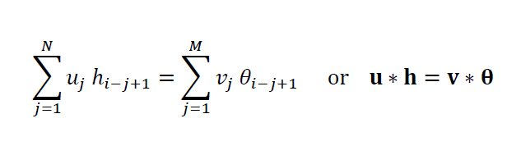
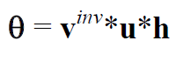
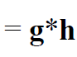
now define v₁=1, so
if we can find short filters u and v such that
v^{inv} * u ≈ g
then we can speed up the convolution process
Notes:
The inverse of v is infinitely long, even when v is short.
Thus we can hope to match an indefinitely long g through the convolution v^{inv} * u

Slide 47
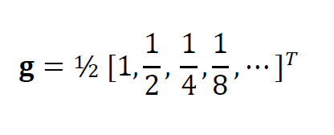
an example
g*h is the weighted average of recent values of h
if g is truncated to N≈10 elements, then each time step takes 10N multiplications and 10N additions
Notes:
The is a simple filter, but a useful one, because it smooths data.

Slide 48
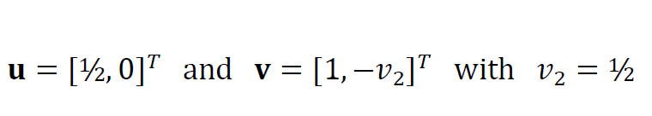
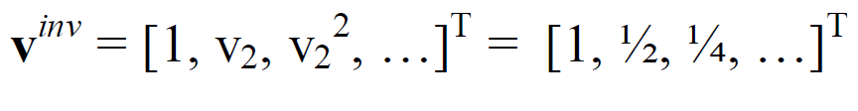
try
this works, since the inverse of a length-2 filter is
Notes:
Here we resort to the time-honored technique of guessing the solution and showing that
its correct.

Slide 49
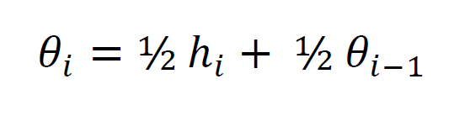
the convolution then becomes
which requires only one addition and one multiplication per time step
a savings of a factor of about ten
Notes:
After factoring the ½ to the outside of the addition, of course.
Dividing by two is particularly easy when the data are represented as binary integers,
since it corresponds to shifting the bit pattern by one bit. Thus, this filter is often
used in simple electronic devices that have only modest processing power.

Slide 50
A)
h(t) and θ(t)
time , t
B)
h(t) and θ(t)
time , t
Notes:
Recursive smoothing filter applied to two time series. A) Time series, h(t) (dots), is a unit spike. The smoothed version, θ(t) (solid line), a decaying exponential, is the impulse response of the smoothing filter. B) Time series, h(t) (dots), consists of random noise with zero mean and unit variance. Smoothed version, θ(t) (solid line), averages out extremes of variation.

