Slide 1
Environmental Data Analysis with MatLab
Lecture 15:
Factor Analysis
Notes:
Today’s lecture starts a new subject, rather different than the time series, spectra and filters

Slide 2
SYLLABUS
Lecture 01 Using MatLab
Lecture 02 Looking At Data
Lecture 03 Probability and Measurement Error
Lecture 04 Multivariate Distributions
Lecture 05 Linear Models
Lecture 06 The Principle of Least Squares
Lecture 07 Prior Information
Lecture 08 Solving Generalized Least Squares Problems
Lecture 09 Fourier Series
Lecture 10 Complex Fourier Series
Lecture 11 Lessons Learned from the Fourier Transform
Lecture 12 Power Spectral Density
Lecture 13 Filter Theory
Lecture 14 Applications of Filters
Lecture 15 Factor Analysis
Lecture 16 Orthogonal functions
Lecture 17 Covariance and Autocorrelation
Lecture 18 Cross-correlation
Lecture 19 Smoothing, Correlation and Spectra
Lecture 20 Coherence; Tapering and Spectral Analysis
Lecture 21 Interpolation
Lecture 22 Hypothesis testing
Lecture 23 Hypothesis Testing continued; F-Tests
Lecture 24 Confidence Limits of Spectra, Bootstraps

Slide 3
purpose of the lecture
introduce
Factor Analysis
a method of detecting patterns in data
Notes:
The key idea here is that the patterns are drawn from the data itself, not imposed upon the data.

Slide 4
example:
sediment samples are a mix of several sources
source A
source B
ocean
sediment
s₁
s₂
s₃
s₄
s₅
Notes:
Point out that sample s1 is likely to contain mostly source A, and s5 is likely to contain mostly B

Slide 5
what does the composition of the samples
tell you about the composition of the sources?
s₁
s₂
e₁
e₁
e₂
e₂
e₃
e₃
e₄
e₄
e₅
e₅
ocean
sediment
Notes:
Here the e’s represent chemical components.

Slide 6
another example
Atlantic Rock Dataset chemical composition for several thousand rocks
Notes:
Recall that in chapter 2 we made scatter plots of pairs of chemical elements from this dataset.

Slide 7
Rocks are a mix of minerals, and …
rock 3
rock 1
rock 2
rock 4
rock 6
rock 7
rock 5
…minerals have a well-defined composition
mineral 1
mineral 2
mineral 3
Notes:
A rock is an aggregate of minerals. A mineral is a crystalline substance with a distinct composition.

Slide 8
Which simpler?
rocks have a chemical composition
or
rocks contain minerals
and
minerals have chemical compositions
Notes:
Might be worth soliciting the class’ opinion on this one.

Slide 9
answer will depend on how many minerals are involved and how many elements are in each mineral
Notes:
N samples, M elements implies NxM numbers.
N sample, P minerals, M elements implies NxP+P*M numbers.

Slide 10
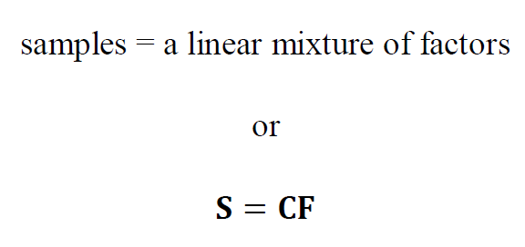
representing mixing with matrices
Notes:
This idea was introduced in Chapter 4.

Slide 11
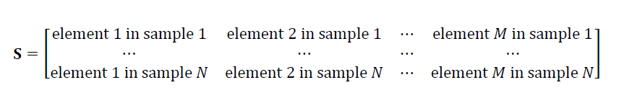
the sample matrix, S
N samples by M elements
e.g.
sediment samples
rock samples
word element is used in the abstract sense and may not refer to actual chemical elements
Notes:
Review each of the matrices carefully, as they will arise many times in the rest of the lecture.

Slide 12
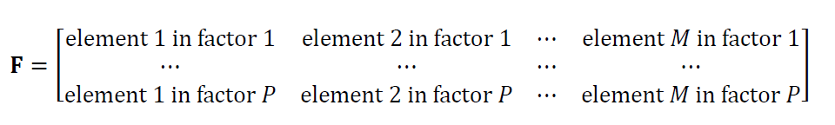
the factor matrix, F
P factors by M elements
e.g.
sediment sources
minerals
note that there are P factors
a simplification if P<M
Notes:
Review each of the matrices carefully, as they will arise many times in the rest of the lecture.

Slide 13
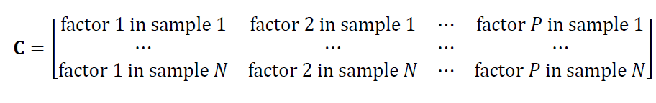
the loading matrix, C
N samples by P factors
specifies the mix of factors for each sample
Notes:
Review each of the matrices carefully, as they will arise many times in the rest of the lecture.

Slide 14
summary samples contain factors factors contain elements
Notes:
This is the basic model of “factor analysis”.

Slide 15
an important issue how many factors are needed to represent the samples? need at most P=M but is P < M ?

Slide 16
simple example using ternary diagrams
Notes:
You might need to go over how a ternary diagram works.

Slide 17
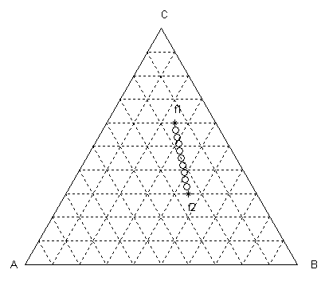
element
samples
element
element B
Notes:
In this case, all the samples fall on a line, as contasted to a 2D cloud. So this is a special case.

Slide 18
element
samples
line of samples implies only 2 factors, so P=2
element
element B
Notes:
In chemistry this would be called a “mixing line”

Slide 19
element
factors
samples
element
element B
Notes:
Each sample is a different mix of factor 1 and factor 2.

Slide 20
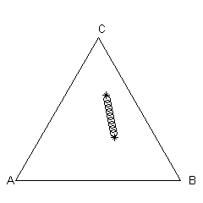
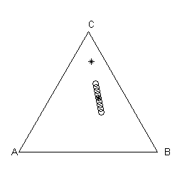
data do not uniquely determine factors
A)
B)
factor, f₁
factor, f’₂
factor, f’₁
factor, f₂
two bracketing factors
most typical factor and deviation from it
Notes:
But the data do not uniquely determine the factors.

Slide 21
mathematically
S = CF = C’ F’
with F’ = M F and C’ = C M⁻¹
where M is any P×P matrix with an inverse
must rely on prior information to choose M
Notes:
Emphasize that prior information plays an important role in choosing “good” factors.

Slide 22
a method to determine the minimum number of factors, P and one possible set of factors
Notes:
The method we are working towards is singular value decomposition. Its introduction is
quite involved however, and will be difficult for the students, especially if they have never
seen the algebraic eigenvalue problem. Go slowly.

Slide 23
a digression, but an important one
suppose that we have an N×N square matrix, M
and we experiment with it by multiplying “input” vectors, v, by it to create “output” vectors, w
w = Mv
Notes:
The next 22 slides deal with the algebraic eigenvalue problem.
Its actually fairly instructive to make plots of v and w in the 2D case.
You might consider assigning a script where the student draws a v and the script computes and draws the corresponding w.

Slide 24
surprisingly, the answer to the question
when is the output parallel to the input ?
tells us everything about the matrix
Notes:
Actually, you need to know the proportionality factors, too.

Slide 25
if w is parallel to v then w = λ v where λ is a proportionality factor the equation w = Mv is then λ v = Mv or (M - λ I)v=0
Notes:
The bottom equation is called the “algebraic eigenvalue problem”; that is, to find all the pairs of (λ,v)
that solve the equation.

Slide 26
but if
(M - λ I)v=0 then it would seem that v = (M - λ I)⁻¹0 = 0 which is not a very interesting solution
w is parallel to v when v is zero

Slide 27
to make an interesting solution you must choose λ so that
(M - λ I)⁻¹ doesn’t exist which is equivalent to choosing λ so that det(M - λ I)=0

Slide 28
to make an interesting solution you must choose λ so that
(M - λ I)⁻¹ doesn’t exist which is equivalent to choosing λ so that det(M - λ I)=0
since a matrix with zero determinant has no inverse

Slide 29
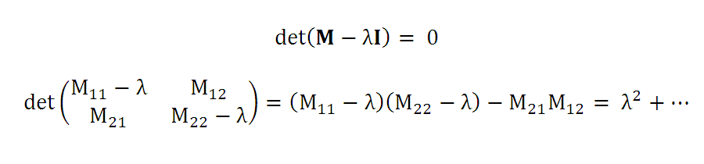
in the 2×2 case …
this is a quadratic equation in λ
and so has two solutions
λ₁ and λ ₂
Notes:
The N=2 case is shown here to make it apparent that det(M-λI)=0 is a quadratic equation for λ.

Slide 30
in the N×N case det(M - λ I)=0 is an N-order polynomial equation and so has N solutions λ₁, λ ₂ , … λ _{N} each corresponds to a different v v⁽¹⁾, v⁽²⁾, … v^{(N)}
Notes:
The general case an N-th order polynomial equation for λ. But a N-th order polynomial equation has N solutions.

Slide 31
in the N×N case det(M - λ I)=0 is an N-order polynomial equation and so has N solutions λ₁, λ ₂ , … λ _{N} each corresponds to a different v v⁽¹⁾, v⁽²⁾, … v^{(N)}
“eigenvalues”
“eigenvectors”
Notes:
Note that nothing in this discussion has said anything significant about how the λ’s and v’s are calculated in practice.
We’ll let MatLab handle that.

Slide 32
N×N matrix, M
w = Mv
when is the output parallel to the input ?
N different cases
Mv⁽¹⁾ = λ₁v⁽¹⁾
Mv⁽²⁾ = λ₂v⁽²⁾
…
Mv^{(N)} = λ_{N}v^{(N)}
Notes:
This emphasizes the result, and especially that the N eigenvalues and eigenvectors are paired.

Slide 33
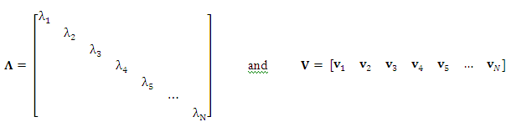
Mv⁽¹⁾ = λ₁v⁽¹⁾
Mv⁽²⁾ = λ₂v⁽²⁾
…
Mv^{(N)} = λ_{N}v^{(N)}
simplify notation
MV = V Λ
Notes:
We collect the eigenvalues into a diagonal matrix, Λ. Each eigenvector is a column of the matrix, V.

Slide 34
In the text its shown that if M is symmetric then all λ’s are real v’s are orthonormal v^{(i)T} v^{(j)} =
1 if i=j
0 if i ≠ j
Notes:
Remind students that orthonormal means v’s are mutually orthogonal (perpendicular) and that they are of unit length.

Slide 35
In the text its shown that if M is symmetric then all λ’s are real v’s are orthonormal v^{(i)T} v^{(j)} =
1 if i=j
0 if i ≠ j
implies V^{T}V = VV^{T}= I
Notes:
Note that V^{T} is equal to V⁻¹.

Slide 36
MV = V Λ
post-multiply by V^{T}
M = V Λ V^{T}
M can be constructed from V and Λ
so
when is the output parallel to the input ?
tells you everything about M
Notes:
This slides concludes this rather long section on the algebraic eigenvalue problem.

Slide 37
now here’s what this has to do with factors
Notes:
Now let’s put them to work.

Slide 38
suppose S is square and symmetric then
S = CF = V Λ V^{T}
Notes:
Of course, its not square or symmetric. But suppose that it was.

Slide 39
suppose S is square and symmetric then
S = CF = V Λ V^{T}
C
F
Notes:
We identify C with V Λ and F with V^{T}.

Slide 40
suppose S is square and symmetric then
S = CF = V Λ V^{T}
C
F
S can be represented by M mutually-perpendicular factors, F
Notes:
Thus the eigenvectors are the factors.

Slide 41
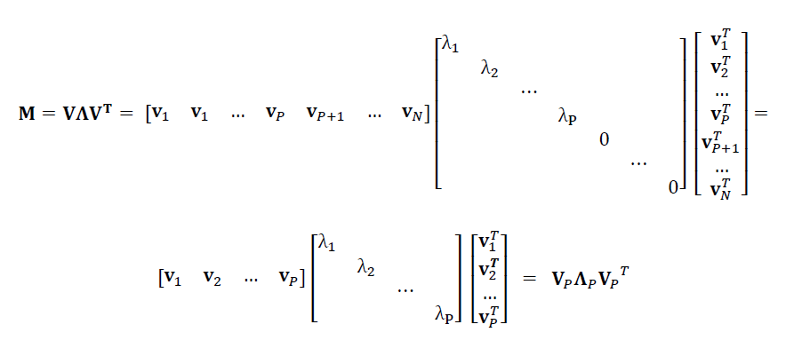
furthermore, suppose that only P eigvenvalues are nonzero
the eigenvectors with zero eigenvalues can be thrown out of the equation
Notes:
This step allows us to reduce the number of factors to the bare mininim, P.

Slide 42
we can reduce the number of factors from M to P
S = CF = V_{P} Λ_{P} V_{P}^{T}
C
F
S can be represented by P
mutually-perpendicular factors, F_{P}
Notes:
However, keep in mind that since there’s observational noise, there will probably never really be
exactly zero eigenvalues, but rather ones that are small enough to be ignored.

Slide 43
unfortunately …
S is usually neither square nor symmetric so a patch in the methodology is needed
Notes:
Thus, we develop a fix-up.

Slide 44
the trick …
S^{T}S is an M×M square matrix
Notes:
You might take the transform of S^{T}S on the board, and show that really is symmetric.

Slide 45
suppose
S^{T}S has eigenvalues Λ_{P} and eigenvectors V_{P}
Notes:
This begins the derivation of the singular value decomposition

Slide 46
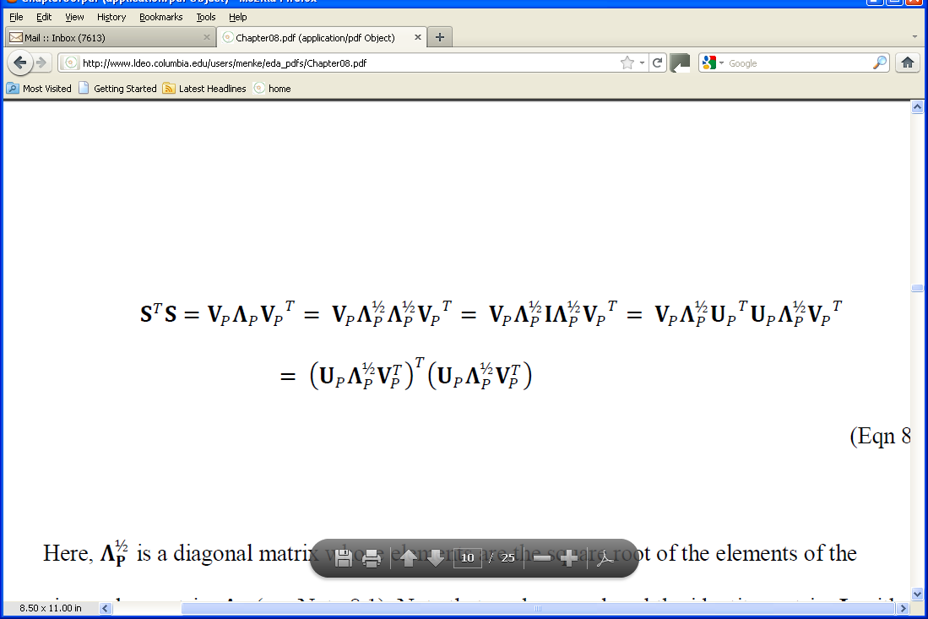
S^{T}S written in terms of its eigenvalues and eigenvectors
Notes:
Step 1

Slide 47
S^{T}S written in terms of its eigenvalues and eigenvectors
write Λ_{P} as product of its square roots
Notes:
Step 2

Slide 48
S^{T}S written in terms of its eigenvalues and eigenvectors
write Λ_{P} as product of its square roots
insert identity matrix, I
Notes:
Step 3

Slide 49
S^{T}S written in terms of its eigenvalues and eigenvectors
write Λ_{P} as product of its square roots
insert identity matrix, I
write I = U_{p}^{T}U_{p}, with U_{p} as yet unknown
Notes:
Step 4. We’ll solve for U_{p} later.

Slide 50
S^{T}S written in terms of its eigenvalues and eigenvectors
write Λ_{P} as product of its square roots
insert identity matrix, I
write I = U_{p}^{T}Up, with U_{p} as yet unknown
group and write first group as transpose of transpose
Notes:
Step 5

Slide 51
S^{T}S written in terms of its eigenvalues and eigenvectors
write Λ_{P} as product of its square roots
insert identity matrix, I
write I = U_{p}^{T}Up, with U_{p} as yet unknown
group and write first group as transpose of transpose
compare
Notes:
Step 6

Slide 52
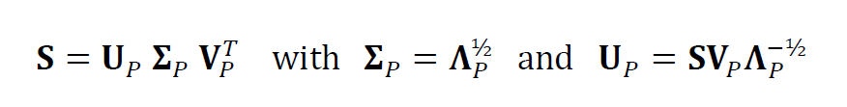
so
Notes:
The second equation is just a definition, to hide the square root.
The third equation is just the first equation, solved for U_{p}. It uses the fact that V^{T}=V⁻¹.
You might also show on the board that U_{p} satisfies U_{p}^{T}U_{p}=I, as required:
(SV_{p}Λ_{p}^{-1/2})^{T}(SV_{p}Λ_{p}^{-1/2}) = Λ_{p}^{-1/2}V_{p}^{T}(S^{T}S)V_{p}Λ_{p}^{-1/2}=Λ_{p}^{-1/2}(V_{p}^{T}V_{p})Λ_{p}(V_{p}^{T}V_{p})Λ_{p}^{-1/2}= Λ_{p}^{-1/2}Λ_{p}Λ_{p}^{-1/2}=I

Slide 53
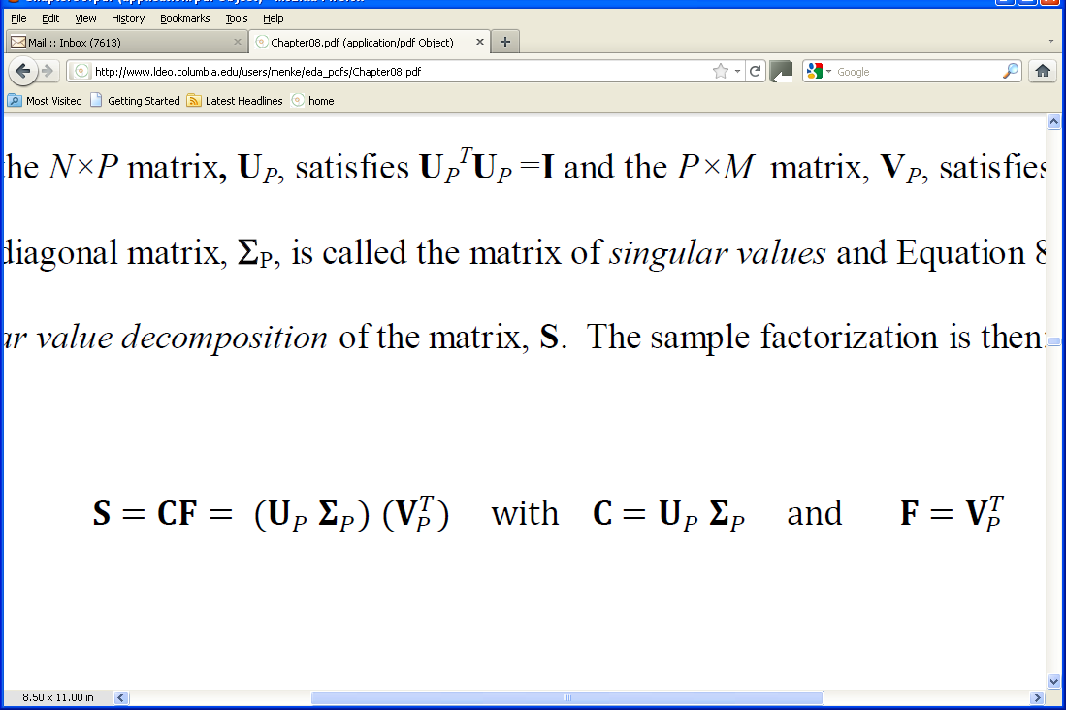
so
and

Slide 54
so
called the “singular value decomposition” of S
called the “singular values”
and
now the non-square, non-symmetric matrix, S, is represented as a mix of P mutually perpendicular factors

Slide 55
the matrix of loadings, C.
the matrix of factors, F
since C depends on Σ,
the samples contains more of the factors with large singular values than of the factors with the small singular values
Notes:
Factors with large corresponding singular values are the most important.
Small ones can be ignored.

Slide 56
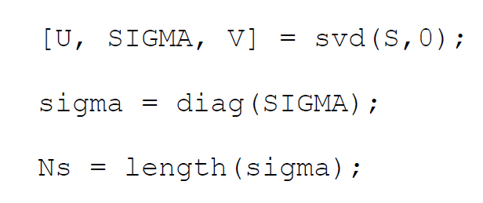
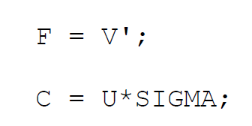
in MatLab
svd() computes all M factors
(you must decide how many to use)
Notes:
Singular Value Decomposition very easy in MatLab. Just one function call, svd().

Slide 57
singular values of the Atlantic Rock dataset
(sorted into order of size)
singular values, Σ_{ii}
index, i

Slide 58
singular values of the Atlantic Rock dataset
(sorted into order of size)
singular values, Σ_{ii}
index, i
discard, since close to zero
Notes:
Emphasize that in the real world, because of observational noise, there is no clear-cut distinction between
zero singular values and near-zero singular values. The singular values just diminish in size to something
small enough to be ignored. But the exact cut-off is often pretty arbitrary.

Slide 59
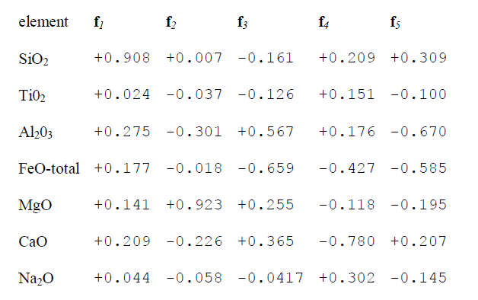
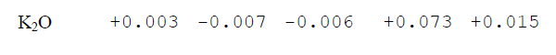
factors of the Atlantic Rock dataset

Slide 60
factor of the Atlantic Rock dataset
factor 1 is the “typical factor”
Notes:
If the is a “typical sample” the first factor will be close to it.
In this case, most of the rocks are basalts, so the typical factor has the composition of a basalt.

Slide 61
factor of the Atlantic Rock dataset
factor 2 as MgO increases, Al₂O₃ and CaO decreases
Notes:
The second factor says that the major source of variability from the “typical rock” is to
increase the MgO while decreasing mostly the Al2O3 abd the CaO.

Slide 62
factor of the Atlantic Rock dataset
factor 3: as Al₂O₃ increases, FeO and CaO increase
Notes:
The third factor says that another, but less significant, source of variability from the “typical rock” is to
increase the Al2O3 while decreasing mostly the FeO and the CaO.
You might have the class interpret factor 3.

Slide 63
graphical representation of factors 2 through 5
SiO₂
TiO₂
Al₂O₃
FeO_{total}
MgO
CaO
Na₂O
K₂O
f₂
f₃
f₄
f₅
Notes:
This is a graphical representation of the major modes of variability around the “typical sample”

Slide 64
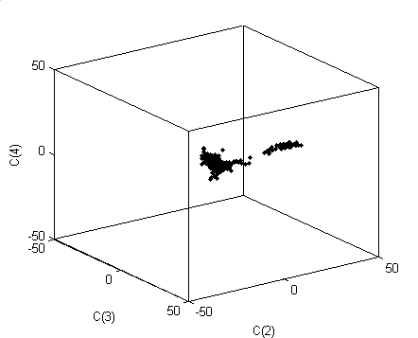
factor loadings C₂ through C₄ plotted in 3D
C₄
C₃
C₂
factors 2 through 4 capture most of the variability of the rocks
Notes:
This “L-shaped” pattern of variability accounts for a very large percentage of the overall variability
of compositions within the Atlantic Rock dataset.
You might consider running the script that generates this 3D plot, and rotate it during class time.

Slide 65
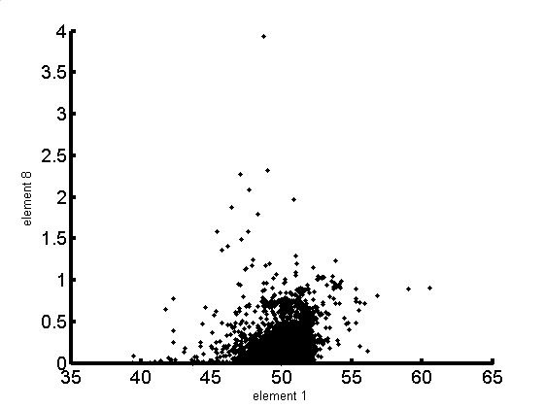
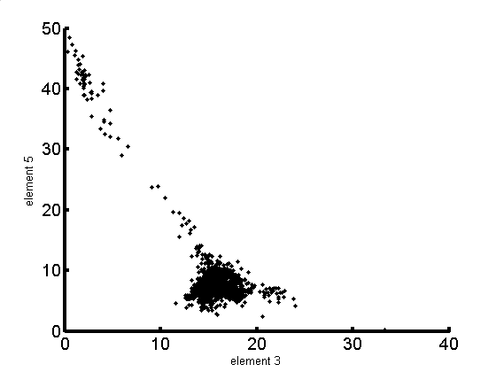
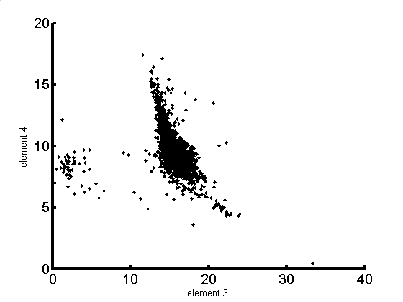
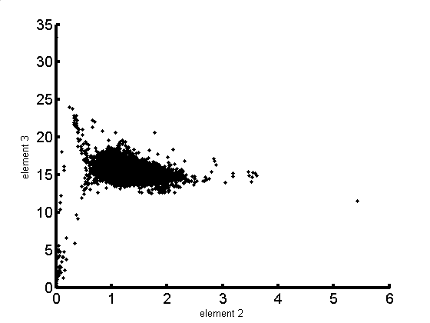
A)
B)
K₂0
Mg0
Si0₂
Al₂0₃
C)
D)
Fe0
Al₂0₃
Al₂0₃
Ti0₂
Notes:
The plot of the most important factors is much simpler and more informative than scatter plots of the
individual elements that we developed in Chapter 2. All these patterns are contained in the simple
“L-shaped” pattern of variability in the previous slide (plus the compositions of the factors, of course).

