Slide 1
Environmental Data Analysis with MatLab
Lecture 16:
Orthogonal Functions
Notes:
Today’s lecture finishes up factor analysis and related subjects/

Slide 2
SYLLABUS
Lecture 01 Using MatLab
Lecture 02 Looking At Data
Lecture 03 Probability and Measurement Error
Lecture 04 Multivariate Distributions
Lecture 05 Linear Models
Lecture 06 The Principle of Least Squares
Lecture 07 Prior Information
Lecture 08 Solving Generalized Least Squares Problems
Lecture 09 Fourier Series
Lecture 10 Complex Fourier Series
Lecture 11 Lessons Learned from the Fourier Transform
Lecture 12 Power Spectral Density
Lecture 13 Filter Theory
Lecture 14 Applications of Filters
Lecture 15 Factor Analysis
Lecture 16 Orthogonal functions
Lecture 17 Covariance and Autocorrelation
Lecture 18 Cross-correlation
Lecture 19 Smoothing, Correlation and Spectra
Lecture 20 Coherence; Tapering and Spectral Analysis
Lecture 21 Interpolation
Lecture 22 Hypothesis testing
Lecture 23 Hypothesis Testing continued; F-Tests
Lecture 24 Confidence Limits of Spectra, Bootstraps

Slide 3
purpose of the lecture
further develop Factor Analysis
and introduce
Empirical Orthogonal Functions
Notes:
The key idea here is that the patterns are drawn from the data itself, not imposed upon the data.

Slide 4
review of the last lecture
Notes:
This is a longish review.

Slide 5
example
Atlantic Rock Dataset chemical composition for several thousand rocks
Notes:
Recall that in chapter 2 we made scatter plots of pairs of chemical elements from this dataset.

Slide 6
Rocks are a mix of minerals, and …
rock 3
rock 1
rock 2
rock 4
rock 6
rock 7
rock 5
…minerals have a well-defined composition
mineral 1
mineral 2
mineral 3
Notes:
A rock is an aggregate of minerals. A mineral is a crystalline substance with a distinct composition.

Slide 7
rocks contain elements
rocks contain minerals
and
minerals contain elements
simpler
Notes:
This is the specific case of rocks

Slide 8
rocks contain elements
rocks contain minerals
and
minerals contain elements
samples
simpler
samples
factors
factors
Notes:
and this is the terminology that we will use for the generic case.

Slide 9
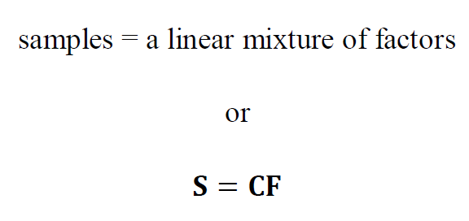
Notes:
This idea was introduced in Chapter 4.

Slide 10
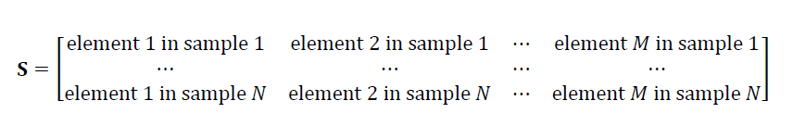
the sample matrix, S
N samples by M elements
e.g.
sediment samples
rock samples
word element is used in the abstract sense and may not refer to actual chemical elements
Notes:
Review each of the matrices carefully, as they will arise many times in the rest of the lecture.

Slide 11
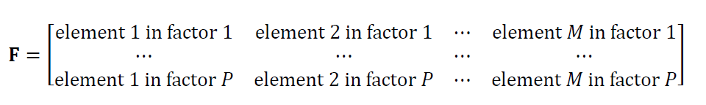
the factor matrix, F
P factors by M elements
e.g.
sediment sources
minerals
note that there are P factors
a simplification if P<M
Notes:
Review each of the matrices carefully, as they will arise many times in the rest of the lecture.

Slide 12
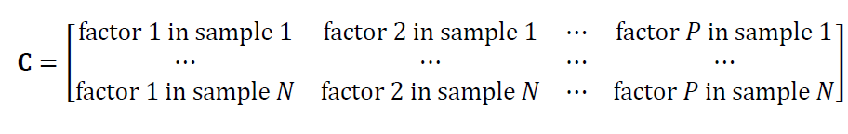
the loading matrix, C
N samples by P factors
specifies the mix of factors for each sample
Notes:
Review each of the matrices carefully, as they will arise many times in the rest of the lecture.

Slide 13
the key question how many factors are needed to represent the samples? and what are these factors?

Slide 14
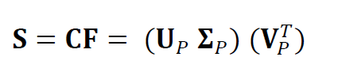
singular value decomposition the methodology for answer these questions
Notes:
Factors with large corresponding singular values are the most important.
Small ones can be ignored.

Slide 15
the matrix of P mutually-perpendicular vectors, each of length M
sample matrix
the matrix of P mutually-perpendicular vectors, each of length N
diagonal matrix Σ,
of P singular values
Notes:
Factors with large corresponding singular values are the most important.
Small ones can be ignored.

Slide 16
the matrix of loadings, C.
the matrix of factors, F
since C depends on Σ,
the samples contains more of the factors with large singular values than of the factors with the small singular values
Notes:
Factors with large corresponding singular values are the most important.
Small ones can be ignored.

Slide 17
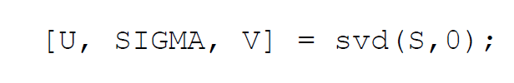
in MatLab
Notes:
Singular Value Decomposition very easy in MatLab. Just one function call, svd().

Slide 18
plot of M singular values, sorted by size
singular values, Σ_{ii}
index, i

Slide 19
use it to discard near-zero singular values
singular values, Σ_{ii}
index, i
discard, since close to zero
Notes:
Emphasize that in the real world, because of observational noise, there is no clear-cut distinction between
zero singular values and near-zero singular values. The singular values just diminish in size to something
small enough to be ignored. But the exact cut-off is often pretty arbitrary.

Slide 20
and to determine the number P of factors
P=5
singular values, Σ_{ii}
index, i
Notes:
Emphasize that in the real world, because of observational noise, there is no clear-cut distinction between
zero singular values and near-zero singular values. The singular values just diminish in size to something
small enough to be ignored. But the exact cut-off is often pretty arbitrary.

Slide 21
Atlantic Rock Dataset
graphical representation of factors 2 through 5
SiO₂
TiO₂
Al₂O₃
FeO_{total}
MgO
CaO
Na₂O
K₂O
f₂
f₃
f₄
f₅
Notes:
This is a graphical representation of the major modes of variability around the “typical sample”

Slide 22
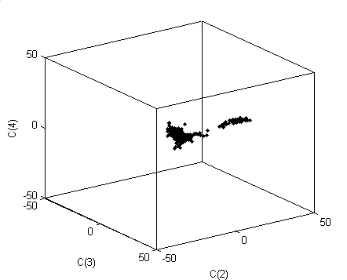
factor loadings C₂ through C₄ plotted in 3D
C₄
C₃
C₂
factors 2 through 4 capture most of the variability of the rocks
Notes:
This “L-shaped” pattern of variability accounts for a very large percentage of the overall variability
of compositions within the Atlantic Rock dataset.
You might consider running the script that generates this 3D plot, and rotate it during class time.

Slide 23
end of review

Slide 24
Part 1: Creating Spiky Factors

Slide 25
can we find “better” factors that those returned by svd()
?

Slide 26
mathematically
S = CF = C’ F’
with F’ = M F and C’ = M⁻¹ C
where M is any P×P matrix with an inverse
must rely on prior information to choose M
Notes:
Emphasize that prior information plays an important role in choosing “good” factors.

Slide 27
one possible type of prior information factors should contain mainly just a few elements

Slide 28
example of minerals
Mineral | Composition
Quartz | SiO₂
Rutile | TiO₂
Anorthite | CaAl₂Si₂O₈
Fosterite | Mg₂SiO₄
Notes:
The point here is that each mineral contains just a few chemical elements.

Slide 29
spiky factors factors containing mostly just a few elements
Notes:
Here we starting to quantify the degree to which a factor contains just a few elements.
“Spiky” is taken as more-or-less synonymous with “containing mostly just a few elements”

Slide 30
How to quantify spikiness?
Notes:
You might ask the class to contribute some ideas.

Slide 31
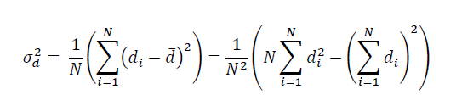
variance as a measure of spikiness
Notes:
E.g. The variance of [1, 1, 1, 1, 1] is zero. The variance of [1, 0, 0, 0, 0] is greater than zero.

Slide 32
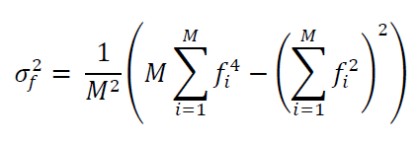
modification for factor analysis
Notes:
This is the variance of f_{i}², not f_{i}.

Slide 33
modification for factor analysis
depends on the square, so positive and negative values are treated the same
Notes:
The underlying notion is that the signs of components of the factor are less important than
the absolute size.

Slide 34
f⁽¹⁾= [1, 0, 1, 0, 1, 0]^{T} is much spikier than f⁽²⁾= [1, 1, 1, 1, 1, 1]^{T}
Notes:
(top) only three elements in this factor
(bottom) 6 factors

Slide 35
f⁽²⁾=[1, 1, 1, 1, 1, 1]^{T} is just as spiky as f⁽³⁾= [1, -1, 1, -1, -1, 1]^{T}
Notes:
(top) six elements of equal size, a positive
(bottom) six elements of equal size, but alternating size
have the same spikiness

Slide 36
“varimax” procedure
find spiky factors without changing P
start with P svd() factors
rotate pairs of them in their plane by angle θ
to maximize the overall spikiness
Notes:
Since the P factors are being mixed together with each other, and not with the M-P factors
with zero eigenvalues, the value of P doen’t change.

Slide 37
f’_{A}
f_{B}
f_{A}
θ
f’_{B}
Notes:
Two factors, f_{A} and f_{B}, are rotated in their plane by a angle θ
The angle θ is chosen to maximize the spikiness of the two factors.

Slide 38
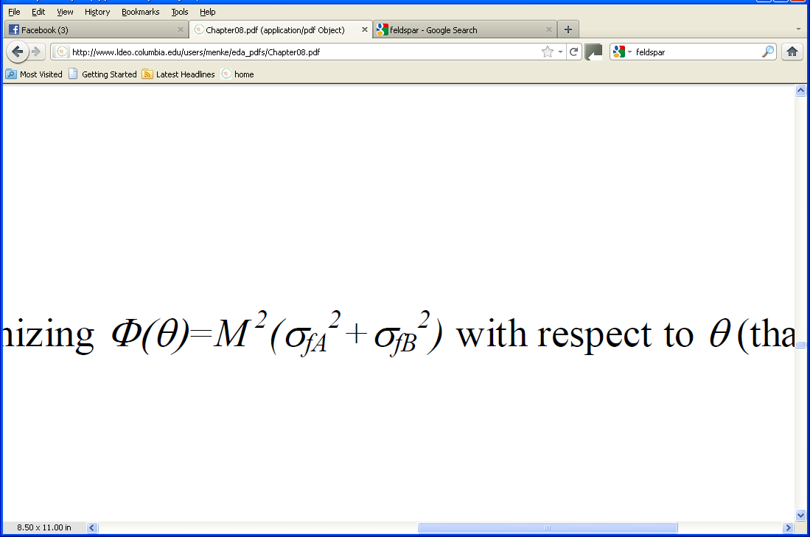
determine θ by maximizing

Slide 39
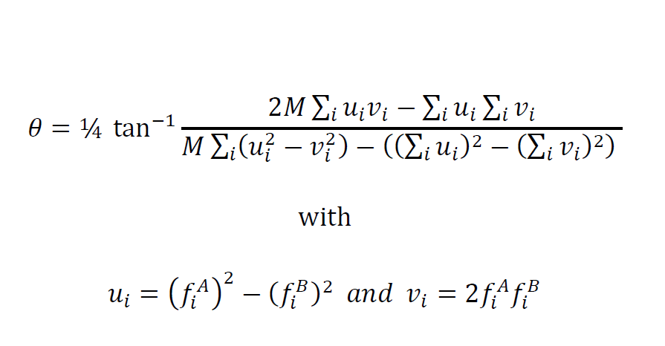
after tedious trig the solution can be shown to be

Slide 40
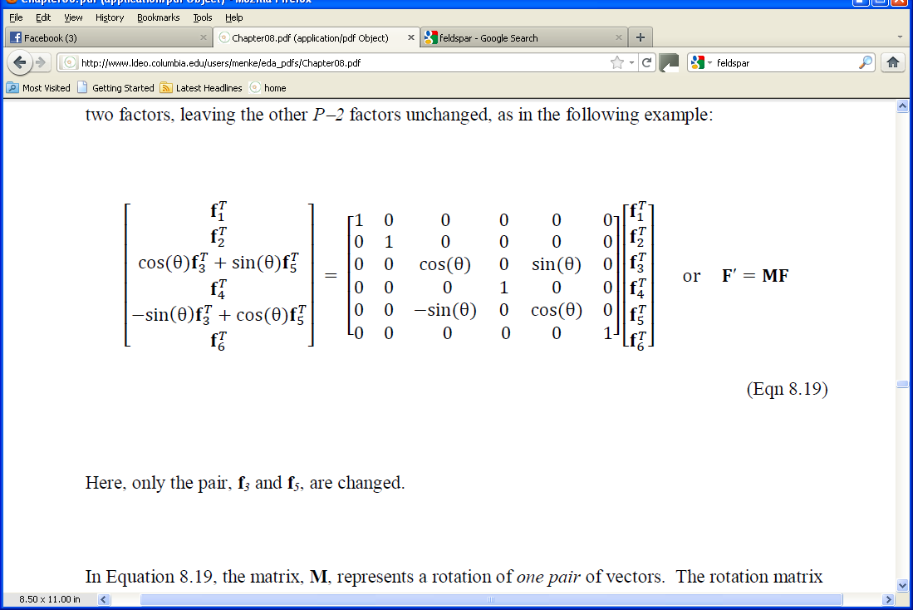
and the new factors are
in this example A=3 and B=5
Notes:
M is a rotation matrix that rotates only in the plane of factors A and B (3 and 5, as sown above).
M obeys M⁻¹ = M^{T}.

Slide 41
now one repeats for every pair of factors and then iterates the whole process several times until the whole set of factors is as spiky as possible
Notes:
The overall rotation matrix is just the product of the individual ones.
It needs to be ‘accumulated’ during the iterations.

Slide 42
example: Atlantic Rock dataset
A)
B)
SiO₂
TiO₂
Al₂O₃
FeO_{total}
MgO
CaO
Na₂O
K₂O
f₂
f₃
f₄
f₅
f’₂
f’₃
f’₄
f’₅
Notes:
svd factors; B) varimax factors. Note that the latter has few large (black) values.

Slide 43
Part 2: Empirical Orthogonal Functions
Notes:
This is an important extension of factor analysis.

Slide 44
row number in the sample matrix could be meaningful
example: samples collected at a succession of times
time
Notes:
Ordering by time is common, but many other types of ordering are useful.

Slide 45
column number in the sample matrix could be meaningful
example: concentration of the same chemical element at a sequence of positions
distance
Notes:
Ordering by distance is common, but many other types of ordering are useful.

Slide 46
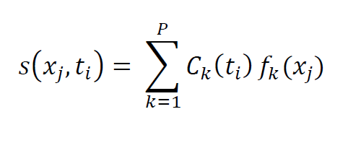
S = CF becomes

Slide 47
S = CF becomes
distance dependence
time dependence

Slide 48
S = CF becomes
each factor:
a spatial pattern of variability of the element
each loading: a temporal pattern of variability of the corresponding factor

Slide 49
S = CF becomes
there are P patterns and they are sorted into order of importance

Slide 50
S = CF becomes
factors now called EOF’s (empirical orthogonal functions)

Slide 51
example
sea surface temperature in the Pacific Ocean

Slide 52
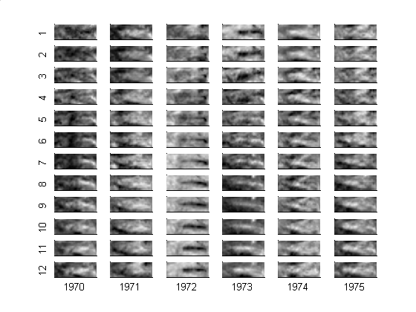
CAC Sea Surface Temperature
29°N
equatorial Pacific Ocean
latitude
29°S
124°E
290°E
longitude
sea surface temperature (black = warm)

Slide 53
Notes:
Sea surface temperature for each month of the year.
The complete dataset is longer than shown here, January 1970 to March 2003, or 399 months of data.

Slide 54
the image is 30 by 84 pixels in size, or 2520 pixels total
to use svd(), the image must be unwrapped into a vector of length 2520

Slide 55
2520 positions in the equatorial Pacific ocean
399 times
“element” means temperature
Notes:
Arrangement of the sample matrix

Slide 56
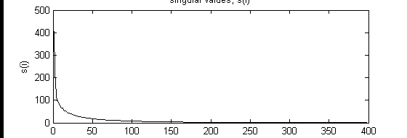
singular values
singular values, Σ_{ii}
index, i

Slide 57
singular values
singular values, Σ_{ii}
index, i
no clear cutoff for P, but the first 10 singular values are considerably larger than the rest

Slide 58
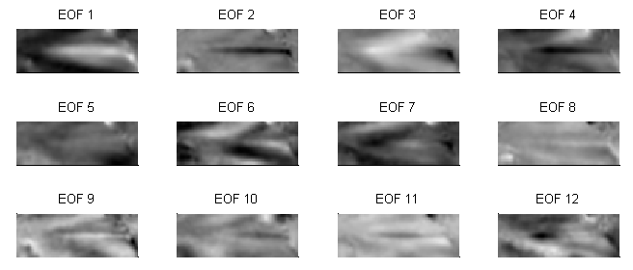
Notes:
EOF 1 is the most important pattern. It has a wide cool band running E-W across the equator.
EOF 2 it the second most important. It has a thin hot band running E-W across the equator.
The EOFs become progressively more and more complicated in spatial pattern.

Slide 59
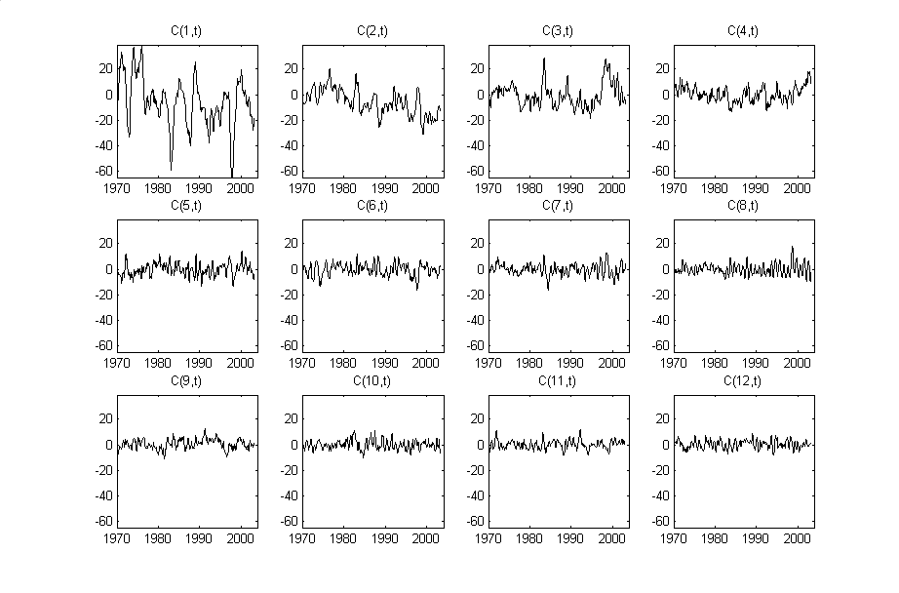
Notes:
Amplitude time series, C_{i}(t), of the First 12 EOF’s of the CAC sea surface temperature dataset for the time period January 1970 to March 2003.

Slide 60
Notes:
C₁(t), which give the time-varying amplitude of the first EOF. It varies with periods of a few years.
Flash back to the EOF plot and point out that the first EOF is a wide cool band across the equator.
This is a La Nina pattern, so C₁(t) functions like a La Nina index. large during La Nina, small during El Nino.

Slide 61
Notes:
C₁(t), which give the time-varying amplitude of the first EOF. It varies with periods of a few years.
Flash back to the EOF plot and point out that the first EOF is a wide cool band across the equator.
This is a La Nina pattern, so C₁(t) functions like a La Nina index. large during La Nina, small during El Nino.

Slide 62
Notes:
C₈(t), which give the time-varying amplitude of the 8th EOF, seems to have annual variability.
Flash back to look at EOF 8.
It is large in the northeast, small in the southwest, intermediate (near zero) elsewhere.
The pattern flips in sign every 6 months, reflecting the change from northern-summer to northern-winter.

Slide 63
Notes:
C₈(t), which give the time-varying amplitude of the 8th EOF, seems to have annual variability.
Flash back to look at EOF 8.
It is large in the northeast, small in the southwest, intermediate (near zero) elsewhere.
The pattern flips in sign every 6 months, reflecting the change from northern-summer to northern-winter.

Slide 64
using SVD to approximate data
Notes:
First few EOFs capture most of the variability of the data.

Slide 65
S=C_{M}F_{M}
S=C_{P}F_{P}
S≈C_{P’}F_{P’}
With M EOF’s, the data is fit exactly
With P chosen to exclude only zero singular values, the data is fit exactly
With P’<P, small non-zero singular values are excluded too, and the data is fit only approximately
Notes:
Because of observational noise, the singular values rarely fall into two distinct groups, one
non-zero and the other zero. More common is the case where their size diminishes smoothly
with index, i, so that one has to make a decision on which ones to include; that is, how accurate
the approximation S≈CF ought to be.

Slide 66
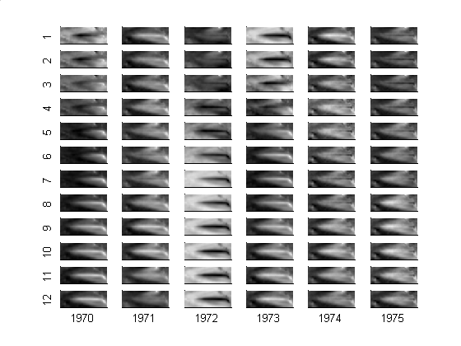
A) Original
B) Based on first 5 EOF’s
Notes:
You should flash back to the slide showing the first 12 EOF’s.
Ask the class to describe what is accurate about the approximation, and what is not.

