Slide 1
Environmental Data Analysis with MatLab
Lecture 17:
Covariance and Autocorrelation
Notes:
Today’s lecture introduces a new subject concerning correlations within time series.

Slide 2
SYLLABUS
Lecture 01 Using MatLab
Lecture 02 Looking At Data
Lecture 03 Probability and Measurement Error
Lecture 04 Multivariate Distributions
Lecture 05 Linear Models
Lecture 06 The Principle of Least Squares
Lecture 07 Prior Information
Lecture 08 Solving Generalized Least Squares Problems
Lecture 09 Fourier Series
Lecture 10 Complex Fourier Series
Lecture 11 Lessons Learned from the Fourier Transform
Lecture 12 Power Spectral Density
Lecture 13 Filter Theory
Lecture 14 Applications of Filters
Lecture 15 Factor Analysis
Lecture 16 Orthogonal functions
Lecture 17 Covariance and Autocorrelation
Lecture 18 Cross-correlation
Lecture 19 Smoothing, Correlation and Spectra
Lecture 20 Coherence; Tapering and Spectral Analysis
Lecture 21 Interpolation
Lecture 22 Hypothesis testing
Lecture 23 Hypothesis Testing continued; F-Tests
Lecture 24 Confidence Limits of Spectra, Bootstraps

Slide 3
purpose of the lecture
apply the idea of covariance
to time series
Notes:
The key idea is that neighboring points in a time series can be correlated, and the
idea of covariance can be applied to quantify the correlation.

Slide 4
Part 1 correlations between random variables
Notes:
In previous chapters, we developed ways of estimating the mean and the variance of a random
variable from data, but we neglected developing a corresponding formula for the covariance. We
do it now.

Slide 5
Atlantic Rock Dataset
Scatter plot of TiO₂ and Na₂O
Na₂O
TiO₂
Notes:
These two variables are positively correlated.

Slide 6
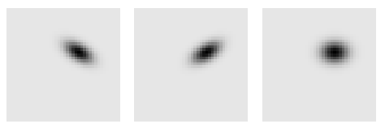
idealization as a p.d.f.
scatter plot
Na₂O
d₁
TiO₂
d₂
Notes:
When enough data are present, the scatter plot starts to resemble the p.d.f. of the two random variables.

Slide 7
types of correlations
positive correlation
negative correlation
d₂
uncorrelated
d₂
d₂
d₁
d₁
d₁
Notes:
For the positive correlation, point out that the right tip of the elliptical cloud occurs with both d₁ and d₂ greater than their means, and the left tip with both d₁ and d₂ less than their means. Point out the opposite for the negative correlation.

Slide 8
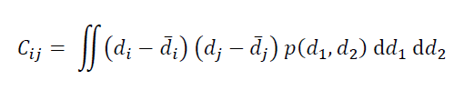
the covariance matrix
σ₁²
σ_{1,2}
σ_{1,3}
…
σ_{1,2}
σ₂²
…
C =
σ_{2,3}
σ_{1,3}
σ_{2,3}
σ₃²
…
…
…
…
…
Notes:
This is the formula for the covariance matrix that was derived in Chapter 3.

Slide 9
recall the covariance matrix
σ₁²
σ_{1,2}
σ_{1,3}
…
σ_{1,2}
σ₂²
…
C =
σ_{2,3}
σ_{1,3}
σ_{2,3}
σ₃²
…
…
…
…
…
covariance of d₁ and d₂
Notes:
The off-diagonal elements are the covariance of pairs of variables.

Slide 10
estimating covariance from data

Slide 11
divide (d_{i}, d_{j}) plane into bins
bin, s
d_{j}
Δd_{j}
d_{i}
Δd_{i}
Notes:
The scatter plot is divided up into bins.
The bins are indexed with the s.

Slide 12
estimate total probability in bin from the data:
P_{s} = p(d_{i}, d_{j}) Δd_{i} Δd_{j} ≈ N_{s}/N
bin, s with N_{s} data
d_{j}
Δd_{j}
d_{i}
Δd_{i}
Notes:
The number of points in each bin scales with the amount of probability in that bin.

Slide 13
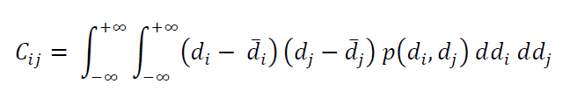
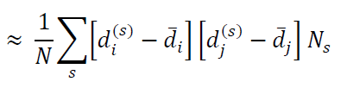
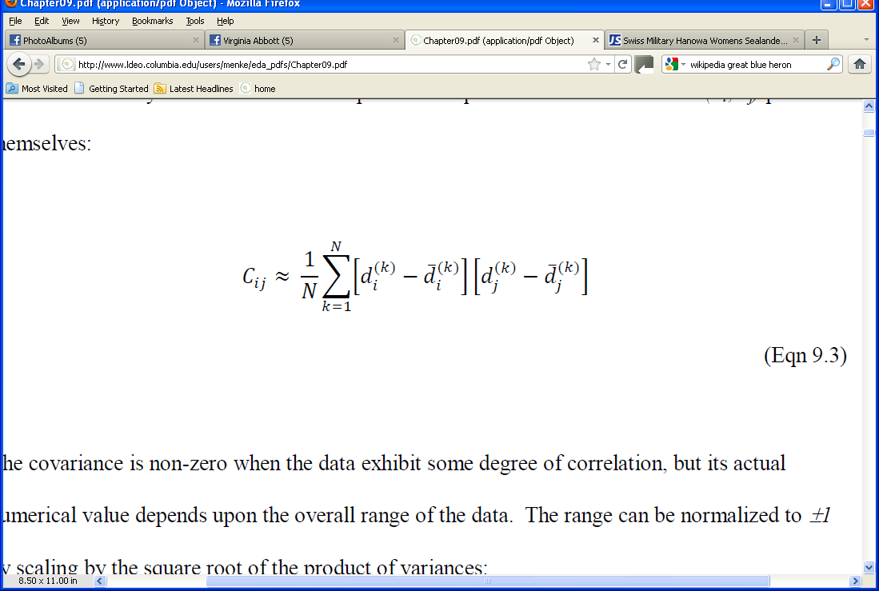
Notes:
The covariance is approximated as follows …

Slide 14
approximate integral with sum and use p(d_{i}, d_{j}) Δd_{i} Δd_{j}≈N_{s}/N
Notes:
The integral is approximated as a Riemann sum.
The probability is approximated by the number of points in each bin.

Slide 15
approximate integral with sum and use p(d_{i}, d_{j}) Δd_{i} Δd_{j}≈N_{s}/N
shrink bins so no more than one data point in each bin
Notes:
The bins are made very small, so that they contain either zero or one point.

Slide 16
“sample” covariance
Notes:
This yields the sample covariance, a way of estimating the covariance of the underlying
p.d.f. from the data.

Slide 17
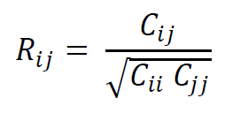
normalize to range ±1
“sample” correlation coefficient

Slide 18
R_{ij}
-1 perfect negative correlation
0 no correlation
1 perfect positive correlation

Slide 19
|R_{ij}| of the Atlantic Rock Dataset
SiO₂
TiO₂
Al₂O₂
FeO
MgO
CaO
Na₂O
K₂O
SiO₂
TiO₂
Al₂O₂
FeO
MgO
CaO
Na₂O
K₂O
Notes:
Here all possible pairs of elements are correlated.

Slide 20
|R_{ij}| of the Atlantic Rock Dataset
SiO₂
0.73
TiO₂
Al₂O₂
FeO
MgO
CaO
Na₂O
K₂O
SiO₂
TiO₂
Al₂O₂
FeO
MgO
CaO
Na₂O
K₂O
Notes:
This is the pair with the largest correlation coefficient.

Slide 21
Atlantic Rock Dataset
Scatter plot of TiO₂ and Na₂O
Na₂O
TiO₂
Notes:
This is what the corresponding scatter plot looks like.

Slide 22
Part 2 correlations between samples within a time series

Slide 23
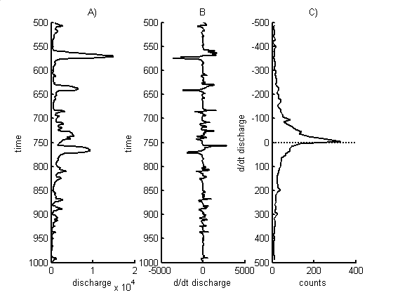
Neuse River Hydrograph
A) time series, d(t)
d(t), cfs
time t, days
Notes:
The bottom plot is an enlargement of a section of the top plot.
Note the annual cycle in the top plot.
Note in the lower plot, that if the river is high, it usually stays high for a few days.
If it is low, it usually stays low for a few days.

Slide 24
high degree of short-term correlation what ever the river was doing yesterday, its probably doing today, too because water takes time to drain away

Slide 25
Neuse River Hydrograph
A) time series, d(t)
d(t), cfs
time t, days
Notes:
Pairs of points (red) separated by a few days tend to have the same value.

Slide 26
low degree of intermediate-term correlation what ever the river was doing last month, today it could be doing something completely different because storms are so unpredictable

Slide 27
Neuse River Hydrograph
A) time series, d(t)
d(t), cfs
time t, days
Notes:
Pairs of points (red) separated by a month tend to have different values.

Slide 28
moderate degree of long-term correlation what ever the river was doing this time last year, its probably doing today, too because seasons repeat

Slide 29
Neuse River Hydrograph
A) time series, d(t)
d(t), cfs
time t, days
Notes:
Pairs of points (red) separated by a year tend to have similar values.

Slide 30
1 day
3 days
30 days
Notes:
The scatter plot is more linear (meaning more highly correlated) for the shorter lags.

Slide 31
Let’s assume different samples in time series are random variables and calculate their covariance

Slide 32
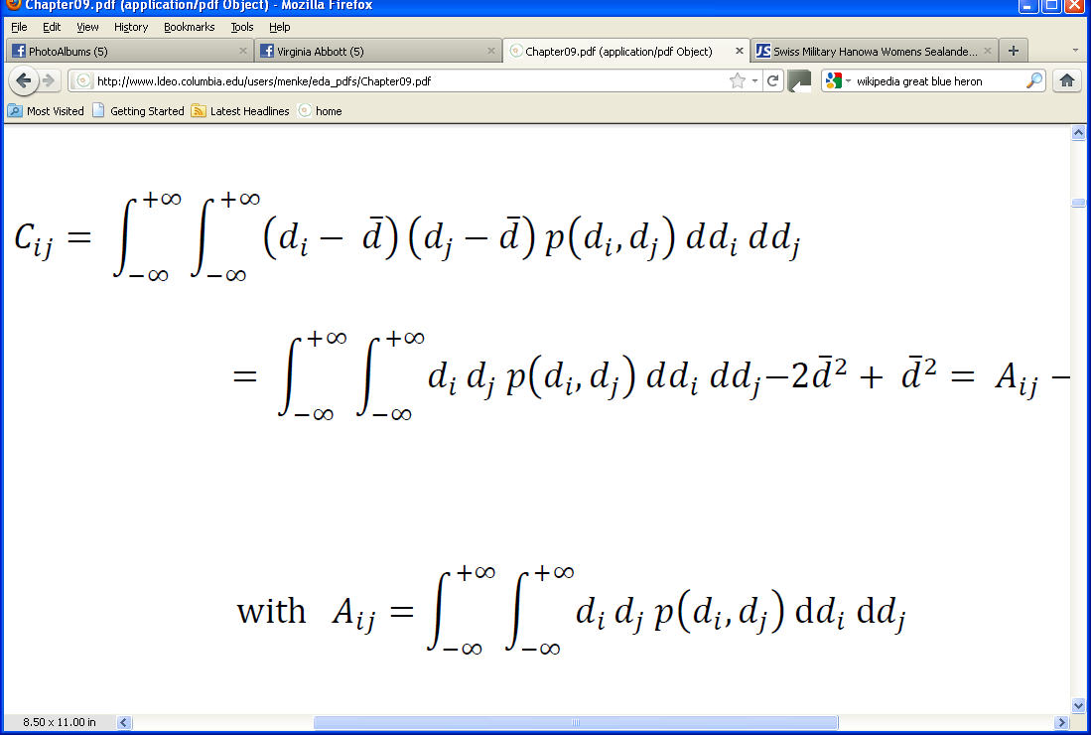
usual formula for the covariance
assuming time series has zero mean

Slide 33
now assume that the time series is stationary
(statistical properties don’t vary with time) so that covariance depends only on time lag between samples

Slide 34
time series of length N time lag of (k-1)Δt

Slide 35
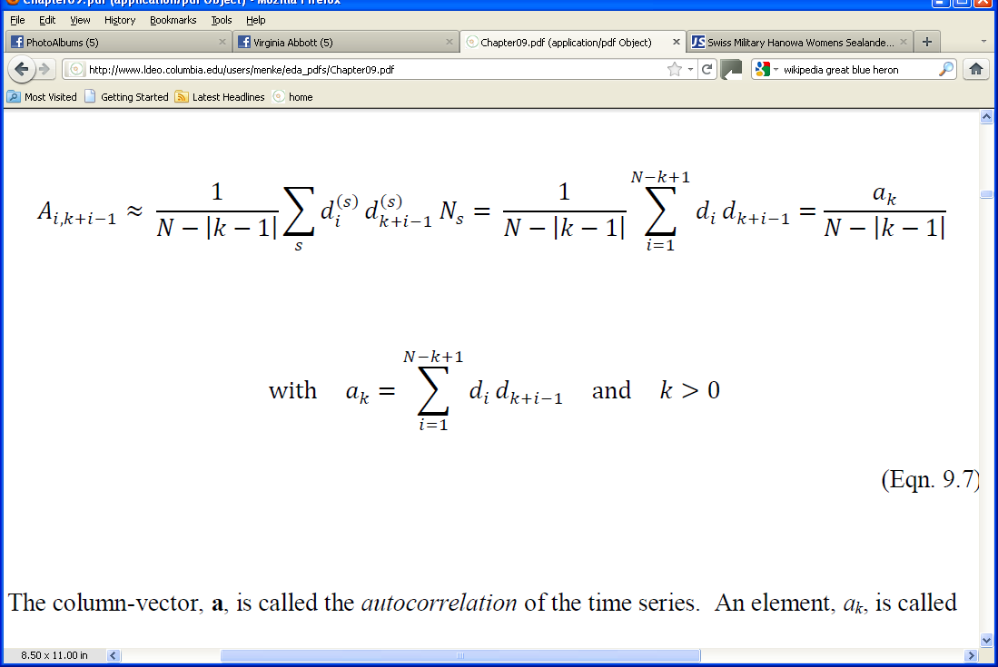
using the same approximation for the sample covariance as before
1

Slide 36
using the same approximation for the sample covariance as before
1
autocorrelation
at lag (k-1)Δt

Slide 37
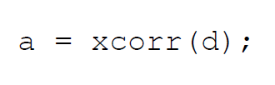
autocorrelation in MatLab

Slide 38
Autocorrelation on Neuse River Hydrograph
Notes:
Autocorrelation function of the Neuse River hydrograph. A) Lags up to one month. Note that the autocorrelation decreases with lag. B) Lags up to ten years. Note that the autocorrelation oscillates with a period of one year, reflecting the seasonal cycle.. The autocorrelation function has been adjusted for the decrease in overlap at the larger lags.

Slide 39
Autocorrelation on Neuse River Hydrograph
symmetric about zero
a point in a time series correlates equally well with another in the future and another in the past
Notes:
The autocorrelation function is symmetric about a lag of zero.

Slide 40
Autocorrelation on Neuse River Hydrograph
peak at zero lag
a point in time series is perfectly correlated with itself
Notes:
The autocorrelation function is peaked at a lag of zero.

Slide 41
Autocorrelation on Neuse River Hydrograph
falls off rapidly in the first few days
lags of a few days are highly correlated because the river drains the land over the course of a few days
Notes:
In the case of the Neuse River hydrograph, the autocorrelation function decreases with lag for the first 10-20 days.

Slide 42
Autocorrelation on Neuse River Hydrograph
negative correlation at lag of 182 days
points separated by a half year are negatively correlated
Notes:
In the case of the Neuse River hydrograph, the autocorrelation function reaches a minimum at a lag of 182 days = ½ year.

Slide 43
Autocorrelation on Neuse River Hydrograph
positive correlation at lag of 360 days
points separated by a year are positively correlated
Notes:
In the case of the Neuse River hydrograph, the autocorrelation has a small peak at a lag of one year.

Slide 44
Autocorrelation on Neuse River Hydrograph
repeating pattern
A)
B)
the pattern of rainfall approximately repeats annually
Notes:
In the case of the Neuse River hydrograph, the autocorrelation function oscillates with a period of one year.

Slide 45
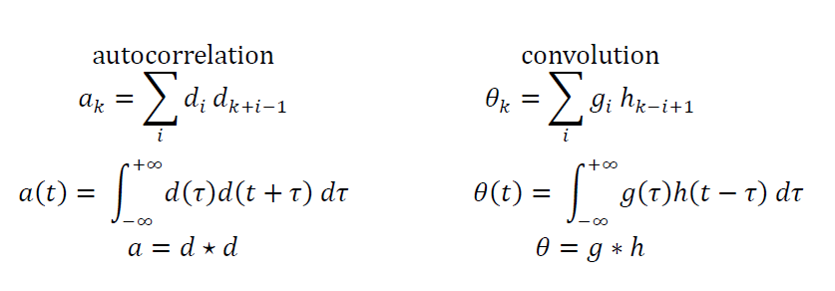
autocorrelation similar to convolution
Notes:
The formula for the autocorrelation is very similar to the formula for the convolution.
Note that we have written an integral version, modeled after the integral version of the convolution.
We use a five-pointed start to indicate autocorrelation, an asterisk to indicate convolution.

Slide 46
autocorrelation similar to convolution
note difference in sign
Notes:
The only difference is the sign.

Slide 47
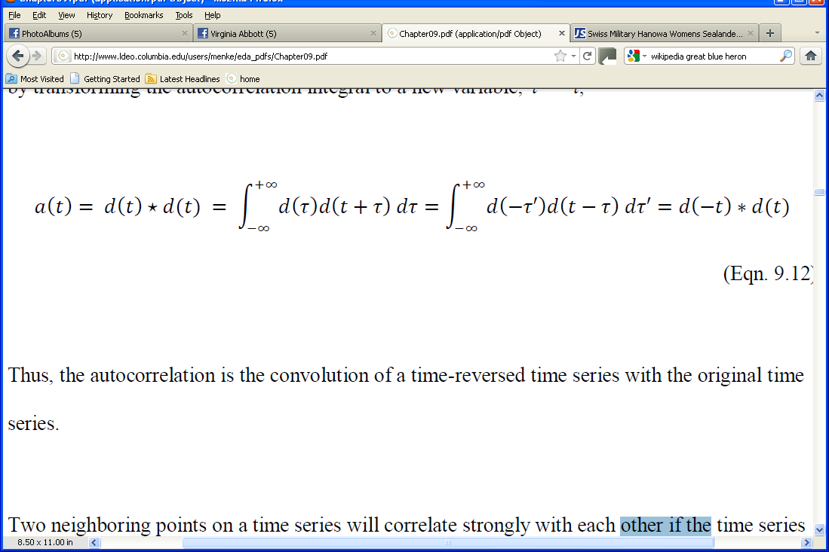
Important Relation #1 autocorrelation is the convolution of a time series with its time-reversed self
Notes:
The relationship between the two.

Slide 48
Notes:
The derivation involves writing down the integral form of the convolution and changing variables so that
it takes on the form of the convolution.

Slide 49
integral form of autocorrelation
Notes:
Write down the integral form of the autocorrelation.

Slide 50
integral form of autocorrelation
change of variables, t’=-t
Notes:
Change variables.

Slide 51
integral form of autocorrelation
change of variables, t’=-t
write as convolution
Notes:
Note that the results is a convolution.

Slide 52
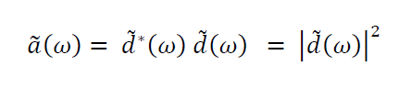
Important Relationship #2
Fourier Transform of an autocorrelation is proportional to the
Power Spectral Density of time series

Slide 53
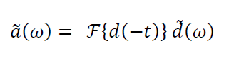
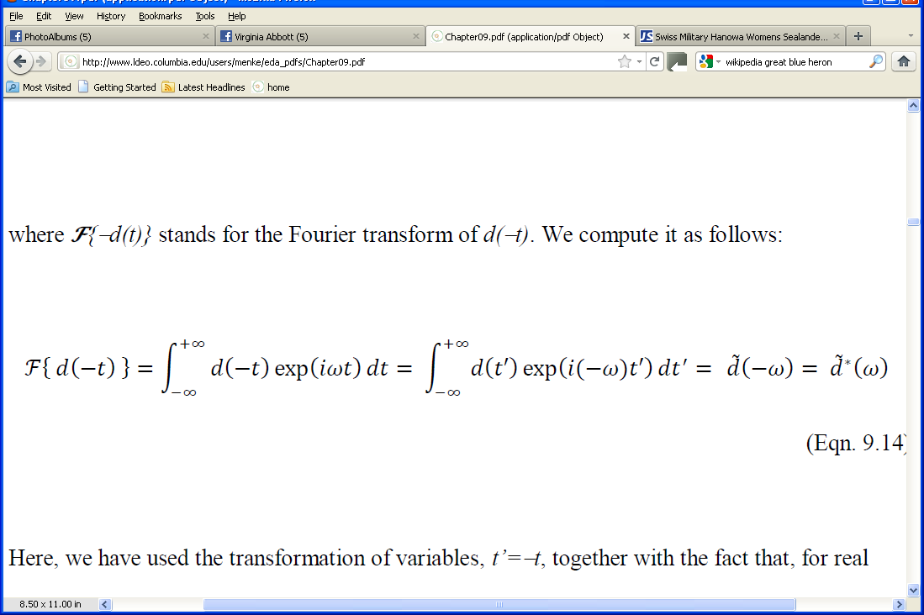
so
since
Notes:
Here the curly-F stands for taking the Fourier Transform.

Slide 54
so
since
Notes:
Here the curly-F stands for taking the Fourier Transform.

Slide 55
so
Fourier Transform of a convolution is product of the transforms
since
Notes:
This is a simple application of the convolution theorem.

Slide 56
so
Fourier Transform of a convolution is product of the transforms
since
Fourier Transform integral
Notes:
Write down the integral version of the Fourier Transform of d(-t).

Slide 57
so
Fourier Transform of a convolution is product of the transforms
since
Fourier Transform integral
transform of variables, t’=-t
Notes:
Change variables and identify the results as a function of –ω.

Slide 58
so
Fourier Transform of a convolution is product of the transforms
since
Fourier Transform integral
transform of variables, t’=-t
symmetry properties of Fourier Transform
Notes:
For the Fourier Transform of a real quantity, the negative frequencies are the complex conjugate of the positive frequencies.

Slide 59
Summary
rapidly fluctuating time series
time
narrow autocorrelation function
lag
0
wide spectrum
0
frequency
Notes:
If the time series is rapidly fluctuating, then only points with small lags are correlated and the autocorrelation function is narrow.
The spectrum of a rapidly fluctuating time series is wide.

Slide 60
Summary
slowly fluctuating time series
time
wide autocorrelation function
lag
0
narrow spectrum
0
frequency
Notes:
If the time series is slowly fluctuating, then points with large lags are correlated and the autocorrelation function is wide.
The spectrum of a slowly fluctuating time series is narrow.

