Slide 1
Environmental Data Analysis with MatLab
Lecture 22:
Hypothesis Testing
Notes:
Today’s lecture treats the subject of interpolation.

Slide 2
Housekeeping
Last home assigned today
Due next Monday
Factor Analysis Worksheet
Available today

Slide 3
SYLLABUS
Lecture 01 Using MatLab
Lecture 02 Looking At Data
Lecture 03 Probability and Measurement Error
Lecture 04 Multivariate Distributions
Lecture 05 Linear Models
Lecture 06 The Principle of Least Squares
Lecture 07 Prior Information
Lecture 08 Solving Generalized Least Squares Problems
Lecture 09 Fourier Series
Lecture 10 Complex Fourier Series
Lecture 11 Lessons Learned from the Fourier Transform
Lecture 12 Power Spectral Density
Lecture 13 Filter Theory
Lecture 14 Applications of Filters
Lecture 15 Factor Analysis
Lecture 16 Orthogonal functions
Lecture 17 Covariance and Autocorrelation
Lecture 18 Cross-correlation
Lecture 19 Smoothing, Correlation and Spectra
Lecture 20 Coherence; Tapering and Spectral Analysis
Lecture 21 Interpolation
Lecture 22 Hypothesis testing
Lecture 23 Hypothesis Testing continued; F-Tests
Lecture 24 Confidence Limits of Spectra, Bootstraps

Slide 4
purpose of the lecture
to introduce
Hypothesis Testing
the process of determining the statistical significance of results

Slide 5
Part 1
motivation
random variation as a spurious source of patterns

Slide 6
d
x

Slide 7
looks pretty linear
d
x

Slide 8
actually, its just a bunch of random numbers!
figure(1);
for i = [1:100]
clf;
axis( [1, 8, -5, 5] );
hold on;
t = [2:7]';
d = random('normal',0,1,6,1);
plot( t, d, 'k-', 'LineWidth', 2 );
plot( t, d, 'ko', 'LineWidth', 2 );
[x,y]=ginput(1);
if( x<1 )
break;
end
end
the script makes plot after plot, and lets you stop when you see one you like

Slide 9
the linearity was due to random variation!

Slide 10
4 more random plots
d
d
x
x
d
d
x
x

Slide 11
scenario test of a drug
Group A
Group B
given drug at start of illness
given placebo at start of illness

Slide 12
Group A
Group B
average length of illness after taking drug
average length of illness after taking placebo
4.1 days
5.2 days

Slide 13
the logic
people’s immune systems differ
some naturally get better faster than others
perhaps the drug test just happened
by random chance -
to have naturally faster people in Group A
?

Slide 14
How much confidence should you have that the difference between 4.1 and 5.2 is not due to random variation
?

Slide 15
67%
90%
95%
99%

Slide 16
67%
90%
95%
99%
1 in 20 chance that the difference was caused by random variation
minimum standard

Slide 17
the goal of this lecture is to develop techniques for quantifying the probability that a result is not due to random variation

Slide 18
Part 2
the distribution of the total error

Slide 19
individual error
e_{i} = d_{i}^{obs} - d_{i}^{pre}
total error
E = Σ _{i=1}^{N} e_{i}²

Slide 20
individual error
e_{i} = d_{i}^{obs} - d_{i}^{pre}
Normal p.d.f.
total error
E = Σ _{i=1}^{N} e_{i}²
Not Normal.

Slide 21
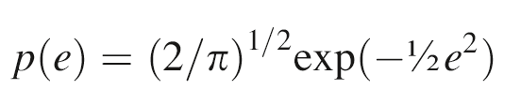
simplest case
N=1
individual error, e
Normal p.d.f.
zero mean
unit variance
assumes e>0
(since sign goes away when we square it)

Slide 22
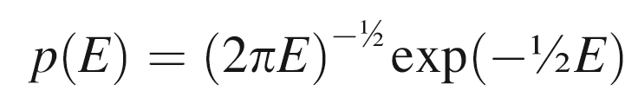
total error, E=e²
p(E)= p[e(E)] |de/dE|
e=E ^{½} so de/dE = ½E ^{-½}

Slide 23
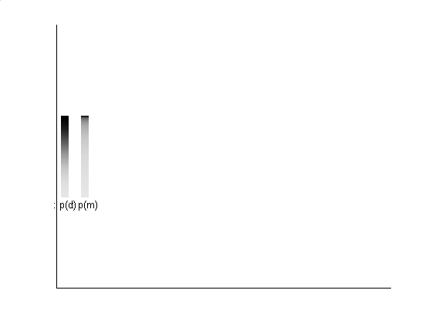
probability squeezed toward 0
p(e)
p(E)

Slide 24
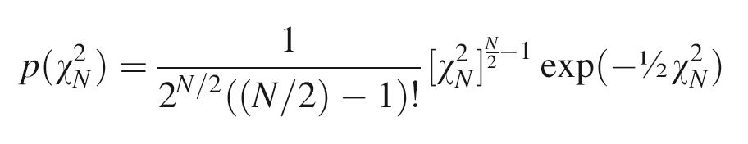
general case of N>1 tedious to compute, but not mysterious
total error
E = χ_{N}² = Σ _{i=1}^{N} e_{i}²

Slide 25
general case of N>1 tedious to compute, but not mysterious
total error
E = χ_{N}² = Σ _{i=1}^{N} e_{i}²
E called chi-squared when e_{i} is Normally-distributed with zero mean and unit variance
called chi-squared p.d.f

Slide 26
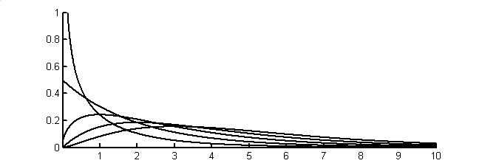
N=1
p(χ_{N}²)
2
3
4
5
χ²
Notes:
Chi-squared probability density function for N=1, 2, 3, 4, and 5.

Slide 27
N=1
case we just worked out
p(χ_{N}²)
2
3
4
5
χ²
Notes:
Chi-squared probability density function for N=1, 2, 3, 4, and 5.

Slide 28
Chi-Squared p.d.f.
N called “the degrees of freedom”
mean N
variance 2N

Slide 29
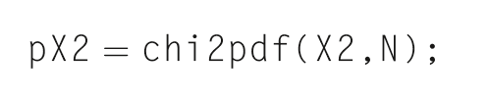
In MatLab

Slide 30
Four Important Distributions used in hypothesis testing

Slide 31
#1 p(Z) with Z=e
Normal distribution for a quantity Z with zero mean and unit variance
Normally-distributed with zero mean and unit variance

Slide 32
if d is Normally-distributed with mean d and variance σ²_{d}
then Z = (d-d)/ σ_{d} is Normally-distributed with zero mean and unit variance

Slide 33
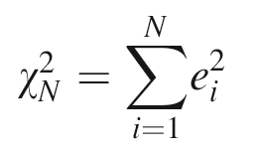
#2
p(χ_{N}²) with
the chi-squared distribution, which we just worked out

Slide 34
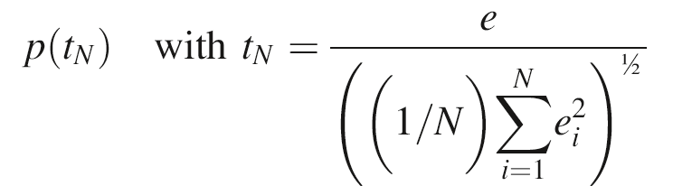
#3
a new distribution, called the
“t-distribution’

Slide 35
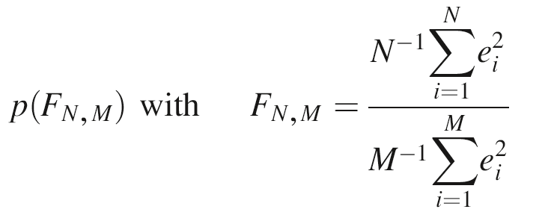
#4
another new distribution, called the
“F-distribution’

Slide 36
t-distribution
N=5
p(t_{N})
N=1
t_{N}
Notes:
Student’s t-probability density function for N=1, 2, 3, 4, and 5.

Slide 37
t-distribution
N=5
wider tailed than a Normal p.d.f.
p(t_{N})
N=1
t_{N}
Notes:
Student’s t-probability density function for N=1, 2, 3, 4, and 5.

Slide 38
F-distribution
p(F_{N,2})
N=2
50
F
N=2
50
p(F_{N,5})
F
p(F_{N,25})
N=2
50
F
p(F_{N,50})
N=2
50
F
Notes:
F-probability density function, p(F_{N,M}), for selected values of M and N.

Slide 39
F-distribution
skewed at low N and M
p(F_{N,2})
N=2
50
F
N=2
50
p(F_{N,5})
F
p(F_{N,25})
N=2
50
F
p(F_{N,50})
N=2
50
F
starts to look Normal at high N and M
Notes:
F-probability density function, p(F_{N,M}), for selected values of M and N.

Slide 40
Part 4
Hypothesis Testing

Slide 41
Step 1. State a Null Hypothesis some variation of the result is due to random variation

Slide 42
Step 1. State a Null Hypothesis some variation of the result is due to random variation
e.g.
the means of the Group A and Group B are different only because of random variation

Slide 43
Step 2. Focus on a quantity that is unlikely to be large when the Null Hypothesis is true

Slide 44
Step 2. Focus on a quantity that is unlikely to be large when the Null Hypothesis is true
called a “statistic”

Slide 45
Step 2. Focus on a quantity that is unlikely to be large when the Null Hypothesis is true
e.g.
the difference in the means Δm=(mean_{A} – mean_{B}) is unlikely to be large if the Null Hypothesis is true

Slide 46
Step 3.
Determine the value of statistic for your problem

Slide 47
Step 3.
Determine the value of statistic for your problem
e.g.
Δm = (mean_{A} – mean_{B}) = 5.2 – 4.1 = 1.1

Slide 48
Step 4.
Calculate that the probability that a the observed value or greater would occur if the Null Hypothesis were true

Slide 49
Step 4.
Calculate that the probability that a the observed value or greater would occur if the Null Hypothesis were true
P( Δm ≥ 1.1 ) = ?

Slide 50
Step 4.
Reject the Null Hypothesis if such large values occur less than 5% of the time

Slide 51
Step 4.
Reject the Null Hypothesis if such large values occur less than 5% of the time
rejecting the Null Hypothesis means that your result is unlikely to be due to random variation

Slide 52
Part 5
An example
test of a particle size measuring device

Slide 53
manufacturer's specs
machine is perfectly calibrated
particle diameters scatter about true value
measurement error is
σ_{d}² = 1 nm²

Slide 54
your test of the machine
purchase batch of 25 test particles
each exactly 100 nm in diameter
measure and tabulate their diameters
repeat with another batch a few weeks later

Slide 55
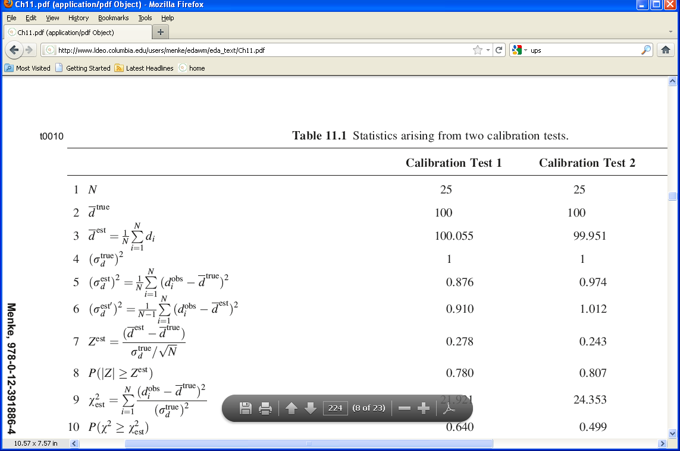
Results of Test 1

Slide 56
Results of Test 2

Slide 57
Question 1
Is the Calibration Correct?
Null Hypothesis
The observed deviation of the average particle size from its true value is due to random variation (as contrasted to a bias in the calibration).

Slide 58
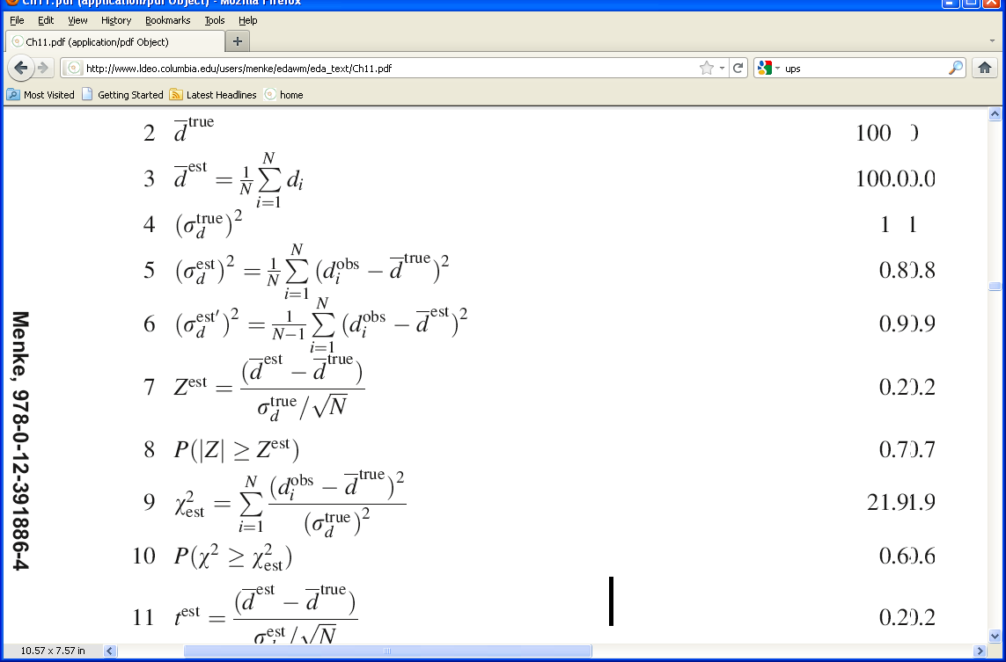
assume that the measurement error is Normally-distributed with zero mean and variance 1 nm²
the mean of 25 measurements has variance
1 nm² / √25
the quantity
is Normal with zero mean and unit variance

Slide 59
in our case
= 0.278 and 0.243
the key question is
Are these unusually large values for Z ?

Slide 60
in our case
= 0.278 and 0.243
the key question is
Are these unusually large values for Z ?
actually, its immaterial whether d^{est} is bigger or smaller than d^{true} =100, but only whether they’re different
so we should really ask whether |Z^{est}|
is unusually large

Slide 61
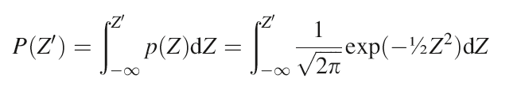
P(Z’) is the cumulative probability from
-∞ to Z’
p(Z)
Z
0
Z’

Slide 62
The quantity we want is
P( |Z| > Z^{est} )
p(Z)
Z
0
-Z^{est}
Z^{est}
which is
1 – [P(Z^{est}) - P(-Z^{est})]

Slide 63
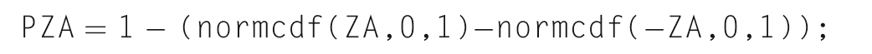
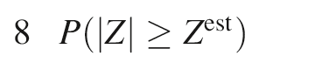
In MatLab
= 0.780 and 0.807
So values of |Z| greater than Z^{est} are very common

Slide 64
In MatLab
= 0.780 and 0.807
So values of |Z| greater than Z^{est} are very common
The Null Hypotheses cannot be rejected

Slide 65
Question 2
Is the variance in spec?
Null Hypothesis
The observed deviation of the variance from its true value of 1 nm² is due to random variation (as contrasted to the machine being noisier than the specs).

Slide 66
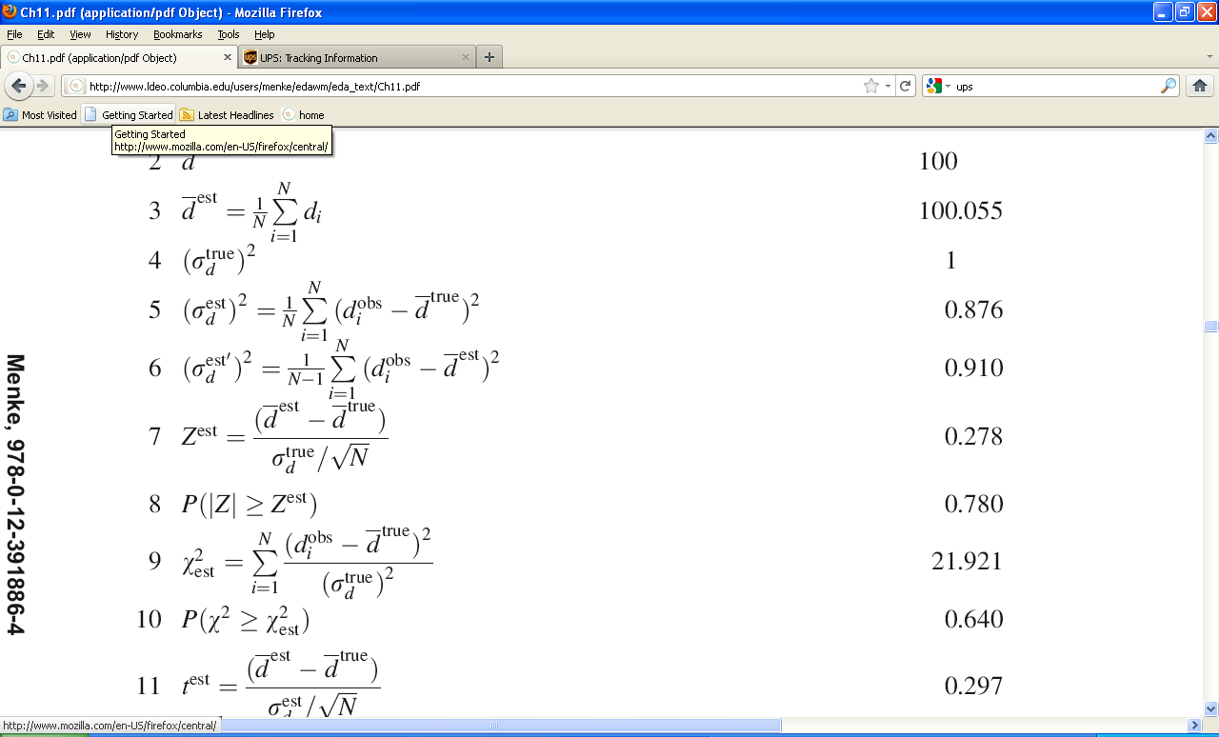
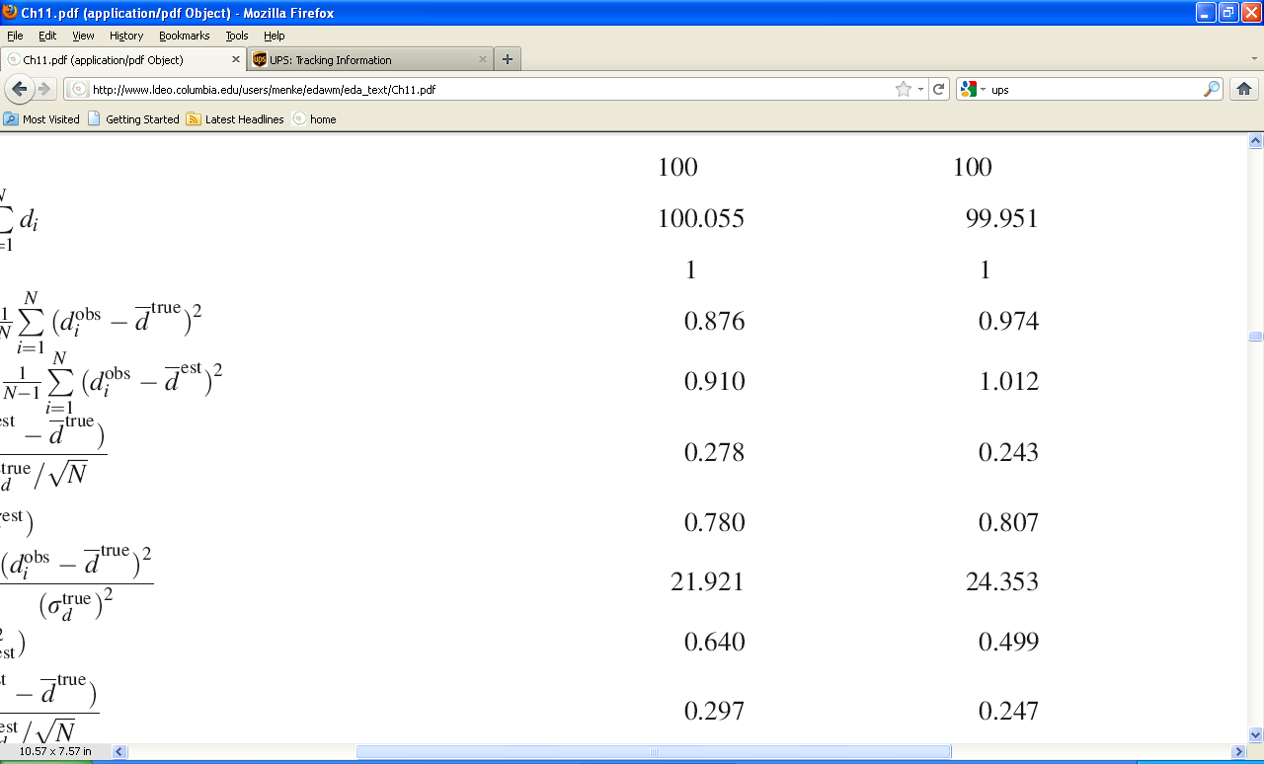
Results of the two tests

Slide 67
Results of the two tests
zero mean
unit variance

Slide 68
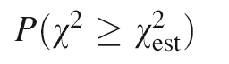
= ?
in our case
the key question is
Are these unusually large values for χ² ?

Slide 69
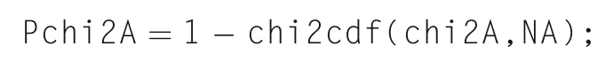
In MatLab
= 0.640 and 0.499

Slide 70
In MatLab
= 0.640 and 0.499
So values of χ² greater than χ_{est}² are very common
The Null Hypotheses cannot be rejected

Slide 71
we will continue this scenario in the next lecture

