Slide 1
Environmental Data Analysis with MatLab
2nd Edition

Slide 2
Course Goals
Make you comfortable with the analysis of numerical data through practice
Teach you a set of widely-applicable data analysis techniques
Provide the strategies for applying what you’ve learned to your own datasets
Notes:
Emphasize that the only way that students will learn to actually apply data analysis is to do the homework, which is based on actual data

Slide 3
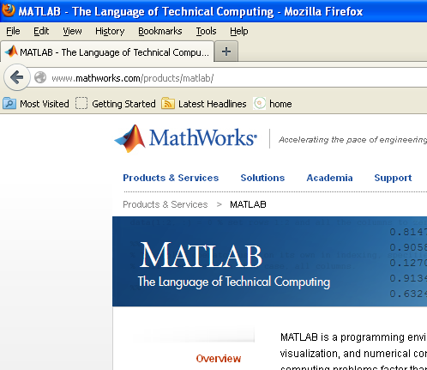
software
MatLab available on-line
Notes:
Matlab is a commercial software product of the MathWorks Inc.

Slide 4
SYLLABUS
Lecture 01 Using MatLab
Lecture 02 Looking At Data
Lecture 03 Probability and Measurement Error
Lecture 04 Multivariate Distributions
Lecture 05 Linear Models
Lecture 06 The Principle of Least Squares
Lecture 07 Prior Information
Lecture 08 Solving Generalized Least Squares Problems
Lecture 09 Fourier Series
Lecture 10 Complex Fourier Series
Lecture 11 Lessons Learned from the Fourier Transform
Lecture 12 Power Spectra
Lecture 13 Filter Theory
Lecture 14 Applications of Filters
Lecture 15 Factor Analysis
Lecture 16 Orthogonal functions
Lecture 17 Covariance and Autocorrelation
Lecture 18 Cross-correlation
Lecture 19 Smoothing, Correlation and Spectra
Lecture 20 Coherence; Tapering and Spectral Analysis
Lecture 21 Interpolation
Lecture 22 Linear Approximations and Non Linear Least Squares
Lecture 23 Adaptable Approximations with Neural Networks
Lecture 24 Hypothesis testing
Lecture 25 Hypothesis Testing continued; F-Tests
Lecture 26 Confidence Limits of Spectra, Bootstraps
Notes:
24 lectures

Slide 5
Today’s Lecture
Part 1: Starting to Look at Data
Part 2: Using MatLab
Notes:
Today is an introduction. A teaser on analyzing an interesting data set, then a drier MatLab tutorial.

Slide 6
Part 1
Starting to Look at Data
Notes:
This tutorial is based on a little example I (Bill Menke) recently worked up. See
Teaching Students to Look at Their Data - A Tutorial
http://www.ldeo.columbia.edu/users/menke/talks/datatutorial/index.html

Slide 7
advice even before looking at the data articulate the properties that you expect them to have and then critically examine them in light of your expectations
Notes:
When you begin to look at data, you should think about your data a little.
You probably know at least a little about the data in general.
What should it look like?
Think about the properties should the data have.
Then, as you analyze the data, see whether they meet your expectations.

Slide 8

Case Study: Stream flow of the Hudson River
Notes:
Photo of the Hudson River, near Albany NY

Slide 9
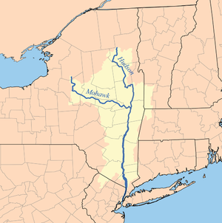
Hudson River
Albany
Watershed:
14,000 sq mi
(36,260 km²)
source: Wikipedia
Notes:
Map of the Hudson River.
Rain falls on land and runs downhill into river.
The land that supplies the river is called its watershed.
Shaded area is the Hudson’s watershed.
But only part of it delivers water to the river above Albany, the point we will focus upon.

Slide 10
discharge
amount of water per unit time
that passes a specific point on the river bank
measured in m³/s
Notes:
How do you quantify the amount of water flowing in a river?
Volume of water per unit time ... called discharge
measured in cubic meters per second

Slide 11
What properties would you expect discharge to have?
Notes:
The idea here is to try to connect the data, discharge, to physical
properties of the river system

Slide 12
What properties would you expect discharge to have?
water flows in one direction – down hill
discharge positive
stream flow fairly steady over minutes hours
more variable over days and weeks
stream flow increases after a period of rain
Notes:
Here are three important properties of discharge that one might surmise by recollecting a river
its sign – always positive
it period of variability – steady over a few minutes, variable over weeks and seasons
increase after rain – because rain in the source of river water

Slide 13
What about the typical size of discharge?
Notes:
the size of the measurement is also important.
is it ten cubic meters per second or a million?

Slide 14
What about the typical size of discharge?
v
h
w
slab of water of volume
w×h×v
flows by per unit time
Notes:
Quick back of the envelope envelope calculation to determine the size of discharge.
Think of the water moving in a river as sequence of many “slabs”,
each moving downhill through the river channel.
The discharge is the volume a slab that is “one second” long,
that is, it passes by an observer in one second.
That’s its area time its velocity

Slide 15
What about the typical size of discharge?
1 m/s
10 m
100 m
discharge = w×h×v = 1000 m³/s
Notes:
Putting some reasonable numbers in, typical of a largish river,
we find that a typical discharge should be around 1000 cubic meters per second.
Emphasize the importance of the units.
Always follow up a number like 1000 with units like cubic meters per second.

Slide 16
What might a plot of discharge vs. time look like?
Try to sketch one.
Include units on both axes
Imagine that there’s a few days of rain during the time period of your sketch
Notes:
Ask the class to sketch a plot of discharge vs. time.
You won’t collect it. Its just to get the students thinking about discharge data.

Slide 17
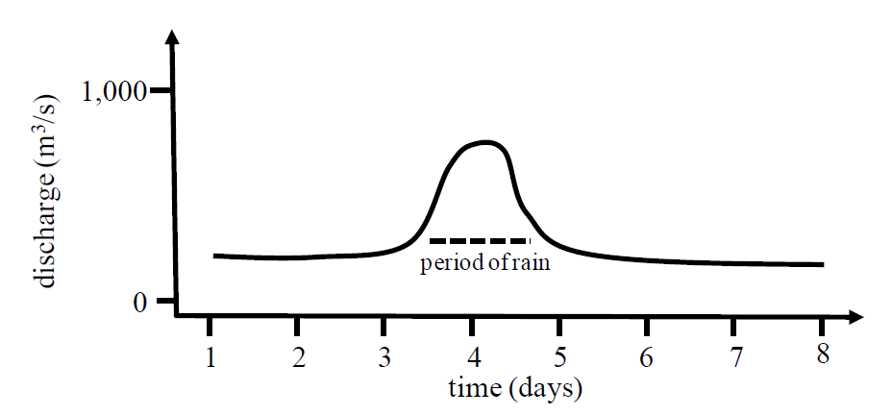
Notes:
Here’s my sketch.
It’s is just my expectation of what discharge might look like.
But being able to make a sketch plot like this is really important.

Slide 18
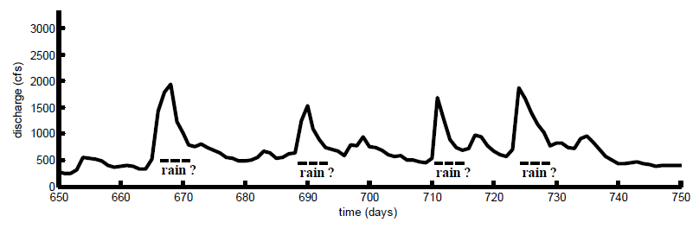
actual discharge for Hudson River at Albany
(time in days after Jan 1, 2002)
Notes:
Here’s some actual discharge data
Note:
time scale: 100 days of data
discharge scale: 0 (no flow) to 3000 (high flow) cubic meters per second
Note the peaks, these are likely periods of rain

Slide 19
What properties would you expect precipitation to have?
precipitation is a positive quantity
time scale of rain very short – minutes to hours
rainy days and dry days
heavy rain is a few inches of rain in a day
Notes:
Now do the same sort of analysis for precipitation.
And sketch a plot of precipitation vs. time.
Line it up with your discharge plot, for comparison.

Slide 20
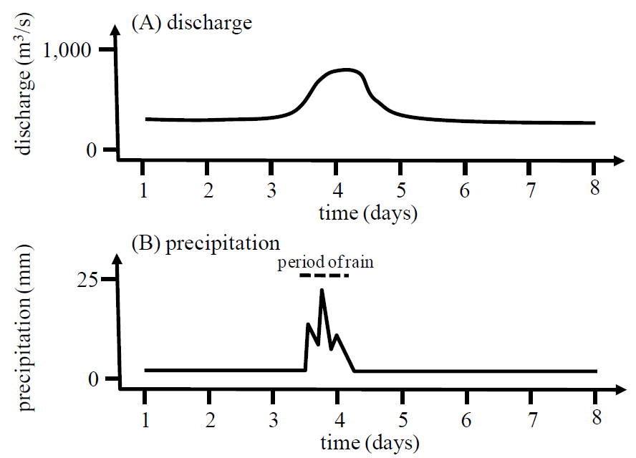
Notes:
Note, I’ve sketched the precipitation to have more short period variability than discharge.

Slide 21
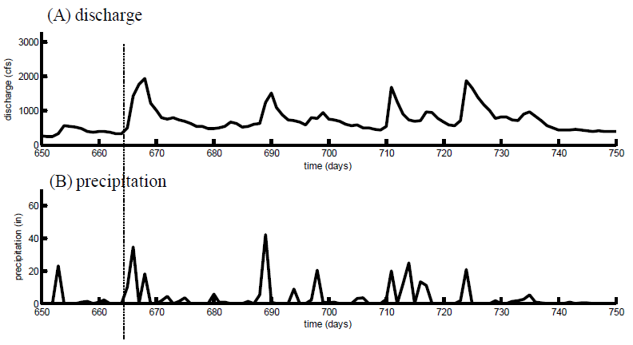
actual precipitation in Albany NY
Notes:
Here’s the actual data for Albany.

Slide 22
do the graphs meet your expectations?
Notes:
Does it meet your expectations?

Slide 23
pattern of peaks similar but not exact
highest discharge
highest precipitation
Why?

Slide 24
pattern of peaks similar but not exact
highest discharge
highest precipitation
Why? Rain at Albany an imperfect proxy for rain over watershed

Slide 25
shape of peaks different
longer pulse with steep rise
and slow decline
short pulse
Why?

Slide 26
shape of peaks different
longer pulse with steep rise
and slow decline
short pulse
Why? Rain takes time to drain from the land
Notes:
Note that the shapes of a pulse in rain and the corresponding pulse in discharge are not
quite the same, because it takes time for the water to train from the land into the river.
Discharge has a ‘tail’ (period of slow decline) after the rain stops.

Slide 27
predict discharge from precipitation
Notes:
Here’s something you might want to do with precipitation data:
Predict discharge on the basis of rain.

Slide 28
predict discharge from precipitation
rain takes time to flow
from the land
to the river
Notes:
It’s important to build into your thinking the idea of the delay.
Rainwater takes time to flow from the land into the river.

Slide 29
predict discharge from precipitation
rain takes time to flow
from the land
to the river
the discharge today
depends upon
precipitation over the last few days
Notes:
So discharge today depends not only on precipitation today,
but over the last few days

Slide 30
now for an example of
of advanced data analysis method
(which we will eventually get to in this course)
which help explore this relationship
Notes:
The object is not for students to fully understand this part of the example,
but only see that the data analysis techniques that they will later learn
can be quite powerful in exploring relationships between data

Slide 31
its mathematical expression: discharge d is a running average of precipitation p
physical idea:
discharge is delayed
since rainwater takes time to flow
from the land to the river
Notes:
Mathematically, this might be considered a running average.
Discharge one a given day is a running average of
precipitation during the last few days/

Slide 32
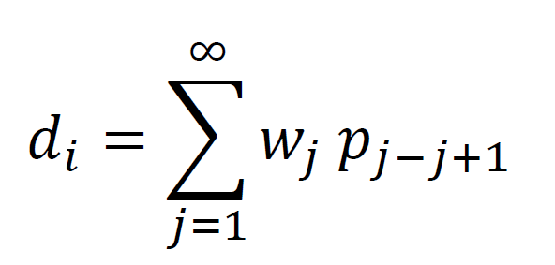
discharge
precipitation
sum
d
p
today
for that day
for that day
present and past days
weights
in the running average
Notes:
formula for a running average
discharge “d” today
is sum of precipitation “p” on present and past days
weighted by a factor “w”.
“w” is different for each day, but is larger for days in the “recent” past than the “deep past”
since most of the rainwater flows to the land quickly, in the first few days.

Slide 33
example d₅ = w₁p₅ + w₂p₄ + w₃p₃ ...
discharge on day i
precipitation in the past
weights
Notes:
formula for a running average
di, discharge on day i, now with indices
writing the sum out for one illustrative day, say day 5
discharge on day 5 =
precipitation on day 5, times a weight w1
plus
precipitation on day 4, times a weight w2
plus
precipitation on day 3, times a weight w3
and so forth

Slide 34
so the details behind the idea that
rainwater takes time to drain from the land are captured by the weights
w₁ w₂ w₃ w₄ ...
Notes:
The weights w1, w2, w3, ... embody the idea that rainwater takes time
to run from the land to the river.
If we knew the weights, we could predict discharge from the precipitation.
In this class, we will eventually get to the point where we could calculate the weights
based on a time period where we observed both precipitation and discharge
we could then use these weights for other periods of time, too, where we had
precipitation but nit discharge.
For now, we will simply guess a set of weights, and see how we do.

Slide 35
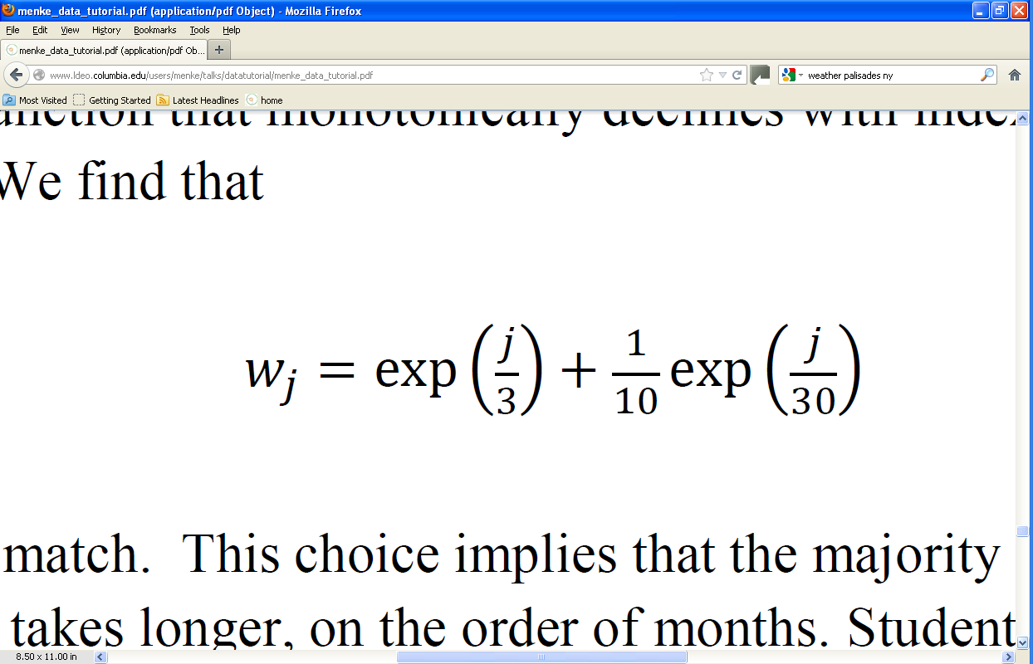
only recent precipitation affects discharge
weights decline exponentially with time in the past
c
T₁
T₂
weights determined by trial and error
Notes:
Here’s a reasonable formula for w (but just a guess).
Since we expect recent precipitation to be the most important,
the weights should decline with days, so let’s use a sum of two declining exponentials.
The term exp(j/T1) corresponds to weights that die away with a characteristic time scale of T1 days.
Similarly, the term exp(j/T2) corresponds to weights that die away with a characteristic time scale of T2 days.
The two exponentials are added together with a constant c, which controls the relative importance of the longer time scale.
Now we find the constants T1, T2 and c by trial and error.

Slide 36
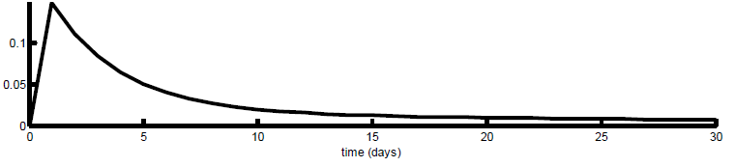
time j
Notes:
The term exp(j/3) corresponds to weights that die away with a characteristic time scale of 3 days.
Similarly, the term exp(j/30) corresponds to weights that die away with a characteristic time scale of 30 days.
The long time scale is less important, so it has a coefficient of 1/10.

Slide 37
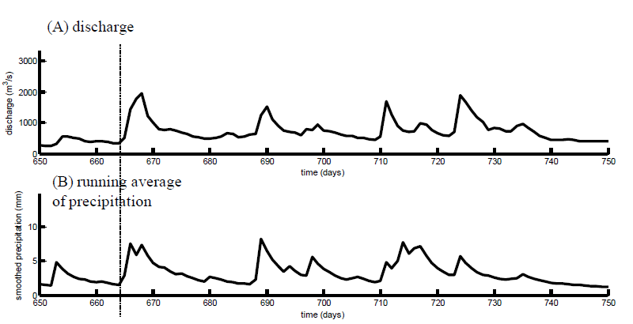
Notes:
Here’s the resulting prediction

Slide 38
Part 2:
Using MatLab
Notes:
This would be a good time to provide the students with advice on how they can get a copy of MatLab, e.g. through a school software license or by purchasing it on their own.

Slide 39
goals of the lecture
get you started using
MatLab
as a tool for analyzing data
Notes:
This lecture just teaches the bare essentials. Furthermore, everything is presented in terms of
commands typed into the MatLab Command Window, rather than through manipulation of the
MatLab GUI (Graphical User Interface). But by all means, encourage the students to take advantage
of the functionality provided by the GUI.

Slide 40
MatLab Fundamentals
Notes:
Emphasize that this lecture covers just enough to get people going.

Slide 41
prompt
The Command Window
Place where you type commands and MatLab displays answers and other information. For example:
>> date
ans =
22-Mar-2011
you type this
MatLab replies with this
Notes:
Mention that the prompt shows you where to type the next command.

Slide 42
Files and Folders
Provide a way to organize your data and data analysis products
- use meaningful and predictable names
- design a folder hierarchy that helps you keep track of things
Notes:
Mention that “folders” are also called “directories”.

Slide 43
Example:
file/folder structure used by text
main folder
chapter folders
chapter files and
section folders
section files
eda
ch01
ch02
file
file
. . .
v
ch03
. . .
v
file
sec02_01
. . .
file
file
. . .
Notes:
Point out that the large boxes represent folders, the small ones files.
Also mention the usefulness of predictable folder and file names.

Slide 44
Commands for Navigating Folders
pwd
cd c:/menke/docs/eda/ch01
cd ..
cd ch01
dir
displays current folder
change to a folder in a specific place
change to the parent folder
change to the named folder that within the current one
display all the files and folders in the current folder
Notes:
Students should be encouraged to use the MatLab GUI to navigate, too. But they should learn these commands, too, since can be used within scripts.

Slide 45
Simple Arithmetic
a=3.5;
b=4.1;
c=a+b;
c
c =
7.6000
you type this
MatLab replies with this
Notes:
Mention that the semicolon suppresses the displaying of a value. The final command displays the results. It is used in preference to omitting the semicolon on the previous line because, in a script, the editing of a working command can introduce errors. Its better to have a line that does nothing but display the result.

Slide 46
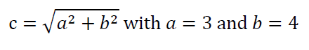
A more complicated formula
a=3;
b=4;
c = sqrt(a^2 + b^2);
c
c =
5
you type this
MatLab replies with this
Notes:
Mention that ^ is used to indicate a power, that is b^2 is b squared.
Mention that the square root is treated as a function, sqrt().

Slide 47
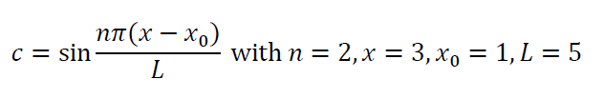
Another complicated formula
n=2; x=3; x0=1; L=5;
c = sin(n*pi*(x-x0)/L);
c
c =
0.5878
you type this
MatLab replies with this
Notes:
Mention the use of nested parenthesis.

Slide 48
MatLab Script
Commands stored in a file with an extension ‘.m’ (an m-file) that can be run as a unit.
Advantages
- Speeds up repetitive tasks
- Can be checked over for correctness
- Documents what you did
Disadvantages:
- Hides what’s actually going on.

Slide 49
Example of a MatLab Script
% eda01_03
% example of simple algebra,
% c=a+b with a=3.5 and b=4.1
a=3.5;
b=4.1;
c=a+b;
c
comments
in m-file eda01_03.m

Slide 50
Running a MatLab Script
>> eda01_03
c =
7.6000
you type this
MatLab replies with this

Slide 51
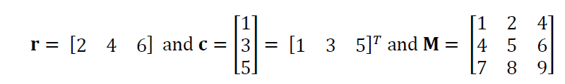
Vectors and Matrices
r = [2, 4, 6];
c = [1, 3, 5]’;
M =[ [1, 4, 7]', [2, 5, 8]', [3, 6, 9]'];
Notes:
Be sure to distinguish row-vectors from column-vectors, since they cannot be interchanged in formulas. Mention that a matrix can be entered in many different ways. The text uses column-vectors in preference to row-vectors, so our preference here is to assemble a matrix from a concatenation of column vectors. But the notation M=[1,2,4;4,5,6;7,8,9]; which views M as a concatenatuon of row-vectors, works as well.

Slide 52
Transpose Operator
Swap rows and columns of an array, so that
Standard mathematical notation: a^{T}
MatLab notation: a’
1
2
3
4
becomes [ 1, 2, 3, 4 ] (and vice versa)
Notes:
Be aware that M’ is actually the Hermitian transpose of M, that is M’=M*’, where * signifies complex conjugation. The distinction is not important for real matrices. The notion M.’ gives the transpose of M without complex conjugation. This should not be mentioned to the class at this point.

Slide 53
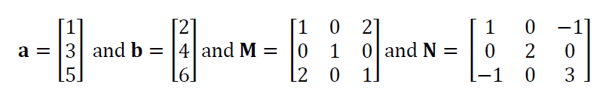
Vector Multiplication
Let’s define some vectors and matrices
a = [1, 3, 5]’;
c = [3, 4, 5]’;
M =[ [1, 0, 2]', [0, 1, 0]', [2, 0, 1]'];
N =[ [1, 0,-1]', [0, 2, 0]', [-1,0, 3]'];

Slide 54
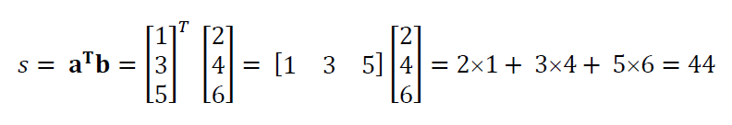
Inner (or Dot) Product
s = a'*b;
Notes:
This part of the lecture should serve to review the basic operations of linear algebra. Show on the board how a row-vector is dotted with a column-vector by draping the row-vector to align with the column-vector, multiplying adjacent elements and adding. Use sweeping hand motions for emphasis. Mention that the dot product of a vector with itself yields the squared length of the vector.

Slide 55
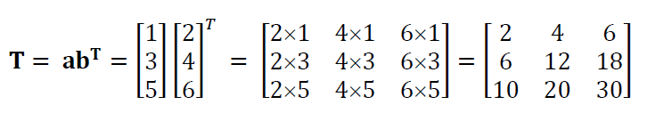
Outer (or Tensor) Product
T = a*b’;
Notes:
Don’t omit discussion of the tensor product. It is really useful for creating useful MatLab matrices.

Slide 56
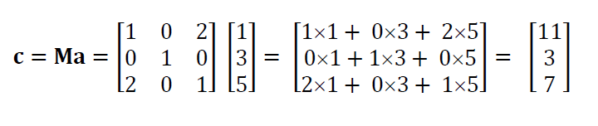
Product of a Matrix and a Vector
c = M*a;
Notes:
Do this one of the board, again with sweeping hand motions, and emphasize it similarity to the dot product. Each tow of the matrix is dotted into the input vector to produce one element of the output vector.

Slide 57
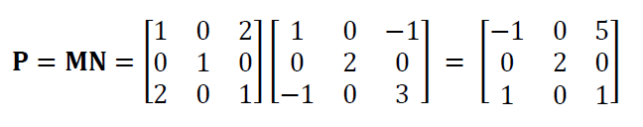
Product of a Matrix and a Matrix
P = M*N;
Notes:
Do this one of the board, again with sweeping hand motions, and emphasize it similarity to the dot product. Each row of the first matrix is dotted into each column of the second matrix, to produce one element of the output matrix.

Slide 58
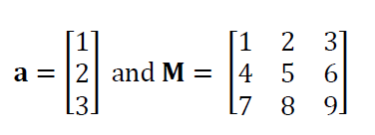
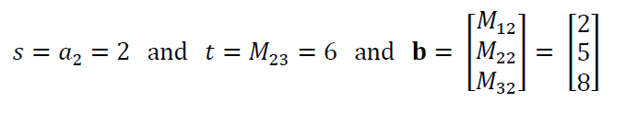
Element Access
s = a(2);
t = M(2,3);
b = M(:,2);
Notes:
Mention that the colon means “the entire row or column”. Mention that a mnemonic for A(row,column) is “Arc”.

Slide 59
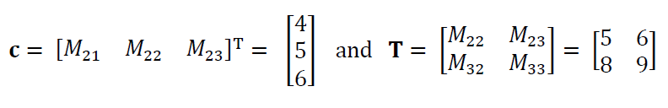
Element Access
c = M(2,:)';
T = M(2:3,2:3);
Notes:
Mention that the 2:3 means “the part of the row or column from element 2 to element 3”. Mention the notation 2:end also works. Mention other uses of the colon notation, e.g. that [1:5]=[1,2,3,4,5] and that [5:-1:1]=[5,4,3,2,1].

Slide 60
Looping
A loop is a mechanism to repeat a group of commands several times, each time with a different value of a variable.
Generally speaking, MatLab vector arithmetic is rich enough that loops usually can be avoided.
However, some people – and especially beginners - find loops to be clearer than the equivalent non-loop commands. If you’re one of them, USE LOOPS, at least at the start.

Slide 61
Example of a FOR Loop
a=[1, 2, 3, 4, 3, 2, 1]’;
b=[3, 2, 1, 0, 1, 2, 3]’;
N=length(a);
Dot product using vector arithmetic
c = a’*b;
Dot product using loop
c = 0;
for i = [1:N]
c = c+a(i)*b(i);
end
Notes:
Go over the functioning of the loop, and especially how the variable i takes on a different value each time through the loop. Mention that for and end need to be paired. Note that our use of the square brackets in [1:N] is unnecessary; we do it to emphasize the presence of a vector. Just 1:N would work as well.

Slide 62
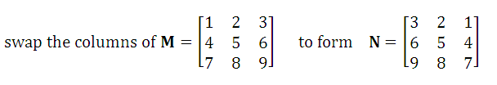
Another Example of a FOR Loop
without looping
N = fliplr(M);
with looping
for i = [1:3]
for j = [1:3]
N(i,4-j) = M(i,j);
end
end
Notes:
Describe how nested loops work. Mention the need to use different variables for each loop. Show on the board that when j=[1,2,3], the quantity 4-j is [3,2,1]. Mention the convenience of a function such as fliplr() and give the students some advice on how to track down useful functions (e.g. using the help command, searching the Web, etc).

Slide 63
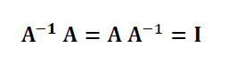
Matrix Inverse
B = inv(A);
Notes:
Remind students that a matrix has to be square to have an inverse.

Slide 64
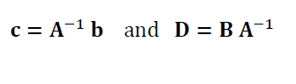
Slash and Backslash Operators
c = A\b;
D = B/A;
Notes:
Point out that the direction of the slash is related to which quantity is in the numerator of the fraction. Mention that the combined quantity (A-inverse)b can be computed more easily than can (A-inverse) itself. The slash and backslash operator smakes use of this efficiency.

Slide 65
Loading Data Files
I downloaded stream flow data from the US Geological Survey’s National Water Information Center for the Neuse River near Goldboro NC for the time period, 01/01/1974-12/31/1985. These data are in the file, neuse.txt. It contains two columns of data, time (in days starting on January 1, 1974) and discharge (in cubic feet per second, cfs). The data set contains 4383 rows of data. I also saved information about the data in the file neuse_header.txt.
Notes:
Mention the importance of maintaining a notes, such as shown here, that describes: 1) where a data file came from; 2) what it contains; and what’s been done to it.

Slide 66
A text file of tabular data is very easy to load into MatLab
D = load(‘neuse.txt’);
t = D(:,1);
d = D(:,2);
Notes:
Mention that you must either be in the directory containing the file (as is assumed here) or given the full pathname of the file. We do not discuss the MatLab Path settings anywhere in the text, but if you want to, this would be a good place.

Slide 67
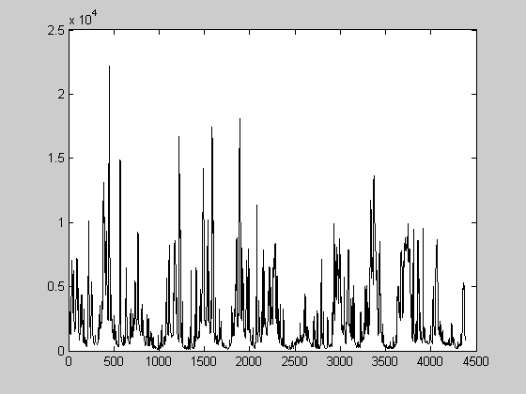
A Simple Plot of Data
plot(t,d);
Notes:
Mention this is a quick plot, using just the default plotting parameters and without any annotations.

Slide 68
A Somewhat Better Controlled Plot
set(gca,'LineWidth',2);
plot(t,d,'k-','LineWidth',2);
title('Neuse River Hydrograph');
xlabel('time in days');
ylabel('discharge in cfs');
make the axes thicker
plot black lines of width 2
title at top of figure
label x axis
label y axis
Notes:
Mention that the ‘k-’ for “black line” is one of many codes for controlling the plotting symbol. Other examples are ‘r:’ for a red dotted line and ‘go’ for green circles. We have noticed that on some Windows operating systems, PDF files of figures will contain extremely thin (and nearly invisible) lines unless the ‘gca’ command is included. This problem may, of course, be fixed in future releases of that operating system.

Slide 69
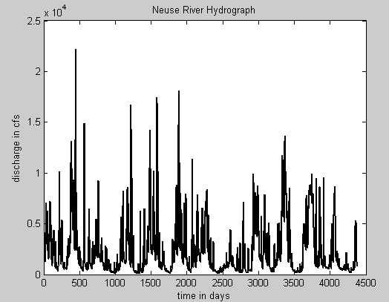

Slide 70
Writing a Data File
example: convert cfs to m³
f=35.3146;
dm = d/f;
Dm(:,1)=t;
Dm(:,2)=dm;
dlmwrite(‘neuse_metric.txt’,Dm,’\t’);
Notes:
Note cfs = cubic feet per second. Mention that a delimiter is the character used to separate numbers. It is set here to a tab, denoted ‘\t’.

Slide 71
Finding and Using Documentation
Notes:
You should check that this section still contains sensible advice. It depends on the MathWorks web site, which may change with time.

Slide 72
MatLab Web Site is one place that your can get a description of syntax, functions, etc.

Slide 73
Example 1: the LENGTH command
Can be very useful in finding exactly what you want if you’ve only found something close to what you want!

Slide 74
. . .
(two more pages below)
Example 2: the SUM command
Some commands have long, complicated explanations. But that’s because they can be applied to very complicated data objects. Their application to a vector is usually short and sweet.

Slide 75
Scripting Advice
Notes:
Give the class a sense of how much scripting you will expect them to do in homework and class projects.

Slide 76
#1
Think about what you want to do before starting to type in code!
Block out on a piece of scratch paper the necessary steps
Without some forethought, you can code for a hour, and then realize that what you’re doing makes no sense at all.

Slide 77
#2
Sure, cannibalize a program to make a new one …
But keep a copy of the old one …
And make sure the names are sufficiently different that you won’t confuse the two …

Slide 78
#3
Be consistent in the use of variable names
amin, bmin, cmin, minx, miny, minz
Don’t use variable names that can be too easily confused, e.g xmin and minx.
(Especially important because it can interact disastrously with MatLab automatic creation of variables. A misspelled variable becomes a new variable).
guaranteed to cause trouble

Slide 79
#4
Build code in small section, and test each section thoroughly before going in to the next.
Make lots of plots to check that vectors look sensible.

Slide 80
#5
Test code on smallish simple datasets before running it on a large complicated dataset
Build test datasets with known properties. Test whether your code gives the right answer!

Slide 81
#6
Don’t be too clever!
Inscrutable code is very prone to error.

