Slide 1
Environmental Data Analysis with MatLab
2nd Edition
Lecture 4:
Multivariate Distributions
Notes:
You should advise students that this is one of the most important, but also most difficult lectures in the course, advise them on ways to get help if they need it.

Slide 2
SYLLABUS
Lecture 01 Using MatLab
Lecture 02 Looking At Data
Lecture 03 Probability and Measurement Error
Lecture 04 Multivariate Distributions
Lecture 05 Linear Models
Lecture 06 The Principle of Least Squares
Lecture 07 Prior Information
Lecture 08 Solving Generalized Least Squares Problems
Lecture 09 Fourier Series
Lecture 10 Complex Fourier Series
Lecture 11 Lessons Learned from the Fourier Transform
Lecture 12 Power Spectra
Lecture 13 Filter Theory
Lecture 14 Applications of Filters
Lecture 15 Factor Analysis
Lecture 16 Orthogonal functions
Lecture 17 Covariance and Autocorrelation
Lecture 18 Cross-correlation
Lecture 19 Smoothing, Correlation and Spectra
Lecture 20 Coherence; Tapering and Spectral Analysis
Lecture 21 Interpolation
Lecture 22 Linear Approximations and Non Linear Least Squares
Lecture 23 Adaptable Approximations with Neural Networks
Lecture 24 Hypothesis testing
Lecture 25 Hypothesis Testing continued; F-Tests
Lecture 26 Confidence Limits of Spectra, Bootstraps
Notes:
24 lectures

Slide 3
Goals of the lecture
understanding propagation of error
from many data
to several inferences
Notes:
This is an generalization of the often heard “nonsense in – nonsense out’” rule”: Noisy data in,
imprecise conclusions out.

Slide 4
probability
with several variables

Slide 5
example
100 birds live on an island
30 tan pigeons
20 white pigeons
10 tan gulls
40 white gulls
treat the species and color of the birds as random variables
Notes:
Color is something that can be easily measured, so its plays the role of the “data”. Species is the more meaningful biological property, so it plays the role of the “model parameter”.

Slide 6
Joint Probability, P(s,c)
probability that a bird has a species, s, and a color, c.
color, c
 | tan, t | white, w
pigeon, p | 30% | 20%
gull, g | 10% | 40%
species, s
Notes:
Point out that these percentages are computed by from the number of birds in each category, divided by the total number of birds.

Slide 7
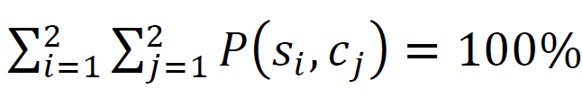
probabilities must add up to 100%
Notes:
Emphasize that a bird must have some color and some species, so the sum over all colors and all species must be 100%.

Slide 8
Univariate probabilities can be calculated by summing the rows and columns of P(s,c)
probability of species, irrespective of color
P(s,c)
color, c
P(s)
 | tan, t | white, w
pigeon, p | 30% | 20%
gull, g | 10% | 40%
pigeon, p | 50%
gull, g | 50%
sum rows
species, s
species, s
sum columns
P(c)
color, c
tan, t | white, w
40% | 60%
probability of color, irrespective of species
Notes:
Do each of the row and column sums out loud. For example, the first column sum is:
30% tan pigeons +10% tan gulls = 40% tan birds.

Slide 9
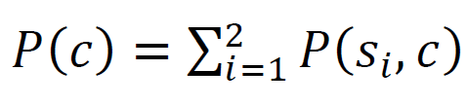
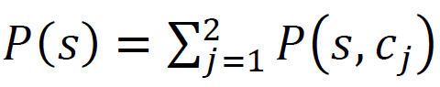
probability of color, irrespective of species
probability of species, irrespective of color
Notes:
This is just the mathematical form of the row and column sums.

Slide 10
Conditional probabilities: probability of one thing, given that you know another
probability of color and species
probability of color, given species
P(s,c)
color, c
P(c|s)
color, c
divide by row sums
 | tan, t | white, w
pigeon, p | 30% | 20%
gull, g | 10% | 40%
 | tan, t | white, w
pigeon, p | 60% | 40%
gull, g | 20% | 80%
species, s
species, s
probability of species, given color
divide by column sums
P(s|c)
color, c
 | tan, t | white, w
pigeon, p | 75% | 33%
gull, g | 25% | 67%
species, s
Notes:
Do each of the row and column divisions out loud. For example, the first column quotient is:
Step 1: 30% tan pigeons +10% tan gulls = 40% tan birds.
Step 2: 30% tan pigeons / 40% tan birds = 75% of tan birds are pigeons

Slide 11
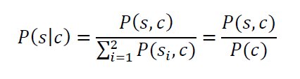
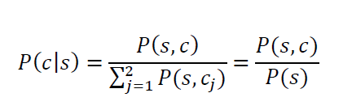
calculation of conditional probabilities
divide each species by fraction of birds of that color
divide each color by fraction of birds of that species
Notes:
This is just the mathematical form of the row and column quotients. The previous slide used the first form, with the summation. But that sum is just the univariate probability, and so is equivalent to the second form. You might want to flash back two slides for the formula for the univariate probability.

Slide 12
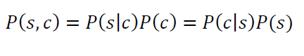
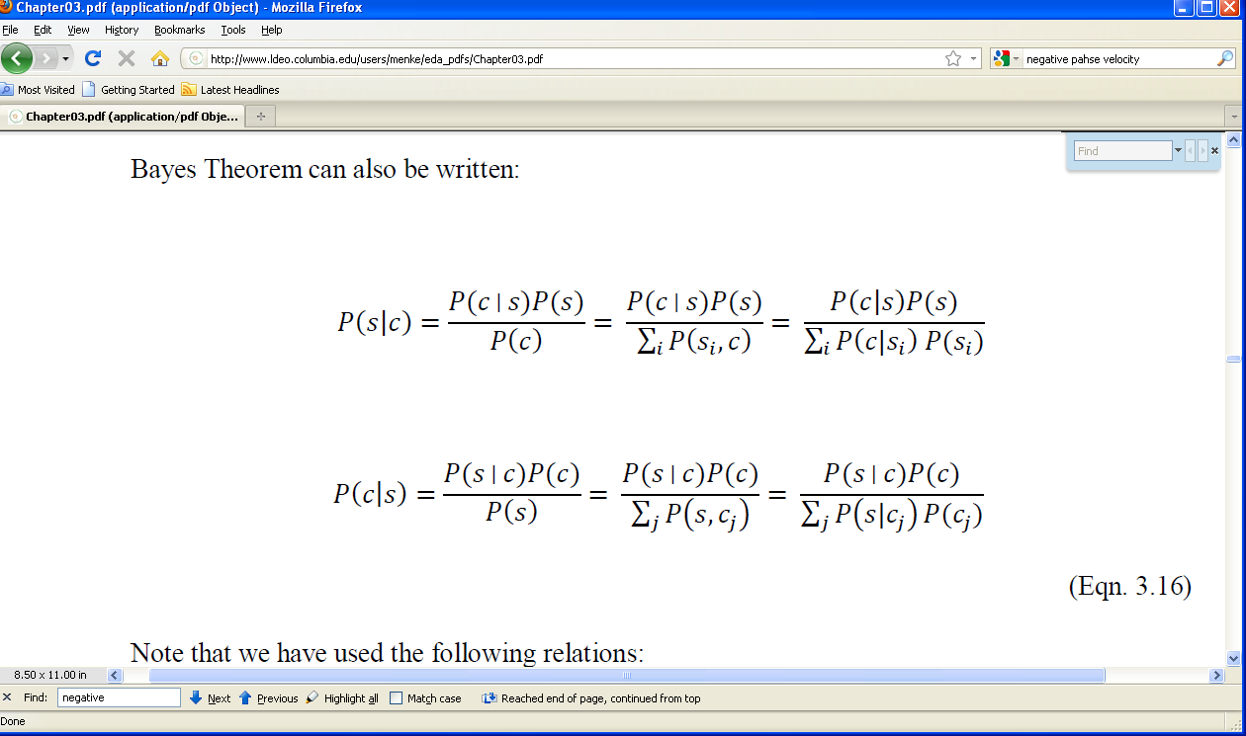
Bayes Theorem
same, so solving for P(s,c)
rearrange
Notes:
Emphasize that Bayes Theorem is extremely important.

Slide 13
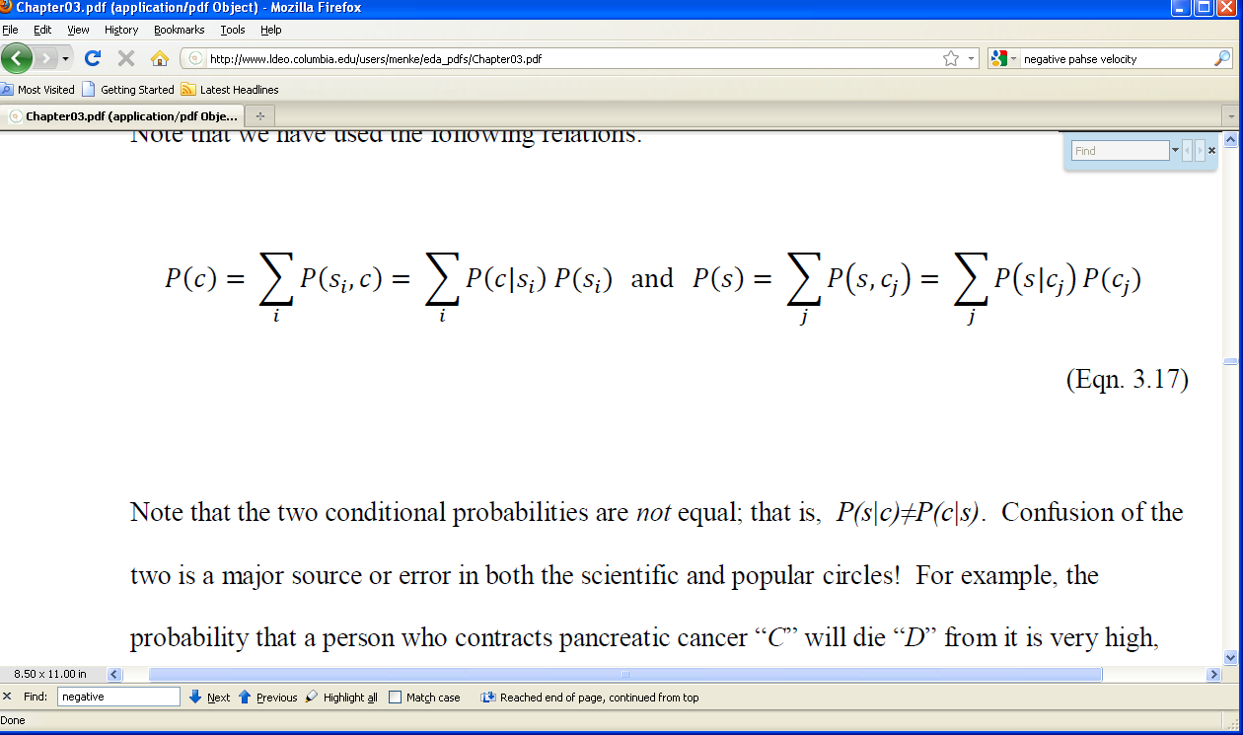
3 ways to write P(c) and P(s)
Notes:
Flash back to remind students where these come from.

Slide 14
so 3 ways to write Bayes Therem
the last way seems the most complicated, but it is also the most useful
Notes:
Point out that only the deniminators are different, corresponding to the three ways to write the univariate probability.

Slide 15
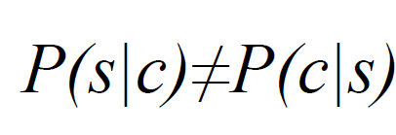
Beware!
major cause of error both
among scientists and the general public
Notes:
The next slide gives an example.

Slide 16
example
probability that a dead person succumbed to pancreatic cancer
(as contrasted to some other cause of death)
P(cancer|death) = 1.4%
probability that a person diagnosed with pancreatic cancer
will die of it in the next five years
P(death|cancer) = 90%
vastly different numbers
Notes:
You might see if anyone can come up with similar examples from popular culture.

Slide 17
Bayesian Inference
“updating information”
An observer on the island has sighted a bird.
We want to know whether it’s a pigeon.
when the observer says, “bird sighted”, the probability that it’s a pigeon is:
P(s=p) = 50%
since pigeons comprise half of the birds on the island.
Notes:
Bayesian Inference will be important in deriving a key result of Chapter 5, so anything that you can do between now and then to ensure that the students understand it will be very valuable.

Slide 18
Now the observer says, “the bird is tan”.
The probability that it’s a pigeon changes.
We now want to know
P(s=p|c=t)
The conditional probability that it’s a pigeon, given that we have observed its color to be tan.

Slide 19
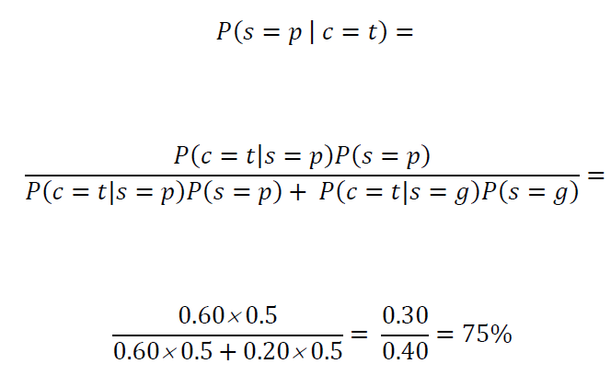
we use the formula
% of tan pigeons
% of tan birds
Notes:
Flashing back to the table of P(c|s) to show where the numerical values come from is helpful.

Slide 20
observation of the bird’s color changed the probability that is was a pigeon from 50% to 75% thus Bayes Theorem offers a way to assess the value of an observation
Notes:
As things go, this is a fairly big improvement in probability, so the measurement was very valuable. Nevertheless, we are still not especially sure that the bird is a pigeon.
This problem routinely arises with medical tests. A positive test greatly increased the probability that a person has a given medical condition. However, the improvement might be, say, from 1% to 30%, so many people, maybe even the majority of people, who have positive tests will not have the condition.

Slide 21
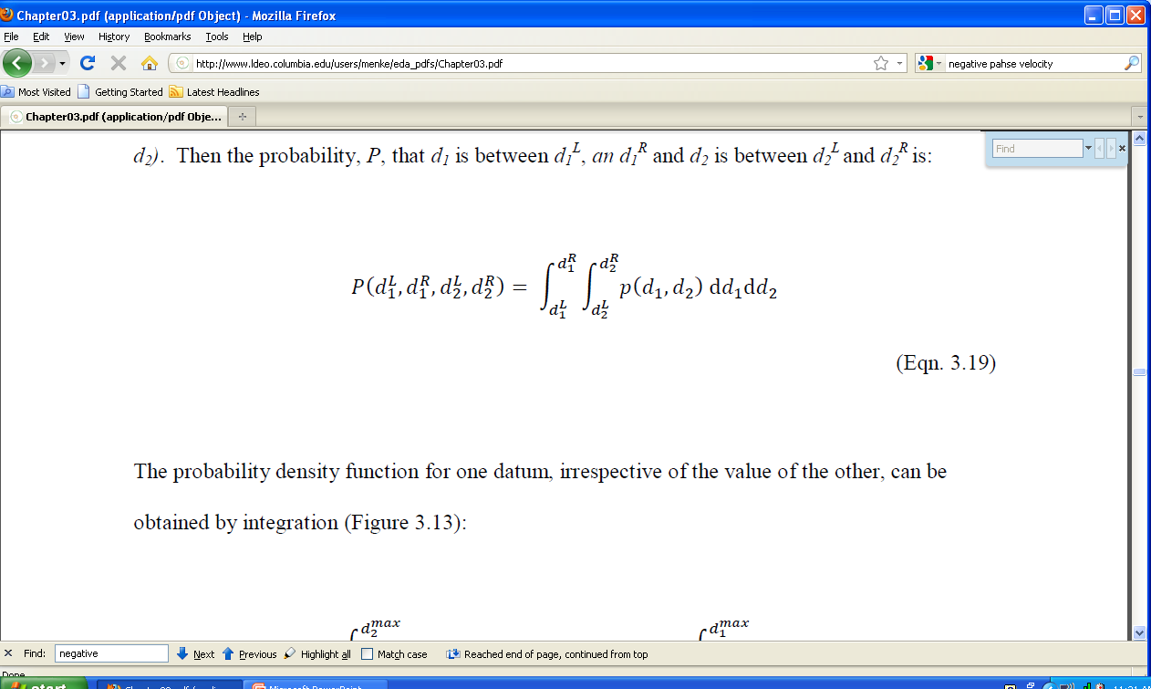
continuous variables
joint probability density function, p(d₁, d₂)
Notes:
Emphasize that continuous variables work just like discrete variables, with the sums turned into integrals.

Slide 22

p(d₁,d₂)
d₂^{L}
d₂^{L}
d₂
if the probability density function , p(d₁,d₂), is though of as a cloud made of water vapor
d₁^{L}
the probability that (d₁,d₂) is in the box given by the total mass of water vapor in the box
d₁^{R}
d₁
Notes:
The cloud analogy, mentioned in red, is usually very helpful in getting students to understand higher dimensional p.d.f.’s.

Slide 23
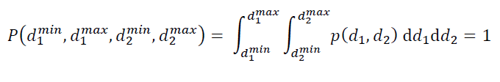
normalized to unit total probability
Notes:
Emphasize that the d₁ and d₂ must take on some value, so the total probability must be unity.

Slide 24
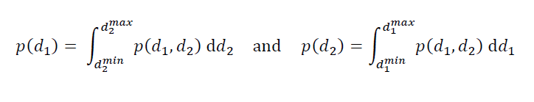
univariate p.d.f.’s
“integrate away” one of the variables
the p.d.f. of d₁ irrespective of d₂
the p.d.f. of d₂ irrespective of d₁
Notes:
You might flash back and compare with the discrete case.

Slide 25


p(d₁,d₂)
d₂
p(d₁)
integrate over d₂
d₁
d₁
integrate over d₁
p(d₂)
d₂
Notes:
Wave your arms first vertically, then horizontally, to indicate the directions of integration.

Slide 26
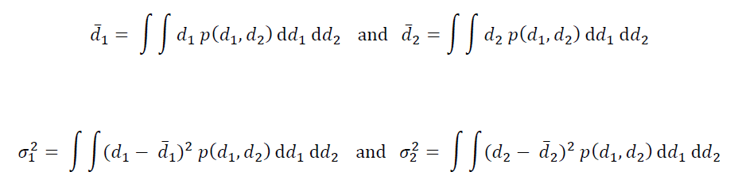
mean and variance calculated in usual way
Notes:
For the mean, point of the presence of the d₁ and d₂ factors.
For the variance, point out the quadratic terms.

Slide 27
correlation tendency of random variable d₁ to be large/small when random variable d₂ is large/small
Notes:
Correlation is something new, not exhibited by last lecture’s univariate p.d.f.’s

Slide 28
positive correlation:
tall people tend to weigh more than short people
…
negative correlation:
long-time smokers tend to die young
…
Notes:
Have the class offer other examples of correlation, and add them to the list

Slide 29

shape of p.d.f.
positive correlation
negative correlation
uncorrelated
d₂
d₂
d₂
d₁
d₁
d₁
Notes:
For the positive correlation, point out that the right tip of the elliptical cloud occurs with both d₁ and d₂ greater than their means, and the left tip with both d₁ and d₂ less than their means. Point out the opposite for the negative correlation.

Slide 30
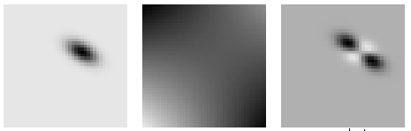
quantifying correlation
p(d₁,d₂)
d₂
s(d₁,d₂)
d₂
s(d₁,d₂) p(d₁,d₂)
d₂
+
−
−
+
d₁
p.d.f.
d₁
4-quadrant function
d₁
now multiply and integrate
Notes:
Explain that the key property of the function s(d₁,d₂) is that it has quadrants of alternating sign.

Slide 31
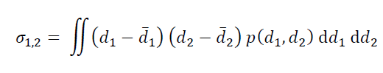
covariance quantifies correlation
Notes:
You might flash back and compare with the variance integral

Slide 32
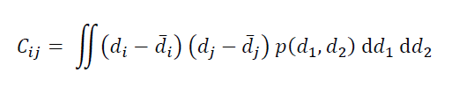
combine variance and covariance into a matrix, C
σ₁²
σ_{1,2}
C =
σ_{1,2}
σ₂²
note that C is symmetric
Notes:
This matrix is very important, because it appears in the error propagation formula.

Slide 33
many random variables d₁, d₂, d₃ … d_{N} write d’s a a vector d = [d₁, d₂, d₃ … d_{N} ]^{T}
Notes:
Grouping conceptually-similar quantities into a vector is almost always helpful.

Slide 34
the mean is then a vector, too
d = [d₁, d₂, d₃ … d_{N} ]^{T}
Notes:
Note that this vector is the same length as d.

Slide 35
and the covariance is an N×N matrix, C
σ₁²
σ_{1,2}
σ_{1,3}
…
σ_{1,2}
σ₂²
…
C =
σ_{2,3}
σ_{1,3}
σ_{2,3}
σ₃²
…
…
…
…
…
variance on the main diagonal
Notes:
Go through each of the elements. Point out that the variances are on the main diagonal. The C_{ij} off-diagional element quantifies the correlation between variables d_{i} and d_{j}.

Slide 36
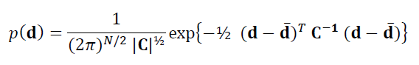
multivariate Normal p.d.f.
data minus its mean
square root of determinant of covariance matrix
inverse of covariance matrix
Notes:
The next slide compares this formula to the univatiate version. Students should be referred to the text if they are interested in where this formula comes from. It shows that the formula is quadratic in the data, has unit area, mean d-bar and covariance, C, and thus is a generalization of the univariate Normal p.d.f.

Slide 37
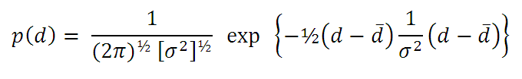
compare with univariate Normal p.d.f.
Notes:
next slides shows the similarities

Slide 38
corresponding terms

Slide 39
error propagation
p(d) is Normal with mean d and covariance, C_{d}.
given model parameters m
where m is a linear function of d
m = Md
Q1. What is p(m)?
Q2. What is its mean m and covariance C_{m}?

Slide 40
Answer
Q1: What is p(m)?
A1: p(m) is Normal
Q2: What is its mean m and covariance C_{m}?
A2: m = Md
and
C_{m} = M C_{d} M^{T}

Slide 41
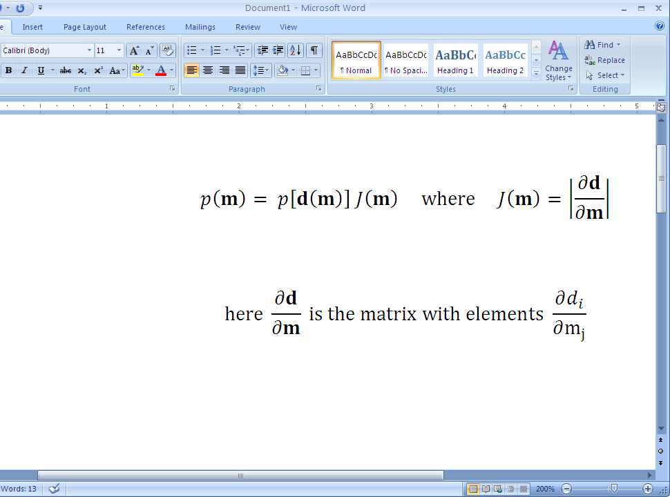
where the answer comes from
transform p(d) to p(m)
starting with a Normal p.d.f. for p(d) :
and the multivariate transformation rule:
determinant
Notes:
You may wish to skip this slide and the next, if you judge that the class cant handle the necessary level of mathematics. The class doesn’t necessarily need to know where the “Answer” comes from, but only to understand it and to apply it,

Slide 42
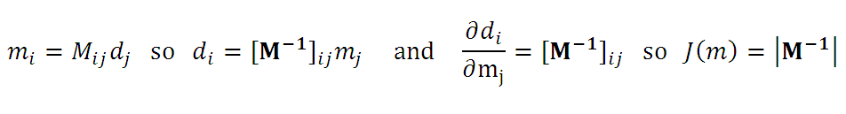
this is not as hard as it looks
because the Jacobian determinant J(m) is constant:
so, starting with p(d), replaces every occurrence of d with M⁻¹m and multiply the result by |M⁻¹|. This yields:

Slide 43
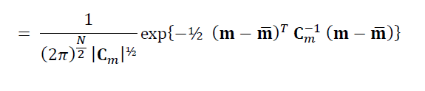
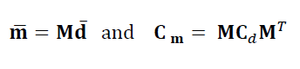
Normal p.d.f. for model parameters
p(m)
where
rule for error propagation

Slide 44
example
B
A
A
d₂
measurement 2: combined weight of A and B
d₁
measurement 1: weight of A
suppose the measurements are uncorrelated and that both have the same variance, σ_{d}²
Notes:
E.g. you didn’t feel like removing A from the scale before you weighed B.

Slide 45
model parameters
m₁
weight of B
B
B
=
+
-
A
A
m₁ = d₂ – d₁
A
B
B
m₂
weight of B
minus
weight of A
+
-
+
d₁
-
=
A
A
A
m₂ = d₂ – 2d₁
Notes:
Point out that any error in measuring d₂ effects m₁ and m₂ equally. If d₂ is overrestimated, then both m₁ and m₂ will tend to be overestimated, too. Thus we expect to find that m₁ and m₂ are highly correlated.

Slide 46
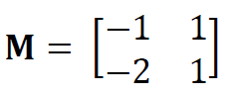
linear rule relating model parameters to data m = M d with
Notes:
You might flash back a slide and convince students that this matrix agrees with the formula.

Slide 47
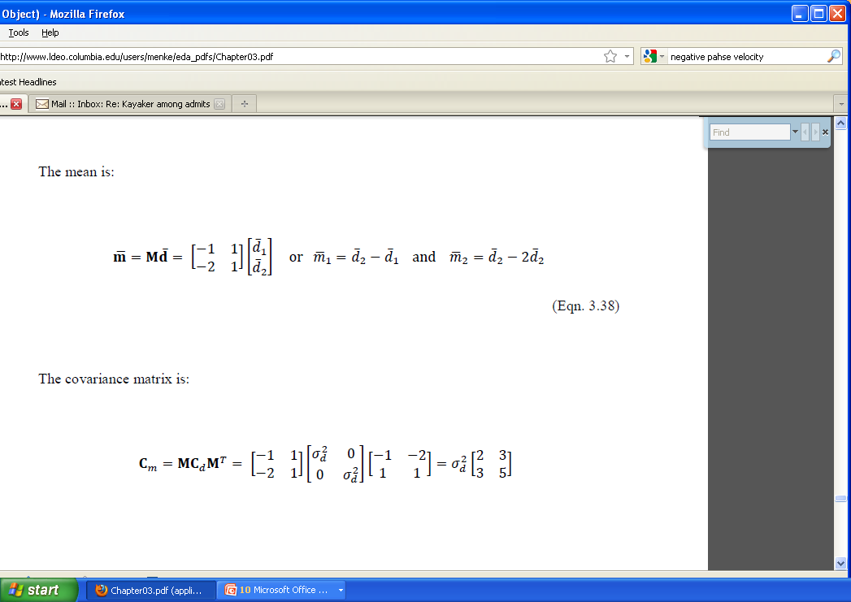
so the means of the model parameters are
Notes:
Point out that the means of the model parameters is just the formulas applied to the means of the data.

Slide 48
and the covariance matrix is
Notes:
You might do the matrix multiplications on the board.

Slide 49
model parameters are correlated, even though data are uncorrelated bad variance of model parameters different than variance of data bad if bigger, good if smaller
Notes:
Part of designing a good experimental design is ensuring that the variance of the model parameters is smaller than the variance of the data. Ensuring that the model parameters are uncorrelated is more difficult, but it can sometimes be accomplished.

Slide 50


example with specific values of d and σ_{d}²
0
p(d₁,d₂)
40
−20
p(m₁,m₂)
20
d₂
m₂
0
−20
40
20
d₁
m₁
The data, (d₁, d₂), have mean (15, 25), variance (5, 5) and zero covariance
The model parameters, (m₁, m₂), have mean (10, -5), variance (10, 25) and covariance,15.
Notes:
Remind students that the width of the distribution is proportional to the square root of the variance. The data are uncorrelated, so its p.d.f. is not “tilted”. The data have equal variance, so the pattern is circular (as contrasted to elliptical). Point out that the model parameters have unequal variance and a positive correlation.

