Slide 1
Environmental Data Analysis with MatLab
2nd Edition
Lecture 6:
The Principle of Least Squares

Slide 2
SYLLABUS
Lecture 01 Using MatLab
Lecture 02 Looking At Data
Lecture 03 Probability and Measurement Error
Lecture 04 Multivariate Distributions
Lecture 05 Linear Models
Lecture 06 The Principle of Least Squares
Lecture 07 Prior Information
Lecture 08 Solving Generalized Least Squares Problems
Lecture 09 Fourier Series
Lecture 10 Complex Fourier Series
Lecture 11 Lessons Learned from the Fourier Transform
Lecture 12 Power Spectra
Lecture 13 Filter Theory
Lecture 14 Applications of Filters
Lecture 15 Factor Analysis
Lecture 16 Orthogonal functions
Lecture 17 Covariance and Autocorrelation
Lecture 18 Cross-correlation
Lecture 19 Smoothing, Correlation and Spectra
Lecture 20 Coherence; Tapering and Spectral Analysis
Lecture 21 Interpolation
Lecture 22 Linear Approximations and Non Linear Least Squares
Lecture 23 Adaptable Approximations with Neural Networks
Lecture 24 Hypothesis testing
Lecture 25 Hypothesis Testing continued; F-Tests
Lecture 26 Confidence Limits of Spectra, Bootstraps
Notes:
24 lectures

Slide 3
Goals of the lecture
estimate model parameters using the
principle of least-squares
Notes:
Least-squares is a standard way to solve a linear model.

Slide 4
part 1
the least squares estimation of model parameters and their covariance
Notes:
Emphasize that calculating covariance is an integral part of the process. A answer is of no value without information about its accuracy. All estimates of model parameters based on noisy data are inherently uncertain. The key question is how uncertain.

Slide 5
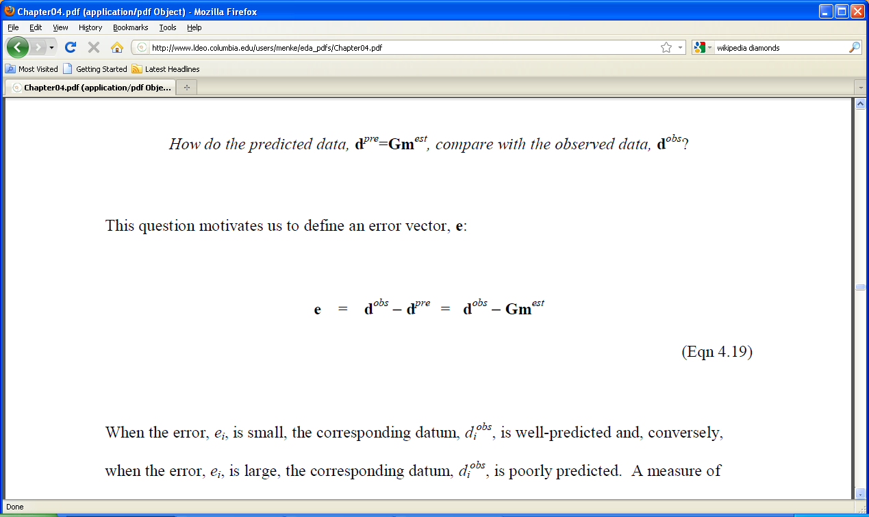
the prediction error
motivates us to define an error vector, e
Notes:
This slide and the next three are review.

Slide 6
prediction error in straight line case
d_{i}^{pre}
e_{i}
data, d
d_{i}^{obs}
auxiliary variable, x
Notes:
Review the distinction between the observed and predicted data.
Review how the error is calculated.

Slide 7
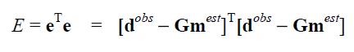
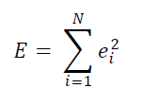
total error single number summarizing the error
sum of squares of individual errors

Slide 8
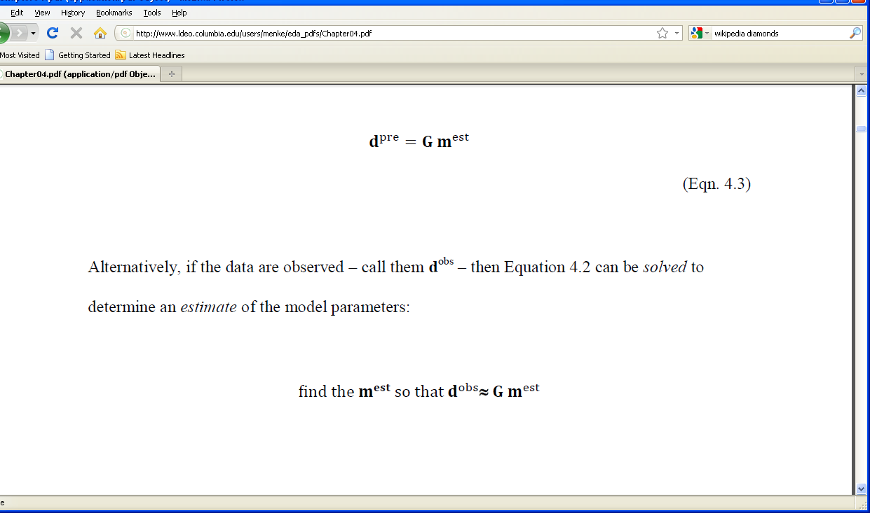
principle of least-squares
that minimizes
Notes:
Remind students that the total error was defined in order to quantify what “about equal” means.

Slide 9
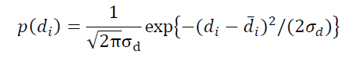
least-squares and probability
suppose that each observation has a Normal p.d.f.
2

Slide 10
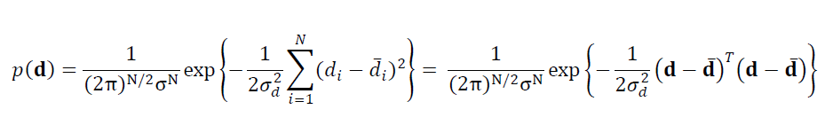
for uncorrelated data the joint p.d.f. is just the product of the individual p.d.f.’s
least-squares formula for E
suggests a link between probability and least-squares

Slide 11
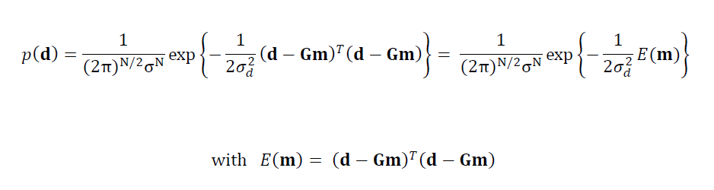
now assume that Gm predicts the mean of d
Gm substituted for d
minimizing E(m) is equivalent to maximizing p(d)

Slide 12
the principle of least-squares determines the m that makes the observations
“most probable” in the sense of maximizing p(d^{obs})
Notes:
Emphasize the strong link between two ways of thinking about goodness-of-fit, one involving error, the other involving probability.

Slide 13
the principle of least-squares determines the model parameters that makes the observations
“most probable”
(provided that the data are Normal) this is the principle of maximum likelihood

Slide 14
a formula for m^{est} at the point of minimum error, E
∂E / ∂m_{i} = 0 so solve this equation for m^{est}

Slide 15
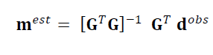
Result

Slide 16
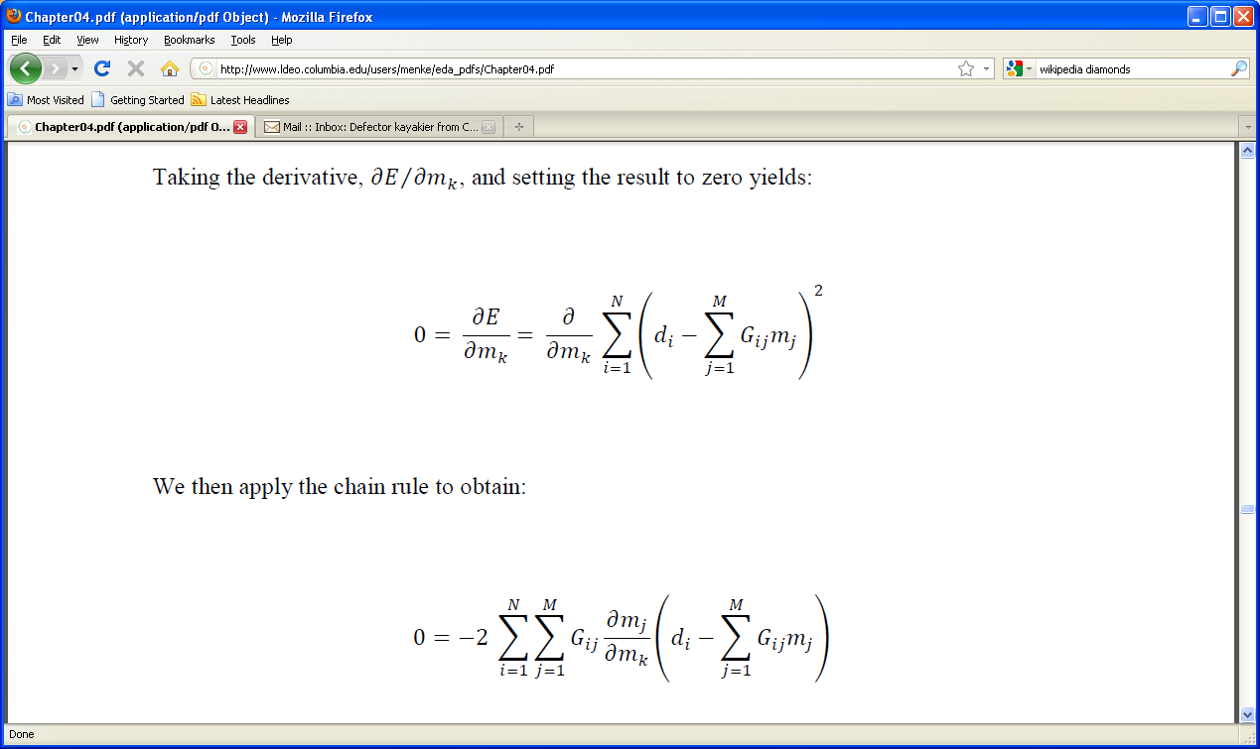
where the result comes from
E =
so

Slide 17
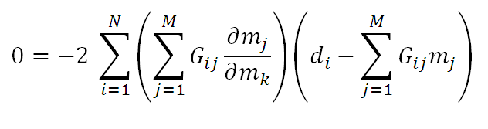
unity when k=j zero when k≠j since m’s are independent
use the chain rule
so just delete sum over j and replace j with k

Slide 18
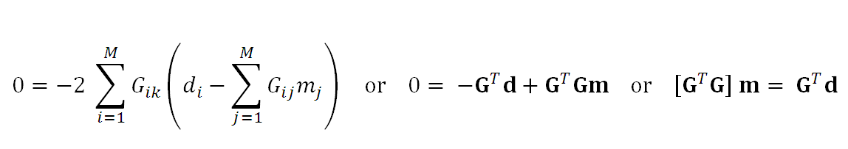
which gives

Slide 19
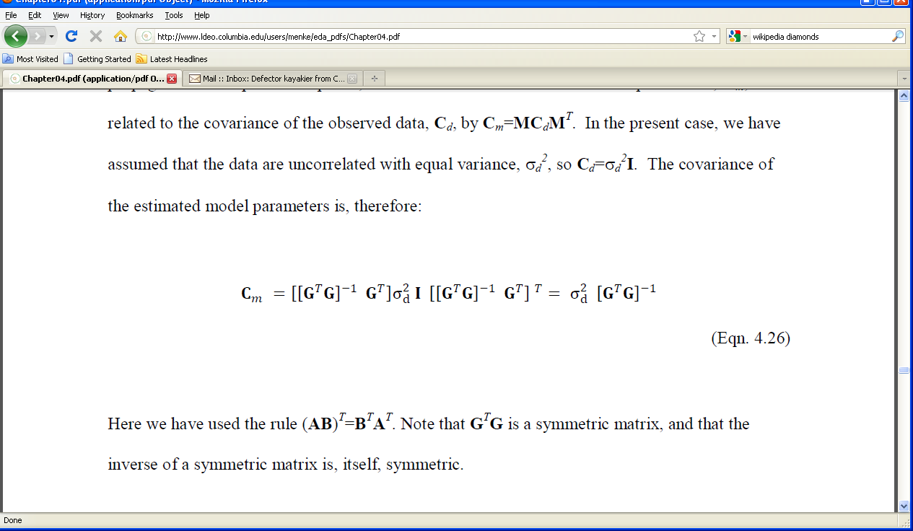
covariance of m^{est}
m^{est} is a linear function of d of the form m^{est} = M d
so C_{m} = M C_{d} M^{T}, with M=[G^{T}G]⁻¹G^{T}
assume C_{d} uncorrelated with uniform variance, σ_{d}²
then
Notes:
Show how many of the factors in the expression cancel one another.

Slide 20
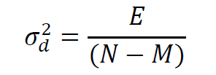
two methods of estimating the variance of the data
prior estimate: use knowledge of measurement technique
the ruler has 1mm tic marks, so σ_{d}≈½mm
posterior estimate: use prediction error

Slide 21
posterior estimates are overestimates when the model is poor
reduce N by M since an M-parameter model can exactly fit N data

Slide 22
confidence intervals for the estimated model parameters
(assuming uncorrelated data of equal variance)
so
σ_{mi} = √[C_{m}]_{ii}
and
m=m^{est}±2σ_{mi} (95% confidence)

Slide 23
MatLab script for least squares solution
mest = (G’*G)\(G’*d);
Cm = sd2 * inv(G’*G);
sm = sqrt(diag(Cm));
Notes:
Emphasize that this solution works regardless of the details of G.
Explain use of backslash operator.
Explain that the diag() function extracts the main diagonal from a matrix and puts it in a vector.

Slide 24
part 2
exemplary least squares problems

Slide 25
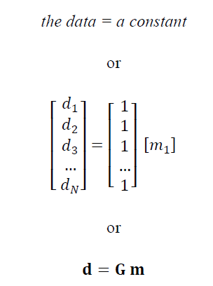
Example 1: the mean of data
the constant
will turn out to be the mean

Slide 26
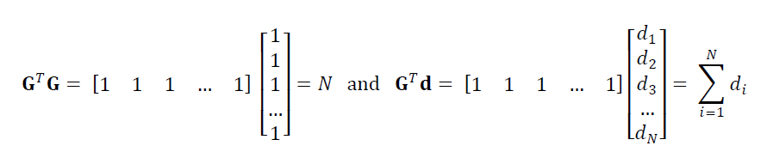
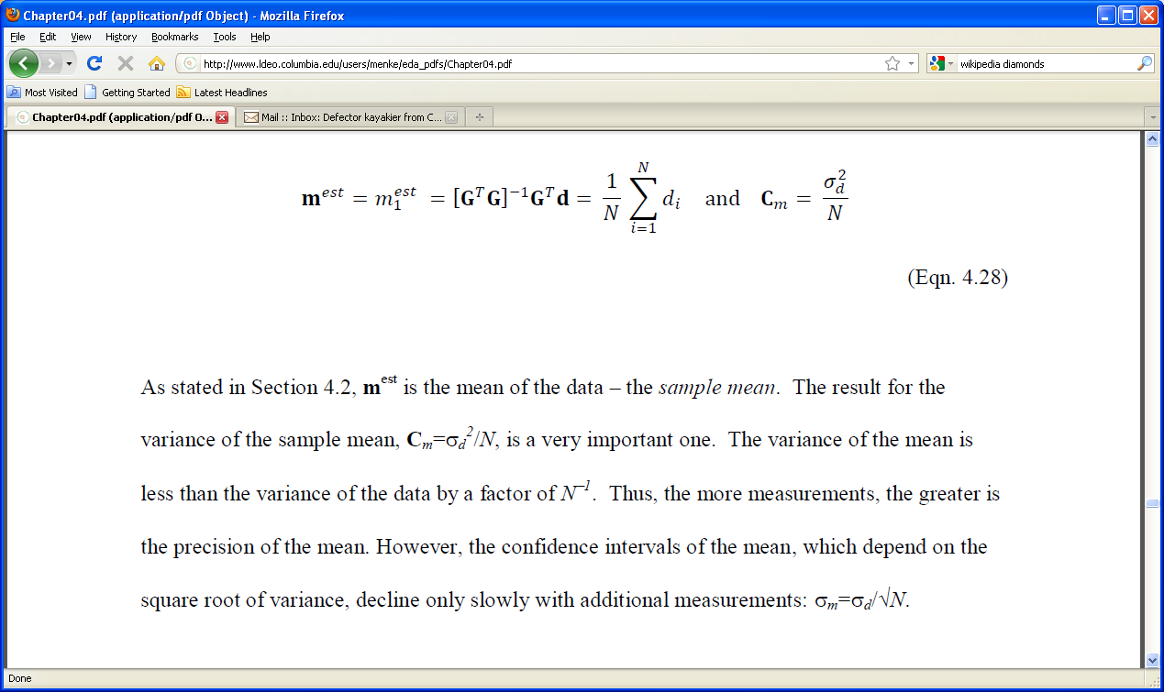
usual formula for the mean
variance decreases with number of data

Slide 27
formula for mean
formula for covariance
combining the two into confidence limits
2σ_{d}
m₁^{est} = d =
±
(95% confidence)
√N

Slide 28
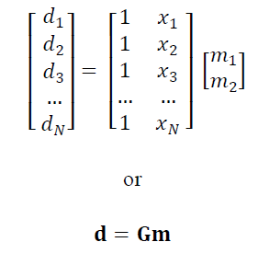
Example 2: fitting a straight line
intercept
slope

Slide 29
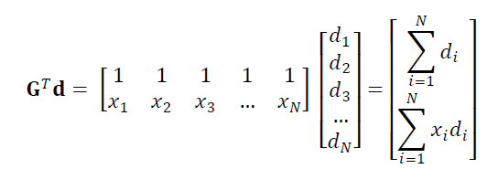

Slide 30
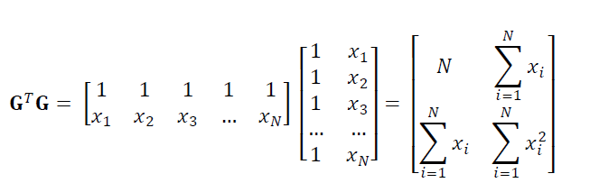

Slide 31
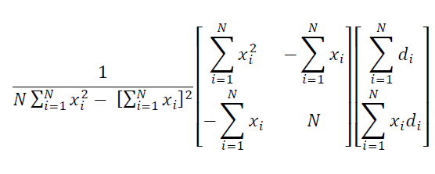
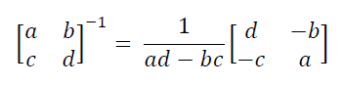
[G^{T}G]⁻¹=
(uses the rule)

Slide 32
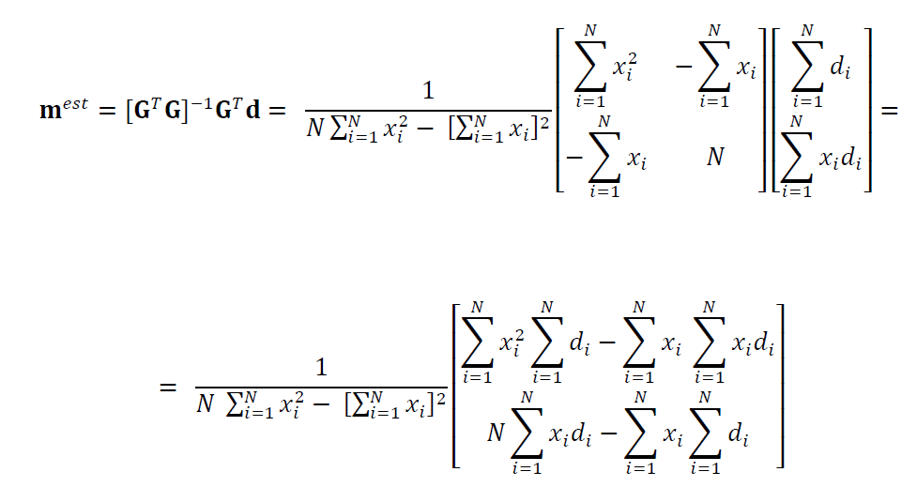

Slide 33
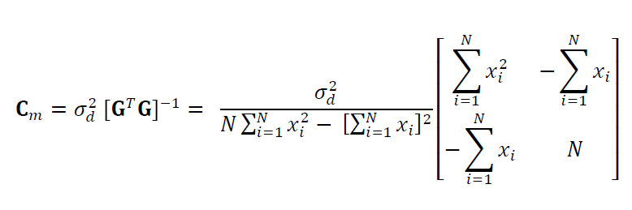
intercept and slope are uncorrelated when the mean of x is zero

Slide 34
keep in mind that none of this algrbraic manipulation is needed if we just compute
using MatLab

Slide 35
Generic MatLab script for least-squares problems
mest = (G’*G)\(G’*dobs);
dpre = G*mest;
e = dobs-dpre;
E = e’*e;
sigmad2 = E / (N-M);
covm = sigmad2 * inv(G’*G);
sigmam = sqrt(diag(covm));
mlow95 = mest – 2*sigmam;
mhigh95 = mest + 2*sigmam;

Slide 36
Example 3:
modeling long-term trend and annual cycle in Black Rock Forest temperature data
d(t)^{obs}
time t, days
d(t)^{pre}
time t, days
error, e(t)
time t, days
Notes:
Note that this plot has the observations, d^{obs}, the “results”, d^{pre}, and the error, e.
The error large in the sense that it is an appreciable fraction of the amplitude of the data.

Slide 37
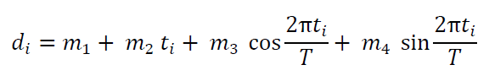
the model:
long-term trend
annual cycle
Notes:
Identify m₂ as the long-term slope. Note that the cosine and sine are paired.

Slide 38
MatLab script to create the data kernel
Ty=365.25;
G=zeros(N,4);
G(:,1)=1;
G(:,2)=t;
G(:,3)=cos(2*pi*t/Ty);
G(:,4)=sin(2*pi*t/Ty);
Notes:
Ty is the number of days in a year, the period of the annual cycle.

Slide 39
prior variance of data based on accuracy of thermometer σ_{d} = 0.01 deg C
posterior variance of data
based on error of fit
σ_{d} = 5.60 deg C
huge difference, since the model does not include diurnal cycle of weather patterns
Notes:
You might discuss the rationale for using one of these estimates over the other. There are arguments both ways. The prior estimate is the better estimate of measurement noise. The posterior estimate more honestly reflects how well the model works (poorly).

Slide 40
long-term slope
95% confidence limits based on prior variance
m₂ = -0.03 ± 0.00002 deg C / yr
95% confidence limits based on posterior variance
m₂ = -0.03 ± 0.00460 deg C / yr
in both cases, the cooling trend is significant, in the sense that the confidence intervals do not include zero or positive slopes.
Notes:
The key point if that the error bars do not overlap the m₂=0, giving confidence to the assertion that the rate is negative.

Slide 41
However
The fit to the data is poor, so the results should be used with caution. More effort needs to be put into developing a better model.
Notes:
Scientists should always be suspicious of models that only poorly fit the data.

Slide 42
part 3
covariance and the shape of the error surface

Slide 43

solutions within the region of low error are almost as good as m^{est}
m₂^{est}
0
4
m₂
0
m^{est}
large range of m₁
m₁^{est}
E(m)
m_{i}
4
m_{i}^{est}
small range of m₂
m₁
near the minimum the error is shaped like a parabola. The curvature of the parabola controls the with of the region of low error
Notes:
The error surface was shown in the previous lecture. Mention that it was computed via a grid search.

Slide 44
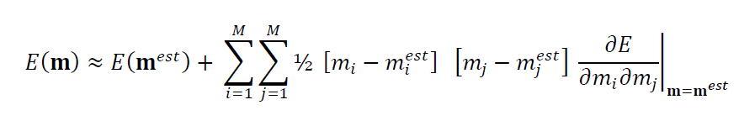
near the minimum, the Taylor series for the error is:
curvature of the error surface
Notes:
You should skip this slide and the nest two if the class has too low a mathematical level to understand Taylor series.

Slide 45
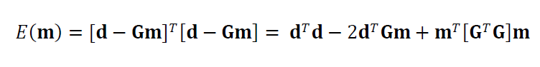
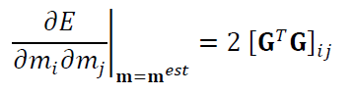
starting with the formula for error
we compute its 2nd derivative

Slide 46
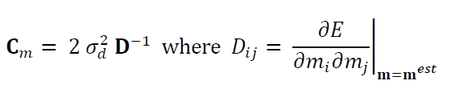
but
so
covariance of the model parameters
curvature of the error surface

Slide 47
the covariance of the least squares solution
is expressed
in the shape of the error surface
large variance
small variance
E(m)
E(m)
m_{i}
m_{i}
m_{i}^{est}
m_{i}^{est}
Notes:
if you skipped the math, just asset the correspondence between variance and curvature of the error surface,

