Slide 1
Environmental Data Analysis with MatLab
2nd Edition
Lecture 7:
Prior Information

Slide 2
SYLLABUS
Lecture 01 Using MatLab
Lecture 02 Looking At Data
Lecture 03 Probability and Measurement Error
Lecture 04 Multivariate Distributions
Lecture 05 Linear Models
Lecture 06 The Principle of Least Squares
Lecture 07 Prior Information
Lecture 08 Solving Generalized Least Squares Problems
Lecture 09 Fourier Series
Lecture 10 Complex Fourier Series
Lecture 11 Lessons Learned from the Fourier Transform
Lecture 12 Power Spectra
Lecture 13 Filter Theory
Lecture 14 Applications of Filters
Lecture 15 Factor Analysis
Lecture 16 Orthogonal functions
Lecture 17 Covariance and Autocorrelation
Lecture 18 Cross-correlation
Lecture 19 Smoothing, Correlation and Spectra
Lecture 20 Coherence; Tapering and Spectral Analysis
Lecture 21 Interpolation
Lecture 22 Linear Approximations and Non Linear Least Squares
Lecture 23 Adaptable Approximations with Neural Networks
Lecture 24 Hypothesis testing
Lecture 25 Hypothesis Testing continued; F-Tests
Lecture 26 Confidence Limits of Spectra, Bootstraps
Notes:
24 lectures

Slide 3
Goals of the lecture
understand the advantages and limitations of supplementing observations with
prior information
Notes:
When applied sensibly, prior information stabilizes the solutions to data analysis problems.

Slide 4
when least-squares fails
Notes:
Ordinary least squares does not always work. The purpose of this lecture is to develop a new version of least squares that always works.

Slide 5
fitting of straight line
cases were there’s more than one solution
d
d
d₁
d*
x₁
x
x*
x
E exactly 0
for any lines passing through point
one point
E minimum
for all lines passing through point x*
Notes:
Emphasize that adding more data points at the same x* does not help.

Slide 6
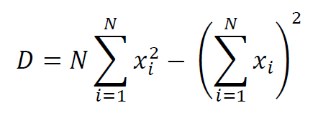
when determinant of [G^{T}G] is zero that is, D=0
[G^{T}G]⁻¹ is singular
Notes:
Mention that this result was derived in the previous lecture

Slide 7
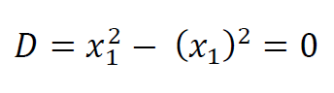
N=1 case
d
d₁
x₁
x
E exactly 0
for any lines passing through point
one point
Notes:
Explain how each term in the general formula (top) simplifies to the result in the bottom formula.

Slide 8
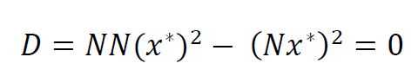
x_{i} =x* case
d
d*
x*
x
E minimum
for any lines passing through point x*
Notes:
Explain how each term in the general formula (top) simplifies to the result in the bottom formula.

Slide 9
least-squares fails when the data do not uniquely determine the solution
Notes:
The larger the problem, the more likely that it will have a non-unique solution.

Slide 10
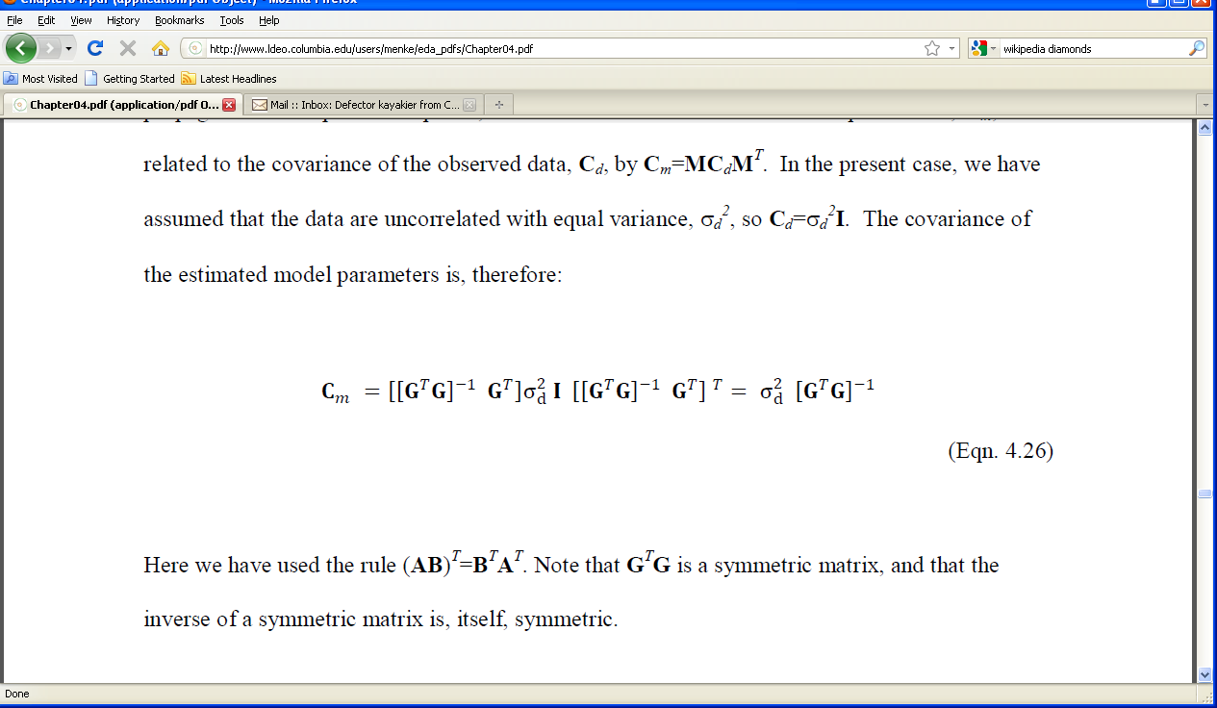
if [G^{T}G]⁻¹ is singular least squares solution doesn’t exist if [G^{T}G]⁻¹ is almost singular least squares is useless because it has high variance
very large
Notes:
Mention that this result was derived in the previous lecture

Slide 11
guiding principle for avoiding failure
add information to the problem that guarantees that matrices like [G^{T}G] are never singular
such information is called
prior information

Slide 12
examples of prior information
soil has density will be around 1500 kg/m³
give or take 500 or so
chemical components sum to 100%
pollutant transport is subject to the diffusion equation
water in rivers always flows downhill
Notes:
Ask the class to come up with a few more.

Slide 13
prior information
things we know about the solution
based on our knowledge and experience
but not directly based on data
Notes:
But knowledge and experience is based on past experiments, so the possibility that it is erroneous always remains.

Slide 14
simplest prior information
m is near some value, m
m ≈ m
with covariance C_{m}^{p}
Notes:
Example: soil has density will be around 1500 kg/m³ give or take 500 or so.
m-bar = 1500, sigma2=500.

Slide 15
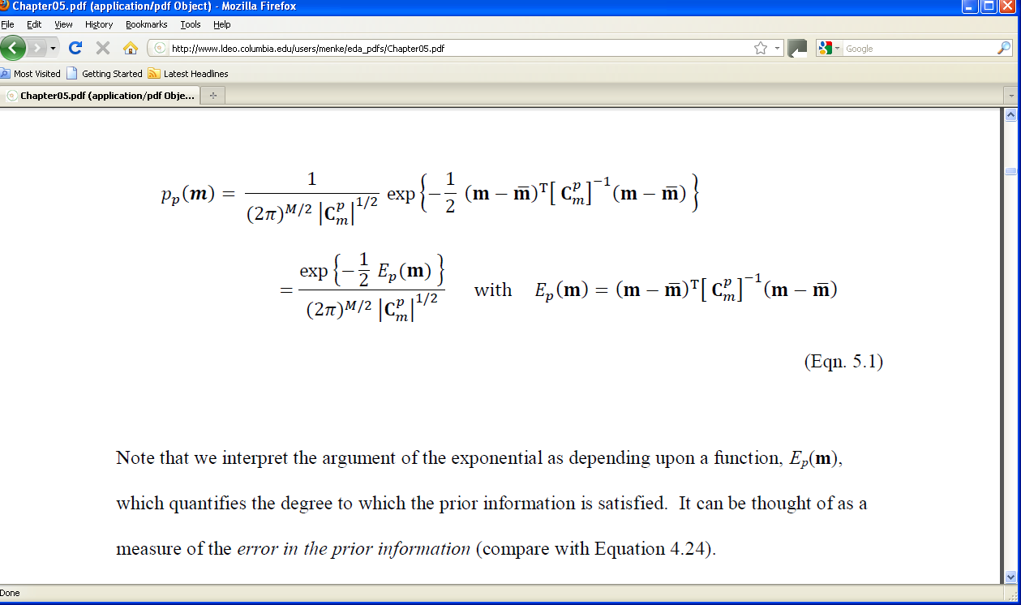
use Normal p.d.f. to prepresent prior information
Notes:
Mention that this is the standard form of a multivariate Normal distribution

Slide 16

prior information
example:
m₁ = 10 ± 5
m₂ = 20 ± 5
m₁ and m₂ uncorrelated
p_{p}(m)
0
20
40
0
m₂
10
40
m₁
Notes:
The distribution is peaked near m₁=10, m₂=20.

Slide 17
Normal p.d.f. defines an
“error in prior information”
individual
errors weighted by their certainty
Notes:
You might flash back two slides to show the standard form of the Normal p.d.f.
Mention that variance is a measure of the width of the p.d.f, so that 1/variance is a measure of it narrowness, that is, its certainty.

Slide 18
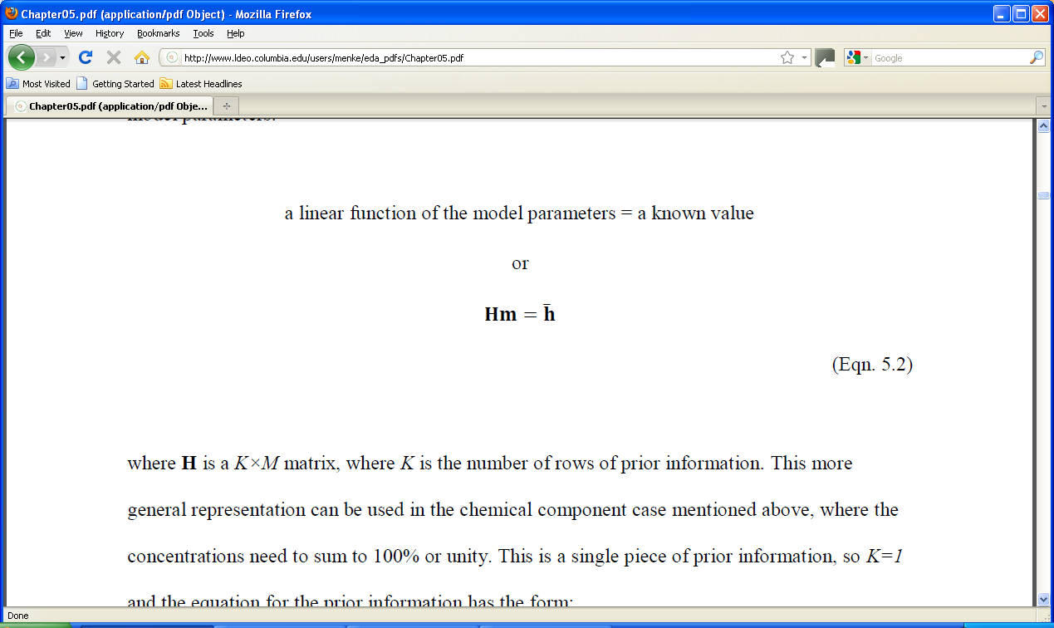
linear prior information
with covariance C_{h}

Slide 19
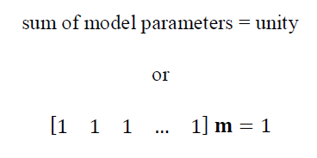
example relevant to chemical constituents
H
h
Notes:
Mention that the matrix H has only one row. Multiplying m by it just sums the elements of m.

Slide 20
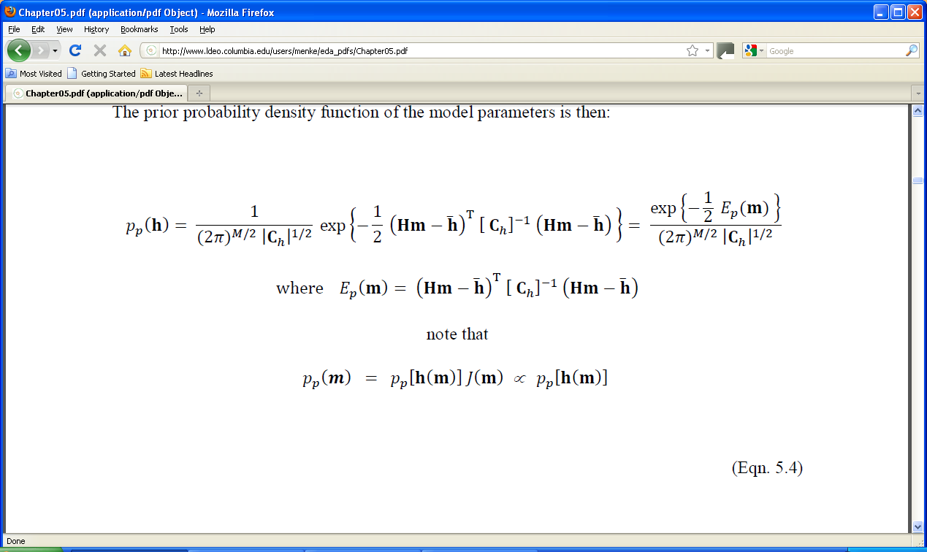
use Normal p.d.f. to represent prior information
Notes:
Mention that this is the standard form of a multivariate Normal distribution

Slide 21

Normal p.d.f. defines an
“error in prior information”
individual
errors weighted by their certainty
Notes:
You might flash back a slide to show the standard form of the Normal p.d.f.
Mention that variance is a measure of the width of the p.d.f, so that 1/variance is a measure of it narrowness, that is, its certainty.

Slide 22
since m ∝ h p_{p}(m) ∝ p_{p}(h)
so we can view this formula as a p.d.f. for the model parameters, m
p_{p}(m) ∝
(Technically, the p.d.f.’s are only proportional when the Jacobian Determinant is constant, which it is in this case).
Notes:
Mention that this is the standard form of a multivariate Normal distribution

Slide 23
now suppose that we observe some data:
d = d^{obs}
with covariance C_{d}

Slide 24
use Normal p.d.f. to represent the observations
d
with covariance C_{d}
Notes:
Same pattern as with the prior information.

Slide 25
now assume that the mean of the data is predicted by the model:
d = Gm

Slide 26
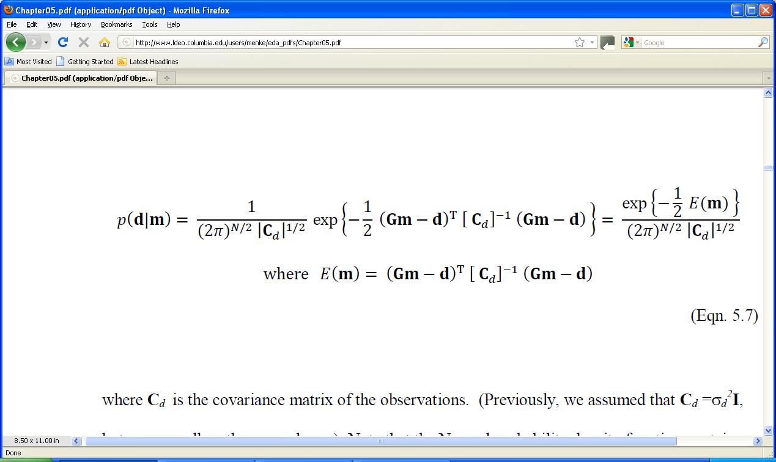
represent the observations with a
Normal p.d.f.
p(d) =
observations weighted by their certainty
mean of data predicted by the model

Slide 27
Normal p.d.f. defines an
“error in data”
weighted least-squares error
p(d) =
Notes:
Mention that this is almost the least-squares error of Chapter 4, except that now each component error is weighted by its certainty.

Slide 28
think of p(d) as a
conditional p.d.f.
probability that a particular set of data values will be observed
given a
particular choice of model parameters

Slide 29

example:
one datum
2 model parameters
model
d₁=m₁ –m₂
one observation
d₁^{obs} = 0 ± 3
p(d|m)
20
40
0
0
m₂
10
40
m₁
Notes:
The datum, d₁, is the difference between the two model parameters. Its measured value is d₁=0±3, that is, the model parameters are the same up to the precision of measurement. The conditional p.d.f., p(d|m), is large when the two model parameters are equal, or nearly, equal. And it is small when the two model parameters are different. This can be interpreted to mean, an observed datum of zero is likely only for the case m₁≈m₂.

Slide 30
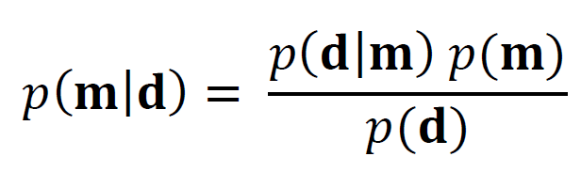
now use Bayes theorem to
update
the prior information
with the
observations

Slide 31
ignore for a moment
Notes:
The only thing we will do with this formula is maximize it with respect to m. The denominator is not a function of model parameters, so it will not effect the results of the maximization.

Slide 32
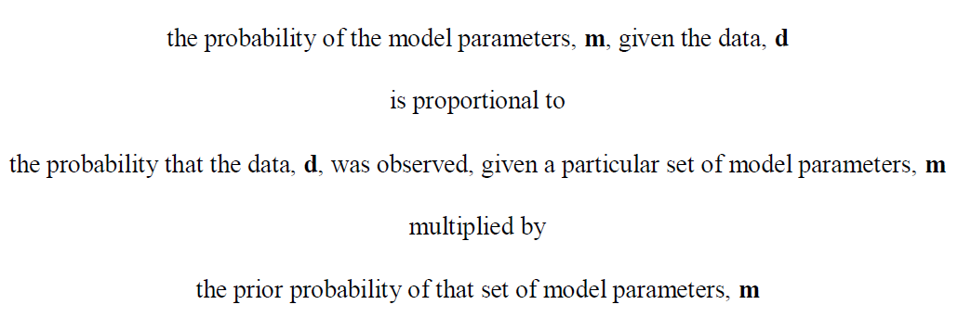
Bayes Theorem in words

Slide 33
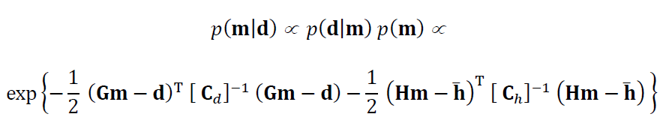
so the updated p.d.f. for the model parameters is:
data part
prior information part

Slide 34
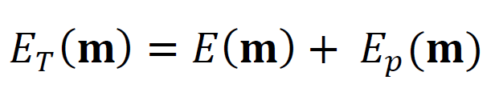
this p.d.f. defines a
“total error”
weighted least squares error in the data
weighted error in the prior information
with
Notes:
You might flash back a slide to show the standard form of the Normal p.d.f.
Mention that variance is a measure of the width of the p.d.f, so that 1/variance is a measure of it narrowness, that is, its certainty.

Slide 35
Generalized Principle of Least Squares the best m^{est} is the one that minimizes the total error with respect to m which is the same one as the one that maximized p(m|d) with respect to m
Notes:
Only differences from ordinary least squares are 1) the error depends on both the prediction error and the error in the prior information. 2) all component errors are weighted by their certainty - the more certain, the more weight that they are given.

Slide 36
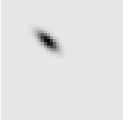
continuing the example …
A) p_{p}(m)
B) p(d|m)
C) p(m|d)
m₂
m₂
m₂
0
20
40
0
20
40
0
15
40
0
0
0
10
10
13
40
40
40
m₁
m₁
m₁
best estimate of the model parameters
Notes:
C) is just the product of A) and B). Note that peak of C) is not at the peak of A) (the prior information),, nor along the line in C), but somewhere in between. The solution is a compromise between the prior information and the observations.

Slide 37
generalized least squares find the m that minimizes
Notes:
You might flash back a slide to show the standard form of the Normal p.d.f.
Mention that variance is a measure of the width of the p.d.f, so that 1/variance is a measure of it narrowness, that is, its certainty.

Slide 38
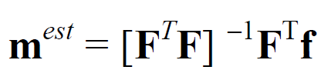
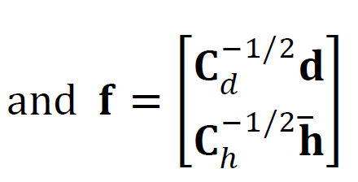
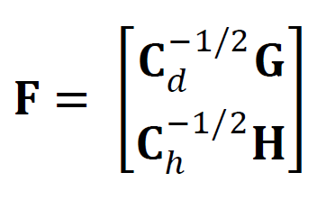
generalized least squares solution
pattern same as ordinary least squares
but with more complicated matrices
Notes:
We will discuss this solution further in the next lecture.

