Slide 1
Environmental Data Analysis with MatLab
2nd Edition
Lecture 9:
Fourier Series
Notes:
Lots of trig in this lecture, including “sum and differrence identities”. Review as necessary.

Slide 2
SYLLABUS
Lecture 01 Using MatLab
Lecture 02 Looking At Data
Lecture 03 Probability and Measurement Error
Lecture 04 Multivariate Distributions
Lecture 05 Linear Models
Lecture 06 The Principle of Least Squares
Lecture 07 Prior Information
Lecture 08 Solving Generalized Least Squares Problems
Lecture 09 Fourier Series
Lecture 10 Complex Fourier Series
Lecture 11 Lessons Learned from the Fourier Transform
Lecture 12 Power Spectra
Lecture 13 Filter Theory
Lecture 14 Applications of Filters
Lecture 15 Factor Analysis
Lecture 16 Orthogonal functions
Lecture 17 Covariance and Autocorrelation
Lecture 18 Cross-correlation
Lecture 19 Smoothing, Correlation and Spectra
Lecture 20 Coherence; Tapering and Spectral Analysis
Lecture 21 Interpolation
Lecture 22 Linear Approximations and Non Linear Least Squares
Lecture 23 Adaptable Approximations with Neural Networks
Lecture 24 Hypothesis testing
Lecture 25 Hypothesis Testing continued; F-Tests
Lecture 26 Confidence Limits of Spectra, Bootstraps
Notes:
24 lectures

Slide 3
Goal of the lecture
detect and quantify periodicities in data
Notes:
Knowing that something is periodic makes it predictable. Hence, the identification of periodicities is extremely important.

Slide 4
importance of periodicities
Notes:
Need to be able to recognize when a periodicity is present, determine is period and its strength.

Slide 5
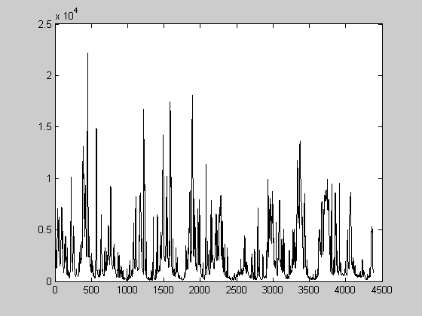
Stream Flow
Neuse River
365 days
1 year
discharge, cfs
time, days
Notes:
Periodicities that are present in datasets that we have already looked at. Neuse River stream flow has an annual periodicity.

Slide 6
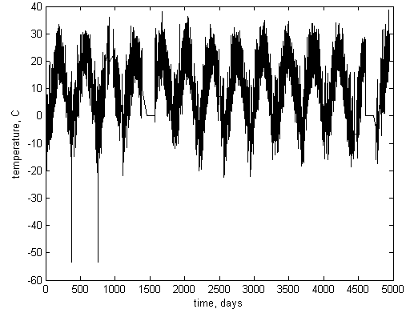
Air temperature
Black Rock Forest
365 days
1 year
Notes:
Black Rock Forest air temperature has a yearly periodicity with strength of ±20 degrees C …

Slide 7
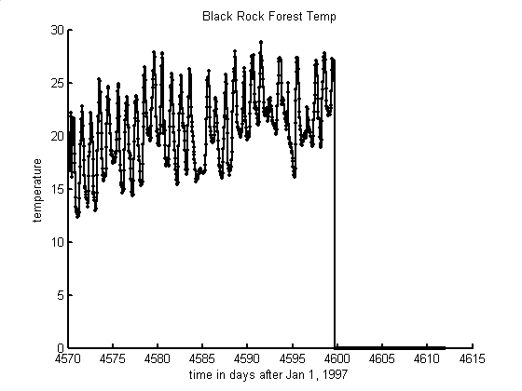
Air temperature
Black Rock Forest
1 day
time, days
Notes:
… and a daily periodicity with strength of ±5 degrees C …

Slide 8
temporal periodicities and their periods
astronomical
rotation
daily
revolution
yearly
other natural
ocean waves
a few seconds
anthropogenic
electric power
60 Hz
Notes:
Ask the class to contribute others, such as (astronomical) ocean tides (12 hours, daily, monthly), precession of the equinox (26,000 years), sunspots (11 years) (other natural) heart beats (a few Hz), predator-prey oscillations (varies), (anthropogenic) work patterns (weekly), machinery (varies)

Slide 9
sinusoidal oscillation
f(t) = C cos{ 2π (t-t₀) / T }
amplitude, C
d(t)
period, T
time, t
delay, t₀
Notes:
Review the basic nomenclature

Slide 10
lingo
temporal
f(t) = C cos{ 2π t / T }
spatial
f(x) = C cos{ 2π x / λ }
amplitude, C
amplitude, C
period, T
wavelength, λ
frequency, f=1/T
-
angular frequency, ω=2 π /T
wavenumber, k=2 π / λ
f(t) = C cos(ωt)
f(x) = C cos(kx)
Notes:
temporal periodicities are described differently than spatial periodicities.

Slide 11
spatial periodicities and their wavelengths
natural
sand dunes
hundreds of meters
tree rings
a few millimeters
anthropogenic
furrows plowed
in a field
few tens of cm
Notes:
Ask the class to contribute others …

Slide 12
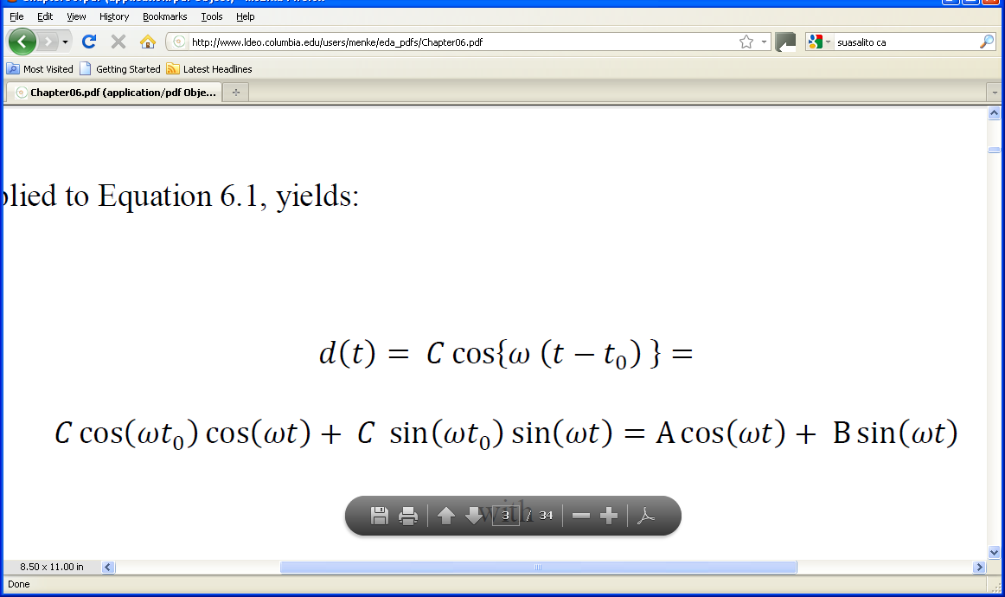
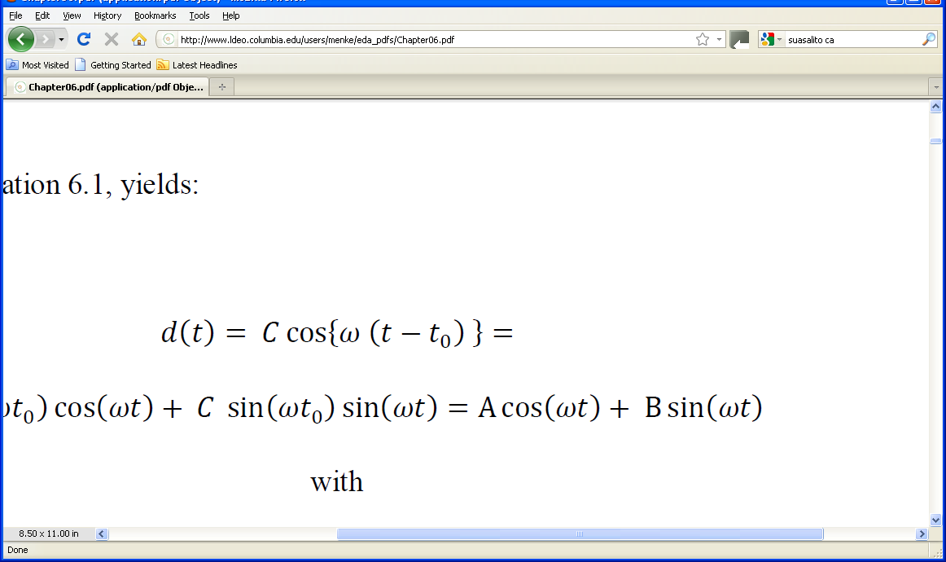
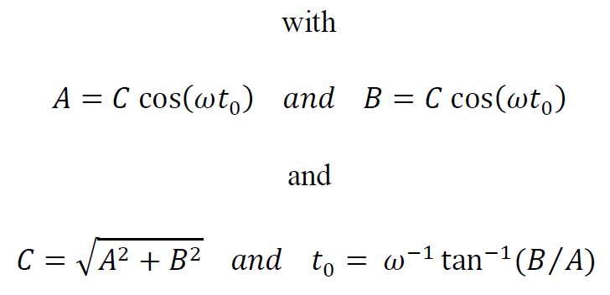
pairing sines and cosines to avoid using time delays
Notes:
Sines and cosines of the same frequency are always paired to avoid having to use explicit time shifts.

Slide 13
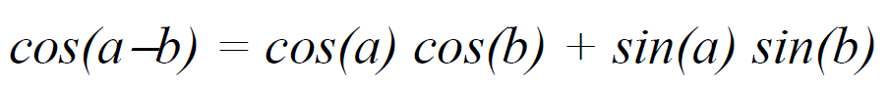
derived using trig identity
A
B
Notes:
Review the “sum identity”, if necessary.

Slide 14
A
B
A=C cos(ωt₀)
B=C sin(ωt₀)
A²=C cos² (ωt₀)
B²=C sin² (ωt₀)
A²+B²=C² [cos² (ωt₀)+sin² (ωt₀)]
= C²
Notes:
Review the “sum of squares identity”, if necessary.

Slide 15
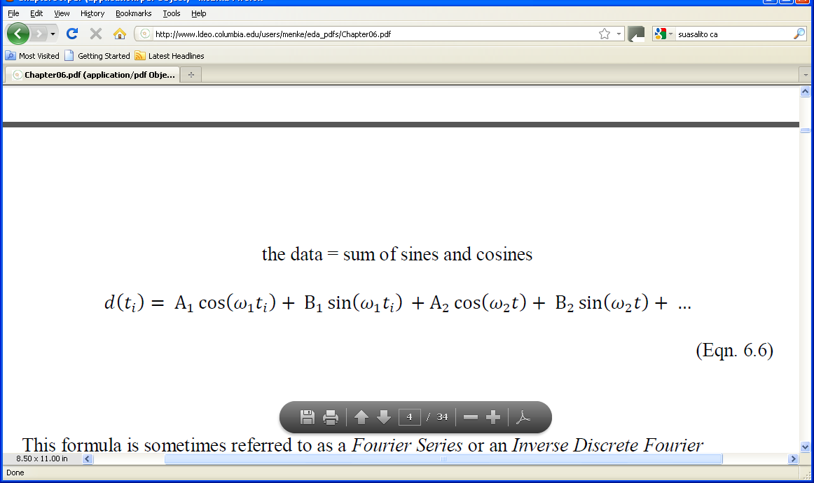
Fourier Series linear model containing nothing but sines and cosines
Notes:
Mention that this brings the discussion back techniques that they already understand, that is,
linear models and their solution by least squares.

Slide 16
A’s and B’s are model parameters
ω’s are auxiliary variables
Notes:
The A’s and B’s quantify the strength of a periodicity at a given frequency. They are the model parameters.
The ω‘s give the frequencies at which periodicities can occur.

Slide 17
two choices
values of frequencies?
total number of frequencies?

Slide 18
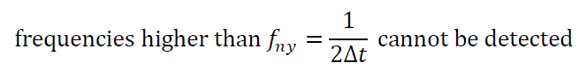
surprising fact about time series with evenly sampled data
Nyquist frequency
Notes:
This is very important.

Slide 19
values of frequencies?
evenly spaced, ω_{n} = (n-1)Δ ω
minimum frequency of zero
maximum frequency of f_{ny}
total number of frequencies? N/2+1
number of model parameters, M
= number of data, N
Notes:
Mention that zero frequency just gets you a constant, because cos(0)=1 and sin(0)=0.

Slide 20
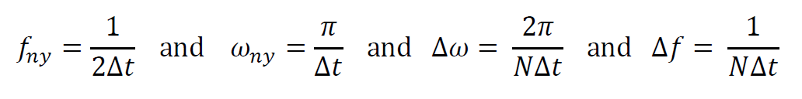
implies
Notes:
Second two formula are derived from first two by dividing by N/2.

Slide 21
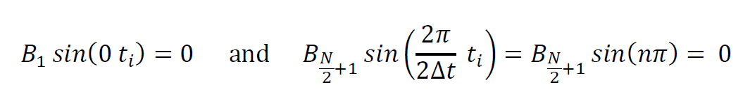
Number of Frequencies
why N/2+1 and not N/2 ?
first and last sine are omitted from the Fourier Series since they are identically zero:
Notes:
Emphasize that choice M=N (number of model parameters equal number of data) is motivated by desire to
use as many sines and cosines as possible without needing to add prior information.

Slide 22
cos(½NΔω t)
cos(0t)
cos(Δω t)
sin(Δωt)
cos(2Δω t)
sin(2Δω t)
Notes:
Idea behind a Fourier Series is that the data are a sum of these sinusoidal patterns.
Zero frequency is a constant. First non-zero frequency corresponds to one full
period over the length of the time series. Nyquist frequency is just a “cosine” that
oscillates from +1 to -1 every sample.

Slide 23
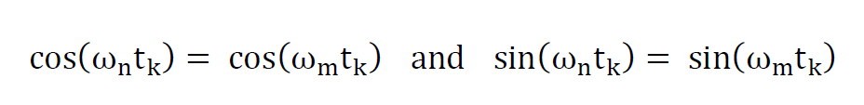
Nyquist Sampling Theorem
another way of stating it
when m=n+N
note evenly sampled times
Notes:
They key point is that two oscillations with different frequencies produce that same pattern
WHEN SAMPLED AT EVENLY SPACED TIME. They do, of course, behave differently BETWEEN
the sampled times.

Slide 24
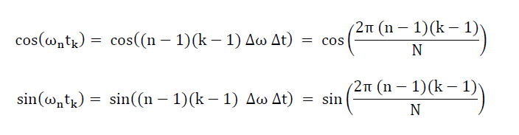
Step 1: Insert discrete frequencies and times into l.h.s. of equations.
ω_{n} = (n-1)Δ ω and t_{k} = (k-1) Δt
Notes:
First step:

Slide 25
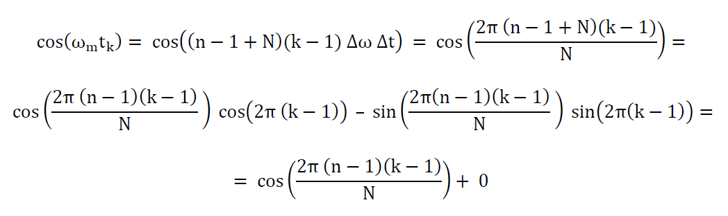
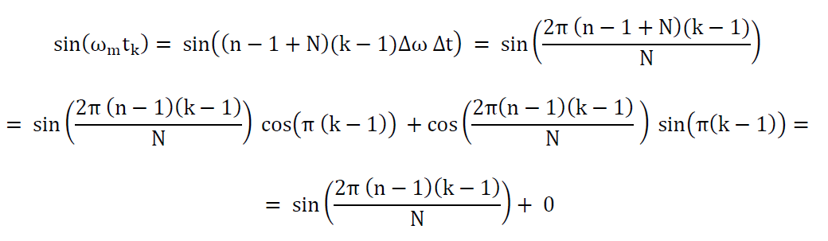
Step 2: Insert discrete frequencies and times into r.h.s. of equations.
ω_{n} = (n-1+N)Δ ω and t_{k} = (k-1) Δt

Slide 26
Step 3: Note that l.h.s equals r.h.s.
same as l.h.s.
same as l.h.s.
Notes:
Flash back one slide to verify they are the same.

Slide 27
Step 4: Identify unique region of ω-axis
when m=n+N
or when
ω_{m}=ω_{n}+2ω_{ny}
only a 2ω_{ny} interval of the ω -axis is unique
say from
-ω_{ny} to +ω_{ny}
Notes:
Note that in the next step we show only half this interval is really unique.

Slide 28
Step 5: Apply symmetry of sines and cosines
cos(ω t) has same shape as cos(-ω t)
and
sin(ω t) has same shape as sin(-ω t)
so really only the
0 to ω_{ny}
part of the ω-axis is unique

Slide 29
equivalent points on the ω-axis
ω
−ω_{ny}
0
ω_{ny}
2ω_{ny}
3ω_{ny}
Notes:
The upshot: High frequencies look like low freuencies.

Slide 30
d₁ (t) = cos(ω₁t), with ω₁=2Δω
d₁(t)
time, t
d₂(t) = cos{ω₂t}, with ω₂=(2+N)Δω,
d₂(t)
time, t
Notes:
example of aliasing, two sinusoids, when sampled at the same, evenly spaced times (circles), produce identical patterns.

Slide 31
problem of aliasing high frequencies masquerading as low frequencies solution: pre-process data to remove high frequencies before digitizing it

Slide 32
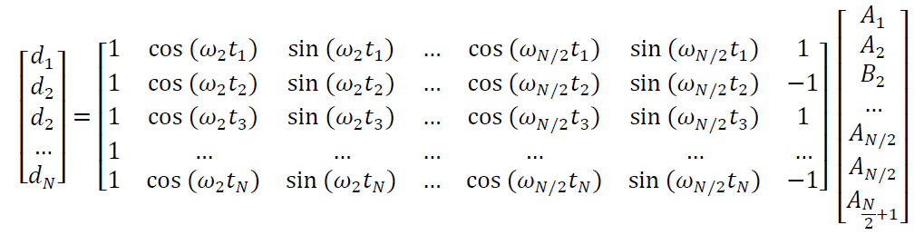
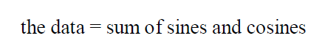
Discrete Fourier Series
d = Gm
Notes:
Here we get back to the linear problem.

Slide 33
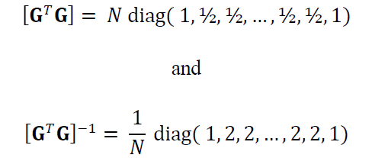
Least Squares Solution
m^{est} = [G^{T}G]⁻¹ G^{T}d
has substantial simplification
… since it can be shown that …
Notes:
We solve by least squares. But in this case, the form of [G^{T}G]⁻¹ is known analytically. This is a
substantial simplification, since there is then no need to invert at matrix.

Slide 34
frequency and time setup
in MatLab
% N = number of data, presumed even
% Dt is time sampling interval
t = Dt*[0:N-1]’;
Df = 1 / (N * Dt );
Dw = 2 * pi / (N * Dt);
Nf = N/2+1;
Nw = N/2+1;
f = Df*[0:N/2];
w = Dw*[0:N/2];

Slide 35
Building G in MatLab
% set up G
G=zeros(N,M);
% zero frequency column
G(:,1)=1;
% interior M/2-1 columns
for i = [1:M/2-1]
j = 2*i;
k = j+1;
G(:,j)=cos(w(i+1).*t);
G(:,k)=sin(w(i+1).*t);
end
% nyquist column
G(:,M)=cos(w(Nw).*t);
Notes:
First and last columns, which have only a cosine term, are handled separately from the others.
Interior columns, which have both sines and cosines, are handled in the loop.

Slide 36
solving for model parameters in MatLab
gtgi = 2* ones(M,1)/N;
gtgi(1)=1/N;
gtgi(M)=1/N;
mest = gtgi .* (G'*d);
Notes:
Note that gtgi is [G^{T}G]⁻¹.
MatLab’s intrinic Fourier Transform function, fft(), will be introduced in the next
lecture, so this form of the solution is shown only to make a connection to things done
in Chapters 4 and 5. In fact, one never needs to build G or to solve m^{est}=[G^{T}G]⁻¹G^{T}d
in this way.

Slide 37
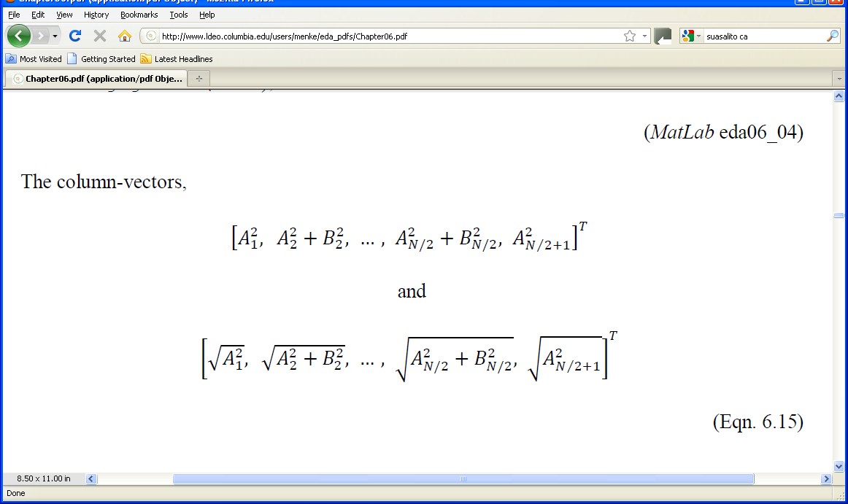
how to plot the model parameters?
A’s and B ’s
plot
against frequency
Notes:
Remind the class that A²+B²=C², the square of the amplitude of a time-shifted cosine.
This form emphasizes the overall amplitude of the oscillatory pattern, irrespective of its time-shift.

Slide 38
power spectral density
big at frequency ω when
when sine or cosine at the frequency
has a large coefficient

Slide 39
alternatively, plot
amplitude spectral density
Notes:
Plots of amplitude spectral density are useful if there are several peaks of different size, since the big
peak does not stand so high compared to power spectral density.

Slide 40
Stream Flow
Neuse River
amplitude
spectral density
all interesting frequencies near origin,
so plot period, T=1/f instead
frequency, cycles per day
60.0 days
365.2 days
amplitude
spectral density
182.6 days
period, days
Notes:
Note that the shorter periods are all integral fractions of one year. Thus, they are synchronized by the annual
cycle and are being driven by it.

