Slide 1
Environmental Data Analysis with MatLab
2nd Edition
Lecture 12:
Power Spectral Density
Notes:
Today’s lecture is develops the ideas of stationary time series and their power spectral density,
and it shows several examples of them.

Slide 2
SYLLABUS
Lecture 01 Using MatLab
Lecture 02 Looking At Data
Lecture 03 Probability and Measurement Error
Lecture 04 Multivariate Distributions
Lecture 05 Linear Models
Lecture 06 The Principle of Least Squares
Lecture 07 Prior Information
Lecture 08 Solving Generalized Least Squares Problems
Lecture 09 Fourier Series
Lecture 10 Complex Fourier Series
Lecture 11 Lessons Learned from the Fourier Transform
Lecture 12 Power Spectral Density
Lecture 13 Filter Theory
Lecture 14 Applications of Filters
Lecture 15 Factor Analysis
Lecture 16 Orthogonal functions
Lecture 17 Covariance and Autocorrelation
Lecture 18 Cross-correlation
Lecture 19 Smoothing, Correlation and Spectra
Lecture 20 Coherence; Tapering and Spectral Analysis
Lecture 21 Interpolation
Lecture 22 Hypothesis testing
Lecture 23 Hypothesis Testing continued; F-Tests
Lecture 24 Confidence Limits of Spectra, Bootstraps

Slide 3
Goals of the lecture
compute and understand
Power Spectral Density
of indefinitely-long time series
Notes:
The important distinction between this lecture and the last two is that underlying physical process
is assumed to be indefinitely long, even though we may have measured only a small portion of it.

Slide 4
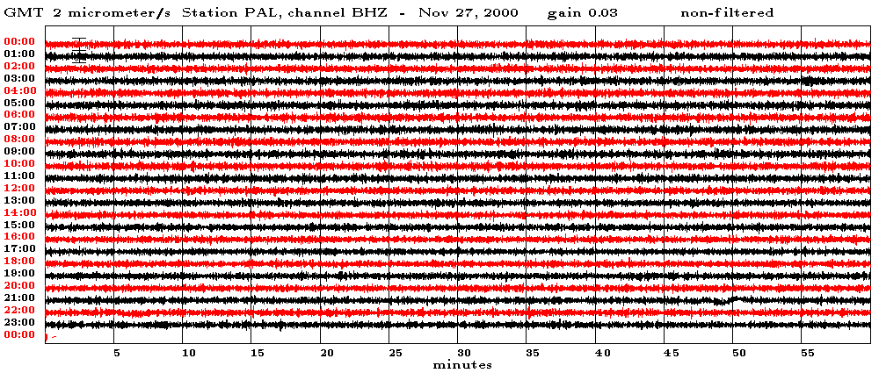
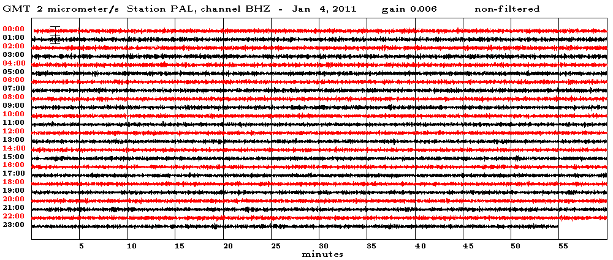
Nov 27, 2000
ground vibrations at the Palisades NY seismographic station
time, minutes
Jan 4, 2011
time, minutes
similar appearance of measurements separated by 10+ years apart
Notes:
This is a time series of ground vibration at Palisades NY.
It’s a seismic record, but no earthquakes are shown, just the time between earthquakes.
Each record is half an hour long, and shows slight up and down motion of the ground caused
by a variety of non-earthquake sources, such as wind and ocean waves.
The two records, though separated by more than ten years, look similar.
This is the basic idea behind the concept of stationarity.

Slide 5
stationary time series
indefinitely long
but
statistical properties don’t vary with time
Notes:
You might enumerate other examples of stationary time series.
Air temperature would be a good example, because it is stationary over time periods of hundreds
to thousands of years. Even so, it is not stationary through a longer period of time that includes
the ice ages, and may not be stationary into the future because of global warming.

Slide 6
assume that we are dealing with a fragment of an indefinitely long time series
time, minutes
time series, d
duration, T
length, N
Notes:
What we measure is just a little piece of an times series that goes on and on …

Slide 7
one quantity that might be stationary is …

Slide 8
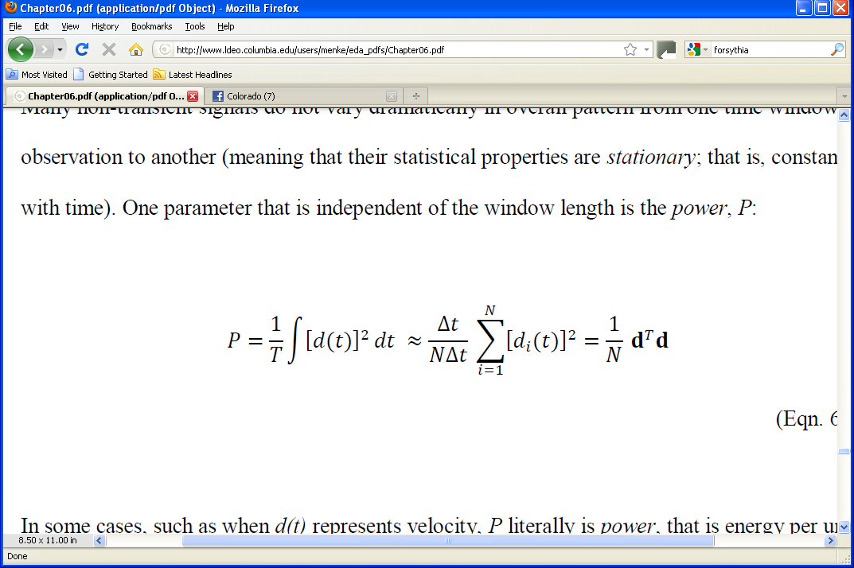
“Power”
T
0
Notes:
The word “power” is used in an abstract sense.
Only in some special cases, such as where d(t) represents the velocity of an object,
is “power” literally proportional to “energy per unity time”.

Slide 9
Power
T
0
mean-squared amplitude of time series
Notes:
Note that if the time series has zero mean, then the formula for power
identical in formula for its variance.

Slide 10
How is power related to
power spectral density ?
Notes:
The next few slides establishes that there is a close relationship.
That’s why its called POWER spectral density.

Slide 11
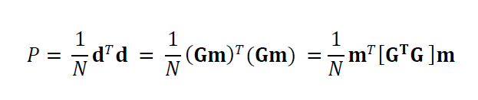
write Fourier Series as d = Gm were m are the Fourier coefficients

Slide 12
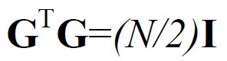
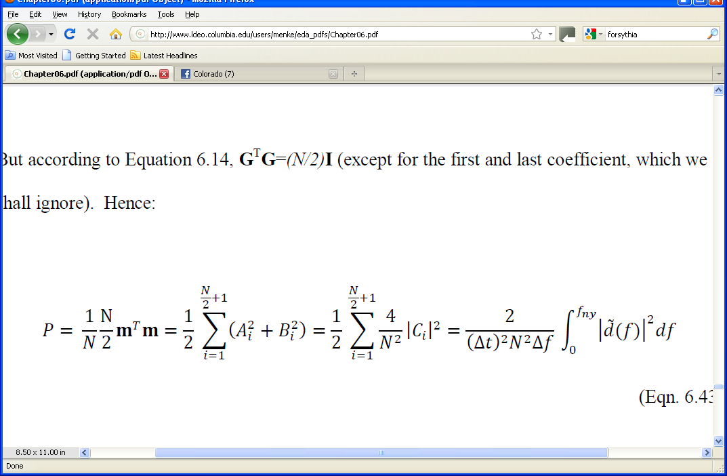
now use
Notes:
The top formula was presented in Lecture 9.
The version here is not correct at zero frequency or at the Nyquist frequency.
However, we will normally assume that the time series has zero mean (and hence
no zero-frequency component) and that there is negligible power exactly at the
Nyquist frequency. In that case, not error is introduced.
A completely correct formula is easy to derive, but must treat zero frequency
and the Nyquist frequency separately.

Slide 13
now use
coefficients of complex exponentials
coefficients of sines and cosines
equals 2/T
Fourier Transform
Notes:
The important result here is that the total power P is related to the
integral over frequency of the Fourier Transform.

Slide 14
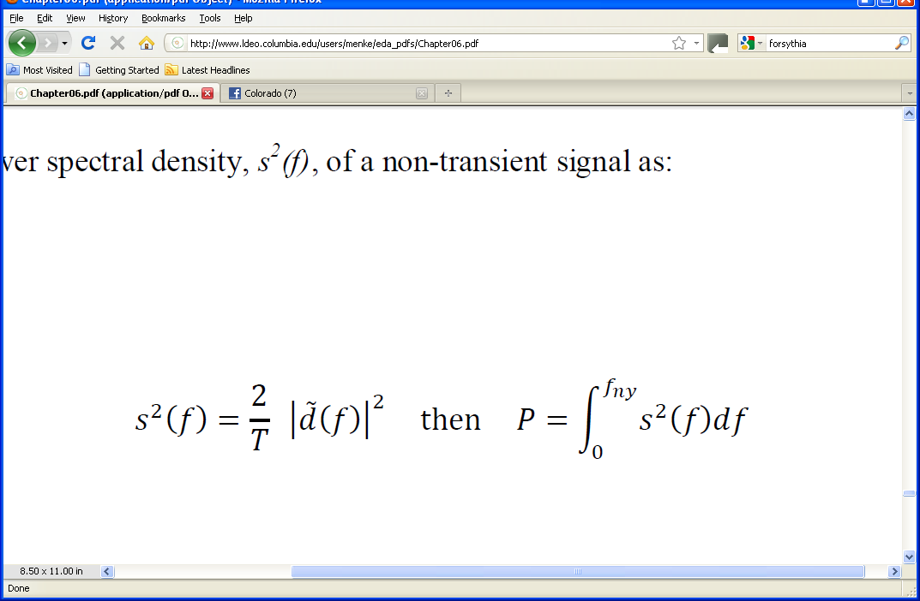
so, if we define the power spectral density of a stationary time series as
the integral of the p.s.d. is the power in the time series
Notes:
The total power is the area under the power spectral density.

Slide 15
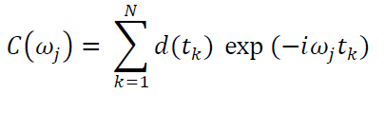
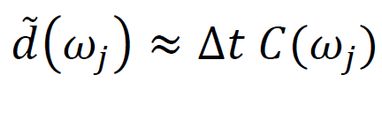
units
if time series d has units of u
coefficients C also have units of u
Fourier Transform has units of u×time
power spectral density has units of u²×time²/time
e.g. u²-s
or equivalently u²/Hz
Notes:
The u²/Hz version seems more natural than the u²-s version,
since one normally thinks of integrating the p.s.d. over frequency
to obtain the total power.

Slide 16
we will assume that the power spectral density is a stationary quantity

Slide 17
when we measure the power spectral density of a finite-length time series, we are making an estimate of the power spectral density of the indefinitely long time series the two are not the same because of statistical fluctuation
Notes:
No calculation based on a short section of time series can completely capture the properties
of the underlying, indefinitely long physical process.

Slide 18
finally we will normally subtract out the mean of the time series so that power spectral density represents fluctuations about the mean value
Notes:
Sometimes, the mean value is of little significance.
For example, when observing ocean tides by measuring the level of the water on a dock,
one can use a completely arbitrary reference level, such as a line painted on the side
of a dock.

Slide 19
Example 1
Ground vibration at Palisades NY
Notes:
The seismometer actually measures the vertical component of ground velocity, in micometers per second.

Slide 20
enlargement
Notes:
Ask the class to gauge by eye the typical period of these oscillations.

Slide 21
enlargement
periods of a few seconds

Slide 22
power spectral density
Notes:
Point out the units of u²/Hz where u is micrometers/s.
Ask the class to estimate by eye the frequency range where most of the energy is concentrated.
Have them convert it to a period and compare with their pervious estimate.

Slide 23
power spectral density
frequencies of a few tenths of a Hz
periods of a few seconds
Notes:
Students should be encourages to practice switching back and forth
between “period” and “frequency”. Both are useful.
remind them that period=1/frequency.

Slide 24
cumulative power
power in time series
Notes:
Only a limited frequency range, 0.2-0.4 Hz, contributes most of the power.

Slide 25
Example 2
Neuse River Stream Flow
Notes:
The Neuse River hydrograph shows stream flow for a roughly 11 year period.
Ask the class to identify the periodicity (1 year) and its cause (seasonal fluctuations in precipitation).

Slide 26
Example 2
Neuse River Stream Flow
period of 1 year

Slide 27
power spectral density, s²(f)
power spectra density
s²(f), (cfs)² per cycle/day
frequency f, cycles/day
Notes:
Ask the class to measure by eye the frequency of the main spectral peak.
While they will not be able to measure it precisely enough to determine whether it
corresponds to a period of 1 year, they should be able to at least tell whether it is
in the right ball park (it is).

Slide 28
power spectral density, s²(f)
power spectra density
s²(f), (cfs)² per cycle/day
frequency f, cycles/day
period of 1 year

Slide 29
Example 3
Atmospheric CO₂
(after removing anthropogenic trend)
Notes:
This is the Hawaii CO2 record, with the anthropogenic increase modeled by a parabola and
removed from the record.
Ask the class to estimate the period of the oscillation by counting the number of cycles in a
5 year period and dividing by 5. They should get a period of 1 year.
Discuss why the record has a annual cycle.

Slide 30
enlargement
Notes:
Note that the oscillations are not exactly sinusoidal in shape.
They rise more slowly than they fall.

Slide 31
enlargement
period of 1 year
Notes:
The period is one year.

Slide 32
power spectral density
frequency, cycles per year
Notes:
Note the logarithmic scale!
The power spectral density has two peaks.
Ask the class to measure their frequecy (and period) by eye.

Slide 33
power spectral density
1 year period
½ year period
frequency, cycles per year

Slide 34
Notes:
The sinusoids of the 1-year (red) and one-half-year (blue) oscillations are
shown superimposed on the actual signal.

Slide 35
shallow side: 1 year and ½ year out of phase
steep side: 1 year and ½ year in phase
Notes:
The red and blue sinusoids are out of phase as CO2 rises, so the rise is slowed down.
The red and blue sinusoids are in phase as CO2 falls, so the fall is speeded up.
In general, a function that has a period T but is not sinusoidal in shape, will be represented
as a sum of sinusoids of period T, T/2, T/3 …

Slide 36
cumulative power
power in time series
Notes:
The annual cycle contributes most of the power.

Slide 37
Example 3:
Tides
90 days of data
Notes:
The actual measurement is the elevation of the sea surface, in feet.

Slide 38
enlargement
7 days of data
Notes:
Have the students measure by eye the period.

Slide 39
enlargement
period of day½
7 days of data
Notes:
Period is ½ day, the semi-diurnal tide.

Slide 40
power spectral density
cumulative power
power in time series
Notes:
Have the class estimate the periods of the major peaks.
Note that there is a peak at about 2 cycles per day, it is much wider than in the previous examples.
The resaon is that there are actually several closely-spaced peak. The two biggest are the principal
semidurnal lunar tide (period of 12.42 hours) and the principal semidiurnal solar tide (period of
12.00 hours), but there are about ten small ones that arise due to the complicated physics of tides.
The same thing is true of the diurnal tides.

Slide 41
power spectral density
about
½ day period
fortnighly
(2 wk)
tide
about
1 day period
cumulative power
power in time series
Notes:
The semidiurnal (12 hr) tide typically contributes the most power.

Slide 42
MatLab
Fourier Transform
dtilde= Dt*fft(d-mean(d));
dtilde = dtilde(1:Nf);
psd = (2/T)*abs(dtilde).^2;
delete negative frequencies
power spectral density
Notes:
Note that the mean is removed from the time series

Slide 43
MatLab
power as a function of frequency
pwr=df*cumsum(psd);
Pf=df*sum(psd);
Pt=sum(d.^2)/N;
total power
should be the same!
total power
Notes:
The cumsum() function creates a running sum of the elements of a vector.
It is used here to approximate an indefinite integral.

