Slide 1
Environmental Data Analysis with MatLab
2nd Edition
Lecture 18:
Cross-correlation
Notes:
Today’s lecture expands the idea of correlations within time series to correlations between time series.

Slide 2
SYLLABUS
Lecture 01 Using MatLab
Lecture 02 Looking At Data
Lecture 03 Probability and Measurement Error
Lecture 04 Multivariate Distributions
Lecture 05 Linear Models
Lecture 06 The Principle of Least Squares
Lecture 07 Prior Information
Lecture 08 Solving Generalized Least Squares Problems
Lecture 09 Fourier Series
Lecture 10 Complex Fourier Series
Lecture 11 Lessons Learned from the Fourier Transform
Lecture 12 Power Spectra
Lecture 13 Filter Theory
Lecture 14 Applications of Filters
Lecture 15 Factor Analysis
Lecture 16 Orthogonal functions
Lecture 17 Covariance and Autocorrelation
Lecture 18 Cross-correlation
Lecture 19 Smoothing, Correlation and Spectra
Lecture 20 Coherence; Tapering and Spectral Analysis
Lecture 21 Interpolation
Lecture 22 Linear Approximations and Non Linear Least Squares
Lecture 23 Adaptable Approximations with Neural Networks
Lecture 24 Hypothesis testing
Lecture 25 Hypothesis Testing continued; F-Tests
Lecture 26 Confidence Limits of Spectra, Bootstraps
Notes:
24 lectures

Slide 3
Goals of the lecture
generalize the idea of autocorrelation
to multiple time series
Notes:
The key idea is that points in one time series can be correlated to points in a different time series, and the
idea of covariance can be applied to quantify the correlation.

Slide 4
Review of last lecture autocorrelation correlations between samples within a time series
Notes:
Last lecture we derived the autocorrelation function.
It expresses the degree of correlation of two points in a time series, separated by a lag,
Up to a multiplicative constant, it is just the covariance.

Slide 5
high degree of short-term correlation what ever the river was doing yesterday, its probably doing today, too because water takes time to drain away
Notes:
Time series usually differ in the degree of correlation of points with different lags.
Usually, points with small lags are highly correlated.

Slide 6
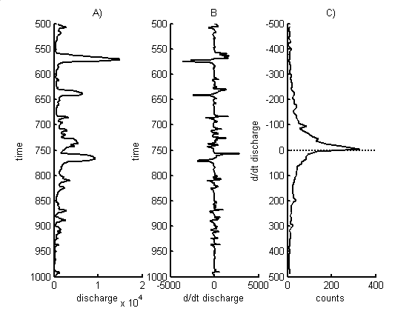
Neuse River Hydrograph
A) time series, d(t)
d(t), cfs
time t, days
Notes:
Pairs of points (red) separated by a few days tend to have the same value.

Slide 7
low degree of intermediate-term correlation what ever the river was doing last month, today it could be doing something completely different because storms are so unpredictable
Notes:
The correlation decreases as the lag increases.

Slide 8
Neuse River Hydrograph
A) time series, d(t)
d(t), cfs
time t, days
Notes:
Pairs of points (red) separated by a month tend to have different values.
Some are high-high, some hi-low, so the correlation averages out to near-zero.

Slide 9
moderate degree of long-term correlation what ever the river was doing this time last year, its probably doing today, too because seasons repeat

Slide 10
Neuse River Hydrograph
A) time series, d(t)
d(t), cfs
time t, days
Notes:
Pairs of points (red) separated by a year tend to have similar values.
Because of the precipitation has an annual cycle.

Slide 11
1 day
3 days
30 days
Notes:
The scatter plot is more linear (meaning more highly correlated) for the shorter lags.

Slide 12
Autocorrelation Function
1
3
30
Notes:
Autocorrelation function of the Neuse River hydrograph. The 1, 3, and 30 day correlations
from the previous slide are highlighted in red.

Slide 13
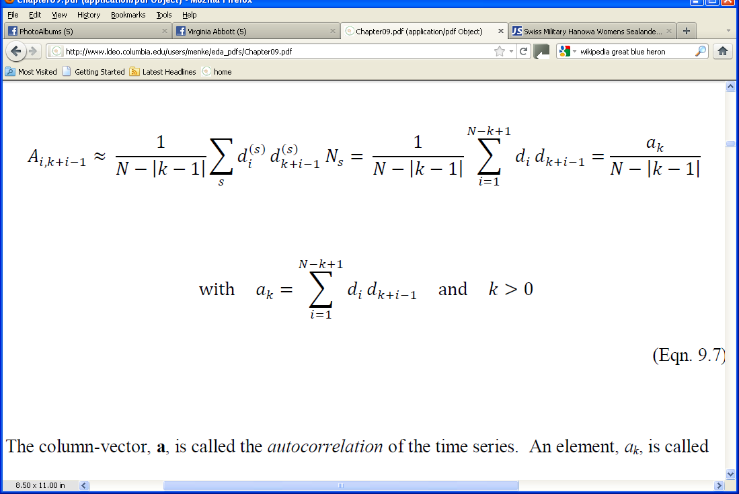
formula for covariance
Notes:
This is the formula for the autocorrelation. Point out that two data values, lagged by time (k-1)Δt are multiplies,
and then all such data values are summed.

Slide 14
formula for autocorrelation
autocorrelation
at lag (k-1)Δt
Notes:
The autocorrelation is itself a time series, where the interpretation of time is lag-time

Slide 15
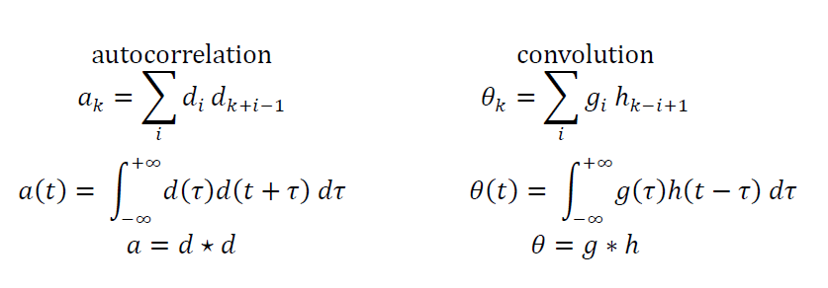
autocorrelation similar to convolution
Notes:
The formula for the autocorrelation is very similar to the formula for the convolution.
Note that we have written an integral version, modeled after the integral version of the convolution.
We use a five-pointed start to indicate autocorrelation, an asterisk to indicate convolution.

Slide 16
autocorrelation similar to convolution
note difference in sign
Notes:
The only difference is the sign.

Slide 17
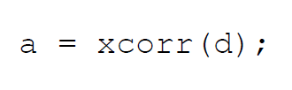
autocorrelation in MatLab
Notes:
MatLab computes the autocorrelation with just one command.

Slide 18
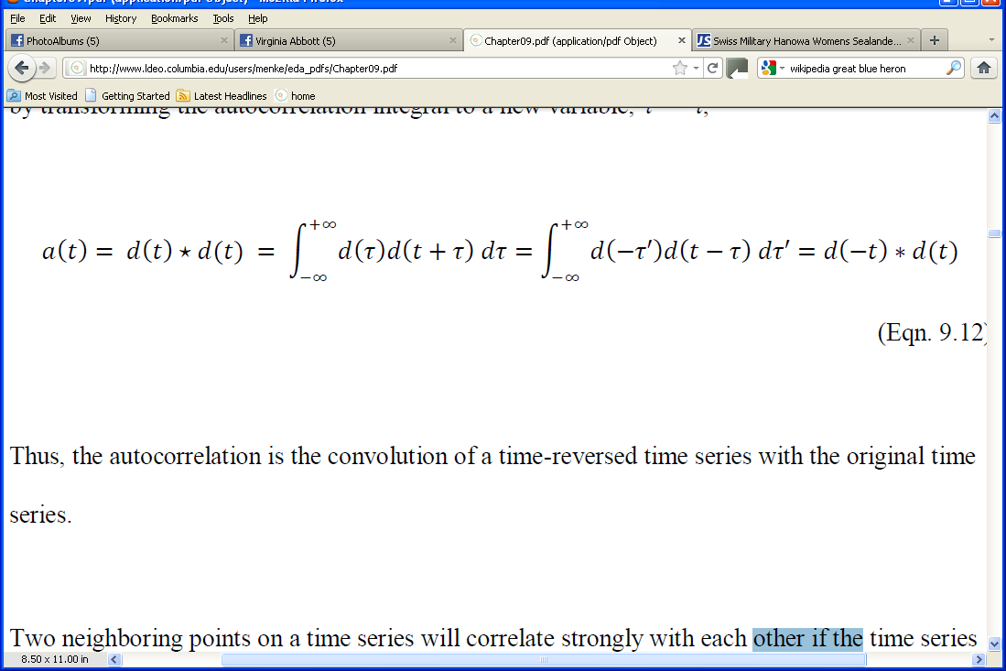
Important Relation #1 autocorrelation is the convolution of a time series with its time-reversed self
Notes:
Because the formula for the autocorrelation is so similar to the formula for the convolution,
there is a really simple relationship between the two.

Slide 19
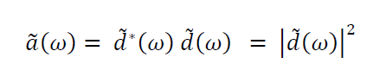
Important Relationship #2
Fourier Transform of an autocorrelation is proportional to the
Power Spectral Density of time series
Notes:
This is very similar to the convolution theorem.

Slide 20
End of Review

Slide 21
Part 1 correlations between time-series

Slide 22
scenario discharge correlated with rain but discharge is delayed behind rain because rain takes time to drain from the land
Notes:
Ask the class to imagine the rain and discharge time series that correspond to this scenario.

Slide 23
rain, mm/day
time, days
dischagre, m³/s
time, days
Notes:
Here’s a hypothetical version.

Slide 24
rain, mm/day
time, days
rain ahead of
discharge
dischagre, m³/s
time, days
Notes:
The peak in discharge is delayed behind the peak in rain.

Slide 25
rain, mm/day
time, days
shape not exactly the same, either
dischagre, m³/s
time, days
Notes:
The shape of the two time series is not exactly the same. Rain tend to be spikier.

Slide 26
treat two time series u and v probabilistically
p.d.f.
p(u_{i}, v_{i+k-1})
with elements lagged by time
(k-1)Δt
and compute its covariance
Notes:
Point out that the time series must be stationary for the covariance to depend only on the lag.

Slide 27
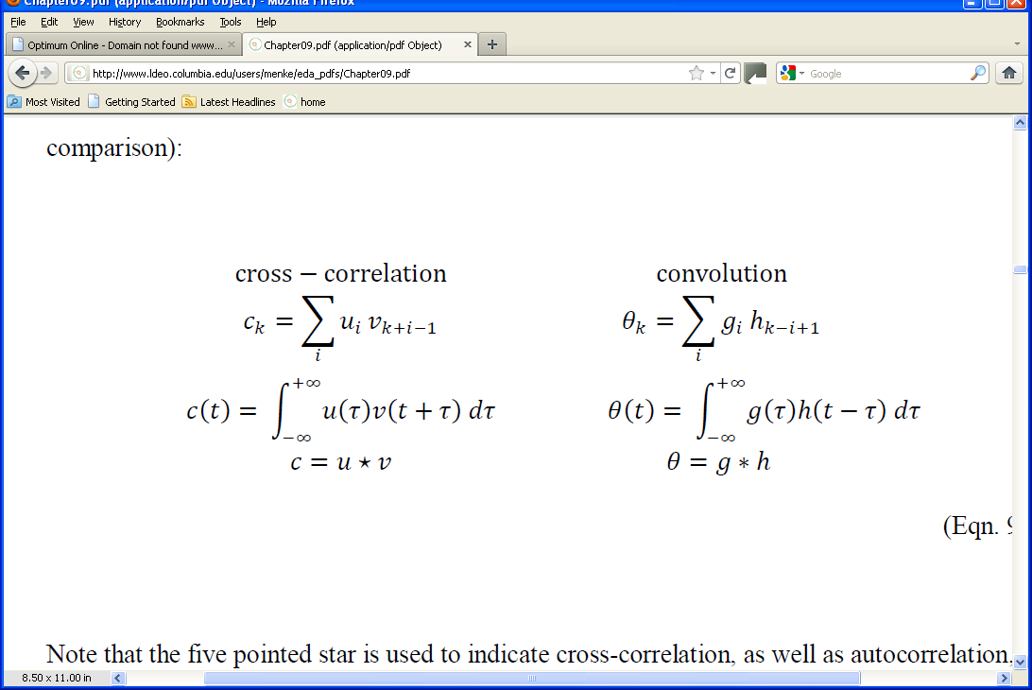
this defines the cross-correlation

Slide 28
just a generalization of the auto-correlation
different times in different time series
different times in the same time series
Notes:
autocorrelation is just a time-series cross-correlated with itself.

Slide 29
like autocorrelation, similar to convolution
Notes:
We use a five-pointed start to indicate cross-correlation, an asterisk to indicate convolution.

Slide 30
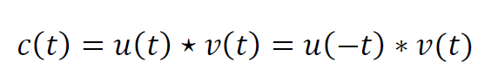
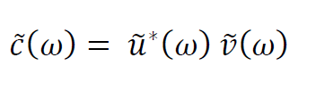
As with auto-correlation two important properties
#1: relationship to convolution
#2: relationship to Fourier Transform
Notes:
You might show on the board that if you set u=v=d, that is, use the same time series
for both u and v, you get the rules that we worked out previously for the autocorrelation.
Emphasize that autocorrelation is just a special case of cross-correlation.

Slide 31
As with auto-correlation two important properties
#1: relationship to convolution
#2: relationship to Fourier Transform
cross-spectral density
Notes:
We will demonstrate one of the uses of the cross-spectral density when we talk about coherence.

Slide 32
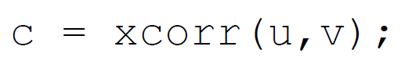
cross-correlation in MatLab
Notes:
Cross-correlation is implemented with a single function, the same function as autocorrelation.

Slide 33
Part 2 aligning time-series a simple application of cross-correlation
Notes:
In many cases, you want to know the delay of one time series behind another.
Once you know the delay, you can plot the time series so that they are lined up.

Slide 34
central idea
two time series are best aligned
at the lag at which they are most correlated,
which is
the lag at which their cross-correlation is maximum
Notes:
Point out that the two time series don’t have to be identical for this to work.
The merely have to track each other approximately, once aligned:
high values on average line up with high values.
low values on average line up with low values.

Slide 35
two similar time-series, with a time shift
(this is simple “test” or “synthetic” dataset)
u(t)
v(t)
Notes:
Point out the importance of testing a method with a “test” or “synthetic” dataset with known properties. Here the
times series contain a simple oscillatory function with known time lags superimposed upon random noise.

Slide 36
cross-correlate
Notes:
Here’s the cross-correlation, computed with the MatLab xcorr() function.

Slide 37
find maximum
maximum
time lag
Notes:
It’s the time lag of the maximum that’s of interest.

Slide 38
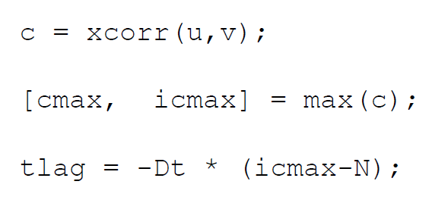
In MatLab
Notes:
Here’s the MatLab script that computes the time lag needed to best-align the time series.

Slide 39
In MatLab
compute cross-correlation
Notes:
Point out that it makes a difference whether you compute xcorr(u,v) or xcorr(v,u).
One is the time-reversed version of the other.

Slide 40
In MatLab
compute cross-correlation
find maximum
Notes:
Remind students that the max() function returns both the value of the maximum and the
index at which the maximum value occurs. In our case, it is the latter value, the lag, that is
of interest.

Slide 41
In MatLab
compute cross-correlation
find maximum
compute time lag
Notes:
The zero-lag element is in the middle of the cross-correlation time series
c, hence the somewhat complicated formula for the time lag.

Slide 42
align time series with measured lag
u(t)
v(t+t_{lag})
Notes:
In this case the procedure recovers exactly the known time lag.

Slide 43
solar insolation and ground level ozone
(this is a real dataset from West Point NY)
A)
B)
Notes:
Introduce this datset:
(Top) Hourly solar radiation data, in W/m², from West Point, NY, for fifteen days starting August 1, 1993.
Point out that the energy delivered by the sun to the top of the atmosphere is 1366 W/m². These
values are somewhat less, presumably because the sun is not directly overhead at the latitude of NY,
and because of shading by clouds.
(Bottom) Hourly tropospheric ozone data, in parts per billion, from the same location and time period.
Ask for a volunteer to describe what ozone is and why we care about it. The text provides this synopsis:
We apply this technique to an air quality dataset, in which the objective is to understand the diurnal fluctuations
of ozone (O₃). Ozone is a highly reactive gas that occurs in small (parts per billion) concentrations in the earth’s
atmosphere. Ozone in the stratosphere plays an important role in shielding the earth’s surface from
ultraviolet (UV) light from the sun, for it is a strong UV absorber. But its presence in the troposphere at ground
level is problematical. It is a major ingredient in smog and a health risk, increasing susceptibility to
respiratory diseases. Tropospheric ozone has several sources, including chemical reactions between
oxides of nitrogen and volatile organic compounds in the presence of sunlight and high temperatures.
We thus focus on the relationship between ozone concentration and the intensity of sunlight (that is,
of solar radiation).
Note the strong diurnal periodicity in both time series. Peaks in the ozone lag peaks in solar radiation (see vertical line)

Slide 44
solar insolation and ground level ozone
B)
note time lag
Notes:
Ask for a volunteer from the class to explain what ozone is and why we care about it.
Ozone is produced by solar radiation interacting with the atmosphere. Ozone builds up during the course of the day,
so its concentration lags sunlight (as quantified by solar insolation).
Hourly solar radiation data, in W/m², from West Point, NY, for fifteen days starting August 1, 1993. B) Hourly tropospheric ozone data, in parts per billion, from the same location and time period. Note the strong diurnal periodicity in both time series. Peaks in the ozone lag peaks in solar radiation (see vertical line)

Slide 45
maximum
C)
time lag
3 hours
Notes:
This is the same procedure as was applied to the synthetic data.

Slide 46
A)
original
B)
delagged
Notes:
The dotted curve is the “delagged” version of the ozone data.
Point out that it now lines up pretty welll with the solar radiation.

