Slide 1
Environmental Data Analysis with MatLab
2nd Edition
Lecture 21:
Interpolation
Notes:
Today’s lecture treats the subject of interpolation.

Slide 2
SYLLABUS
Lecture 01 Using MatLab
Lecture 02 Looking At Data
Lecture 03 Probability and Measurement Error
Lecture 04 Multivariate Distributions
Lecture 05 Linear Models
Lecture 06 The Principle of Least Squares
Lecture 07 Prior Information
Lecture 08 Solving Generalized Least Squares Problems
Lecture 09 Fourier Series
Lecture 10 Complex Fourier Series
Lecture 11 Lessons Learned from the Fourier Transform
Lecture 12 Power Spectra
Lecture 13 Filter Theory
Lecture 14 Applications of Filters
Lecture 15 Factor Analysis
Lecture 16 Orthogonal functions
Lecture 17 Covariance and Autocorrelation
Lecture 18 Cross-correlation
Lecture 19 Smoothing, Correlation and Spectra
Lecture 20 Coherence; Tapering and Spectral Analysis
Lecture 21 Interpolation
Lecture 22 Linear Approximations and Non Linear Least Squares
Lecture 23 Adaptable Approximations with Neural Networks
Lecture 24 Hypothesis testing
Lecture 25 Hypothesis Testing continued; F-Tests
Lecture 26 Confidence Limits of Spectra, Bootstraps
Notes:
24 lectures

Slide 3
Goals of the lecture
to introduce
Interpolation
the process of filling in missing data points
Notes:
We have already encountered interpolation (or at least something very close to it)
in Lecture 8, as an application of generalized least squares. Today’s lecture deals
with more “traaditional” forms of interpolation.

Slide 4
Scenario 1: data are collected at irregular time intervals, but you want to compute power spectral density, which requires evenly sampled data.
A(t)
0
1
2
time
?
psd
frequency
Notes:
A common scenario where interpolation is handy is converting an irregularly
sampled data set into one with even sampling, so that the standard tools of
a spectral analysis can be applied. Note, however, that the new Δt must be
chosen sensibly, so as not to artificially increase the Nyquist frequency. If
one were to make the Δt very small, the Nyquist frequency would become
very high. But the high-frequency portion of the spectrum would then be
almost entirely unconstrained by the data. You would be just fooling yourself.

Slide 5
Scenario 2: two datasets are collected with different sampling intervals, but you want to combine them into a scatter plot
A(t)
1
2
B(t)
0
1
2
time
?
B
A
Notes:
A common scenario where interpolation is handy is changing the sampling
of two data sets to a common time base. The two data sets can then be more
easily compared, for instance, by a scatter plot. Once again, the choice of
the new Δt must be sensible or else the results are likely to be misleading.

Slide 6
in both scenarios the times that the data are collected at are inconvenient
Notes:
From this point of view, interpolation is about making the sampling of the data convenient.
A purist might point out that these sort of issues should have been thought through before
the data were collected.

Slide 7
we encountered a problem similar to this one back in Lecture 8, where we used prior information to fill in data gaps
Notes:
You can only estimate the data at a time at which you didn’t measure it by
using some kind of prior information about its general behavior – smoothness,
for example.

Slide 8
observed data with missing points
d^{obs}(t)
0
1
2
time
estimated data with missing points filled in
d^{est}(t)
0
1
2
time
Notes:
The top plot is a time series with a few missing points.
In the bottom plot, the points have been filled in using the
Generalized Least Square methodology of Lecture 8.

Slide 9
find d_{i}^{est} so that d_{i}^{est} ≈ d_{i}^{obs} at the observation points and roughness of d_{i}^{est} ≈ 0 everywhere
Notes:
Generalized least squares minimized a combination of the prediction error
(top) and error in prior information (bottom). Both were satisfied only
approximately.

Slide 10
the solution is inexact d_{i}^{est} ≠ d_{i}^{obs} everywhere and roughness of d_{i}^{est} ≠ 0 everywhere
Notes:
If its approximate, then it isn’t exact.

Slide 11
but the inexactness isn’t a problem because both observations and prior information have error
Notes:
The inexactness is not necessarily a problem, because you do not know the
data exactly anyway, but only up to measurement error. Similarly, the prior
information isn’t exact either. We only know that the data is “sort of” smooth.

Slide 12
now we examine an alternative approach traditional interpolation similar, but subtly different
Notes:
One of the characteristic of traditional interpolation is that the data will be fit
exactly. At first this seems a virtue, until you realize that you are exactly fitting
noise.

Slide 13
find d(t) so that d(t_{i}) = d_{i}^{obs} at the observation points and roughness of d(t) = 0 in between the observation points
Notes:
The data are satisfied exactly,
and the prior information is satisfied in between the data points.

Slide 14
find d(t) so that d(t_{i}) = d_{i}^{obs} at the observation points and roughness of d(t) = 0 in between the observation points
exact
exact
Notes:
Again, both exactly.

Slide 15
find d(t) so that d(t_{i}) = d_{i}^{obs} at the observation points and roughness of d(t) = 0 in between the observation points
“interpolant”
Notes:
The key concept in traditional interpolation is the interpolant, a function
that goes through the data and can be evaluated at ant time, t.

Slide 16
disadvantage the observation points are singled out as special
advantage
interpolant d(t) is an analytic function that is known everywhere
Notes:
You might see if the class can suggest some ways in which an analytic interpolant can be put to work.

Slide 17
disadvantage the observation points are singled out as special
advantage
interpolant d(t) is an analytic function that is known everywhere
can evaluate d(t) at any time, t
can differentiate d(t), integrate it, etc.
d(t) behaves differently at the observation points than between them
Notes:
In most data collection scenarios, the observation times are not special in any way. So there is
no reason that the function should behave differently at the observation times than between them.
If it does behave differently, then there is something artificial about it.

Slide 18
the interpolation problem
find an interpolant
d(t)
that goes through all the data points
and
“does something sensible”
or
“satisfies some prior information”
between them
Notes:
Again, only the availability of prior information makes this possible.

Slide 19
some obvious ideas don’t work at all
an (N-1) order polynomial can easily be constructed to that it passes through N points
so use a polynomial for d(t)
Notes:
To see how this might work, start with the polynomial
d = m₁ + m₂ t + m₃ t² + … + m_{N} t^{(N-1)}
where the m’s are unknown coefficients. Now
evaluate the polynomial at the N observation points
d_{i} = m₁ + m₂ t_{i} + m₃ t_{i}² + … + m_{N} t_{i}^{(N-1)}
and write as a matrix equation of form
d = Gm
Here G is a matrix of powers of t_{i}. In this case, G is square, so the solution is
m = G⁻¹ d

Slide 20
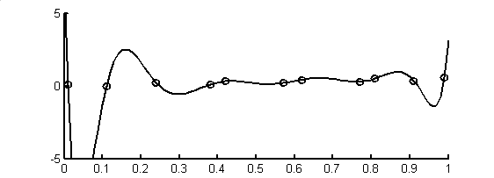
example
d(t)
time, t
Notes:
Presumably this is enough to convince everyone that interpolating data using
a high order polynomial is usually a terrible idea.

Slide 21
example
d(t)
what happened here?
and here?
time, t
Notes:
Note the overshoots.

Slide 22
solution
a low-order polynomial
has less potential for wild swings
so use many low-order polynomial
each valid in a small time interval
such a function is called a “spline”
Notes:
Spline – an interpolant constructed by pasting together many simple functions,
each valid over a small interval of time.

Slide 23
simplest case
set of linear polynomials
each valid between two data points
“connect the data points with straight lines”
Notes:
Most plotting software performs linear interpolation …

Slide 24
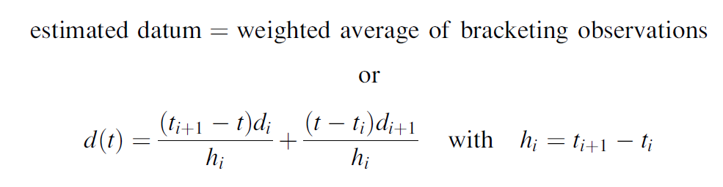
d(t)
d
t
t_{i}
t_{i+1}
Notes:
Point out that the first term is 1 when t=t_{i}, and 0 when t=t_{i}+1.
Similarly, the second term is 0 when t=t_{i}, and 1 when t=t_{i}+1.
Thus the interpolant varies linearly from d_{i} to d_{i+1}.

Slide 25
disadvantage
advantages
conceptually very simple
always get what you expect
zero roughness between observations
d(t) has kinks at observation points
Notes:
My advice: use linear interpolation for everything where the presence of a kink doesn’t matter.
However, one place that kinks are really bad is spectral analysis, because they introduce spurious
high frequencies into the data.

Slide 26
example
d(t)
time, t
Notes:
You might flash back to the polynomial interpolation for comparison. The data and plotting scales are the same.

Slide 27
example
kink
d(t)
time, t
Notes:
But is does introduce kinks …

Slide 28
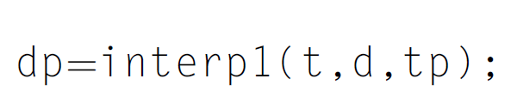
in MatLab
observations
times of interpolation
interpolated observations
Notes:
Pretty simple in MatLab.

Slide 29
getting rid of the kinks
use cubic polynomials
S_{i}(t) = c₀ + c₁ t + c₂ t² + c₃ t³
each valid between two data points

Slide 30
cubic polynomial has 4 coefficients
two constrained by need to pass through two data
two to implement prior information
no kinks in d(t) or its first derivative

Slide 31
the trick second derivative of cubic is linear so use linear interpolation formula for second derivative

Slide 32
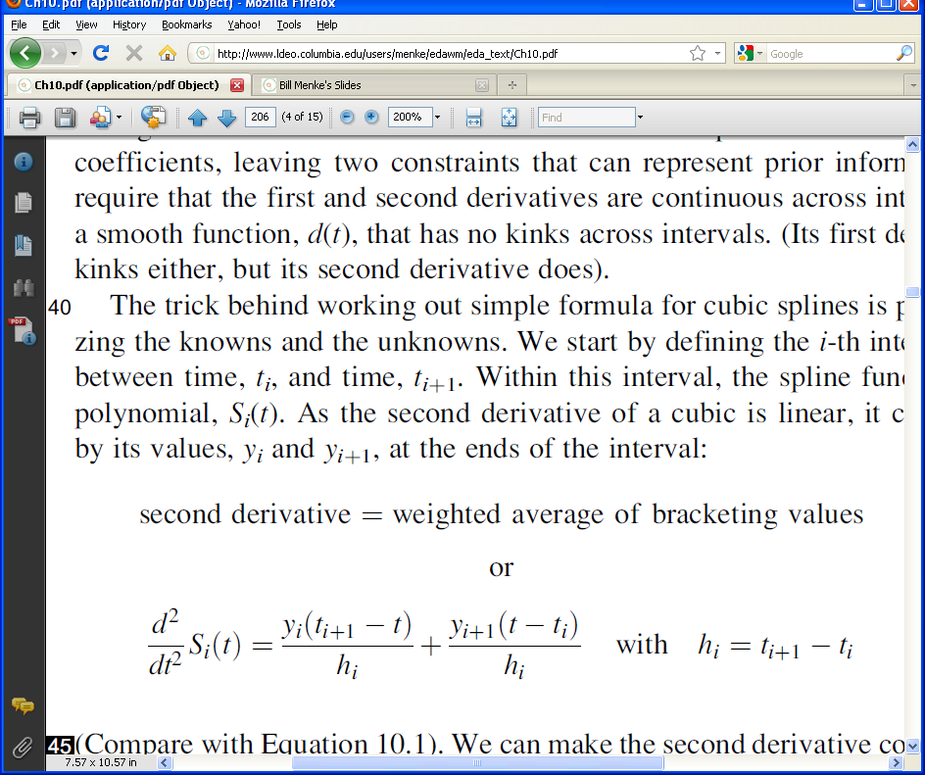
y_{i+1}
2nd derivative
y_{i}
y_{i-1}
t
t_{i-1}
t_{i}
t_{i+1}
Notes:
Flash back to compare with the linear interpolation formula.

Slide 33
y_{i+1}
2nd derivative
y_{i}
y_{i-1}
t
t_{i-1}
t_{i}
t_{i+1}
the second derivative at the observation points, denoted y_{i}, become an unknown in the problem
Notes:
The y’s are the second derivative of the spline at the observation point. They are initially unknown.

Slide 34
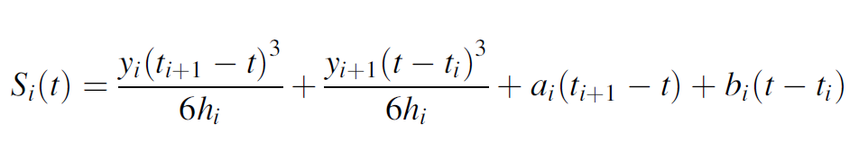
the second derivative is now integrated twice to give the spline function
here a_{i} and b_{i} are two more unknowns that arise from the integration constants
Notes:
A linear function, twice integrated, is a cubic. It will have two integration constants, one for each integral.

Slide 35
finally one finds the y’s, a’s and b’s so that the spline
1. goes through the observations and
2. has a first derivative that is continuous across the observation points

Slide 36
the solution involves solving a matrix equation for the unknowns
(see text for details)
Notes:
I’m leaving out the details of the solution in this lecture, for lack of time.
It’s enough for the students to get the sense that standard methods can be used to solve for the coefficients.

Slide 37
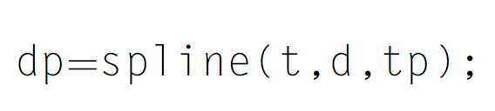
in MatLab
observations
times of interpolation
interpolated observations
Notes:
In MatLab, its just as easy as linear interpolation.

Slide 38
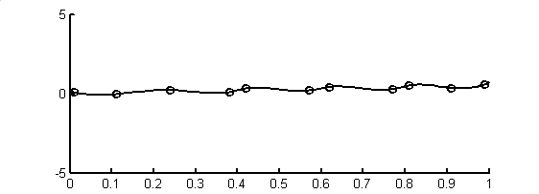
example
d(t)
time, t
Notes:
A little smoother than linear interpolation, but other than that, it looks about the same.

Slide 39
example
no kinks
d(t)
time, t
Notes:
No kinks.

Slide 40
interpolation involves prior information of smoothness
Notes:
Again, whenever we interpolate, we are making assumptions about the general behavior of the data
not constrained by the obsevratons.

Slide 41
in generalized least-squares
the prior information of smoothness is quantified by a roughness matrix, H
Hm
then we minimize the overall roughness, which is to say the overall error in the prior information
(Hm)^{T} (Hm)
Notes:
In the example in Lecture 8, the matrix H contained second derivatives, and had rows
that looked like [ 0, 0, … 0, -1, 2, -1, 0, … 0]

Slide 42
note that
(Hm)^{T} (Hm) = m^{T} (H^{T}H) m
but in generalized error also has the form
m^{T} C_{m}⁻¹ m
where C_{m}⁻¹ is a covariance matrix
so in this case
C_{m} = (H^{T}H)⁻¹
Notes:
The point here is that there is a connection between the
somewhat ad hoc notion of minimizing roughness
and the more general idea of minimizing an error that is
weighted by the inverse of a covariance matrix.

Slide 43
so the prior information that the data are smooth is equivalent to the requirement that they have a specific covariance matrix which for stationary time series is equivalent to saying that they have a specific autocorrelation function
Notes:
Instead of thinking about a smooth interpolant,
think about one that has a specific autocorrelation function.

Slide 44
so an alternative, more flexible way of interpolating data is by specifying the autocorrelation function that we want the results to have this is called Kriging
(after Danie G Krige, its inventor)

Slide 45
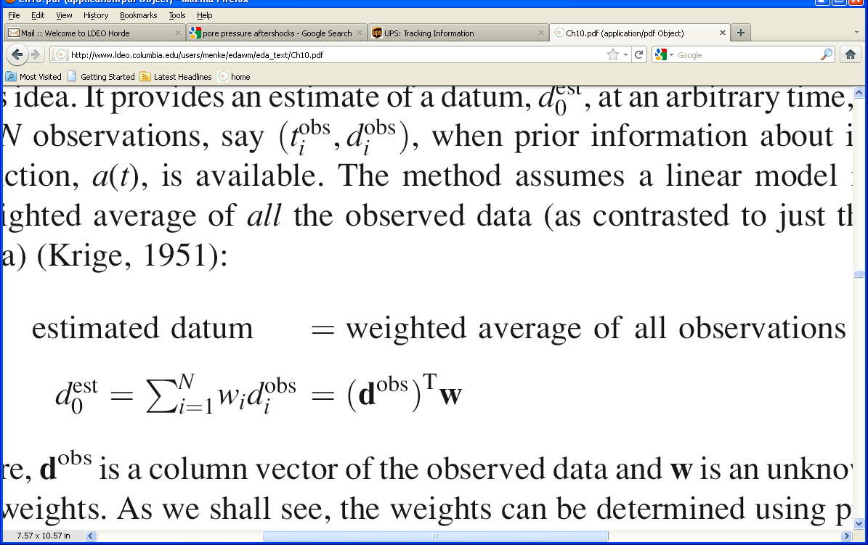
Kriging
estimate data at arbitrary time t₀
Notes:
Note the difference from linear and cubic splines, in that we use all observations, not just the bracketing ones.

Slide 46
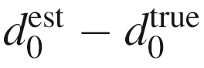
determine weights w
by
minimizing the variance of
with respect to w_{i}
we’ll find that we don’t need to know d₀^{true}
only its autocorrelation
Notes:
The unknown in this problem is the weights, w.

Slide 47
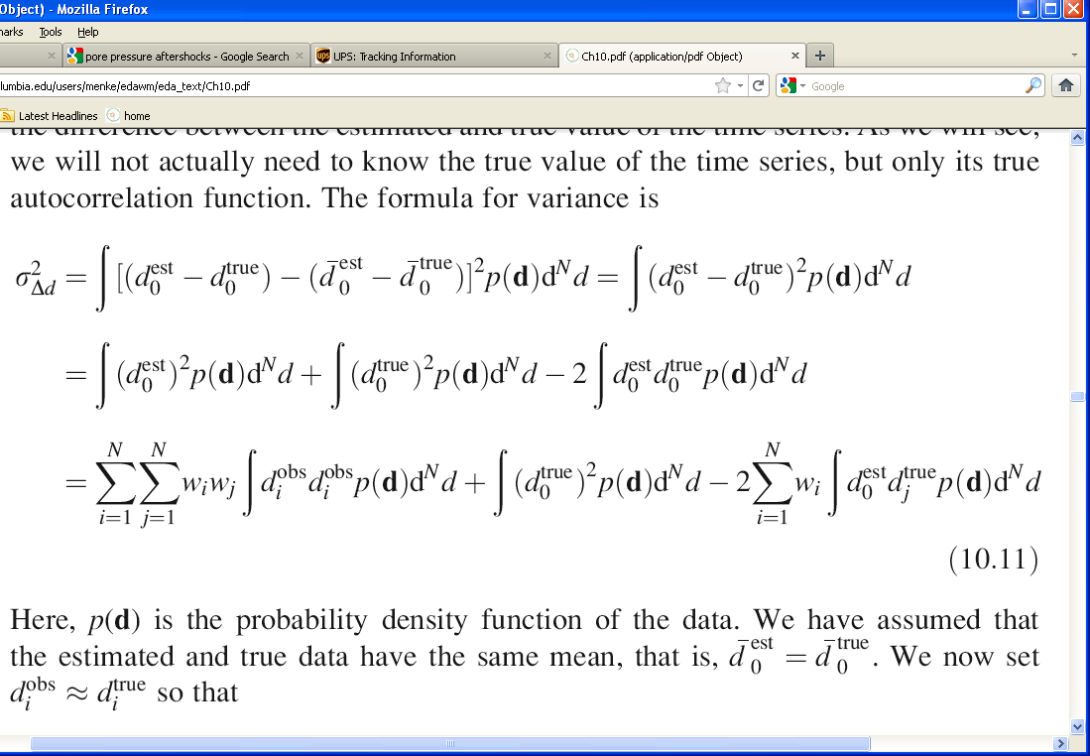
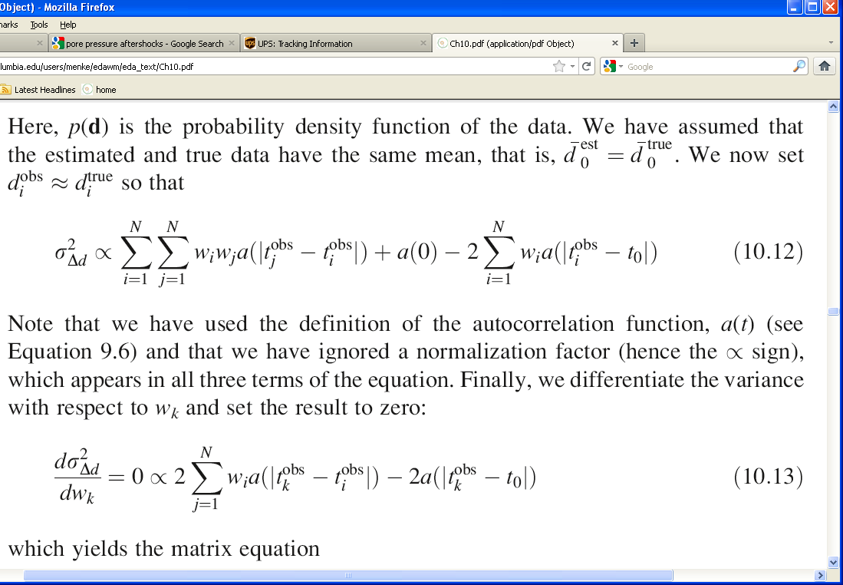
j
assuming
and
Notes:
This is a step-by step derivation.
The first term is the usual integral for the variance, for the variable (d₀^{est}-d₀^{true}).

Slide 48
means approximately cancel
j
assuming
and
Notes:
Assume that observed and true means are approximately equal, so that they cancel.

Slide 49
means approximately cancel
expand square
j
assuming
and
Notes:
Expand the square in the previous integral

Slide 50
means approximately cancel
expand square
insert weighted average formula
j
assumming
and
Notes:
Now substitute in the weigthted average formula.

Slide 51
means approximately cancel
expand square
insert weighted average formula
j
identify terms proportional to autocorrelation
assumming
and
Notes:
Finally, identify the integrals as formulas for the covariance of two data, lagged with respect to each other.
In these integrals, don’t distinguish the observed and true data; assume they have approximately the same effect.
Finally, interpret the covariance as the autocorrelation function (up to a normalization, hence the proportional sign).

Slide 52
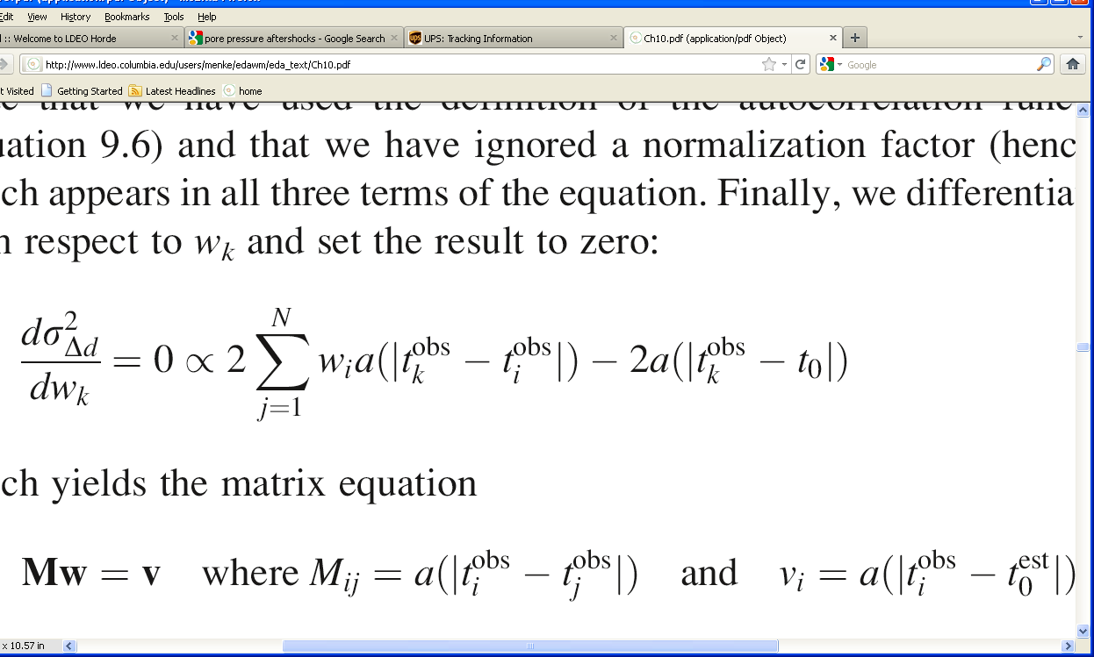
now differentiate with respect to the weight, w_{k}
which yields the matrix equation
Mw = v
Notes:
the rest is just standard minimization by taking a derivative and setting the results to zero.
The matrix M is just the autocorrelation function evaluated at the lags associated with the observations.
The vector v is just the autocorrelation function evaluated at lags associated with the point at which the interpolant is evaluated.

Slide 53
now differentiate with respect to the weight, w_{k}
which yields the matrix equation
Mw = v
note that the autocorrelation appears on both sides of the equation, so that its overall normalization cancels out
Notes:
So we don’t have to concern ourselves with the amplitude of the autocorrelation, just its shape.

Slide 54
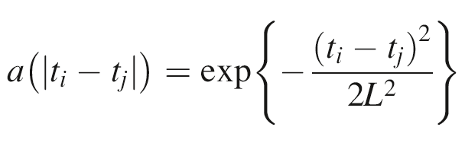
all we need now do is specify an autocorrelation function for example we could use the Normal function
the variance, L², controls the width of the autocorrelation and hence the smoothness of the interpolation
Notes:
Here’s one possible autocorrelation function, a normal function of variance L².
It implies that the data is smooth over a scale length, L.

Slide 55
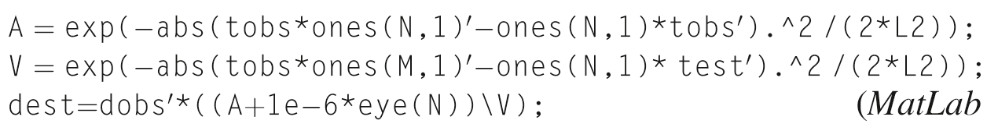
In MatLab
observations: t^{obs}, d^{obs}
interpolated values: t^{est}, d^{est}
Normal autocorrelation function with variance L²
Notes:
Just three lines of code in Matlab … not bad!

Slide 56
Example
A) Kriging
B) Generalized Least Squares
d(t)
d(t)
d(t)
time, t
time, t
Notes:
Example of filling in data gaps using Kriging. A) Kriging using prescribed Normal autocorrelation fucntion. B) Generalized least squares result from Chapter 5.

Slide 57
Interpolation in two-dimensions
construct an interpolant
d(x,y)
that goes through the observations
and
does something sensible in between
Notes:
Interpolation is two (or more) dimensions is conceptually the same as in 1D. But there is a significant complication …

Slide 58
1 dimensions
notion of bracketing observations more complicated
y₀
d
y₀
t
t₀
x
x₀
2 dimensions
Notes:
In 1D, it’s easy to identify the data points that bracket a given point.
It’s not so easy in 2D …

Slide 59
1 dimensions
notion of bracketing observations more complicated
y
triangular tile
d
y₀
t
t_{i}
t_{i+1}
t₀
x
segment of t-axis
x₀
2 dimensions
Notes:
Triangles are only one possible way – the simplest - of dividing the (x,y) plane up into tiles.
Once its done, then the vertices of the enclosing triangle brackets the point.

Slide 60
Delaunay triangles
set of most equilateral triangles connecting data points
Notes:
MatLab’s interpolation functions use Delaunay triangulations, but mostly ‘behind the scenes”.
So its sufficient for students to simply know that they exist.
Students should be aware that they have lots of uses besides interpolation, and are not
particularly difficult to manipulate using MatLab. Some of the functions are introduced
briefly in the text.

Slide 61
A) Observations
B) Delaunay triangles
x
x
y
y
Notes:
Left. Data points, positioned according to their (x_{i},y_{i}) values and with
grey level indicating the value of d_{i}.
(Right) Delaunay triangulation

Slide 62
A) Observations
B) Delaunay triangles
x
x
y
y
triangle enclosing a point of interest

Slide 63
C) Linear Splines
D) Cubic Splines
x
x
y
y
Notes:
Results of MatLab 2D interpolation function.
C) Linear interpolation of the pressure data. D) Cubic spline interpolation of the pressure data.

Slide 64
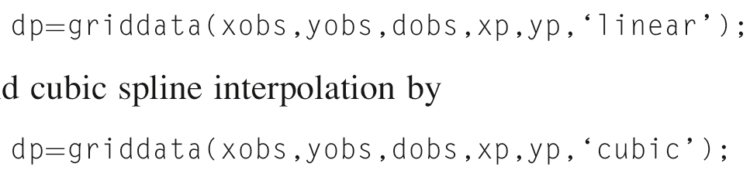
In MatLab
linear splines
cubic splines
Notes:
Note: griddata() is apparently being depreciated. You may wish to teach students
how to use triscatteredinterp() instead, even though it is somewhat more complicated
to use.

