Slide 1
Environmental Data Analysis with MatLab
2nd Edition
Lecture 22:
Linear Approximations
and
Non Linear Least Squares
Notes:
Today’s lecture continues the subject of Hypothesis Testing.

Slide 2
SYLLABUS
Lecture 01 Using MatLab
Lecture 02 Looking At Data
Lecture 03 Probability and Measurement Error
Lecture 04 Multivariate Distributions
Lecture 05 Linear Models
Lecture 06 The Principle of Least Squares
Lecture 07 Prior Information
Lecture 08 Solving Generalized Least Squares Problems
Lecture 09 Fourier Series
Lecture 10 Complex Fourier Series
Lecture 11 Lessons Learned from the Fourier Transform
Lecture 12 Power Spectra
Lecture 13 Filter Theory
Lecture 14 Applications of Filters
Lecture 15 Factor Analysis
Lecture 16 Orthogonal functions
Lecture 17 Covariance and Autocorrelation
Lecture 18 Cross-correlation
Lecture 19 Smoothing, Correlation and Spectra
Lecture 20 Coherence; Tapering and Spectral Analysis
Lecture 21 Interpolation
Lecture 22 Linear Approximations and Non Linear Least Squares
Lecture 23 Adaptable Approximations with Neural Networks
Lecture 22 Hypothesis testing
Lecture 23 Hypothesis Testing continued; F-Tests
Lecture 24 Confidence Limits of Spectra, Bootstraps
Notes:
24 lectures

Slide 3
Goals of the lecture
learn how to make linear approximations
of non-linear functions
apply liner approximations to error estimation
apply liner approximations to least squares
Notes:
This is an generalization of the often heard “nonsense in – nonsense out’” rule”: Noisy data in,
imprecise conclusions out.

Slide 4
Taylor Series and Linear Approximations
Notes:
Many students will have encountered Taylor series in courses in elementary calculus. Our treatment here emphasizes their importance as a form of approximation.

Slide 5
polynomial approximation to a function y(t)
in the neighborhood of a point t₀
Notes:
The idea here is to design a polynomial yp(t) that is a good approximation to the arbitrary function y(t) in the neighborhood of the point t0. The formula is just a polynomial of indefinite order, with coefficients c0, c1, c2, etc. The trick is to determine these coefficients.

Slide 6
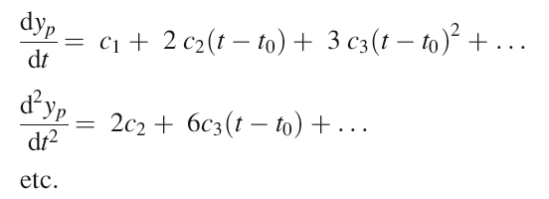
polynomial approximation to a function y(t)
in the neighborhood of a point t₀
find coefficients by taking derivatives
Notes:
Here , we compute the derivatives of the polynomial.

Slide 7
polynomial approximation to a function y(t)
in the neighborhood of a point t₀
evaluate at t₀
0
find coefficients by taking deriatives
0
0
Notes:
Note that when the functions and its derivatives are evaluated at t0, each is proportional to a single constant. yp(t0)=c0; dyp/dt evaluated at t0 is c1, etc.

Slide 8
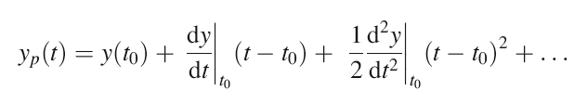
polynomial approximation to a function y(t)
in the neighborhood of a point t₀
Notes:
Substituting these values for the c’s yields the polynomia.

Slide 9
polynomial approximation to a function y(t)
in the neighborhood of a point t₀
Taylor series
Notes:
Which is called a Taylor Series

Slide 10
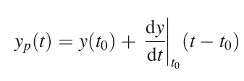
Taylor Series
Linear approximation
≈
Notes:
A linear approximation to the function y(t) uses just the first two terms of the Taylor Series.

Slide 11
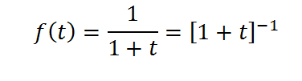
example
Notes:
An example of the Taylor series expansion of a simple function

Slide 12
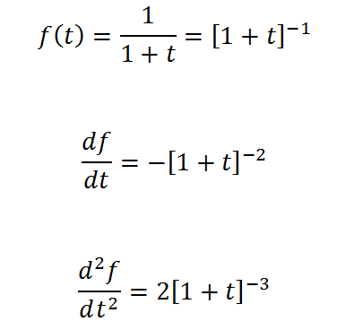
example
Notes:
Compute the derivatives. You should mention that the chain rule is being used.

Slide 13

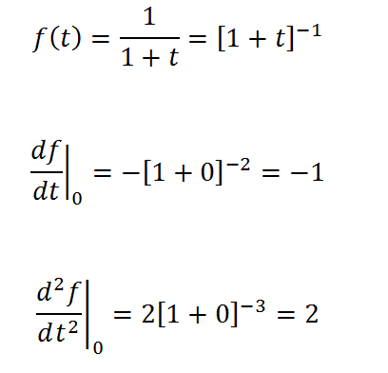

example
Notes:
Evaluate the derivatives at t0=0

Slide 14
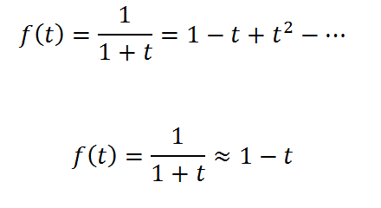
example
Linear approximation
Notes:
The Taylor series (top). The linear approximation is just the first two terms.

Slide 15

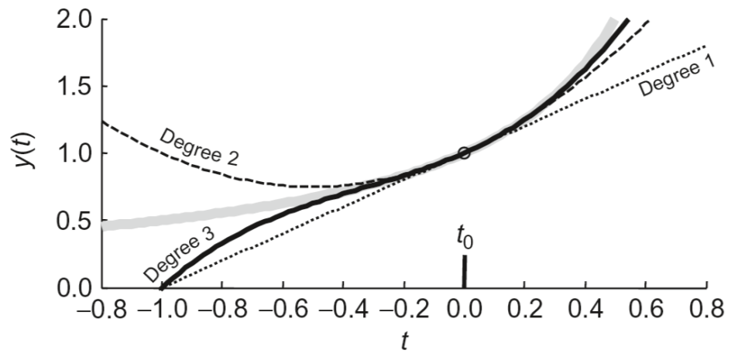
Notes:
The exact function is in grey. The point t0=0 is shown with a vertical bar. The degree 1 (linear), degree 2 and degree 3 approximations are shown in black. Note that the approximations are very good, close to the point t0.

Slide 16
example: distances on a sphere
(λ₁,L₁)
(λ₂,L₂)
r
measured in terms of central angle, r
Notes:
Another example, involving measuring distances on a sphere. Lambda and L are latitude and longitude, respectively. Note that distances are quantified by their central angle, r.

Slide 17






exact formula: 6 trig functions
approximate formula: 1 trig function and 1 square root
Notes:
The exact formula for distance r is derived using spherical tigonometry and is complicated. Involving 6 trig functions. When the distance is small (that is, in the neighborhood of lambda1=lamnbda2 and L1=L2), first order approximations can be used to represent all the trig functions. The resulting approximate formula is simpler. Furthermore, the first two terms can be identified as a ‘flat – earth’ Euclidian distamce. The third term is a correction to the Euclidian distance that accounts for the curvature of the sphere.

Slide 18
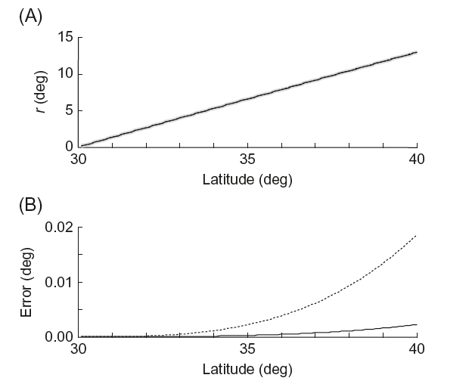
(λ₂,L₂=0)
(λ₁=0,L₁=0)
linear
quadratic
Notes:
(Top) Two points with a longitude of zero but with different latitudes. (top) The approximate distance (solid) agrees well with the exact distance (grey). (bottom) The error for the first order (linear) and second order (quadratic) approximations is small, but does grow with di

Slide 19
application to estimates of variance
Notes:
Scatter of data around its mean can analyzed using a linear approximation, as long as the scatter is only a small percentage of the mean.

Slide 20
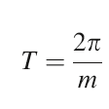
spectral analysis scenario
measure angular frequency, m
want confidence bounds on corresponding period, T
Notes:
Example: presume that we estimate the angular frequency of a process. We know its mean and variance. What is the mean and variance of the period?

Slide 21
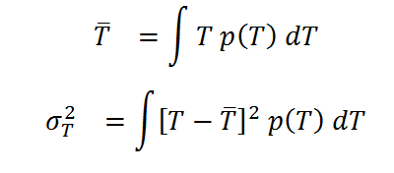
exact (but difficult) method
assume m is Normally-distributed, p(m)
work out the distribution p(T)
compute its mean and variance by integration
Notes:
We know the ‘right way’ to do this. View period T as a function of angular frequency m, and transform p(m) to p(T). Then compute the mean and variance of p(T). The only problem is that both steps are complicated.

Slide 22
approximate (and easy) method
assume m is Normally-distributed with mean m^{est}
work out a linear approximation of T in neighborhood of m^{est}
use formula for error propagation for a linear functions
Notes:
An alternative is to linearise the period of angular frequency function about the estimated angular frequency and then use the simple formula for variance propagation in a linear system.

Slide 23
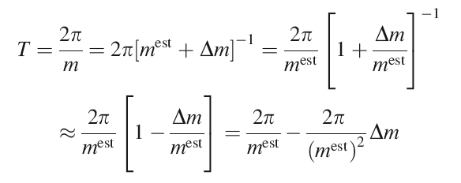

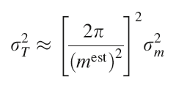


consider small fluctuations about the estimated angular frequency
T^{est}
so
Notes:
Expand the formula for period around the point m=mest. Here Delta m quantifies small deviations of m from mest.
The resulting formula gives Delta T as a constant times Delta M. The variances are then related by the constant squared.

Slide 24
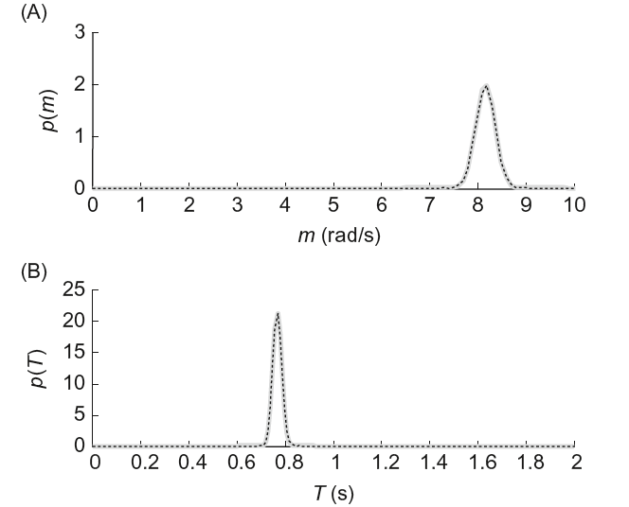
Notes:
(Top) Probability distribution p(m) (Bottom) Probability distribution p(T) computed exactly (grey) and via linear approximation (dashed) are in very good agreement.

Slide 25
application to least squares

Slide 26

Goal
Solve non-linear problems of the form
by generalized least squares
Notes:
An extremely important application of linear approximations is solving least squares problems in which the predicted data are nonlinear functions of the model parameters.

Slide 27
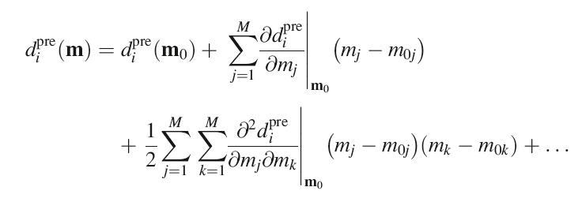
Taylor series of predicted data
Notes:
Taylor series when both independent variable m and dependent variable d are vectors. Here we are expanding about a point m0. The formula is similar to the univariate case, but involves sums of derivatives.

Slide 28

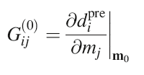

Taylor expansion of predicted data
with
and
Notes:
(top) The first two terms are the linear approximation. Written in terms of vectors, and the deviation Delta m, the formula looks a lot like the standard linear formula d=Gm, especially after identifying the first derivative as a linearized data kernel matrix G.

Slide 29
Taylor expansion of predicted data
linearized equation
with
and
Notes:
The linearized equation.

Slide 30
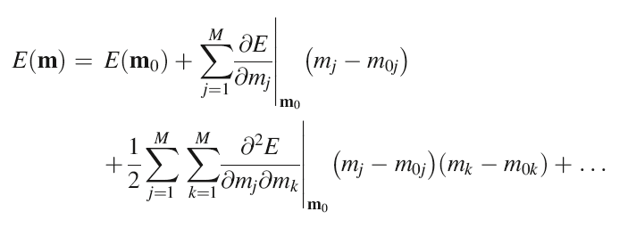
Taylor expansion of total error
Notes:
Similarly, the total error E can be written in as a Taylor series in model parameters m, expanded around a point m0.

Slide 31

Taylor expansion of total error
Notes:
This can be written in matrix form using a vertcor b of first derivatives and a matrix B of second derivatives.

Slide 32
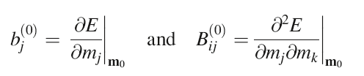
Taylor expansion of total error
gradient
vector
curvature
matrix
Notes:
We will call the vector b the gradient vector and the matrix B the curvature matrix.

Slide 33
linearized least squares
Notes:
To derive linearized least squares, we start with a quadratic approximation for the total error.

Slide 34

linearized least squares
minimize error
Notes:
The least squares solution is the one that minimizes the total error. The first derivative of error is zero at this point.

Slide 35

linearized least squares
minimize error
Notes:
Taking the first derivative of the error and setting it to zero yields a formula for Delta m.

Slide 36

linearized least squares
minimize error
linear theory
Notes:
Let’s examine this result in the special case of a linear theory.

Slide 37
linearized least squares
minimize error
linear theory
Notes:
The least squares error is ..

Slide 38
linearized least squares
minimize error
linear theory
Notes:
We can identify m0, b and B by comparison with the original formula.

Slide 39

linearized least squares
minimize error
linear theory
Notes:
Putting it all together yields (of course) simple least squares.

Slide 40

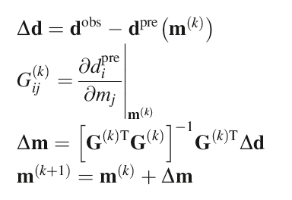
linearized least squares
guess for the solution
Notes:
This suggest an approach for solving a nonlinear least squares problem. Start by guessing a solution.

Slide 41
linearized least squares
trial solution
deviation of data from
prediction of trial solution
Notes:
See how well the solution fits the data. This defines a deviation Delta d.

Slide 42
linearized least squares
trial solution
deviation of data from
prediction of trial solution
linearized data kernel
Notes:
Compute the linearized data kernel, the first derivatives of the theory evaluated at the guess.

Slide 43
linearized least squares
trial solution
deviation of data from
prediction of trial solution
linearized data kernel
correction
to solution
Notes:
Solve for a correction Delta m to the guess using simple least suqares.

Slide 44
linearized least squares
trial solution
deviation of data from
prediction of trial solution
linearized data kernel
correction
to solution
updated solution
Notes:
Update the guess

Slide 45
linearized least squares
repeat
Notes:
Repeat and hope the process converges

Slide 46




prior information
written in terms of the unknown
=
Notes:
Linear prior information is easy to add. First write it as a function of Delta m.

Slide 47
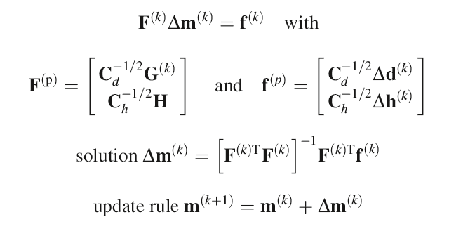
modification of generalized least squares
Notes:
Use the linearized data kernel in the standard formulation of generalized least squares, and iterate to get the solution.

Slide 48
example of generalized least squares

Slide 49
example of generalized least squares
sinusoid of unknown amplitude & frequency
superimposed on a constant background level
Notes:
Here is a formula for a sinusoidal oscillation superimposed on a background level. Suppose that we assume that both the amplitude and frequency oscillation are unknown, and solve for them. This is a little different from what we did in Fourier analysis, where we assumed that the time series was built up of many sinusoids, each with a known frequency and unknown amplitude.

Slide 50

example of generalized least squares
sinusoid of unknown amplitude & frequency
superimposed on a constant background level
normalized unknowns, so m_{i}≈1
background
level
amplitude
frequency
Notes:
Note that we have written the formula so that the model parameters multiply scale factors. As long as we get these scale factors roughly correct, then the model parameters will all be of order unity. That’s helpful, since it means that our initial guess can be m_{i}=1.

Slide 51
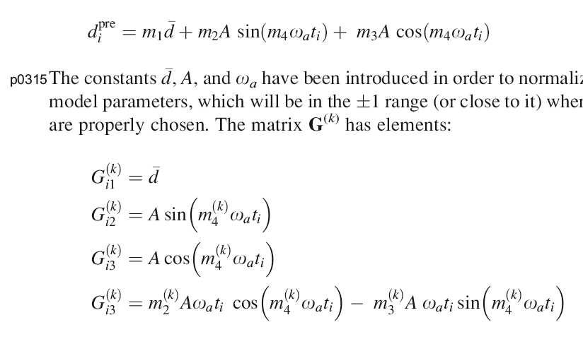
compute derivatives & evaluate in neighborhood of a guess mω_{a}
Notes:
Here are the derivatives. Gi1 is the derivative of the formula with respect to m1. G2i is the derivative of the formula with respect to m2. And so forth.

Slide 52
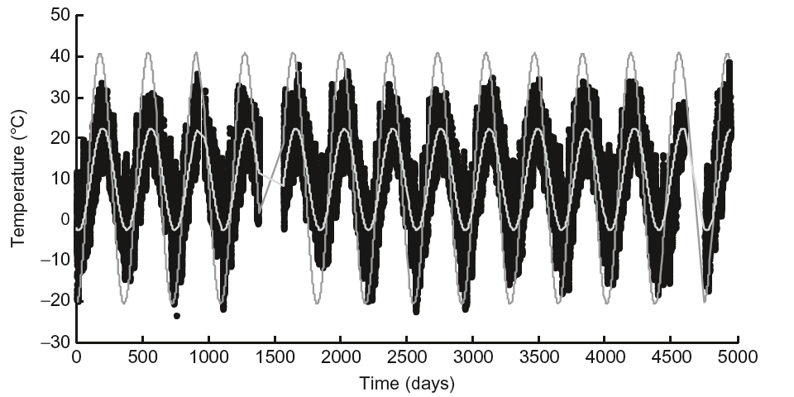
Notes:
Here the Black Rock Forest data (black), with the starting guess (dark grey) and final solution (light greay, smaller amplitude).

Slide 53
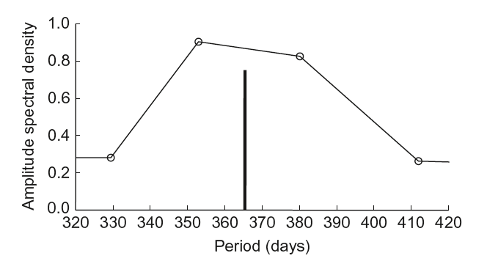
Notes:
The solution is depicted as a bar and compared to the spectrum of the data, as determined by Fourier analysis. The set of Fourier frequencies do have an oscillation at exactly at the period given by the nonlinear inversion. Instead, the two bracketing periods have high amplitude.

