Slide 1
Environmental Data Analysis with MatLab
2nd Edition
Lecture 23:
Adaptable Approximations
with Neural Networks
Notes:
Today’s lecture continues the subject of Hypothesis Testing.

Slide 2
SYLLABUS
Lecture 01 Using MatLab
Lecture 02 Looking At Data
Lecture 03 Probability and Measurement Error
Lecture 04 Multivariate Distributions
Lecture 05 Linear Models
Lecture 06 The Principle of Least Squares
Lecture 07 Prior Information
Lecture 08 Solving Generalized Least Squares Problems
Lecture 09 Fourier Series
Lecture 10 Complex Fourier Series
Lecture 11 Lessons Learned from the Fourier Transform
Lecture 12 Power Spectra
Lecture 13 Filter Theory
Lecture 14 Applications of Filters
Lecture 15 Factor Analysis
Lecture 16 Orthogonal functions
Lecture 17 Covariance and Autocorrelation
Lecture 18 Cross-correlation
Lecture 19 Smoothing, Correlation and Spectra
Lecture 20 Coherence; Tapering and Spectral Analysis
Lecture 21 Interpolation
Lecture 22 Linear Approximations and Non Linear Least Squares
Lecture 23 Adaptable Approximations with Neural Networks
Lecture 24 Hypothesis testing
Lecture 25 Hypothesis Testing continued; F-Tests
Lecture 26 Confidence Limits of Spectra, Bootstraps
Notes:
24 lectures

Slide 3
Goals of the lecture
Understand the motivation behind neural networks,
what neural networks are,
why they are adaptable,
and a few simple applications
Notes:
A neural network is many things to different people. Here we view is as device for approximating a function, one that embodies a greater deal of adaptability (or “trainability”) than traditional approximations. Based roughly on the workings of nervous systems, it consists of a inter-conencted set of components, each of which implements only a smooth version of a step function, but the ensemble of which can mimic exteremely complicated behaviors.

Slide 4
Look-up table as a form of approximation
d=4
x=3
x | d(x)
1 | 0
2 | 2
3 | 4
4 | 5
5 | 4
6 | 2
7 | 0
Notes:
The look-up table embodies a approximation to a function. This one-dimensional version is just a time series; higher dimensional versions are only slighly more complicated.

Slide 5
advantages
d=4
x=3
x | d(x)
1 | 0
2 | 2
3 | 4
4 | 5
5 | 4
6 | 2
7 | 0
fast
Notes:
An advantage of the look-up table is that it is fast, at least when the rows are separated by a fixed Delta x, so that any given value of x can easily be converted into a row number.

Slide 6
advantages
d=4.5
x=3
x | d(x)
1 | 0
2 | 2
3 | 4
4 | 5
5 | 4
6 | 2
7 | 0
4.5
easy to update
Notes:
Another advantage is that the look-up table is easy to update as more information becomes available.

Slide 7
disadvantages
d=2
d=4
x=2.99
x | d(x)
1 | 0
2 | 2
3 | 4
4 | 5
5 | 4
6 | 2
7 | 0
x=3.01
sharp jumps
Notes:
A disadvantage of the look-up table is that the output junps as one moves from row to row.

Slide 8
disadvantages
d=4
x=3
x | d(x)
1 | 0
2 | 2
3 | 4
3.5 | 4.75
4 | 5
5 | 4
6 | 2
7 | 0
hard to reconfigure
Notes:
The Delta x of a look-up table is chosen when it is originally set up, based on information available at the time. This parameter is harder to change as more information becomes available. While its possible to add rows, as above, to capture newly-determined details in the function d(x), doig so interupts the evenly-spaced character of the x’s and makes finding a given value of x harder.

Slide 9
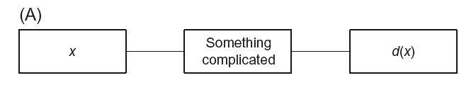
“network” representation of a function
Notes:
By “network”, we mean an interconnected set of elements that implement some function, such as the function d(x). The left and right elements are the “input” and “output”, resepctively. The interior box or boxes can be arbitrarily complicated.

Slide 10
“network” representation of a function
flow of information
Notes:
Information flows from left to right in all the networks that we will consider.

Slide 11
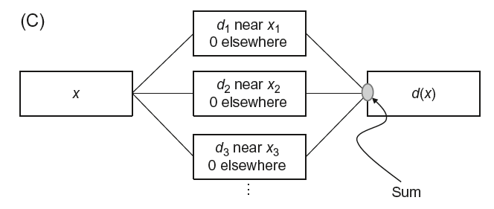
“network” representation of a table
Notes:
A look-up table can be though of a network where the middle column of boxes implement the rows of the table. They produce the value d when x is on “their row” and zero otherwise. The results of all the middle boxes are summed to determine the output.

Slide 12
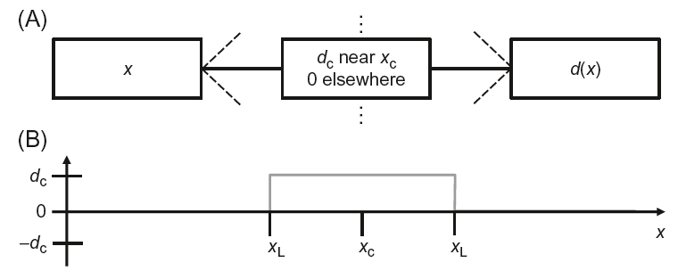
row of a table represented as a
“boxcar” or “tower” function
Notes:
Mathematically, one could think of the row as being equivalent to a “boscar” or “tower” function. It had a value of dc when xc is on the row, and zero otherwise.

Slide 13
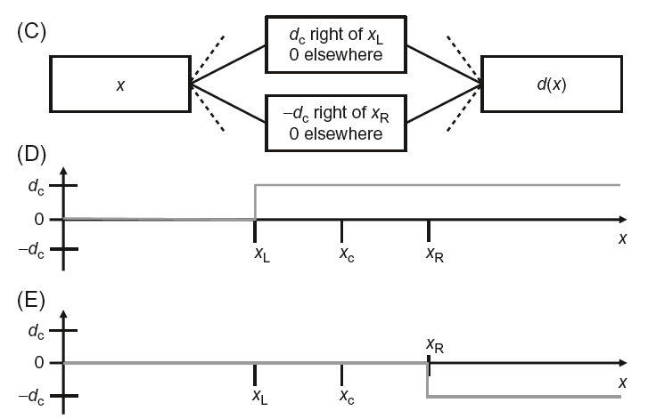
another “network” representation of one row of a table
representation in terms of two step functions
Notes:
It is helpful to think of the boxcar as being built from two step functions, because then the “top” and “bottom” edges of the row are controlled separately.

Slide 14
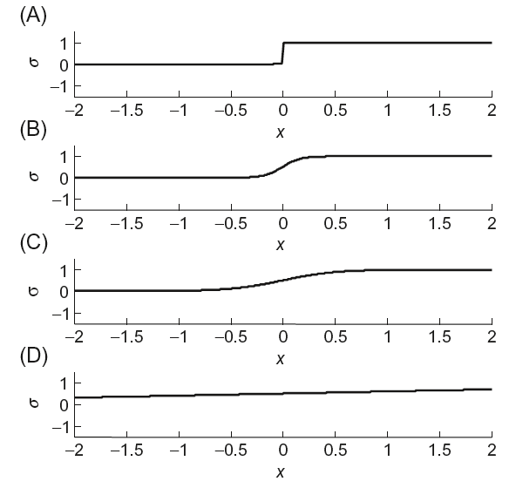


smooth alternative to a step function
sigmoid function
with
Notes:
The essential features of the neural net are that (1) the step function is replaced with a smoother “sigmoid” function, σ(z), and (2) these sigmoid functions are allowed to overlap in more complicated ways than they would in a table.

Slide 15
smooth alternative to a step function
sigmoid function
with
weight
bias
Notes:
The shape of the sigmoid function is controlled by two parameters, the weight w and the boas b.

Slide 16


smooth alternative to a step function
sigmoid function
big w
with
center
max slope at x₀
small w
Notes:
The weight controls the steepness of the sigmoid function. The bigger the w the steeper the slope. The bias and weight together control the x position of the “center” of the function; that is, the x at which the “step” occurs. The graph shows the gigmoid function for a bias of b=0 and a range of choices of weight w.

Slide 17
neural net
Notes:
A neural new is a collection of interconnected boxes, each of which implements a sigmoid function.

Slide 18
neural net
neuron
Notes:
The boxes are called “neurons”, in analagy with the nervous systems of animals.

Slide 19
neural net
neuron
with bias b
bias b: property of neuron
Notes:
Each neuron has a bias associated with it.

Slide 20
neural net
layer
Notes:
Neurons are grouped into layers

Slide 21
neural net
connection
Notes:
Information flows along connections

Slide 22
neural net
connection
with weight w
weight w: property of a connection
Notes:
A connection has a weight associated with it.

Slide 23
neural net
connection
a
output or “activity” a of a neuron
Notes:
The output (or “activity” a) of a neuron is DUPLICATED along connections that diverge from it.

Slide 24
neural net
connection
z
input z a of a neuron
Notes:
The input z of a neuron is the sum of the values of all the connections that converge onto it.

Slide 25
neural net
input 1
output 1
input 2
output 2
input 3
output 3
input 4
information flow
Notes:
Information flows from left (the inputs) to right (the outputs).

Slide 26
neural net
let’s examine this part
Notes:
Let’s examine how calculations occur in a small part of this network.

Slide 27
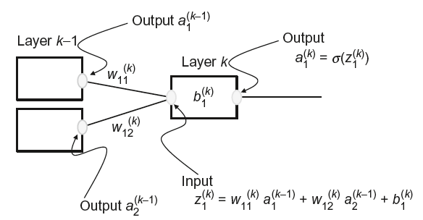
Notes:
Here’s the fragment of the network with all its variables.

Slide 28
layers numbered from left to right
Notes:
Layers are numbered from left to right.

Slide 29
neuron 1
neuron 2
neurons in each layer are numbered from top to bottom
Notes:
Neurons are numbered from top to bottom.

Slide 30
bias b_{i}^{(k)} of i-th neuron in k-th layer

Slide 31
input z_{i}^{(k)} of i-th neuron in k-th layer

Slide 32
output (or activity) a_{i}^{(k)} of i-th neuron in k-th layer

Slide 33
weight w_{ij}^{(k)} of connection from i-th neuron in layer (k-1) to j-th neuron in layer k

Slide 34
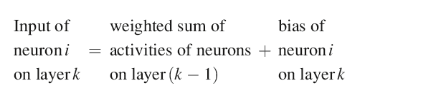
Notes:
Input is sum of activities of lower layer, weighted by the weights of their connections.

Slide 35
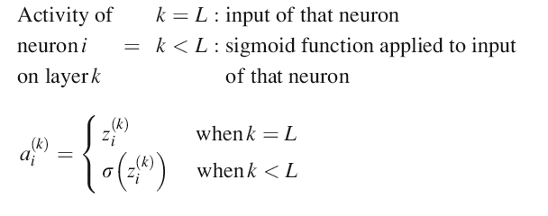
Notes:
The output is the sigmoid function applied to the input.

Slide 36
sigmoid function NOT applied to last layer
Notes:
The sigmoid function is not applied to the last layer.

Slide 37
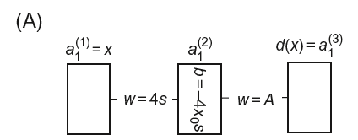
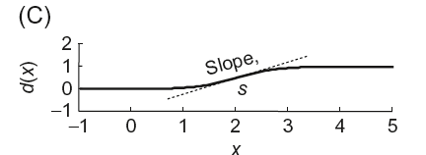
neural net for a step-like function
Notes:
The neural net for a step-like function has a single neuron in the middle layer.

Slide 38
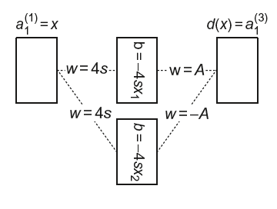
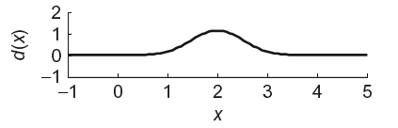
neural net for a tower function
Notes:
The neural net for a tower-like function has a two neurons in the middle layer.

Slide 39
neural nets can easily be amalgamated so construct a function using a row of towers
Notes:
Two or more small neural nets can be amalgamated to produce a larger net that shares some of the properties of the two smaller ones.

Slide 40
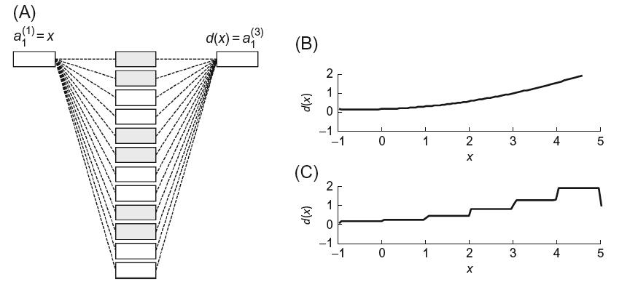
neural net for an arbitrary function
(made with a superposition of towers)
Notes:
For instance, an arbitrary 1D function, d(x), can be constructed from a sequence of towers.

Slide 41
neural net for an arbitrary function
makes this tower
Notes:
Every pair of neurons makes one tower. The weights have been chosen here to emphasize the individual “towers”, but in a realiztic case could be chosen to made the approximation smoother. This is investigated in one of the homeworks.

Slide 42
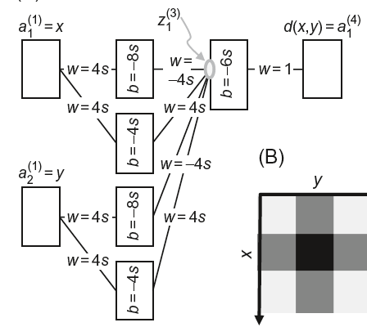
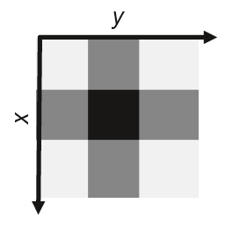
neural net for 2d tower function
(made with a superposition of towers)
Notes:
Two amalgamated 1D towers can create a crude approximation of single 2D tower (crude because of the sidelobes).

Slide 43
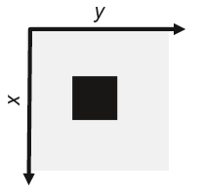
neural net for 2d tower function
Notes:
But adding an extra layer does better by deleting the sidelobes.

Slide 44
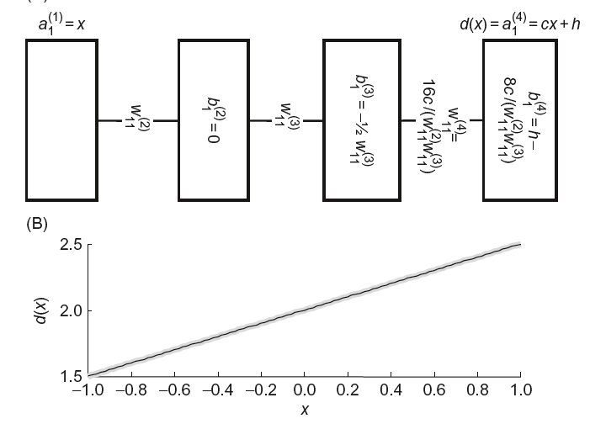
neural net for a linear function
Notes:
Here’s a neural net that creates a linear function. It relies on numerically small weights that produce very wide sigmoid functions that are approximately linear near their centers.

Slide 45
challenge of designing a neural net
1) choosing
number of layers
number of neurons in each layer
their connections
2) finding
the weights and biases that best approximate a given behavior
Notes:
The design of neural nets requires the choice of the number neurons and their connectivity as well as the numerical values of the weights and biases.

Slide 46
training = machine learning
finding
the weights and biases that best approximate a given behavior
given a training dataset
a (large) set of desired input/output pairs
Notes:
Once the network configuration has been chosen, the weights and biases can be chosen to fit a “training dataset”

Slide 47
treat as a least squares problem
find
the weights and biases that
minimize the total error between
the desired output
and the actual output
Notes:
This can be thought of as error minimization problem: Find the weights and biases that minimize the prediction error o the network. We could, for instance, use linearized least squares to solve the problem.

Slide 48
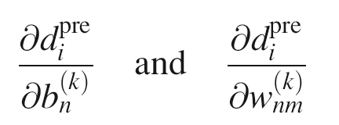
least squares requires that you know the linearized data kernel, that is, the derivatives
Notes:
The weights and biases are the model parameters. So the linearized data kernel are the partial derivatives of the predicted data with respect to the weights and biases, evaluated at an initial guess.

Slide 49
least squares requires that you know the linearized data kernel, that is, the derivatives
the network formulas are simple, so these derivatives can be computed
(with copious use of the chain rule)
Notes:
These partial derivatives are derived in the text. Calculating them is straightforward, but tedious. The procedure relies heavily on the chain rule.

Slide 50
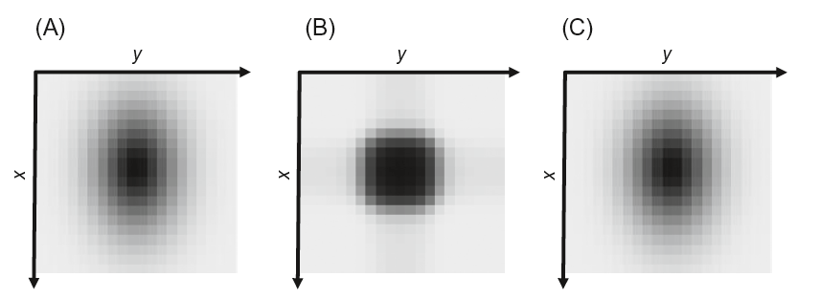
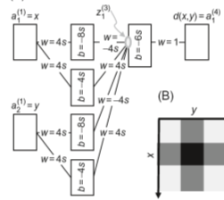
a simple tower trained to fit a 2D function
true function
initial guess
after training
Notes:
Here’s a simple network that is initialized to a tower and then trained to fit a 2D function.

Slide 51
neural nets can easily be amalgamated so create a linear filter by amalgamating linear functions
Notes:
Here’s another example of amalgamation …

Slide 52
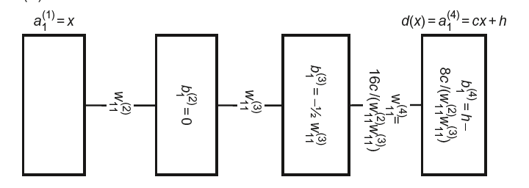
network for linear function y=cx
input
x
output
y=cx
Notes:
Here’s the linear function of one input x that produces one output y=cx.

Slide 53
network for a linear filter
input
x_{i}
output
y=
c₁x_{i}+c₂x_{i-1}+c₃x_{i-2}+c₄x_{i-3}
x_{i-1}
x_{i-2}
x_{i-3}
Notes:
Amalgamating several of them, now with different inputs, creates a network that implements a linear filter. One might imagine initialzing a network to a linear filter and then training it to capture behaviors that are more complicated than can be represented with a linear filter.

Slide 54
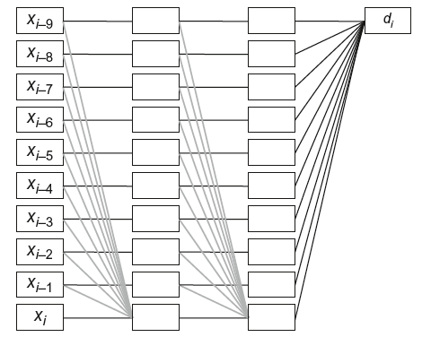
a best-fitting linear filter trained to predict nonlinear behavior
Notes:
Here we’ve added a few connections to the linear filter network, each with initially zero weight, that allow the network to capture more complicated behaviors.

Slide 55
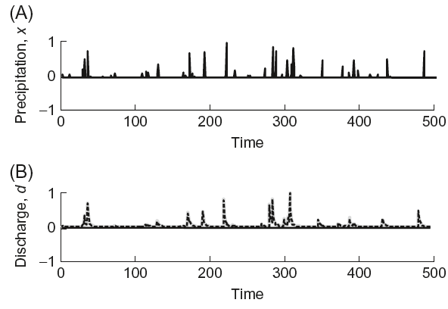
river discharge from precipitation when river overflows it banks
Notes:
We have previously used linear filters to predict the discharge of a river from precipitation data. We determined the filter coefficients by a least squaresprocedure. Now we extend this idea by initializing a neural net to a linear filter, but then training it so that so that it can handle nonlinearities.

Slide 56
river discharge from precipitation when river overflows it banks
Notes:
An important nonlinearity of rivers occurs at high water when they overflow their banks. Then the discharge can be much higher than expected. This violates the ‘double the input – double the output’ property of a linear filer, and is thus a nonlinearity.

Slide 57
Notes:
We take a close look at this section of the data.

Slide 58
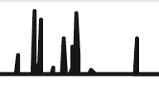
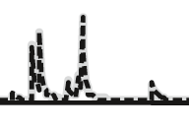
network captures nonlinearity: doubling precipitation more than doubles discharge
precipitation
time
discharge
time
Notes:
The output of the network (dashed) does a good job at capturing the amplitude variability of the discharge data (grey)

