Slide 1
Environmental Data Analysis with MatLab
2nd Edition
Lecture 24:
Hypothesis Testing
Notes:
Today’s lecture treats the subject of interpolation.

Slide 2
SYLLABUS
Lecture 01 Using MatLab
Lecture 02 Looking At Data
Lecture 03 Probability and Measurement Error
Lecture 04 Multivariate Distributions
Lecture 05 Linear Models
Lecture 06 The Principle of Least Squares
Lecture 07 Prior Information
Lecture 08 Solving Generalized Least Squares Problems
Lecture 09 Fourier Series
Lecture 10 Complex Fourier Series
Lecture 11 Lessons Learned from the Fourier Transform
Lecture 12 Power Spectra
Lecture 13 Filter Theory
Lecture 14 Applications of Filters
Lecture 15 Factor Analysis
Lecture 16 Orthogonal functions
Lecture 17 Covariance and Autocorrelation
Lecture 18 Cross-correlation
Lecture 19 Smoothing, Correlation and Spectra
Lecture 20 Coherence; Tapering and Spectral Analysis
Lecture 21 Interpolation
Lecture 22 Linear Approximations and Non Linear Least Squares
Lecture 23 Adaptable Approximations with Neural Networks
Lecture 24 Hypothesis testing
Lecture 25 Hypothesis Testing continued; F-Tests
Lecture 26 Confidence Limits of Spectra, Bootstraps
Notes:
24 lectures

Slide 3
purpose of the lecture
to introduce
Hypothesis Testing
the process of determining the statistical significance of results

Slide 4
Part 1
motivation
random variation as a spurious source of patterns

Slide 5
d
x

Slide 6
looks pretty linear
d
x

Slide 7
actually, its just a bunch of random numbers!
figure(1);
for i = [1:100]
clf;
axis( [1, 8, -5, 5] );
hold on;
t = [2:7]';
d = random('normal',0,1,6,1);
plot( t, d, 'k-', 'LineWidth', 2 );
plot( t, d, 'ko', 'LineWidth', 2 );
[x,y]=ginput(1);
if( x<1 )
break;
end
end
the script makes plot after plot, and lets you stop when you see one you like

Slide 8
the linearity was due to random variation!

Slide 9
4 more random plots
d
d
x
x
d
d
x
x

Slide 10
scenario test of a drug
Group A
Group B
given drug at start of illness
given placebo at start of illness

Slide 11
Group A
Group B
average length of illness after taking drug
average length of illness after taking placebo
4.1 days
5.2 days

Slide 12
the logic
people’s immune systems differ
some naturally get better faster than others
perhaps the drug test just happened
by random chance -
to have naturally faster people in Group A
?

Slide 13
How much confidence should you have that the difference between 4.1 and 5.2 is not due to random variation
?

Slide 14
67%
90%
95%
99%

Slide 15
67%
90%
95%
99%
1 in 20 chance that the difference was caused by random variation
minimum standard

Slide 16
the goal of this lecture is to develop techniques for quantifying the probability that a result is not due to random variation

Slide 17
Part 2
the distribution of the total error

Slide 18
individual error
e_{i} = d_{i}^{obs} - d_{i}^{pre}
total error
E = Σ _{i=1}^{N} e_{i}²

Slide 19
individual error
e_{i} = d_{i}^{obs} - d_{i}^{pre}
Normal p.d.f.
total error
E = Σ _{i=1}^{N} e_{i}²
Not Normal.

Slide 20
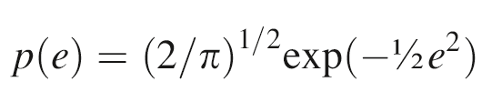
simplest case
N=1
individual error, e
Normal p.d.f.
zero mean
unit variance
assumes e>0
(since sign goes away when we square it)

Slide 21
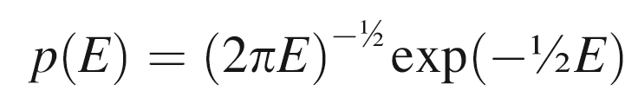
total error, E=e²
p(E)= p[e(E)] |de/dE|
e=E ^{½} so de/dE = ½E ^{-½}

Slide 22
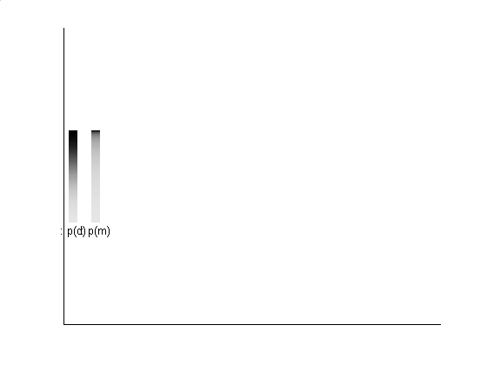
probability squeezed toward 0
p(e)
p(E)

Slide 23
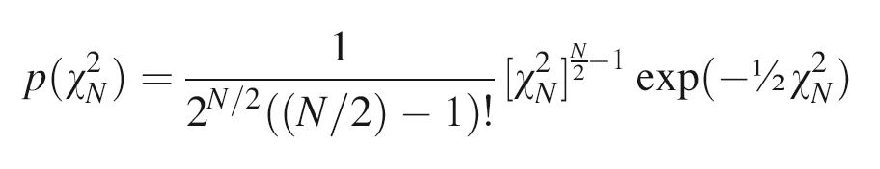
general case of N>1 tedious to compute, but not mysterious
total error
E = χ_{N}² = Σ _{i=1}^{N} e_{i}²

Slide 24
general case of N>1 tedious to compute, but not mysterious
total error
E = χ_{N}² = Σ _{i=1}^{N} e_{i}²
E called chi-squared when e_{i} is Normally-distributed with zero mean and unit variance
called chi-squared p.d.f

Slide 25
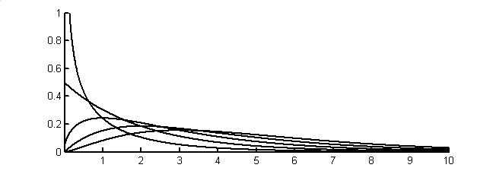
N=1
p(χ_{N}²)
2
3
4
5
χ²
Notes:
Chi-squared probability density function for N=1, 2, 3, 4, and 5.

Slide 26
N=1
case we just worked out
p(χ_{N}²)
2
3
4
5
χ²
Notes:
Chi-squared probability density function for N=1, 2, 3, 4, and 5.

Slide 27
Chi-Squared p.d.f.
N called “the degrees of freedom”
mean N
variance 2N

Slide 28
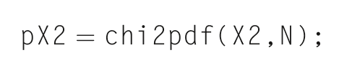
In MatLab

Slide 29
Four Important Distributions used in hypothesis testing

Slide 30
#1 p(Z) with Z=e
Normal distribution for a quantity Z with zero mean and unit variance
Normally-distributed with zero mean and unit variance

Slide 31
if d is Normally-distributed with mean d and variance σ²_{d}
then Z = (d-d)/ σ_{d} is Normally-distributed with zero mean and unit variance

Slide 32
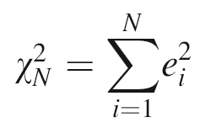
#2
p(χ_{N}²) with
the chi-squared distribution, which we just worked out

Slide 33
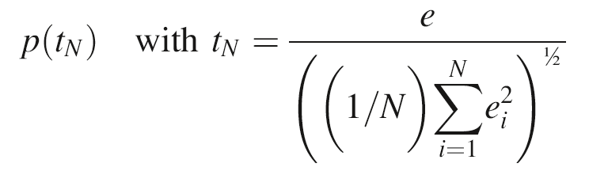
#3
a new distribution, called the
“t-distribution’

Slide 34
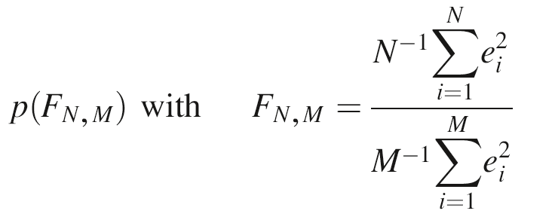
#4
another new distribution, called the
“F-distribution’

Slide 35
t-distribution
N=5
p(t_{N})
N=1
t_{N}
Notes:
Student’s t-probability density function for N=1, 2, 3, 4, and 5.

Slide 36
t-distribution
N=5
wider tailed than a Normal p.d.f.
p(t_{N})
N=1
t_{N}
Notes:
Student’s t-probability density function for N=1, 2, 3, 4, and 5.

Slide 37
F-distribution
p(F_{N,2})
N=2
50
F
N=2
50
p(F_{N,5})
F
p(F_{N,25})
N=2
50
F
p(F_{N,50})
N=2
50
F
Notes:
F-probability density function, p(F_{N,M}), for selected values of M and N.

Slide 38
F-distribution
skewed at low N and M
p(F_{N,2})
N=2
50
F
N=2
50
p(F_{N,5})
F
p(F_{N,25})
N=2
50
F
p(F_{N,50})
N=2
50
F
starts to look Normal at high N and M
Notes:
F-probability density function, p(F_{N,M}), for selected values of M and N.

Slide 39
Part 4
Hypothesis Testing

Slide 40
Step 1. State a Null Hypothesis some variation of the result is due to random variation

Slide 41
Step 1. State a Null Hypothesis some variation of the result is due to random variation
e.g.
the means of the Group A and Group B are different only because of random variation

Slide 42
Step 2. Focus on a quantity that is unlikely to be large when the Null Hypothesis is true

Slide 43
Step 2. Focus on a quantity that is unlikely to be large when the Null Hypothesis is true
called a “statistic”

Slide 44
Step 2. Focus on a quantity that is unlikely to be large when the Null Hypothesis is true
e.g.
the difference in the means Δm=(mean_{A} – mean_{B}) is unlikely to be large if the Null Hypothesis is true

Slide 45
Step 3.
Determine the value of statistic for your problem

Slide 46
Step 3.
Determine the value of statistic for your problem
e.g.
Δm = (mean_{A} – mean_{B}) = 5.2 – 4.1 = 1.1

Slide 47
Step 4.
Calculate that the probability that a the observed value or greater would occur if the Null Hypothesis were true

Slide 48
Step 4.
Calculate that the probability that a the observed value or greater would occur if the Null Hypothesis were true
P( Δm ≥ 1.1 ) = ?

Slide 49
Step 4.
Reject the Null Hypothesis if such large values occur less than 5% of the time

Slide 50
Step 4.
Reject the Null Hypothesis if such large values occur less than 5% of the time
rejecting the Null Hypothesis means that your result is unlikely to be due to random variation

Slide 51
Part 5
An example
test of a particle size measuring device

Slide 52
manufacturer's specs
machine is perfectly calibrated
particle diameters scatter about true value
measurement error is
σ_{d}² = 1 nm²

Slide 53
your test of the machine
purchase batch of 25 test particles
each exactly 100 nm in diameter
measure and tabulate their diameters
repeat with another batch a few weeks later

Slide 54
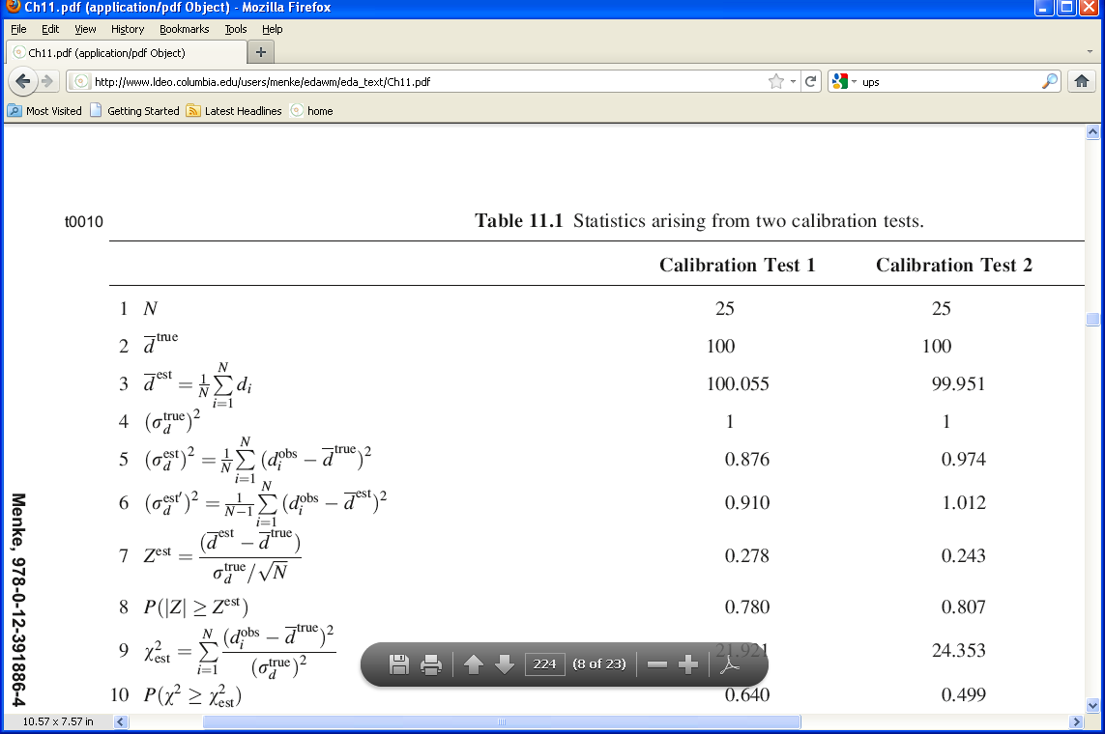
Results of Test 1

Slide 55
Results of Test 2

Slide 56
Question 1
Is the Calibration Correct?
Null Hypothesis
The observed deviation of the average particle size from its true value is due to random variation (as contrasted to a bias in the calibration).

Slide 57
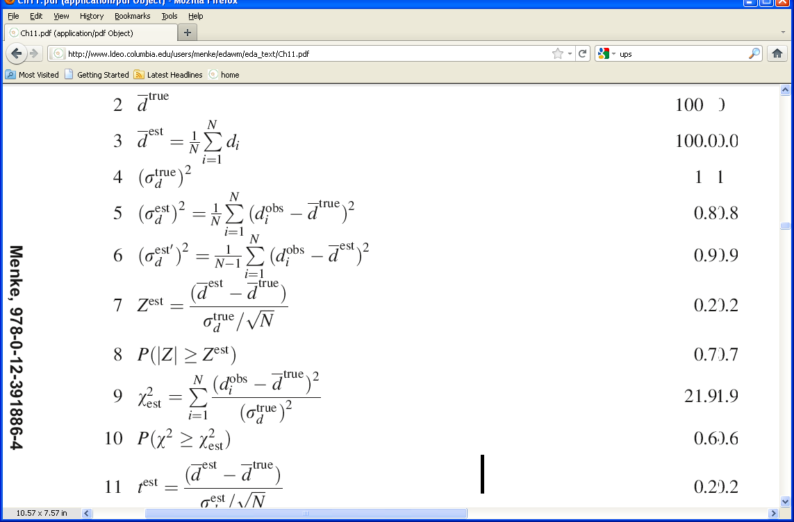
assume that the measurement error is Normally-distributed with zero mean and variance 1 nm²
the mean of 25 measurements has variance
1 nm² / √25
the quantity
is Normal with zero mean and unit variance

Slide 58
in our case
= 0.278 and 0.243
the key question is
Are these unusually large values for Z ?

Slide 59
in our case
= 0.278 and 0.243
the key question is
Are these unusually large values for Z ?
actually, its immaterial whether d^{est} is bigger or smaller than d^{true} =100, but only whether they’re different
so we should really ask whether |Z^{est}|
is unusually large

Slide 60
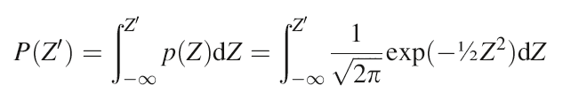
P(Z’) is the cumulative probability from
-∞ to Z’
p(Z)
Z
0
Z’

Slide 61
The quantity we want is
P( |Z| > Z^{est} )
p(Z)
Z
0
-Z^{est}
Z^{est}
which is
1 – [P(Z^{est}) - P(-Z^{est})]

Slide 62
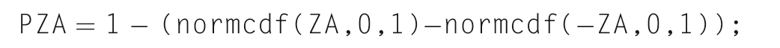
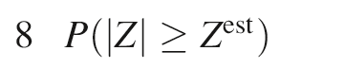
In MatLab
= 0.780 and 0.807
So values of |Z| greater than Z^{est} are very common

Slide 63
In MatLab
= 0.780 and 0.807
So values of |Z| greater than Z^{est} are very common
The Null Hypotheses cannot be rejected

Slide 64
Question 2
Is the variance in spec?
Null Hypothesis
The observed deviation of the variance from its true value of 1 nm² is due to random variation (as contrasted to the machine being noisier than the specs).

Slide 65
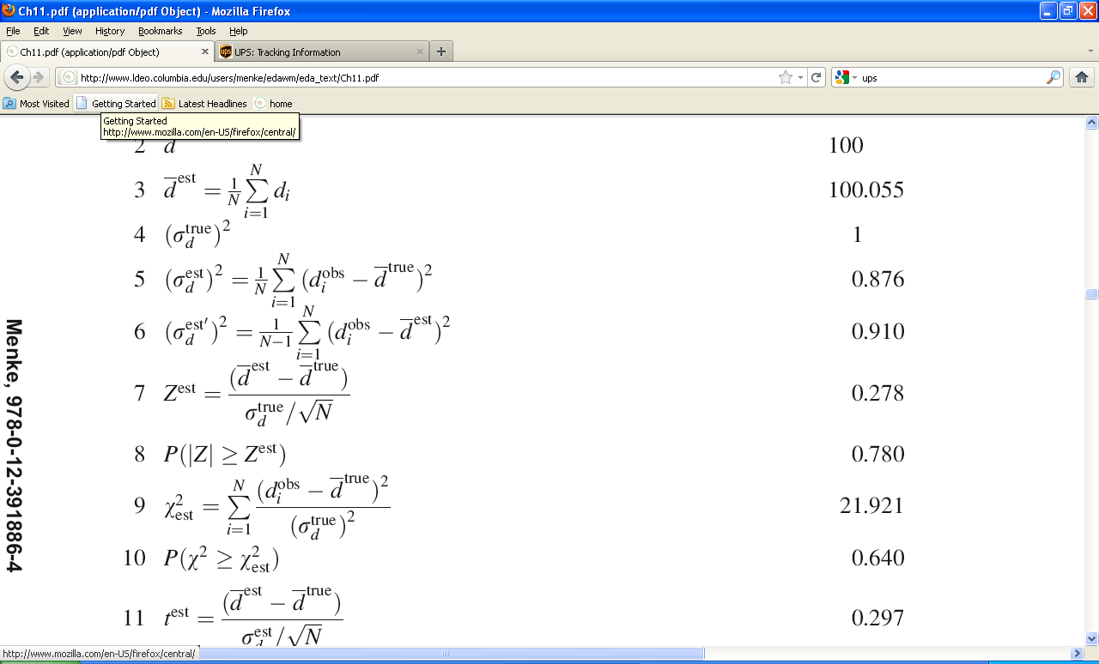
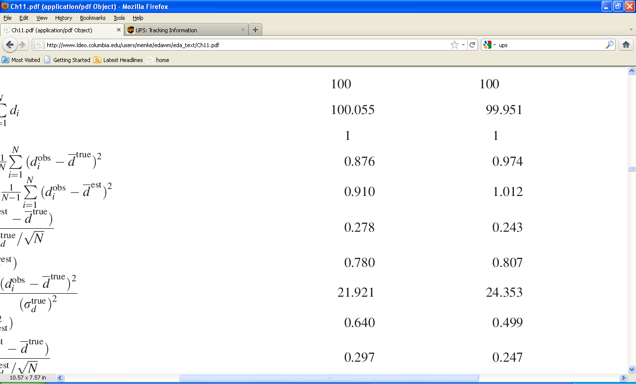
Results of the two tests

Slide 66
Results of the two tests
zero mean
unit variance

Slide 67
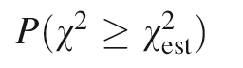
= ?
in our case
the key question is
Are these unusually large values for χ² ?

Slide 68
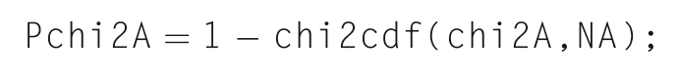
In MatLab
= 0.640 and 0.499

Slide 69
In MatLab
= 0.640 and 0.499
So values of χ² greater than χ_{est}² are very common
The Null Hypotheses cannot be rejected

Slide 70
we will continue this scenario in the next lecture

