Slide 1
Environmental Data Analysis with MatLab
2nd Edition
Lecture 26:
Confidence Limits of Spectra; Bootstraps
Notes:
Today’s lecture continues the subject of Hypothesis Testing, applying the idea to spectra.
It also discusses how the bootstrap method can be used to develop an empirical p.d.f.
when an analytic one is unavailable.

Slide 2
SYLLABUS
Lecture 01 Using MatLab
Lecture 02 Looking At Data
Lecture 03 Probability and Measurement Error
Lecture 04 Multivariate Distributions
Lecture 05 Linear Models
Lecture 06 The Principle of Least Squares
Lecture 07 Prior Information
Lecture 08 Solving Generalized Least Squares Problems
Lecture 09 Fourier Series
Lecture 10 Complex Fourier Series
Lecture 11 Lessons Learned from the Fourier Transform
Lecture 12 Power Spectra
Lecture 13 Filter Theory
Lecture 14 Applications of Filters
Lecture 15 Factor Analysis
Lecture 16 Orthogonal functions
Lecture 17 Covariance and Autocorrelation
Lecture 18 Cross-correlation
Lecture 19 Smoothing, Correlation and Spectra
Lecture 20 Coherence; Tapering and Spectral Analysis
Lecture 21 Interpolation
Lecture 22 Linear Approximations and Non Linear Least Squares
Lecture 23 Adaptable Approximations with Neural Networks
Lecture 24 Hypothesis testing
Lecture 25 Hypothesis Testing continued; F-Tests
Lecture 26 Confidence Limits of Spectra, Bootstraps
Notes:
24 lectures

Slide 3
purpose of the lecture
continue
develop a way to assess the significance of
a spectral peak
and
develop the Bootstrap Method
of determining confidence intervals
Notes:
This is a two-part lecture. There is some continuity of underlying concepts, but the two
applications are quite distinct.

Slide 4
Part 1
assessing the confidence level of a spectral peak
Notes:
E.g. you observe a given periodicity and want to know if it’s statistically significant.

Slide 5
what does confidence in a spectral peak mean?

Slide 6
one possibility
indefinitely long phenomenon
you observe a short time window
(looks “noisy” with no obvious periodicities)
you compute the p.s.d. and detect a peak
you ask
would this peak still be there if I observed some other time window?
or did it arise from random variation?

Slide 7
example
d
t
a.s.d
Y
N
N
N
f
f
f
f
Notes:
This time series is purely uncorrelated random noise. The first spectra has a peak (red arrow0
but subsequent spectra lack peaks at the same frequency. The peak is being caused by random processes.

Slide 8
d
t
Y
Y
Y
Y
a.s.d
f
f
f
f
Notes:
This time series is uncorrelated random noise plus a cosine wave. All the spectra have a large peak (red arrow0
at the same frequency. The peak is being caused by the cosine, even though its hard to see in the time series..

Slide 9
Null Hypothesis
The spectral peak can be explained by random variation in a time series that consists of nothing but random noise.
Notes:
This is just one possible Null Hypothesis. But its represents an important extreme.

Slide 10
Easiest Case to Analyze
Random time series that is:
Normally-distributed
uncorrelated
zero mean
variance that matches power of time series under consideration
Notes:
This is the only case done in the text. More advanced cased will allow some
correlation between points, e.g. to make the p.s.d. have more power at low
frequencies than at high (a red spectrum) or vice versa (a blue spectra).

Slide 11
So what is the probability density function p(s²)
of points in the power spectral density s² of such a time series ?
Notes:
If we knew this p.d.f., we could perform the usual hypothesis testing.
So we need to work it out.

Slide 12
Chain of Logic, Part 1
The time series is Normally-distributed
The Fourier Transform is a linear function of the time series
Linear functions of Normally-distributed variables are Normally-distributed, so the Fourier Transform is Normally-distributed too
For a complex FT, the real and imaginary parts are individually Normally-distributed
Notes:
Part 1: The Fourierr Transform is Normal.

Slide 13
Chain of Logic, Part 2
The time series has zero mean
The Fourier Transform is a linear function of the time series
The mean of a linear function is the function of the mean value, so the mean of the FT is zero
For a complex FT, the means of the real and imaginary parts are individually zero
Notes:
Part 2: The Fourier Transform has zero mean.

Slide 14
Chain of Logic, Part 3
The time series is uncorrelated
The Fourier Transform has [G^{T}G]⁻¹ proportional to I
So by the usual rules of error propagation, the Fourier Transform is uncorrelated too
For a complex FT, the real and imaginary parts are uncorrelated
Notes:
Part 3. The Fourier Transform is uncorrelated.

Slide 15
Chain of Logic, Part 4
The power spectral density is proportional to the sum of squares of the real and imaginary parts of the Fourier Transform
The sum of squares of two uncorrelated Normally-distributed variables with zero mean and unit variance is chi-squared distributed with two degrees of freedom.
Once the p.s.d. is scaled to have unit variance, it is chi-squared distributed with two degrees of freedom.
Notes:
Part 4. The p.s.d. is chi-squared distributed with 2 degrees of freedom.

Slide 16
so s²/c is chi-squared distributed where c is a yet-to-be-determined scaling factor
Notes:
The spectrum needs to be normalized by a factor that scales it to have unit variance
(so it matches the chi-squared distribution).

Slide 17
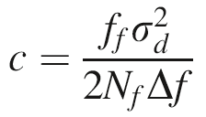
in the text, it is shown that
where:
σ_{d}² is the variance of the data
N_{f} is the length of the p.s.d.
Δf is the frequency sampling
f_{f} is the variance of the taper.
It adjusts for the effect of a tapering.
Notes:
The factor c is derived in the text. I merely cite it here, for lack of time in the lecture
to derive it.

Slide 18
example 1: a completely random time
series
A) tapered time series
+2σ_{d}
d(i)
−2σ_{d}
time t, seconds
B) power spectral density
s²(f)
95%
mean
frequency f, Hz
Notes:
Random time series, d(t), after multiplication by Hamming taper. B) power spectral density, s²(f), of time series, d(t).
The mean and 95% confidence level is taken directly from the chi-squared distribution.
Point out tat several peaks exceed the 95% level. Not surprising, for the p.s.d. has 513 points, and 5% of 513 is about 25.

Slide 19
example 1:
histogram of
spectral
values
mean
95%
counts
power spectral density, s²(f)
Notes:
Actual (jagged curve) and theoretical (smooth curve) histogram of power spectral density, s²(f), of the time series shown in previous slide.
Emphasize the good fit between the histogram and the theoretical chi-squared distribution.

Slide 20
example 2: random time
series consisting
of 5 Hz cosine
plus noise
A) tapered time series
+2σ_{d}
d(i)
−2σ_{d}
time t, seconds
B) power spectral density
s²(f)
95%
mean
frequency f, Hz
Notes:
Time series, d(t), consisting of the sum of a 5 Hz sinusoidal oscillation plus random noise, after multiplication by Hamming taper. B) power spectral density, s²(f), of time series, d(t).
Note that the 5 Hz peak is way above the 95% confidence level.

Slide 21
example 2:
histogram of
spectral
values
mean
95%
peak
counts
power spectral density, s²(f)
Notes:
Actual (jagged curve) and theoretical (smooth curve) histogram of power spectral density, s²(f), of the time series shown in the previous slides.
Point out that the peak is way out in the tail of the distribution.

Slide 22
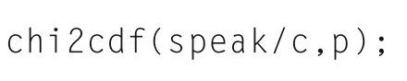
so how confident are we of a peak at 5 Hz ?
= 0.99994
the p.s.f. is predicted to be less than the level of the peak 99.994% of the time
But here we must be very careful

Slide 23
two alternative Null Hypotheses
a peak of the observed amplitude at 5 Hz is caused by random variation
a peak at the observed amplitude somewhere in the p.s.d. is caused by random variation
Notes:
Emphasize that these two Hull Hypotheses are not the same.
In most cases, we are interested in the second, because we usually don’t know
whether a data set contains periodicities at all until we compute a p.s.d.
Then, if it has a big peak, we want to know if its significant.

Slide 24
two alternative Null Hypotheses
a peak of the observed amplitude at 5 Hz is caused by random variation
a peak at the observed amplitude somewhere in the p.s.d. is caused by random variation
much more likely, since p.s.d. has many frequency points
(513 in this case)

Slide 25
two alternative Null Hypotheses
a peak of the observed amplitude at 5 Hz is caused by random variation
peak of the observed amplitude or greater occurs only 1-0.99994
= 0.006 % of the time
The Null Hypothesis can be rejected to high certainty
a peak at the observed amplitude somewhere in the p.s.d. is caused by random variation

Slide 26
two alternative Null Hypotheses
a peak of the observed amplitude at 5 Hz is caused by random variation
a peak at the observed amplitude somewhere in the p.s.d. is caused by random variation
peak of the observed amplitude occurs only 1-(0.99994)⁵¹³
= 3% of the time
The Null Hypothesis can be rejected to acceptable certainty

Slide 27
Part 2
The Bootstrap Method
Notes:
New subject here.

Slide 28
The Issue
What do you do when you have a statistic that can test a Null Hypothesis
but you don’t know its probability density function
?
Notes:
In order to test a Null Hypothesis,
you must evaluate a p.d.f. (or the corresponding cumulative probability distribution).
If you don’t know the p.d.f., your’re stuck.

Slide 29
If you could repeat the experiment many times, you could address the problem empirically
perform experiment
calculate statistic, s
make histogram of s’s
normalize histogram into empirical p.d.f.
repeat

Slide 30
The problem is that it’s not usually possible to repeat an experiment many times over

Slide 31
Bootstrap Method
create approximate repeat datasets
by randomly resampling (with duplications)
the one existing data set
Notes:
Point out that “approximate” here means in some abstract mathematical sense.
There is only one experiment. You are not re-doing it, approximately or otherwise.

Slide 32
example of resampling
original data set
random integers in range 1-6
resampled data set
1 2 3 4 5 6
1.4 2.1 3.8 3.1 1.5 1.7
3 1 3 2 5 1
1 2 3 4 5 6
3.8 1.4 3.8 2.1 1.5 1.4
Notes:
Point out that this data set consists of a single column of data with 6 rows.
The resampled data set also has 6 rows.
Each row of the resampled data set matches an entry somewhere in the original dataset.
But the order is scrambled and there are repeats.

Slide 33
example of resampling
original data set
random integers in range 1-6
new data set
1 2 3 4 5 6
1.4 2.1 3.8 3.1 1.5 1.7
3 1 3 2 5 1
1 2 3 4 5 6
3.8 1.4 3.8 2.1 1.5 1.4
Notes:
(red) randomly choose a row of the original dataset
(blue) copy to the next available row of the resampled dataset

Slide 34
interpretation of resampling
mixing
sampling
duplication
p(d)
p’(d)
Notes:
A probability density function, p(d), is represented by the large urn at the left and a few of realizations of this function are represented by the small goblet. The contents of the goblet are duplicated indefinitely many times, mixed together and poured into the large urn at the right, creating a new probability density function, p’(d). Under some circumstances, p’(d)≈p(d).

Slide 35
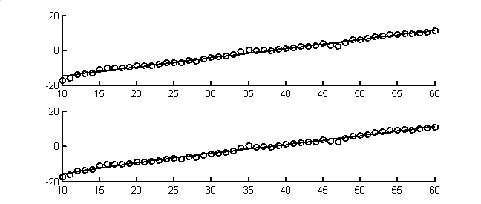
Example
what is the p(b)
where b is the slope of a linear fit?
d(i)
time t, hours
Notes:
A simple example

Slide 36
This is a good test case, because we know the answer
if the data are Normally-distributed, uncorrelated with variance σ_{d}²,
and given the linear problem
d = G m where m = [intercept, slope]^{T}
The slope is also Normally-distributed with a variance that is the lower-right element of
σ_{d}² [G^{T}G]⁻¹
Notes:
This just emphasizes that we know the answer in this case, and that Bootstrapping is therefore unnecessary.

Slide 37
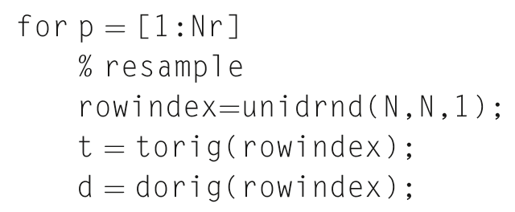
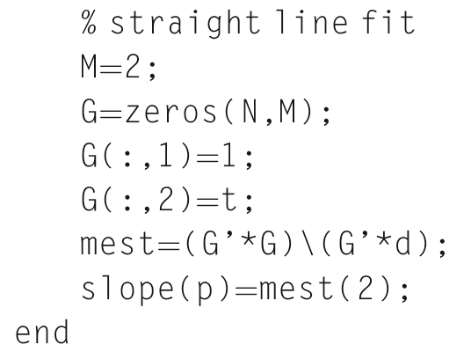
Notes:
m-script for bootstrapping. Draw attention to the for loop

Slide 38
create resampled data set
returns N
random integers from 1 to N
Notes:
Part 1: create resampled dataset. Mention that the unidrnd() function is very handy when
implementing resampling.

Slide 39
usual code for least squares fit of line
save slopes
Notes:
Part 2. Completely standard least squares fit of straight line to data. Note that the slope is saved in an array.

Slide 40
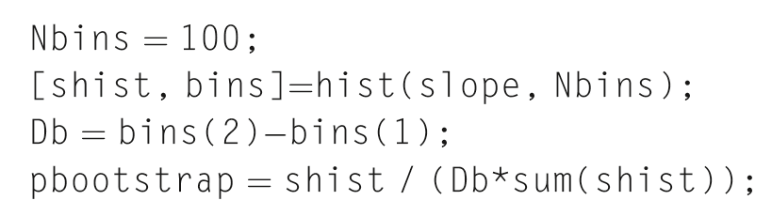
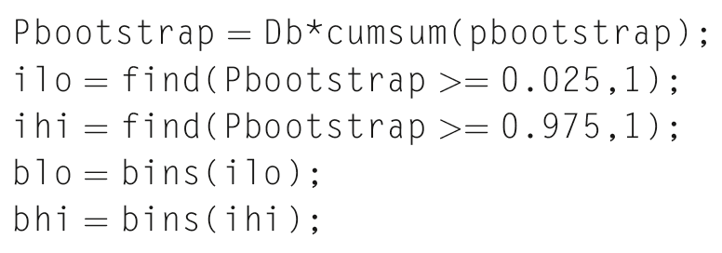
histogram of slopes
Notes:
Part 3: Create a histogram and normalize it into a p.d.f.

Slide 41
integrate p(b) to P(b)
2.5% and 97.5% bounds
Notes:
Part 4: Integrate the p.d.f. to a cumulative probability function.
Seach for 2.5% and 97.5% limits (95% of area between these limits).

Slide 42
standard error propagation
bootstrap
p(b)
95% confidence
slope, b
Notes:
Bootstrap method applied to estimating the probability density function, p(b), of slope, b, when a straight line is fit to a fragment of the Black Rock Forest temperature dataset. (Smooth curve) Normal probability density function, with parameters determined by standard error propagation. (Rough curve) Bootstrap estimate.
Point out that the two curves matche pretty well.

Slide 43
a more complicated example
p(r)
where r is
ratio of
CaO to Na₂O ratio of the second varimax factor of the Atlantic Rock dataset
Notes:
Just a hypothetical example. The process of computing r:
SVD then varimax rotation then division
is so complicated that deriving an analytic p.d.f. would be tedious at the very least, and
probably impossible.

Slide 44
p(r)
95% confidence
mean
CaO / Na₂O ratio, r
Notes:
Bootstrap method applied to estimating the probability density function, p(r), of a parameter, r, that has a very complicated relationship to the data. Here the parameter, r, represents the CaO to Na₂O ratio of the second varimax factor of the Atlantic Rock dataset (see Fig. 8.6). The mean of the parameter, r, and its 95% confidence intervals are then estimated from p(r).

Slide 45
we can use this histogram to write confidence intervals for r
r has a mean of 0.486
95% probability that r is between 0.458 and 0.512
and roughly, since p(r) is approximately symmetrical
r = 0.486 ± 0.025 (95% confidence)
Notes:
The latter set of error bounds presumes that the p.d.f. is symmetric about its mean. which it is, sort of.
Point out, however, that the use of the notation x±y can be very misleading when the p(x) is skewed.

