Slide 1
Environmental Data Analysis with MATLAB or Python 3rd Edition Lecture 1

Slide 2
Course Goals
Make you comfortable with the analysis of numerical data through practice
Teach you a set of widely-applicable data analysis techniques
Provide the strategies for applying what you’ve learned to your own datasets
Notes:
Emphasize that the only way that students will learn to actually apply data analysis is to do the homework, which is based on actual data

Slide 3
MATLAB commercial software available on-line
Notes:
Matlab is a commercial software product of the MathWorks Inc.

Slide 4
Or

Slide 5
Python
free
software
available
online
Logo by www.python.org - www.python.org,
GPL, https://commons.wikimedia.org/w/index.php?curid=34991651
Notes:
Python, free software available from python.org, supplemented by other freely-available packages. The course can be taught using just one of these two languages, or with both, according to the preference of the instructor.

Slide 6
SYLLABUS
Lecture 01 Intro; Using MTLAB or Python Lecture 02 Looking At Data Lecture 03 Probability and Measurement Error Lecture 04 Multivariate Distributions Lecture 05 Linear Models Lecture 06 The Principle of Least Squares Lecture 07 Prior Information Lecture 08 Solving Generalized Least Squares Problems Lecture 09 Fourier Series Lecture 10 Complex Fourier Series Lecture 11 Lessons Learned from the Fourier Transform
Lecture 12 Power Spectra Lecture 13 Filter Theory Lecture 14 Applications of Filters Lecture 15 Factor Analysis and Cluster Analysis Lecture 16 Empirical Orthogonal functions and Clusters Lecture 17 Covariance and Autocorrelation Lecture 18 Cross-correlation Lecture 19 Smoothing, Correlation and Spectra Lecture 20 Coherence; Tapering and Spectral Analysis Lecture 21 Interpolation and Gaussian Process Regression
Lecture 22 Linear Approximations and Non Linear Least Squares
Lecture 23 Adaptable Approximations with Neural Networks Lecture 24 Hypothesis testing Lecture 25 Hypothesis Testing continued; F-Tests Lecture 26 Confidence Limits of Spectra, Bootstraps
Notes:
26 lectures are sufficient to survey the material in the book. However, not every topic in the book is covered, so students should be encouraged to read the book.

Slide 7
Today’s Lecture
Part 1: Starting to Look at Data
Part 2: Using MATLAB
Part 3: Using Python
Notes:
Today is an introduction. A teaser on analyzing an interesting data set, then a drier MatLab tutorial.

Slide 8
Part 1
Starting to Look at Data
Notes:
This tutorial is based on a little example I (Bill Menke) recently worked up. See
Teaching Students to Look at Their Data - A Tutorial
http://www.ldeo.columbia.edu/users/menke/talks/datatutorial/index.html

Slide 9
advice even before looking at the data articulate the properties that you expect them to have and then critically examine them in light of your expectations
Notes:
When you begin to look at data, you should think about your data a little.
You probably know at least a little about the data in general.
What should it look like?
Think about the properties should the data have.
Then, as you analyze the data, see whether they meet your expectations.

Slide 10
Case Study: Stream flow of the Hudson River
Notes:
Photo of the Hudson River, near Albany NY (Photo Credit: William Menke)

Slide 11
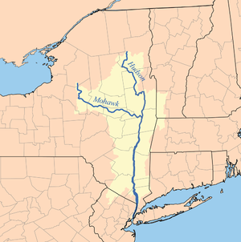
Hudson River
Albany
Watershed:
14,000 sq mi
(36,260 km²)
source: Wikipedia
Notes:
Map of the Hudson River (credit: Wikipedia)
Rain falls on land and runs downhill into river.
The land that supplies the river is called its watershed.
Shaded area is the Hudson’s watershed.
But only part of it delivers water to the river above Albany, the point we will focus upon.

Slide 12
discharge
amount of water per unit time
that passes a specific point on the river bank
measured in m³/s
Notes:
How do you quantify the amount of water flowing in a river?
Volume of water per unit time ... called discharge
measured in cubic meters per second

Slide 13
What properties would you expect discharge to have?
Notes:
The idea here is to try to connect the data, discharge, to physical
properties of the river system

Slide 14
What properties would you expect discharge to have?
water flows in one direction – down hill
discharge positive
stream flow fairly steady over minutes hours
more variable over days and weeks
stream flow increases after a period of rain
Notes:
Here are three important properties of discharge that one might surmise by recollecting a river
its sign – always positive
it period of variability – steady over a few minutes, variable over weeks and seasons
increase after rain – because rain in the source of river water

Slide 15
What about the typical size of discharge?
Notes:
the size of the measurement is also important.
is it ten cubic meters per second or a million?

Slide 16
What about the typical size of discharge?
v
h
w
slab of water of volume
w×h×v
flows by per unit time
Notes:
Quick back of the envelope envelope calculation to determine the size of discharge.
Think of the water moving in a river as sequence of many “slabs”,
each moving downhill through the river channel.
The discharge is the volume a slab that is “one second” long,
that is, it passes by an observer in one second.
That’s its area time its velocity

Slide 17
What about the typical size of discharge?
1 m/s
10 m
100 m
discharge = w×h×v = 1000 m³/s
Notes:
Putting some reasonable numbers in, typical of a largish river,
we find that a typical discharge should be around 1000 cubic meters per second.
Emphasize the importance of the units.
Always follow up a number like 1000 with units like cubic meters per second.

Slide 18
What might a plot of discharge vs. time look like? Try to sketch one. Include units on both axes Imagine that there’s a few days of rain during the time period of your sketch
Notes:
Ask the class to sketch a plot of discharge vs. time.
You won’t collect it. Its just to get the students thinking about discharge data.

Slide 19
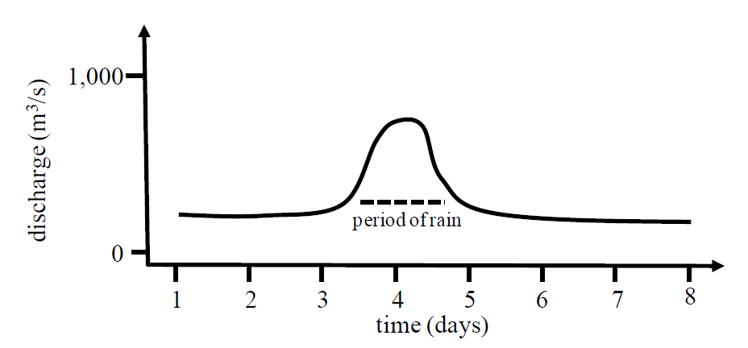
Notes:
Here’s my sketch.
It’s is just my expectation of what discharge might look like.
But being able to make a sketch plot like this is really important.

Slide 20
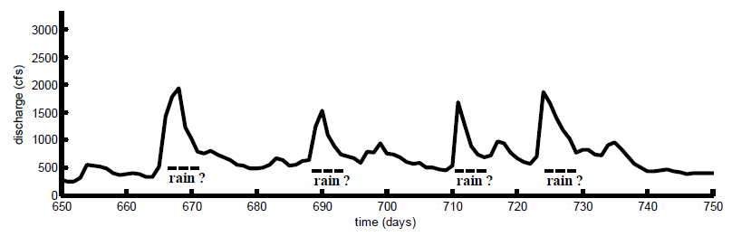
actual discharge for Hudson River at Albany
(time in days after Jan 1, 2002)
Notes:
Here’s some actual discharge data
Note:
time scale: 100 days of data
discharge scale: 0 (no flow) to 3000 (high flow) cubic meters per second
Note the peaks, these are likely periods of rain

Slide 21
What properties would you expect precipitation to have?
precipitation is a positive quantity
time scale of rain very short – minutes to hours
rainy days and dry days
heavy rain is a few inches of rain in a day
Notes:
Now do the same sort of analysis for precipitation.
And sketch a plot of precipitation vs. time.
Line it up with your discharge plot, for comparison.

Slide 22
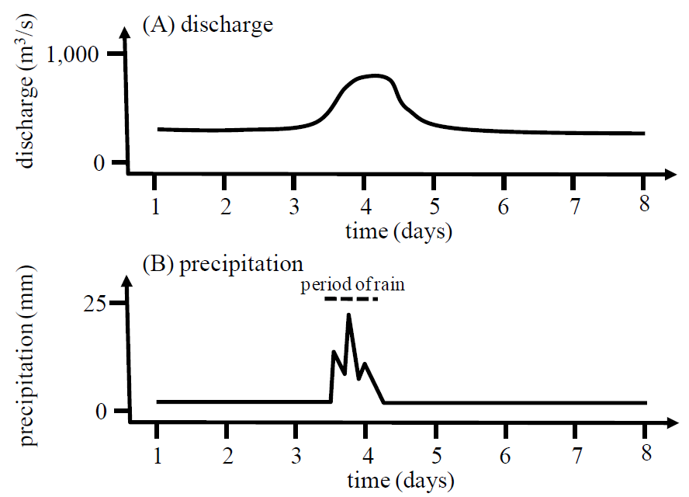
Notes:
Note, I’ve sketched the precipitation to have more short period variability than discharge.

Slide 23
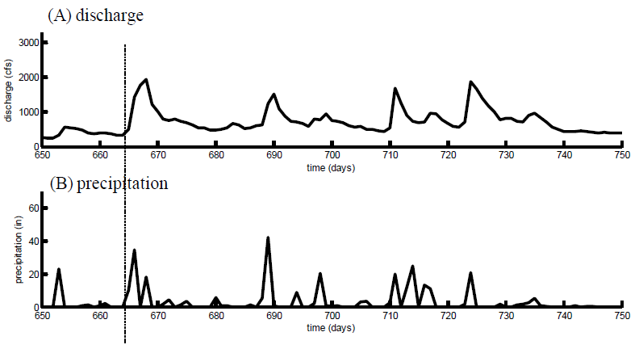
actual precipitation in Albany NY
Notes:
Here’s the actual data for Albany.

Slide 24
do the graphs meet your expectations?
Notes:
Does it meet your expectations? Ask the students to look closely at the relative amplitudes of the peaks.

Slide 25
pattern of peaks similar but not exact
highest discharge
highest precipitation
Why?
Notes:
The amplitudes of the peaks are not exactly proportional. Ask the student to hypothesize why that is.

Slide 26
pattern of peaks similar but not exact
highest discharge
highest precipitation
Why? Rain at Albany an imperfect proxy for rain over watershed
Notes:
The rain gauge at Albany is not a completely accurate proxy for rainfall over the entire Hudson River watershed.

Slide 27
shape of peaks different
longer pulse with steep rise
and slow decline
short pulse
Why?
Notes:
Encourage the students to think about the physical processes that lead to rainfall in the watershed becoming river water that passes the hydrographic station, and the time scales involved.

Slide 28
shape of peaks different
longer pulse with steep rise
and slow decline
short pulse
Why? Rain takes time to drain from the land
Notes:
Note that the shapes of a pulse in rain and the corresponding pulse in discharge are not
quite the same, because it takes time for the water to train from the land into the river.
Discharge has a ‘tail’ (period of slow decline) after the rain stops.

Slide 29
predict discharge from precipitation
Notes:
Here’s something you might want to do with precipitation data:
Predict discharge on the basis of rain.

Slide 30
predict discharge from precipitation
rain takes time to flow
from the land
to the river
Notes:
It’s important to build into your thinking the idea of the delay.
Rainwater takes time to flow from the land into the river.

Slide 31
predict discharge from precipitation
rain takes time to flow
from the land
to the river
the discharge today
depends upon
precipitation over the last few days
Notes:
So discharge today depends not only on precipitation today,
but over the last few days

Slide 32
now for an example of
of advanced data analysis method
(which we will eventually get to in this course)
which help explore this relationship
Notes:
The object is not for students to fully understand this part of the example,
but only see that the data analysis techniques that they will later learn
can be quite powerful in exploring relationships between data

Slide 33
its mathematical expression: discharge d is a running average of precipitation p
physical idea:
discharge is delayed
since rainwater takes time to flow
from the land to the river
Notes:
Mathematically, this might be considered a running average.
Discharge one a given day is a running average of
precipitation during the last few days/

Slide 34
discharge
precipitation
sum
d
p
today
for that day
for that day
present and past days
weights
in the running average
Notes:
formula for a running average
discharge “d” today
is sum of precipitation “p” on present and past days
weighted by a factor “w”.
“w” is different for each day, but is larger for days in the “recent” past than the “deep past”
since most of the rainwater flows to the land quickly, in the first few days.

Slide 35
example d₅ = w₁p₅ + w₂p₄ + w₃p₃ ...
discharge on day i
precipitation in the past
weights
Notes:
formula for a running average
di, discharge on day i, now with indices
writing the sum out for one illustrative day, say day 5
discharge on day 5 =
precipitation on day 5, times a weight w1
plus
precipitation on day 4, times a weight w2
plus
precipitation on day 3, times a weight w3
and so forth

Slide 36
so the details behind the idea that
rainwater takes time to drain from the land are captured by the weights
w₁ w₂ w₃ w₄ ...
Notes:
The weights w1, w2, w3, ... embody the idea that rainwater takes time
to run from the land to the river.
If we knew the weights, we could predict discharge from the precipitation.
In this class, we will eventually get to the point where we could calculate the weights
based on a time period where we observed both precipitation and discharge
we could then use these weights for other periods of time, too, where we had
precipitation but nit discharge.
For now, we will simply guess a set of weights, and see how we do.

Slide 37
only recent precipitation affects discharge
weights decline exponentially with time in the past
c
T₁
T₂
weights determined by trial and error
Notes:
Here’s a reasonable formula for w (but just a guess).
Since we expect recent precipitation to be the most important,
the weights should decline with days, so let’s use a sum of two declining exponentials.
The term exp(j/T1) corresponds to weights that die away with a characteristic time scale of T1 days.
Similarly, the term exp(j/T2) corresponds to weights that die away with a characteristic time scale of T2 days.
The two exponentials are added together with a constant c, which controls the relative importance of the longer time scale.
Now we find the constants T1, T2 and c by trial and error.

Slide 38
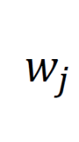
time j
Notes:
The term exp(j/3) corresponds to weights that die away with a characteristic time scale of 3 days.
Similarly, the term exp(j/30) corresponds to weights that die away with a characteristic time scale of 30 days.
The long time scale is less important, so it has a coefficient of 1/10.

Slide 39
Notes:
Here’s the resulting prediction. Ask the students what is “right” and “wrong” about it.

Slide 40
Part 2:
Using MATLAB
Notes:
NOTE: Both a MATLAB and Python tutorial probably will fit into a single lecture. So if your class uses both, you will need to schedule a separate tutorial for one or the other. This would be a good time to provide the students with advice on how they can get a copy of MATLAB, e.g. through a school software license or by purchasing it on their own.

Slide 41
goals of this part of lecture
get you started using
MATLAB
as a tool for analyzing data
Notes:
This lecture just teaches the bare essentials. Furthermore, everything is presented in terms of
commands typed into a LiveScript, rather than through manipulation of the
MATLAB Graphical User Interface (GUI). But by all means, encourage the students to take advantage
of the functionality provided by the GUI.

Slide 42
MATLAB Fundamentals
Notes:
Emphasize that this lecture covers just enough to get people going.

Slide 43
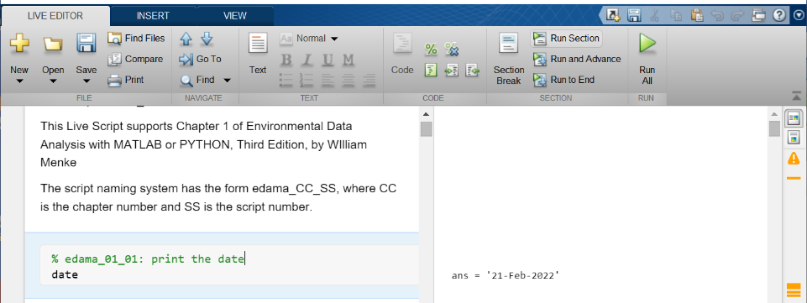
LiveScript Window
Notes:
We will be using “LiveScripts”.

Slide 44
“section” of code
Notes:
You type code in to a “section” of the left-hand window.

Slide 45
Run Section
Notes:
You run the section by clicking the “Run Section” button

Slide 46
Results appear here
Notes:
Results appear in the right-hand window, next tp the section. Results can include text, graphs, images, etc.

Slide 47
LiveScript – your code and the output it produces
date
ans = '21-Feb-2022'
you type this in the left section
then you run the section
and MATLAB prints this at the right
Notes:
Mention that it’s easy to create a new section

Slide 48
Use comments to document and explain your code
comment
starts with #
Notes:
Comments are used to explain what’s happening in the code. They have no effect on the results. They begin with a percent sign.

Slide 49
Files and Folders
Provide a way to organize your data and data analysis products
- use meaningful and predictable names
- design a folder hierarchy that helps you keep track of things
Notes:
Mention that “folders” are also called “directories”.

Slide 50
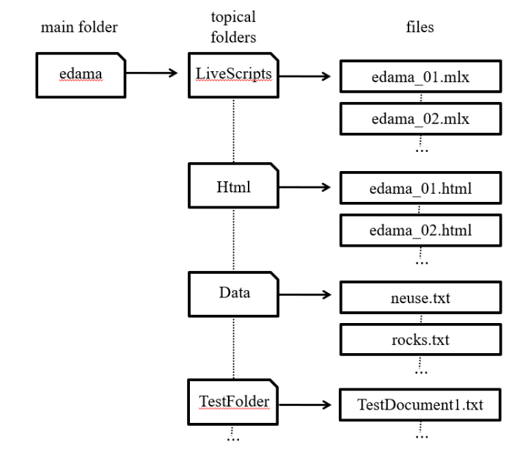
Example: file/folder structure used in text
Notes:
Point out that the large boxes represent folders, the small ones files.
Also mention the usefulness of predictable folder and file names.

Slide 51
Commands for Navigating Folders
pwd
cd c:/menke/docs/eda/ch01
cd ..
cd ch01
dir
displays current folder
change to a folder in a specific place
change to the parent folder
change to the named folder that within the current one
display all the files and folders in the current folder
Notes:
Students should be encouraged to use the MATLAB GUI to navigate, too. But they should learn these commands, too, since can be used within scripts.

Slide 52
Simple Arithmetic
a=3.5;
b=4.1;
c=a+b;
c
c =
7.6000
you type this
MALTAB replies with this
Notes:
Mention that the semicolon suppresses the displaying of a value. The final command displays the results. It is used in preference to omitting the semicolon on the previous line because, in a script, the editing of a working command can introduce errors. Its better to have a line that does nothing but display the result.

Slide 53
A more complicated formula
a=3;
b=4;
c = sqrt(a^2 + b^2);
c
c =
5
you type this
MATLAB replies with this
Notes:
Mention that ^ is used to indicate a power, that is b^2 is b squared.
Mention that the square root is treated as a function, sqrt().

Slide 54
Another complicated formula
n=2; x=3; x0=1; L=5;
c = sin(n*pi*(x-x0)/L);
c
c =
0.5878
you type this
MATLAB replies with this
Notes:
Mention the use of nested parenthesis.

Slide 55
MATLAB LiveScript
Stored in a file with an extension ‘.mlx’ that can be run section-by-section or all at once.
Advantages over spreadsheet - Speeds up repetitive tasks
- Can be checked over for correctness
- Documents what you did
Disadvantages:
- Variables can hide what’s actually going on.
Notes:
A LiveScript does a better job at documenting what you dis than does a spreadsheet. But it also makes the data a little harder to see than when it is presented in spreadsheet format

Slide 56
Example of a LiveScript
% eda01_03
% example of simple algebra,
% c=a+b with a=3.5 and b=4.1
a=3.5;
b=4.1;
c=a+b;
c
comments
in LiveScript edama_01_03.m
Notes:
LiveScript with comments at the top

Slide 57
Running a LiveScript
you position the cursor to the correct section
and then click on the “Run Section” button
MATLAB
writes this into
the right-hand window
c =
7.6000
Notes:
Results section after running the LiveScript

Slide 58
Vectors and Matrices
r = [2, 4, 6];
c = [1, 3, 5]’;
M =[ [1, 4, 7]', [2, 5, 8]', [3, 6, 9]'];
Notes:
Be sure to distinguish row-vectors from column-vectors, since they cannot be interchanged in formulas. Mention that a matrix can be entered in many different ways. The text uses column-vectors in preference to row-vectors, so our preference here is to assemble a matrix from a concatenation of column vectors. But the notation M=[1,2,4;4,5,6;7,8,9]; which views M as a concatenation of row-vectors, works as well.

Slide 59
Transpose Operator
Swap rows and columns of an array, so that
Standard mathematical notation: a^{T}
MatLab notation: a’
1
2
3
4
becomes [ 1, 2, 3, 4 ] (and vice versa)
Notes:
Be aware that M’ is actually the Hermitian transpose of M, that is M’=M*’, where * signifies complex conjugation. The distinction is not important for real matrices. The notion M.’ gives the transpose of M without complex conjugation. This should not be mentioned to the class at this point.

Slide 60
Vector Multiplication
Let’s define some vectors and matrices
a = [1, 3, 5]’;
c = [3, 4, 5]’;
M =[ [1, 0, 2]', [0, 1, 0]', [2, 0, 1]'];
N =[ [1, 0,-1]', [0, 2, 0]', [-1,0, 3]'];
Notes:
Note that column vectors are created as transposed row vectors. The notation a = [1; 2; 3]; works as well.

Slide 61
Inner (or Dot) Product
s = a'*b;
Notes:
This part of the lecture should serve to review the basic operations of linear algebra. Show on the board how a row-vector is dotted with a column-vector by draping the row-vector to align with the column-vector, multiplying adjacent elements and adding. Use sweeping hand motions for emphasis. Mention that the dot product of a vector with itself yields the squared length of the vector.

Slide 62
Outer (or Tensor) Product
T = a*b’;
Notes:
Don’t omit discussion of the tensor product. It is really useful for creating useful MATLAB matrices.

Slide 63
Product of a Matrix and a Vector
c = M*a;
Notes:
Do this one of the board, again with sweeping hand motions, and emphasize it similarity to the dot product. Each tow of the matrix is dotted into the input vector to produce one element of the output vector.

Slide 64
Product of a Matrix and a Matrix
P = M*N;
Notes:
Do this one of the board, again with sweeping hand motions, and emphasize it similarity to the dot product. Each row of the first matrix is dotted into each column of the second matrix, to produce one element of the output matrix.

Slide 65
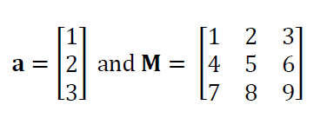
Element Access
s = a(2);
t = M(2,3);
b = M(:,2);
Notes:
Mention that the colon means “the entire row or column”. Mention that a mnemonic for A(row,column) is “Arc”.

Slide 66
Element Access
c = M(2,:)';
T = M(2:3,2:3);
Notes:
Mention that the 2:3 means “the part of the row or column from element 2 to element 3”. Mention the notation 2:end also works. Mention other uses of the colon notation, e.g. that [1:5]=[1,2,3,4,5] and that [5:-1:1]=[5,4,3,2,1].

Slide 67
Looping
A loop is a mechanism to repeat a group of commands several times, each time with a different value of a variable.
Generally speaking, MATLAB vector arithmetic is rich enough that loops usually can be avoided.
However, some people – and especially beginners - find loops to be clearer than the equivalent non-loop commands. If you’re one of them, USE LOOPS, at least at the start.
Notes:
Generally, I find that novice users find loops to be more intuitive than complex function that avoid loops.

Slide 68
Example of a FOR Loop
a=[1, 2, 3, 4, 3, 2, 1]’;
b=[3, 2, 1, 0, 1, 2, 3]’;
N=length(a);
Dot product using vector arithmetic
c = a’*b;
Dot product using loop
c = 0;
for i = [1:N]
c = c+a(i)*b(i);
end
Notes:
Go over the functioning of the loop, and especially how the variable i takes on a different value each time through the loop. Mention that for and end need to be paired. Note that our use of the square brackets in [1:N] is unnecessary; we do it to emphasize the presence of a vector. Just 1:N would work as well.

Slide 69
Another Example of a FOR Loop
without looping
N = fliplr(M);
with looping
for i = [1:3]
for j = [1:3]
N(i,4-j) = M(i,j);
end
end
Notes:
Describe how nested loops work. Mention the need to use different variables for each loop. Show on the board that when j=[1,2,3], the quantity 4-j is [3,2,1]. Mention the convenience of a function such as fliplr() and give the students some advice on how to track down useful functions (e.g. using the help command, searching the Web, etc).

Slide 70
Matrix Inverse
B = inv(A);
Notes:
Remind students that a matrix has to be square to have an inverse, and that not all square matrices have inverses.

Slide 71
Slash and Backslash Operators
c = A\b;
D = B/A;
Notes:
Point out that the direction of the slash is related to which quantity is in the numerator of the fraction. Mention that the combined quantity (A-inverse)b can be computed more easily than can (A-inverse) itself. The slash and backslash operator makes use of this efficiency.

Slide 72
Loading Data Files
I downloaded stream flow data from the US Geological Survey’s National Water Information Center for the Neuse River near Goldboro NC for the time period, 01/01/1974-12/31/1985. These data are in the file, neuse.txt. It contains two columns of data, time (in days starting on January 1, 1974) and discharge (in cubic feet per second, cfs). The data set contains 4383 rows of data. I also saved information about the data in the file neuse_header.txt.
Notes:
Mention the importance of maintaining a notes, such as shown here, that describes: 1) where a data file came from; 2) what it contains; and what’s been done to it.

Slide 73
A text file of tabular data is very easy to load into MatLab
D = load(‘,,/Data/neuse.txt’);
t = D(:,1);
d = D(:,2);
Notes:
Mention that you must either be in the directory containing the file, or give a relative path (as is sone here), or given the full pathname of the file. We do not discuss the MATLAB Path settings anywhere in the text, but if you want to, this would be a good place.

Slide 74
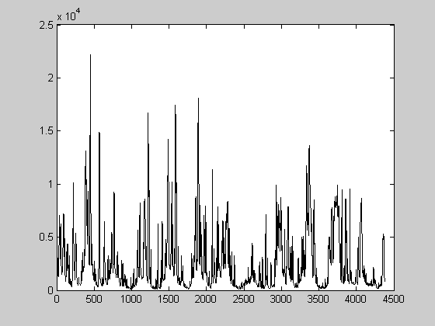
A Simple Plot of Data
plot(t,d);
Notes:
Mention this is a quick plot, using just the default plotting parameters and without any annotations.

Slide 75
A Somewhat Better Controlled Plot
set(gca,'LineWidth',2);
plot(t,d,'k-','LineWidth',2);
title('Neuse River Hydrograph');
xlabel('time in days');
ylabel('discharge in cfs');
make the axes thicker
plot black lines of width 2
title at top of figure
label x axis
label y axis
Notes:
Mention that the ‘k-’ for “black line” is one of many codes for controlling the plotting symbol. Other examples are ‘r:’ for a red dotted line and ‘go’ for green circles. We have noticed that on some Windows operating systems, PDF files of figures will contain extremely thin (and nearly invisible) lines unless the ‘gca’ command is included. This problem may, of course, be fixed in future releases of that operating system.

Slide 76
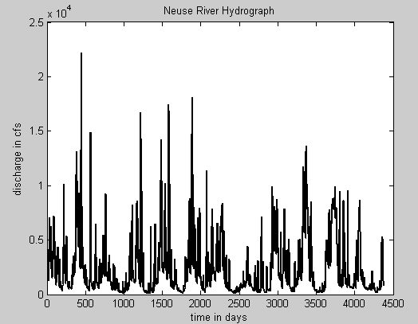

Slide 77
Writing a Data File
example: convert cfs to m³
f=35.3146;
dm = d/f;
Dm(:,1)=t;
Dm(:,2)=dm;
dlmwrite(‘neuse_metric.txt’,Dm,’\t’);
Notes:
Note cfs = cubic feet per second. Mention that a delimiter is the character used to separate numbers. It is set here to a tab, denoted ‘\t’.

Slide 78
Finding and Using Documentation
Notes:
You should check that this section still contains sensible advice. It depends on the MathWorks web site, which may change with time.

Slide 79
MatLab Web Site is one place that your can get a description of syntax, functions, etc.
Notes:
Simple doing a web search works pretty well, too. For instance: “MATLAB extract diagonal of matrix”

Slide 80
Example 1: the LENGTH command
Can be very useful in finding exactly what you want if you’ve only found something close to what you want!

Slide 81
. . . (two more pages below)
Example 2: the SUM command
Some commands have long, complicated explanations. But that’s because they can be applied to very complicated data objects. Their application to a vector is usually short and sweet.

Slide 82
Scripting Advice
Notes:
Give the class a sense of how much scripting you will expect them to do in homework and class projects.

Slide 83
#1
Think about what you want to do before starting to type in code!
Block out on a piece of scratch paper the necessary steps
Without some forethought, you can code for a hour, and then realize that what you’re doing makes no sense at all.
Notes:
Emphasize the need to plan how code should work.

Slide 84
#2
Sure, cannibalize a program to make a new one …
But keep a copy of the old one …
And make sure the names are sufficiently different that you won’t confuse the two …
Notes:
Choice of file names and organization in folders is essential

Slide 85
#3
Be consistent in the use of variable names
amin, bmin, cmin, minx, miny, minz
Don’t use variable names that can be too easily confused, e.g xmin and minx.
(Especially important because it can interact disastrously with MATLAB automatic creation of variables. A misspelled variable becomes a new variable).
guaranteed to cause trouble
Notes:
Informative variable names lead to code being self-documenting. But inconsistent naming convections can cause trouble.

Slide 86
#4
Build code in small section, and test each section thoroughly before going in to the next.
Make lots of plots to check that vectors look sensible.
Notes:
Incremental approach is especially important for novice coders. Every significant step should be checked.

Slide 87
#5
Test code on smallish simple datasets before running it on a large complicated dataset
Build test datasets with known properties. Test whether your code gives the right answer!
Notes:
Always test a script on input with a known “answer”

Slide 88
#6
Don’t be too clever!
Inscrutable code is very prone to error.
Notes:
Simple code is better than complicated code, even if it takes longer to execute.
Most time is spent developing code, not running it.

Slide 89
Part 3:
Using Python
Notes:
NOTE: Both a MATLAB and Python tutorial probably will fit into a single lecture. So if your class uses both, you will need to schedule a separate tutorial for one or the other. This would be a good time to provide the students with instructions for downloading and install Python and related software. The python_notes document may help, but I recommend that you check whether anything has changed in the installation procedure since it was last updated.

Slide 90
goals of this part of lecture
get you started using
Python
as a tool for analyzing data
Notes:
This lecture just teaches the bare essentials. Furthermore, everything is presented in terms of
commands typed into cells of the Jupyter Notebook, and does not use the many features that
can be accessed via the Notebook’s many menus. But by all means, introduce a few to the students that you
think are especially important.

Slide 91
Python Fundamentals
Notes:
Emphasize that this lecture covers just enough to get people going.

Slide 92
Python Jupyter Notebook
Notebook stored in a file with an extension ‘ipynb’ that can be run cell-by-cell or all at once.
Advantages - Speeds up repetitive tasks
- Can be checked over for correctness
- Documents what you did
Disadvantages:
- Variables can hide what’s actually going on.
Notes:
A Notebook does a better job at documenting what you dis than does a spreadsheet. But it also makes the data a little harder to see than when it is presented in spreadsheet format

Slide 93
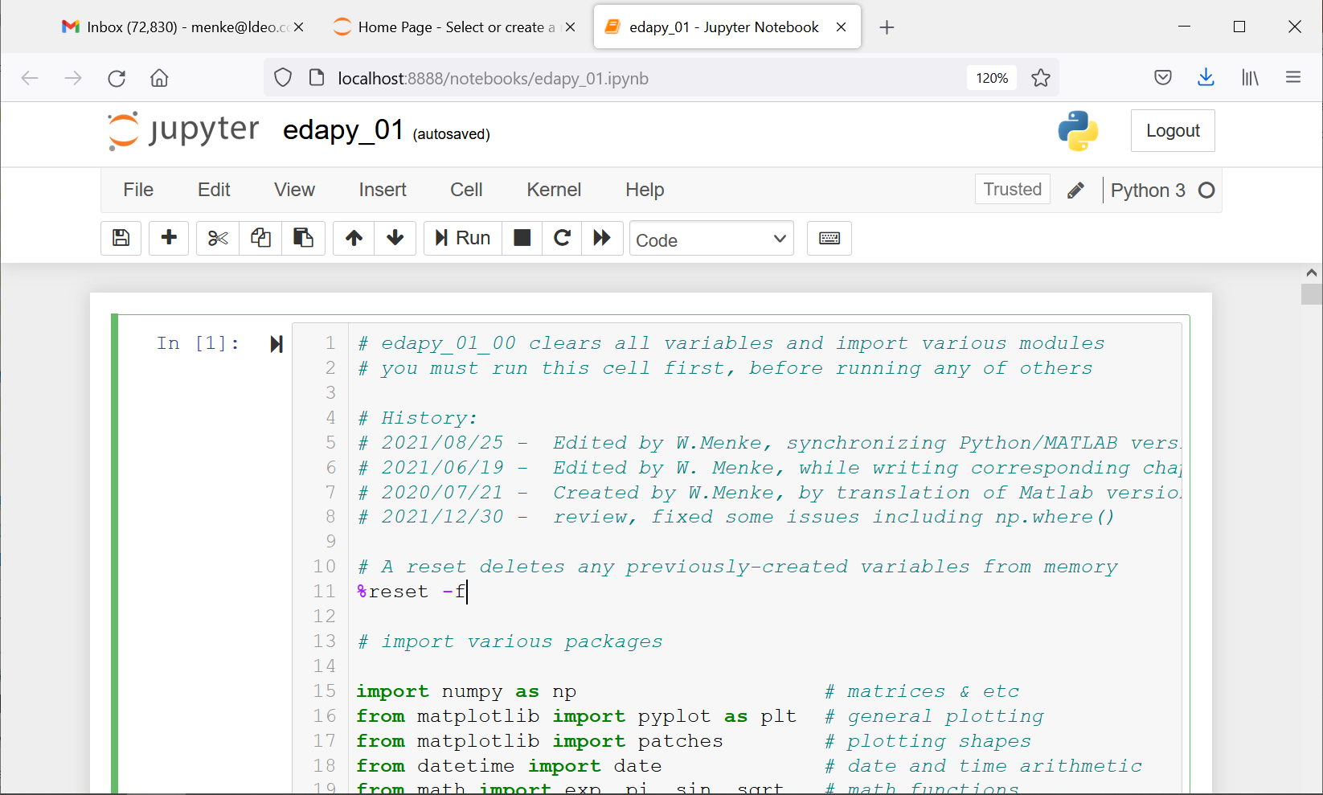
Jupyter Notebook
Notes:
We will be using Jupyter Notebook. The version here is running in web browser.

Slide 94
Jupyter Notebook
Cell 1 sets up the environment, and must be run first
Notes:
The way that I have set up the eda software is that cell 1 does all the initialization. So it must always be run first. When students create their own Notebook, I recommend that the just copy Cell 1 from one of the eda Notebooks and paste it into Cell 1 of their Notebook. I would not explain what the Cell one does in any detail. It’s complications should be avoided at this point.

Slide 95
Jupyter Notebook
Note the cell does a reset (to clear environment) and then installs various packages, such as numpy
Notes:
However, you should mention that cell 1 clears (deletes) all existing variables and reloads all the packages, like numpy.

Slide 96
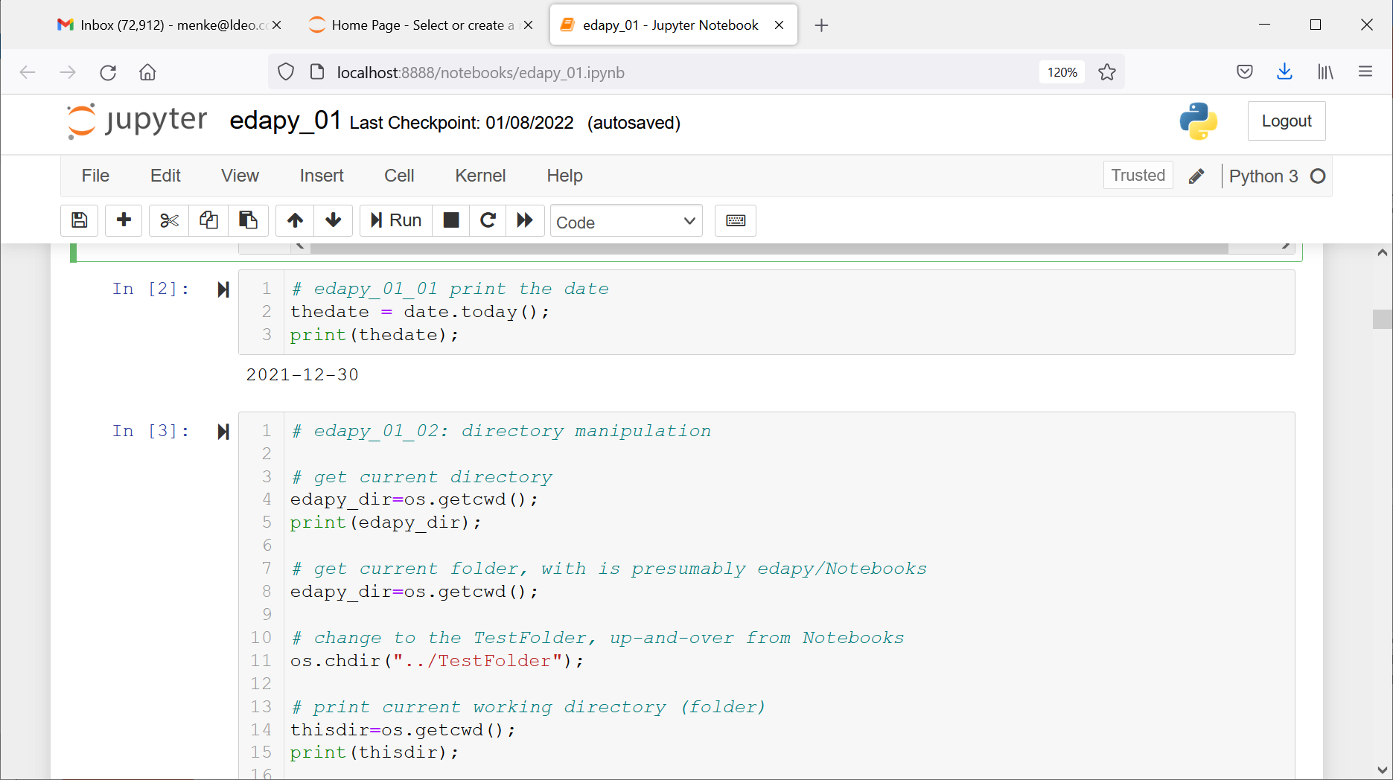
A simple piece of code
“cell” of code
Notes:
You type code in to a “cell” of the left-hand window.

Slide 97
A simple piece of code
run the cell
Notes:
Then click on the cell to position the cursor there, and then click the “run” button

Slide 98
A simple piece of code
results
Notes:
Results appear below the cell.

Slide 99
LiveScripts – you code and the output it produces
# edapy_01_01 print the date
thedate = date.today();
print(thedate);
you type
this into
the cell
then you run the cell
2021-12-30
and the results
appear below
the cell
Notes:
Mention that it’s easy to create a new cell.

Slide 100
Use comments to document and explain your code
# edapy_01_01 print the date
thedate = date.today();
print(thedate);
comment
Notes:
Comments are used to explain what’s happening in the code. They have no effect on the results. They begin with a hash-tag.

Slide 101
Creating a variable
# edapy_01_01 print the date
thedate = date.today();
print(thedate);
Create a variable “thedate” with the value of today’s date by calling the “today” method of the “date” module.
Notes:
The equal sign means “set the value to” and does not mean “equality” in the normal mathematical sense.
Emphasize that a large fraction of code involves setting the value of variables.
The concepts of modules and methods is explained in the next slide.

Slide 102
Printing the value of a variable
# edapy_01_01 print the date
thedate = date.today();
print(thedate);
Print the value of the variable “thedate”
Notes:
The print() function can print more-or-less anything, though not always in the most aesthetic fashion.

Slide 103
module (or package):
publicly-available library of code that extends the functionality of python
method
a component of a module that provides
specific functionality
date.today()
module name
method name
Notes:
The equal sign means “set the value to” and does not mean “equality” in the normal mathematical sense.
Emphasize that a large fraction of code involves setting the value of variables.
The concepts of modules and methods is explained in the next slide.

Slide 104
some modules used in this class:
date
date manipulation
numpy
matrix arithmetic
scipy
scientific functions
matplotlib
plotting
os
file/folder manipulation
Notes:
The version of Python used in this class is extended with many modules. These modules are imported into the Python environment in Cell 1. Finding out which modules exist and are right for any given application is tricky.

Slide 105
Files and Folders
Provide a way to organize your data and data analysis products
- use meaningful and predictable names
- design a folder hierarchy that helps you keep track of things
Notes:
Mention that “folders” are also called “directories”.

Slide 106
Example: file/folder structure used in text
Notes:
Point out that the large boxes represent folders, the small ones files.
Also mention the usefulness of predictable folder and file names.

Slide 107
Commands for Navigating Folders
os.getcwd();
os.chdir("TestFolder");
os.chdir("..");
mydirlist=os.listdir();
print(mydirlist);
determined current folder
change current folder to “../TestFolder”
change to the parent folder
get list of files in director and print them
Notes:
These os module can be called within a script to change the current folder (or current working directory, as it is sometime called), to list the files in a director, etc. This functionality is especially handy when processing a large number of data files.

Slide 108
Simple Arithmetic
a = 3.5;
b = 4.1;
c = a+b;
print(c);
7.6000
you type this
This appears below the cell
Notes:
Mention that you must print a variable to see its value.

Slide 109
A more complicated formula
a = 3.0;
b = 4.0;
c = sqrt(a**2 + b**2);
print(c);
5.0
you type this
This appears below the cell
Notes:
Mention that ** is used to indicate a power, that is b**2 is b squared.
Mention that the square root is treated as a function, sqrt().

Slide 110
Another complicated formula
n = 2; x = 3; x0 = 1; L = 5;
c = sin(n*pi*(x-x0)/L);
print(c);
0.5877852522924732
you
type
this
This appears below the cell
Notes:
Mention that several commands can be typed on a line, separated by semicolons.
Mention the use of nested parenthesis.
Mention that print() printed out way to many significant digits!

Slide 111
Vectors and Matrices
3
c = eda_cvec( [1.,3.,5.] );
r = eda_cvec( [2.,4.,6.] ).T;
A = np.array( [[1., 2., 3.],
[4., 5., 6.],
[7., 8., 9.]] );
Notes:
Be sure to distinguish row-vectors from column-vectors, since they cannot be interchanged in formulas. In this book, we use primarily column-vectors; that is, arrays that are Nx1 (and not lists that are Nx0 or row-vectors that are 1xN). I encourage the use of the eda_cvec() function, which creates Nx1 column-vectors from more-or-less anything.
Mention that a matrix can be entered in many different ways. The text uses column-vectors in preference to row-vectors, so our preference here is to assemble a matrix from a concatenation of column vectors. But the notation M=[1,2,4;4,5,6;7,8,9]; which views M as a concatenatuon of row-vectors, works as well.

Slide 112
Vectors and Matrices
3
c = eda_cvec( [1.,3.,5.] );
r = eda_cvec( [2.,4.,6.] ).T;
A = np.array( [[1., 2., 3.],
[4., 5., 6.],
[7., 8., 9.]] );
function that creates a column-vector from more of less anything
“array” method of
numpy module
(which Cell 1 abbreviates as “np”_
Notes:
Be sure to distinguish row-vectors from column-vectors, since they cannot be interchanged in formulas. In this book, we use primarily column-vectors; that is, arrays that are Nx1 (and not lists that are Nx0 or row-vectors that are 1xN). I encourage the use of the eda_cvec() function, which creates Nx1 column-vectors from more-or-less anything. Mention that the numpy module has been abbreviated as “np” in Cell 1. Also mention that methods can have arguments (meaning the stuff that appears inside the parentheses of np.array().

Slide 113
Transpose Operator
Swap rows and columns of an array, so that
Standard mathematical notation: a^{T}
Python notation: a.T
1
2
3
4
becomes [ 1, 2, 3, 4 ] (and vice versa)
Notes:
The notion a.T gives the transpose of a.

Slide 114
addition of column-vectors
Notes:
Adding column-vectors is easy. Just use the plus-sign.

Slide 115
addition of column-vectors
“ones” method of
numpy module
makes matrix of all ones
Notes:
Adding matrices is easy, too. Just use the plus-sign.

Slide 116
Multiplication
dot-product
“matmul” method of
numpy module
multiplies matrices
Notes:
In this book, I call most methods using a “function” type. I have several reasons for this choice: (1) my sense that the alternate notation s=(a.T).matmul(b); is more difficult for novice students; (2) Avoiding a problem introduces by the Python left-to-right convention, that u=A.matmul(B).matmul(v) is evaluated as u=(A*B)*v whereas the more sensible order is u=A*(B*v ); and (3) to maintain as much structural similarity to MATLAB as possible. However, I do not prevent students from using the “dot” syntax.

Slide 117
Outer (or Tensor) Product
Notes:
Don’t omit discussion of the tensor product. It is really useful for creating useful matrices.

Slide 118
Product of a Matrix and a Vector
Notes:
Do this one of the board, again with sweeping hand motions, and emphasize it similarity to the dot product. Each tow of the matrix is dotted into the input vector to produce one element of the output vector.

Slide 119
Product of a Matrix and a Matrix
Notes:
Do this one of the board, again with sweeping hand motions, and emphasize it similarity to the dot product. Each row of the first matrix is dotted into each column of the second matrix, to produce one element of the output matrix.

Slide 120
Element Access
In Python
indices
start with zero
Notes:
In Python, upper-left element of matrix A is A[0,0], in contrast to standard linear algebra notation, where it is denoted A₁₁.

Slide 121
Element Access
$$B=\left[\begin{matrix}1 & 2 & 3 \\ 4 & 5 & 6 \\ 7 & 8 & 9\end{matrix}\right]$$
$$b$$
Notes:
Mention that the 2:3 means “the part of the row or column from element 2 to element 3”. Mention the notation 2:end also works. Mention other uses of the colon notation, e.g. that [1:5]=[1,2,3,4,5] and that [5:-1:1]=[5,4,3,2,1].

Slide 122
Element Access
$$B=\left[\begin{matrix}1 & 2 & 3 \\ 4 & 5 & 6 \\ 7 & 8 & 9\end{matrix}\right]$$
$$b$$
“copy” method of the numpy module
Notes:
B[0:3,1:2] is a “view” into B, not a separate variable. So it must be copied, else changing B also changes b (which is seldom desired).

Slide 123
Element Access
$$B=\left[\begin{matrix}1 & 2 & 3 \\ 4 & 5 & 6 \\ 7 & 8 & 9\end{matrix}\right]$$
$$b$$
from row 0 up to but not including row 3
Notes:
Emphasize the “up to but no including” part of the notation.

Slide 124
Element Access
$$B=\left[\begin{matrix}1 & 2 & 3 \\ 4 & 5 & 6 \\ 7 & 8 & 9\end{matrix}\right]$$
$$b$$
from column 1 up to but not including column 2
Notes:
If you don’t specify the start and end indices for both the rows and columns, you don’t get a column-vector as output. So I always put them in.

Slide 125
Looping
A loop is a mechanism to repeat a group of commands several times, each time with a different value of a variable.
Generally speaking, Python vector arithmetic is rich enough that loops usually can be avoided.
However, some people – and especially beginners - find loops to be clearer than the equivalent non-loop commands. If you’re one of them, USE LOOPS, at least at the start.

Slide 126
Example of a FOR Loop
$$M=\left[\begin{matrix}1 & 2 & 3 \\ 4 & 5 & 6 \\ 7 & 8 & 9\end{matrix}\right]$$
$$a$$
using a for loop
initialize a to column-vector of zeros
i=0:
a[0,0]=M[0,0];
i=1:
a[1,0]=M[1,1];
i=2:
a[2,0]=M[2,2];
Notes:
Go over the functioning of the loop, and especially how the variable i takes on a different value each time through the loop. Mention that for-statement has a colon and that subsequent statements inside the loop are indented.

Slide 127
Example of a FOR Loop
$$M=\left[\begin{matrix}1 & 2 & 3 \\ 4 & 5 & 6 \\ 7 & 8 & 9\end{matrix}\right]$$
$$a$$
using a for loop
using a method
a = eda_cvec(np.diagonal(A));
Notes:
Many loops can be avoided by using pre-existing method, such as numpy’s diagonal() method. However, you have to learn how the method works. In this case, there is a hiccup in that np.diagonal(0) returns an Nx0 list, not a Nx1 column-vector, and so eda_cvec() need to be called to convert it to a column-vector.

Slide 128
Another Example of a FOR Loop
$$A=\left[\begin{matrix}1 & 2 & 3 \\ 4 & 5 & 6 \\ 7 & 8 & 9\end{matrix}\right] and B=\left[\begin{matrix}3 & 2 & 1 \\ 6 & 5 & 4 \\ 9 & 8 & 7\end{matrix}\right]$$
initialize B to column-vector of zeros
i=0 and j=0:
B[0,2]=A[0,0];
i=0 and j=1:
B[0,1]=A[0,1];
i=0 and j=2:
B[0,0]=A[0,2];
i=1 and j=0:
B[1,2]=A[1,0];
and so forth
Notes:
Describe how nested loops work. Mention the need to use different variables for each loop. Show on the board that when j=[0,1,2], the quantity 2-j is [2,1,0].

Slide 129
Another Example of a FOR Loop
$$A=\left[\begin{matrix}1 & 2 & 3 \\ 4 & 5 & 6 \\ 7 & 8 & 9\end{matrix}\right] and B=\left[\begin{matrix}3 & 2 & 1 \\ 6 & 5 & 4 \\ 9 & 8 & 7\end{matrix}\right]$$
using a method
B = np.fliplr(A);
Notes:
Mention the convenience of a method such as np.fliplr() and give the students some advice on how to track down useful methods (e.g. using the help command, searching the Web, etc).

Slide 130
Matrix Inverse
B = la.inv(A);
“la” abbreviation for “scipy.linalg”
Notes:
Remind students that a matrix has to be square to have an inverse.

Slide 131
Combination of Inverse and vector
c = la.solve(A,b);
Notes:
Mention that the combined quantity (A-inverse)b can be computed more easily than can (A-inverse) itself, using the solve() method.

Slide 132
Loading Data Files
I downloaded stream flow data from the US Geological Survey’s National Water Information Center for the Neuse River near Goldboro NC for the time period, 01/01/1974-12/31/1985. These data are in the file, neuse.txt. It contains two columns of data, time (in days starting on January 1, 1974) and discharge (in cubic feet per second, cfs). The data set contains 4383 rows of data. I also saved information about the data in the file neuse_header.txt.
Notes:
Mention the importance of maintaining a notes, such as shown here, that describes: 1) where a data file came from; 2) what it contains; and what’s been done to it.

Slide 133
A text file of tabular data is very easy to load into MatLab
Notes:
A simple text file of tab-delimited values can be read into a matrix using the genfromtxt() method.

Slide 134
A text file of tabular data is very easy to load into MatLab
matrix
data file
tab
Notes:
Here, “D” is the matrix, ,“neuse.txt” is the data file, and “\t” (for tab) is the delimiter (the character separating data entries).

Slide 135
A text file of tabular data is very easy to load into MatLab
shape
N=rows M=columns
Notes:
The shape() method returns the number of rows and columns in a matrix.

Slide 136
A text file of tabular data is very easy to load into MatLab
copy data to
time vector and
data vector v
Notes:
I believe that copying columns of a data vector to individual variables with well-chosen names can avoid errors being made
(e.g. by mistyping an column index number).

Slide 137
A Simple Plot of Data
Notes:
Mention this is a quick plot, using just the default plotting parameters and without any annotations.

Slide 139
A Simple Plot of Data
create figure 1 of 5x5 size
Notes:
Create figure 1, with a size that is 5 by 5. Although the variable “fig1” can be used to refer to the figure, we will seldom have the need to do so.

Slide 140
A Simple Plot of Data
this figure contains a 1x1 grid of plots, with the current plot being 1
Notes:
The figure consiss of a 1x1 grid of plots, and subsequent plot commands act on the first of them. Although the variable “ax1” can be used to refer to the plot, we will seldom have the need to do so.

Slide 141
A Simple Plot of Data
make a graph with horizontal coordinate specified by t, vertical coordinate by d, with the symbols a black line (abbreviated ‘k-’)
Notes:
Mention that many symbols are available. For instance, ‘ro’ means that the symbols are red circles.

Slide 142
A Simple Plot of Data
the plot is now done, so show it below the cell
Notes:
You need to use show() to ensure the relative positioning of text printed with the print() function and graphs created with the plt module,

Slide 143
A Somewhat Better Controlled Plot
plt.title('Neuse River Hydrograph');
plt.xlabel('time in days');
plt.ylabel('discharge in cfs');
title at top of figure
label x axis
label y axis
Notes:
Mention that these are just a few of the methods that be used to improve the appearance of a plot.

Slide 144
Writing a Data File
example: convert cfs to m³
f = 35.3146;
t = D[0:N,0:1];
d = D[0:N,1:2];
dm = d/f;
# concatenate time, discharge into a matrix C
C = np.concatenate( (t,dm),axis=1);
# save matrix to file of tab-separated values
np.savetxt("../Data/neuse_metric.txt",C, delimiter="\t");
Notes:
The time vector is t and the original data vector is d. The data is converted to new units by dividing by a factor f, resulting in a new data vector dm. Time t and data rm are concatenated into a two-column matrix C using the numpy concatenate() method. Here axis=1 means side-by-size. The new data re written to the file "../Data/neuse_metric.txt“ using tabs (denoted “\t”) as the delimiter.
A delimiter is the character used to separate numbers. It is set here to a tab, denoted ‘\t’.

Slide 145
Finding and Using Documentation
Notes:
You should check that this section still contains sensible advice. It depends on web sites of individual packages, which may change with time.

Slide 146
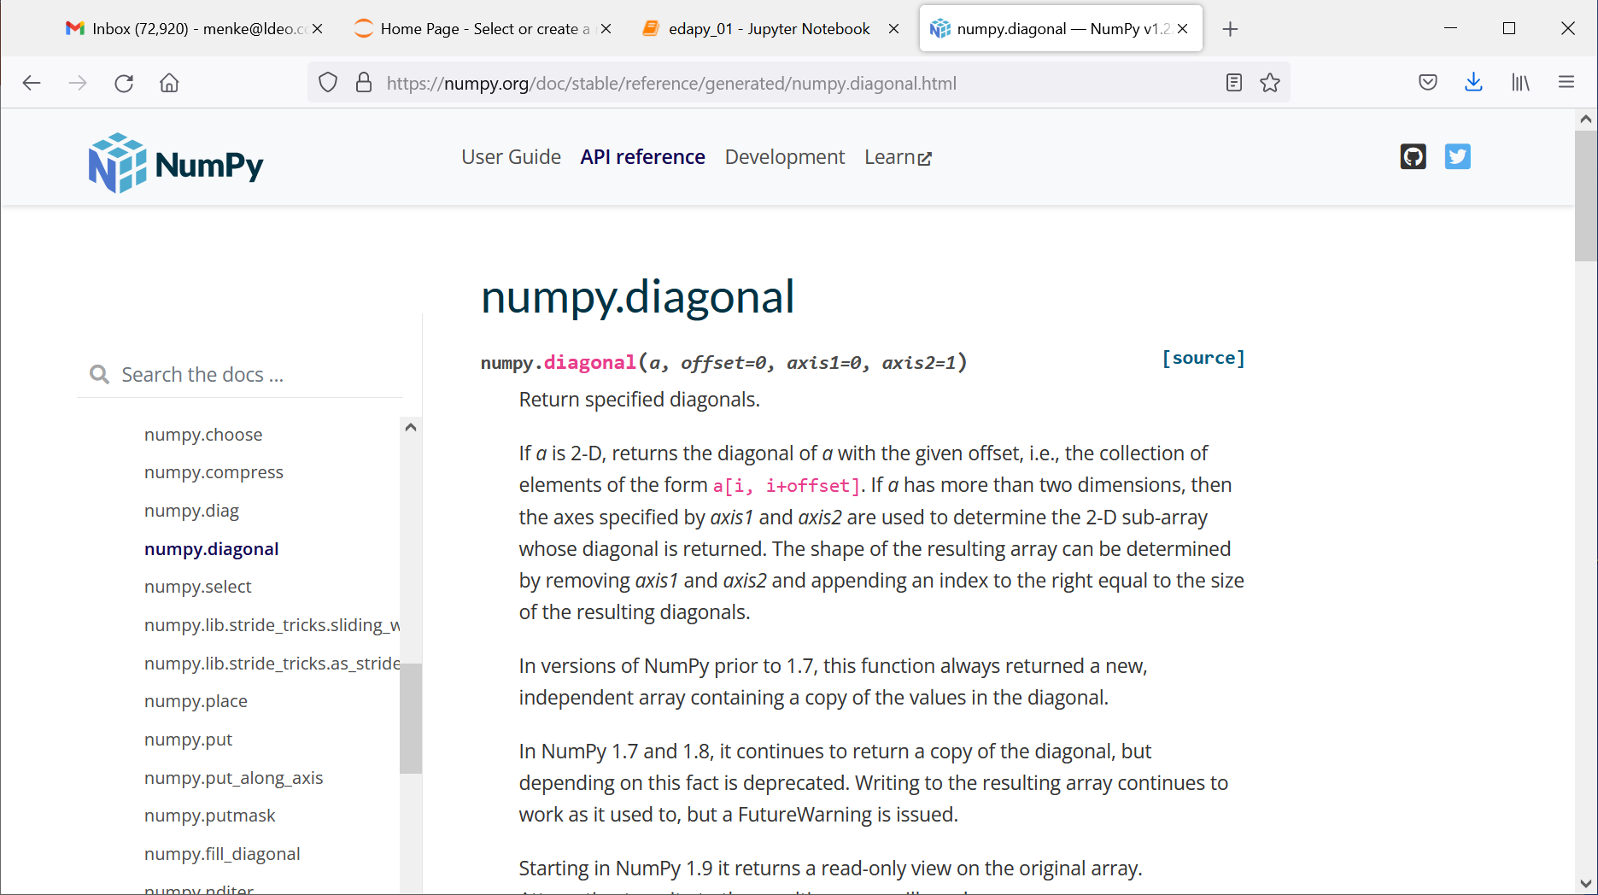
on-line manuals of the various packages e.g. numpy
Notes:
googling “scipy solve” led me to this page on the solve() method.

Slide 147
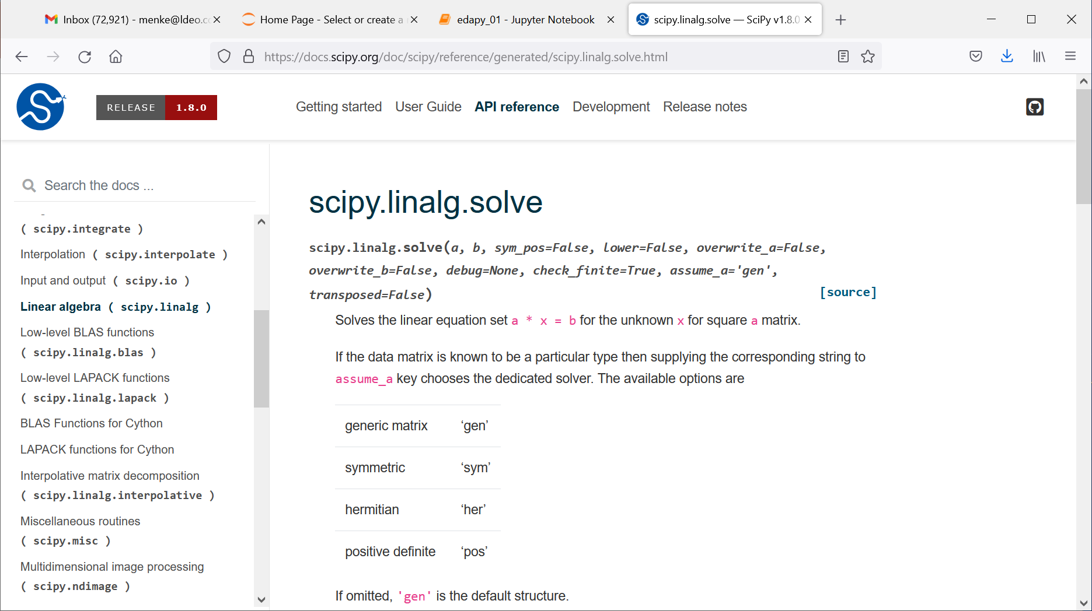
and scipy
Notes:
googling “numpy diagonal” led me to this page on the diagonal() method.

Slide 148
Scripting Advice
Notes:
Give the class a sense of how much scripting you will expect them to do in homework and class projects.

Slide 149
#1
Think about what you want to do before starting to type in code!
Block out on a piece of scratch paper the necessary steps
Without some forethought, you can code for a hour, and then realize that what you’re doing makes no sense at all.
Notes:
Emphasize the need to plan how code should work.

Slide 150
#2
Sure, cannibalize a program to make a new one …
But keep a copy of the old one …
And make sure the names are sufficiently different that you won’t confuse the two …
Notes:
Choice of file names and organization in folders is essential

Slide 151
#3
Be consistent in the use of variable names
amin, bmin, cmin, minx, miny, minz
Don’t use variable names that can be too easily confused, e.g xmin and minx.
(Especially important because it can interact disastrously with MATLAB automatic creation of variables. A misspelled variable becomes a new variable).
guaranteed to cause trouble
Notes:
Informative variable names lead to code being self-documenting

Slide 152
#4
Build code in small section, and test each section thoroughly before going in to the next.
Make lots of plots to check that vectors look sensible.
Notes:
Incremental approach is especially important for novice coders. Every significant step should be checked.

Slide 153
#5
Test code on smallish simple datasets before running it on a large complicated dataset
Build test datasets with known properties. Test whether your code gives the right answer!
Notes:
Always test a script on input with a known “answer”

Slide 154
#6
Don’t be too clever!
Inscrutable code is very prone to error.
Notes:
Simple code is better than complicated code, even if it takes longer to execute.
Most time is spent developing code, not running it.

