Slide 1
Environmental Data Analysis with MATLAB or Python
3rd Edition
Lecture 6

Slide 2
SYLLABUS
Lecture 01 Intro; Using MTLAB or Python
Lecture 02 Looking At Data
Lecture 03 Probability and Measurement Error
Lecture 04 Multivariate Distributions
Lecture 05 Linear Models
Lecture 06 The Principle of Least Squares
Lecture 07 Prior Information
Lecture 08 Solving Generalized Least Squares Problems
Lecture 09 Fourier Series
Lecture 10 Complex Fourier Series
Lecture 11 Lessons Learned from the Fourier Transform
Lecture 12 Power Spectra
Lecture 13 Filter Theory
Lecture 14 Applications of Filters
Lecture 15 Factor Analysis and Cluster Analysis
Lecture 16 Empirical Orthogonal functions and Clusters
Lecture 17 Covariance and Autocorrelation
Lecture 18 Cross-correlation
Lecture 19 Smoothing, Correlation and Spectra
Lecture 20 Coherence; Tapering and Spectral Analysis
Lecture 21 Interpolation and Gaussian Process Regression
Lecture 22 Linear Approximations and Non Linear Least Squares
Lecture 23 Adaptable Approximations with Neural Networks
Lecture 24 Hypothesis testing
Lecture 25 Hypothesis Testing continued; F-Tests
Lecture 26 Confidence Limits of Spectra, Bootstraps
Notes:
26 lectures are sufficient to survey the material in the book. However, not every topic in the book is covered, so students should be encouraged to read the book.

Slide 3
Goals of the lecture
estimate model parameters using the
principle of least-squares
Notes:
Least-squares is a standard way to solve a linear model.

Slide 4
part 1
the least squares estimation of model parameters and their covariance
Notes:
Emphasize that calculating covariance is an integral part of the process. A answer is of no value without information about its accuracy. All estimates of model parameters based on noisy data are inherently uncertain. The key question is how uncertain.

Slide 5
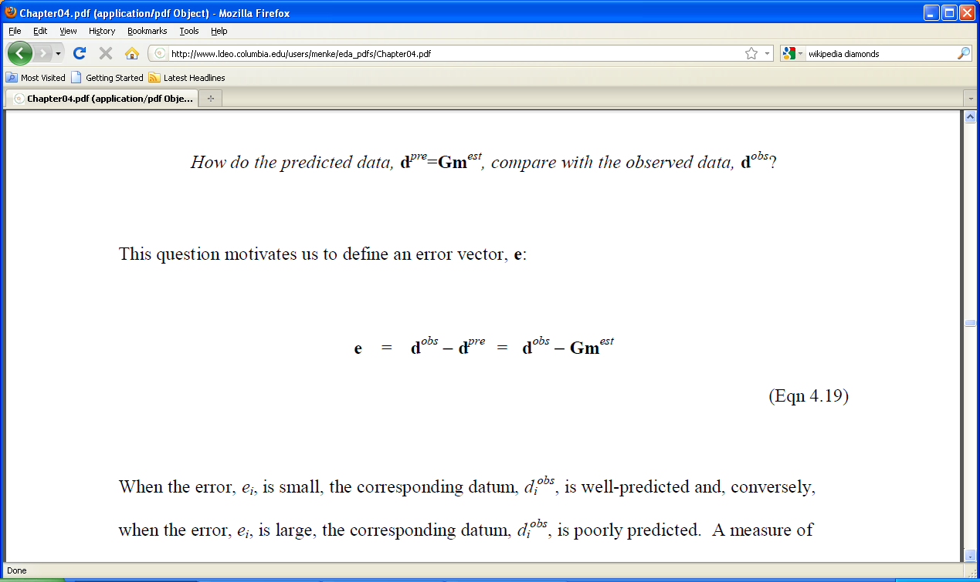
the prediction error
motivates us to define an error vector, e
Notes:
This slide and the next three are review.

Slide 6
prediction error in straight line case
d_{i}^{pre}
e_{i}
data, d
d_{i}^{obs}
auxiliary variable, x
Notes:
Review the distinction between the observed and predicted data.
Review how the error is calculated.

Slide 7
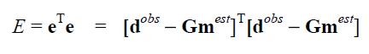
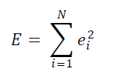
total error single number summarizing the error
sum of squares of individual errors
Notes:
Mention that summary numbers like E are helpful, but also possibly deceptive, because they don’t distinguish “all the data fitting pretty well” from “all but one of the data fitting very well but the one fitting terribly”

Slide 8
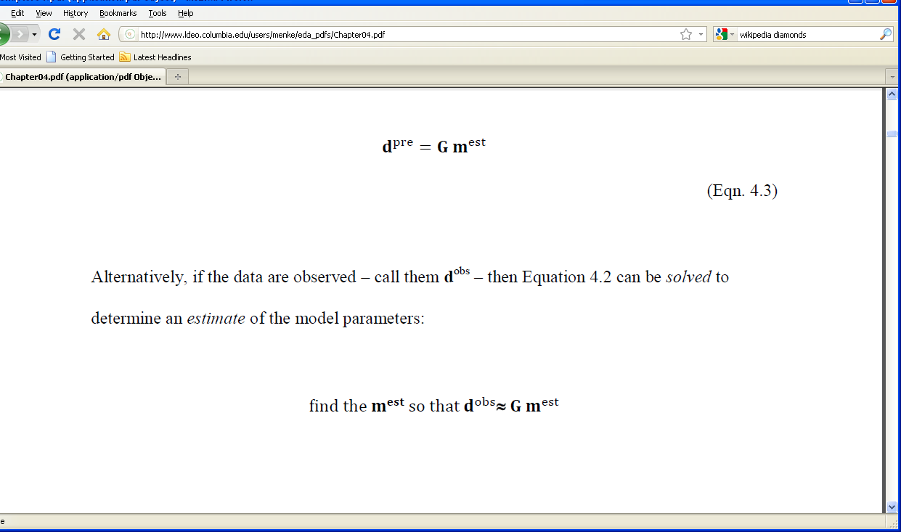
principle of least-squares
that minimizes
Notes:
Remind students that the total error was defined in order to quantify what “about equal” means.

Slide 9
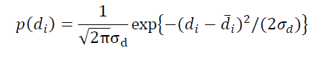
least-squares and probability
suppose that each observation has a Normal p.d.f.
2
Notes:
This is the standard formula for the normal p.d.f., with mean d_i_bar and variance sigma_d_2.

Slide 10
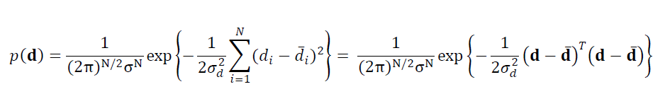
for uncorrelated data the joint p.d.f. is just the product of the individual p.d.f.’s
least-squares formula for E
suggests a link between probability and least-squares
Notes:
uncorrelated data means that if d1 is unusually small are large, there is not tendancy for d2 to be unusually small of large, too.

Slide 11
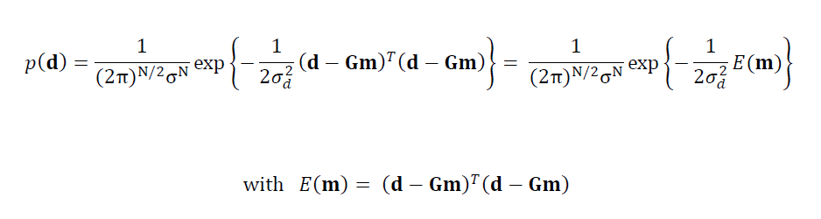
now assume that Gm predicts the mean of d
Gm substituted for d
minimizing E(m) is equivalent to maximizing p(d)
Notes:
Here we have asserted that dbar = Gm, that is, the model preducts the average data.

Slide 12
the principle of least-squares determines the m that makes the observations
“most probable” in the sense of maximizing p(d^{obs})
Notes:
Emphasize the strong link between two ways of thinking about goodness-of-fit, one involving error, the other involving probability.

Slide 13
the principle of least-squares determines the model parameters that makes the observations
“most probable”
(provided that the data are Normal) this is the principle of maximum likelihood
Notes:
The notion of most probable data may need further explanation. Image a million hypothetical sets of model parameters, each of which predict a datasets with a different error E, measured with respect to the true dataset. The ones with predicted data closest to the true data, which are also the ones with the lowest E, are in some sense the “most probably correct”.

Slide 14
a formula for m^{est} at the point of minimum error, E
∂E / ∂m_{i} = 0 so solve this equation for m^{est}
Notes:
Remind students that this minimization is the same one that is typically encountered in elementary calculus courses.

Slide 15
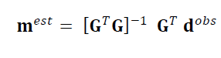
Result
Notes:
The result is moderately simple formula.

Slide 16
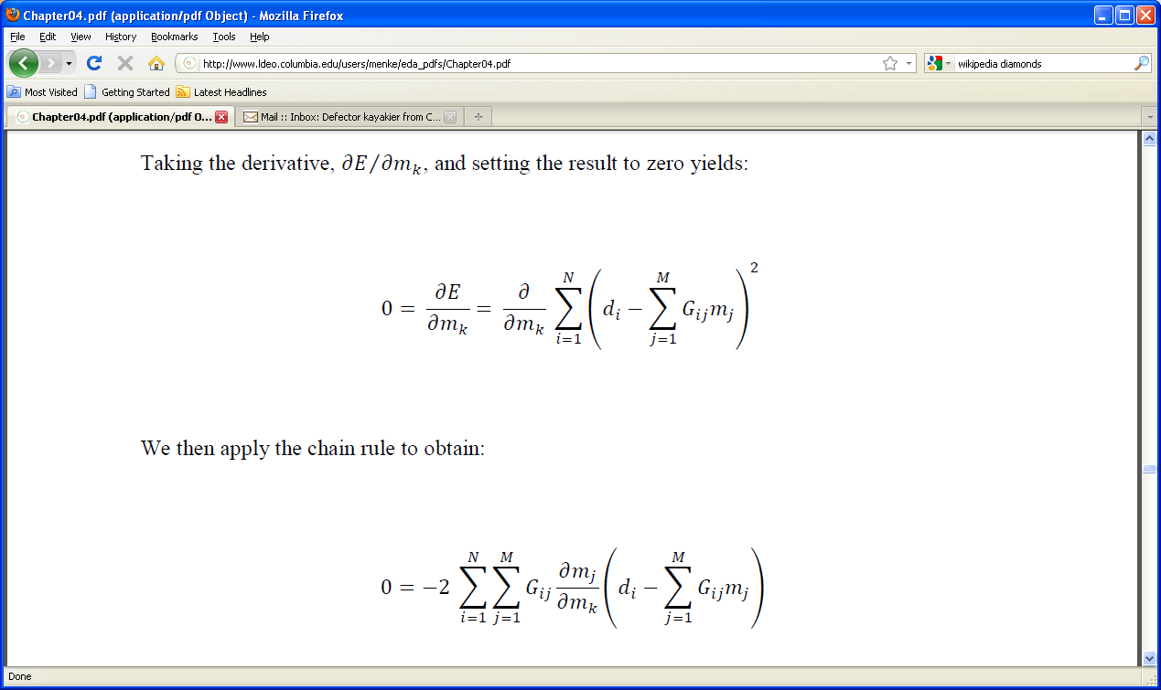
where the result comes from
E =
so
Notes:
Consider skipping the next several slides if your students don’t have a strong math background.

Slide 17
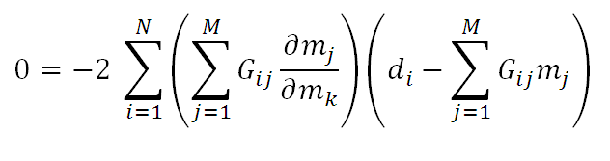
unity when k=j zero when k≠j since m’s are independent
use the chain rule
so just delete sum over j and replace j with k
Notes:
The rule the dmi/dmj = I_ij, wher I is the identity matrix, is an importamt one that is used in almost all such derivations. So if you are including this material, you ought to make sure that the students understand it.

Slide 18
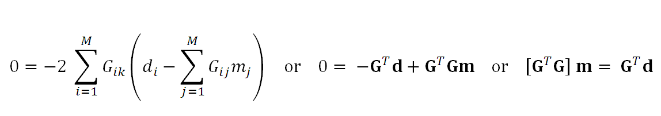
which gives
Notes:
You might mention that the matric GT G is called the Gram Matrix. In practice, the equation in the upper right, [GT G] m = [GT d], is the one that is solved to get the soluton.

Slide 19
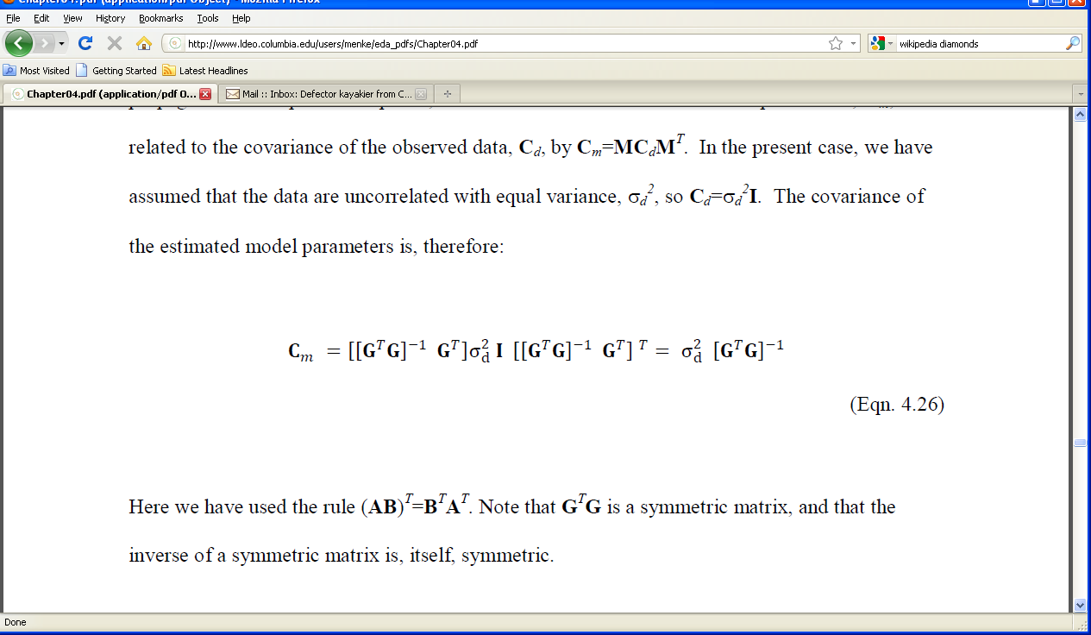
covariance of m^{est}
m^{est} is a linear function of d of the form m^{est} = M d
so C_{m} = M C_{d} M^{T}, with M=[G^{T}G]⁻¹G^{T}
assume C_{d} uncorrelated with uniform variance, σ_{d}²
then
Notes:
Show how many of the factors in the expression cancel one another.

Slide 20
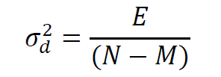
two methods of estimating the variance of the data
prior estimate: use knowledge of measurement technique
the ruler has 1mm tic marks, so σ_{d}≈½mm
posterior estimate: use prediction error
Notes:
You should point out that the posterior error may be too large if the theory is a poor one. E.g. if you fit a parabola with a straight line, you will get some sort of “best fit”, but it will have much more error than can be accounted for by measurement error, alone.

Slide 21
posterior estimates are overestimates when the model is poor
reduce N by M since an M-parameter model can exactly fit N data
Notes:
You might give the example of fitting a straight line (M=2) to three data. (N-3), in which case N-M=1. Since the line can go through any two of the points,only the third has error. If the error of that third ppoint is e3, then the best estimate of the variance of the data is (e_3)^2 / 1 not (e_3)^2 / 3.

Slide 22
confidence intervals for the estimated model parameters
(assuming uncorrelated data of equal variance)
so
σ_{mi} = √[C_{m}]_{ii}
and
m=m^{est}±2σ_{mi} (95% confidence)
Notes:
Remind students that 95% confidence is the minimum standard in science.

Slide 23
MATLAB script for least squares solution
mest = (G’*G)\(G’*d);
Cm = sd2 * inv(G’*G);
sm = sqrt(diag(Cm));
Notes:
Emphasize that this solution works regardless of the details of G.
Explain use of backslash operator.
Explain that the diag() function extracts the main diagonal from a matrix and puts it in a vector.

Slide 24
Python script for least squares solution
GTG = np.matmul(G.T,G);
mest = la.solve( GTG, np.matmul(G.T, dobs) );
Cm = sd2*la.inv(GTG);
sm = eda_cvec( np.sqrt(np.diag(Cm)) );
Notes:
Emphasize that this solution works regardless of the details of G. Explain that solve() has been applied to the equation GTG m = GT d
Explain that the diag() function extracts the main diagonal from a matrix and puts it in a Mx0 list,
which is turned into an Mx1 column-vector by eda_cvec().

Slide 25
part 2
exemplary least squares problems

Slide 26
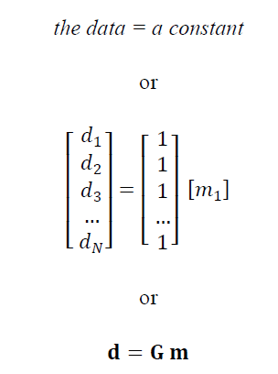
Example 1: the mean of data
the constant
will turn out to be the mean
Notes:
The model “data = a constant” implies that the data scatter about a typical value.

Slide 27
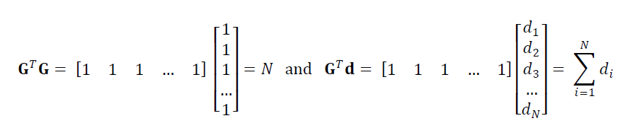
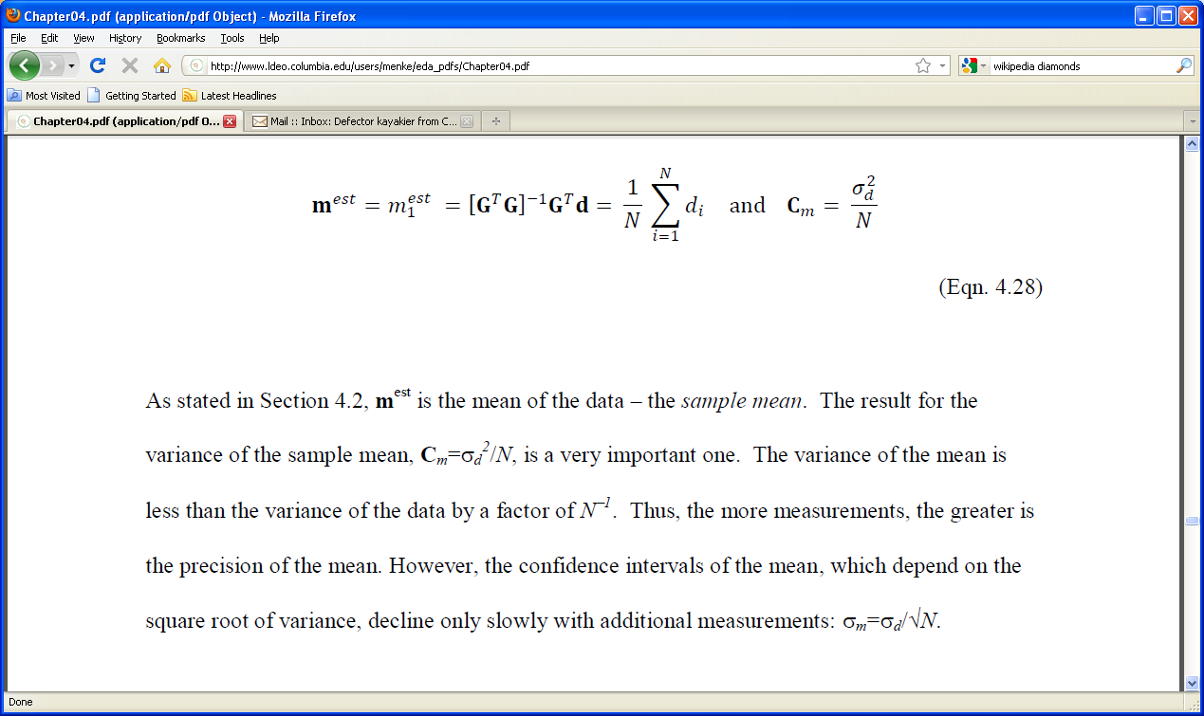
usual formula for the
“sample mean”
variance decreases with number of data
Notes:
Emphasize that the :sample mean” is an estimate of the mean.

Slide 28
formula for sample mean
formula for covariance
combining the two into confidence limits
2σ_{d}
m₁^{est} = d =
±
(95% confidence)
√N
Notes:
Point out that confidence interval narrows as number of data N increase, but only slowly (because of square root)

Slide 29
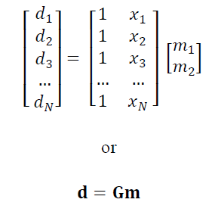
Example 2: fitting a straight line
intercept
slope
Notes:
Point out that the number of model parameters is M=2

Slide 30
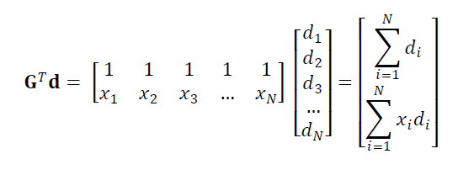
Notes:
Point out how matrix multiplication produces sums.

Slide 31
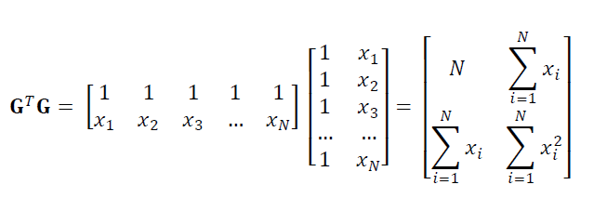
Notes:
Point out how matrix multiplication produces sums.

Slide 32
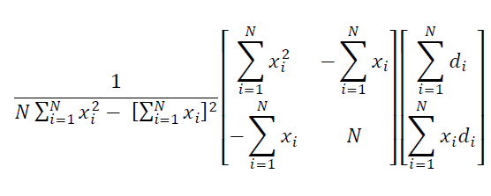
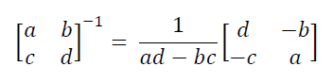
[G^{T}G]⁻¹=
(uses the rule)
Notes:
The 2x2 inverse rule is really handy, so students ought to know it exists.

Slide 33
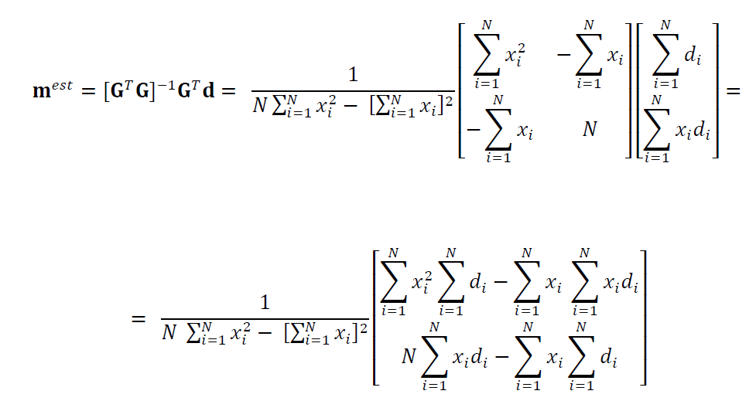
Notes:
This formula often appears in an intro calculus book

Slide 34
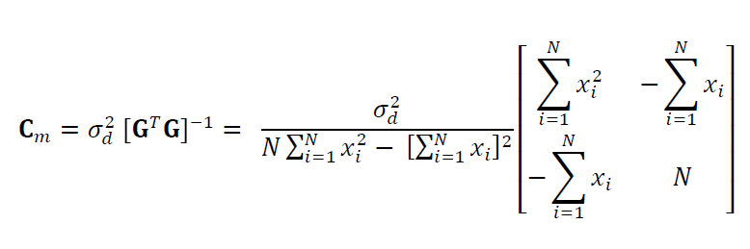
intercept and slope are uncorrelated when the mean of x is zero
Notes:
The implication is that it would be better to formulate the problem with an intercept representing where the line crosses the
y = ymean level, rather than the usual y=0 level.

Slide 35
keep in mind that none of this algrbraic manipulation is needed if we just compute
using MATLAB or Python
Notes:
Although the analytic formulas occasionally are handy, in most cases, one just solved [GT G] m = GT d numerically.

Slide 36
Generic MATLAB script for least-squares problems
mest = (G’*G)\(G’*dobs);
dpre = G*mest;
e = dobs-dpre;
E = e’*e;
sigmad2 = E / (N-M);
covm = sigmad2 * inv(G’*G);
sigmam = sqrt(diag(covm));
mlow95 = mest – 2*sigmam;
mhigh95 = mest + 2*sigmam;

Slide 37
Generic MatLab script for least-squares problems
GTG = np.matmul(G.T,G);
mest = la.solve(GTG,np.matmul(G.T,dobs));
dpre = np.matmul(G,mest);
e = dobs-dpre;
E = np.matmul(e.T,e);
sd2 = E/(N-M);
Cm = sd2*la.inv(GTG);
sm = eda_cvec(np.sqrt(np.diag(Cm)));
mlow95 = mest – 2*sm;
mhigh95 = mest + 2*sm;
Notes:
Note that sd2 is the posterior estimate of the variance of the data.

Slide 38
Example 3:
modeling long-term trend and annual cycle in Black Rock Forest temperature data
d(t)^{obs}
time t, days
d(t)^{pre}
time t, days
error, e(t)
time t, days
Notes:
Note that this plot has the observations, d^{obs}, the “results”, d^{pre}, and the error, e.
The error large in the sense that it is an appreciable fraction of the amplitude of the data.

Slide 39
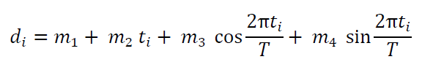
the model:
long-term trend
annual cycle
Notes:
Identify m₂ as the long-term slope. Note that the cosine and sine are paired.

Slide 40
MATLAB script to create the data kernel
M=4;
Ty=365.25;
G=zeros(N,M);
G(:,1)=1;
G(:,2)=t;
G(:,3)=cos(2*pi*t/Ty);
G(:,4)=sin(2*pi*t/Ty);
Notes:
Ty is the number of days in a year, the period of the annual cycle. The functions sin() and cos() operate element-wise.

Slide 41
MATLAB script to create the data kernel
M=4;
Ty = 365.25;
G = np.zeros((N,M));
G[0:N,0:1] = np.ones((N,1));
G[0:N,1:2] = t;
G[0:N,2:3] = np.cos(2*pi*t/Ty);
G[0:N,3:4] = np.sin(2*pi*t/Ty);
Notes:
Ty is the number of days in a year, the period of the annual cycle. Note the need to use the numpy versions of sine and cosine,
which operate element-wise.

Slide 42
prior variance of data based on accuracy of thermometer σ_{d} = 0.01 deg C
posterior variance of data
based on error of fit
σ_{d} = 5.60 deg C
huge difference, since the model does not include diurnal cycle of weather patterns
Notes:
You might discuss the rationale for using one of these estimates over the other. There are arguments both ways. The prior estimate is the better estimate of measurement noise. The posterior estimate more honestly reflects how well the model works (poorly).

Slide 43
long-term slope
95% confidence limits based on prior variance
m₂ = -0.03 ± 0.00002 deg C / yr
95% confidence limits based on posterior variance
m₂ = -0.03 ± 0.00460 deg C / yr
in both cases, the cooling trend is significant, in the sense that the confidence intervals do not include zero or positive slopes.
Notes:
The key point if that the error bars do not overlap the m₂=0, giving confidence to the assertion that the rate is negative.

Slide 44
However
The fit to the data is poor, so the results should be used with caution. More effort needs to be put into developing a better model.
Notes:
Scientists should always be suspicious of models that only poorly fit the data.

Slide 45
part 3
covariance and the shape of the error surface
Notes:
We return to the issue of deriving confidence estimates from the shape of E(m).

Slide 46

solutions within the region of low error are almost as good as m^{est}
m₂^{est}
0
4
m₂
0
m^{est}
large range of m₁
m₁^{est}
E(m)
m_{i}
4
m_{i}^{est}
small range of m₂
m₁
near the minimum the error is shaped like a parabola. The curvature of the parabola controls the with of the region of low error
Notes:
The error surface was shown in the previous lecture. Mention that it was computed via a grid search.

Slide 47
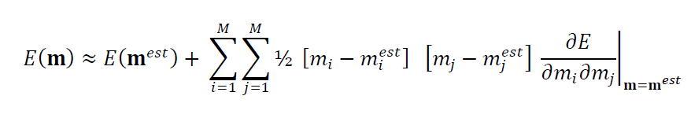
near the minimum, the Taylor series for the error is:
curvature of the error surface
Notes:
You should skip this slide and the nest two if the class has too low a mathematical level to understand Taylor series.

Slide 48
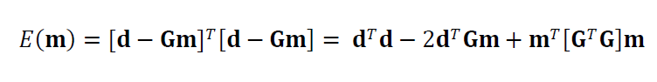
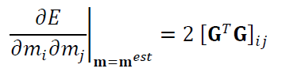
starting with the formula for error
we compute its 2nd derivative

Slide 49
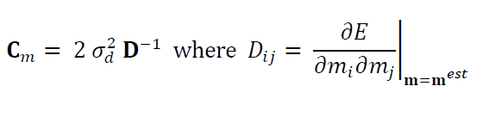
but
so
covariance of the model parameters
curvature of the error surface
Notes:
Covariance is related to the reciprocal of curvature. Low curvature, high covariance. High curvature, lo covariance.

Slide 50
the covariance of the least squares solution
is expressed
in the shape of the error surface
large variance
small variance
E(m)
E(m)
m_{i}
m_{i}
m_{i}^{est}
m_{i}^{est}
Notes:
If you skipped the math, just asset the correspondence between variance and curvature of the error surface,

