Slide 1
Environmental Data Analysis with MATLAB or Python
3rd Edition
Lecture 8

Slide 2
SYLLABUS
Lecture 01 Intro; Using MTLAB or Python
Lecture 02 Looking At Data
Lecture 03 Probability and Measurement Error
Lecture 04 Multivariate Distributions
Lecture 05 Linear Models
Lecture 06 The Principle of Least Squares
Lecture 07 Prior Information
Lecture 08 Solving Generalized Least Squares Problems
Lecture 09 Fourier Series
Lecture 10 Complex Fourier Series
Lecture 11 Lessons Learned from the Fourier Transform
Lecture 12 Power Spectra
Lecture 13 Filter Theory
Lecture 14 Applications of Filters
Lecture 15 Factor Analysis and Cluster Analysis
Lecture 16 Empirical Orthogonal functions and Clusters
Lecture 17 Covariance and Autocorrelation
Lecture 18 Cross-correlation
Lecture 19 Smoothing, Correlation and Spectra
Lecture 20 Coherence; Tapering and Spectral Analysis
Lecture 21 Interpolation and Gaussian Process Regression
Lecture 22 Linear Approximations and Non Linear Least Squares
Lecture 23 Adaptable Approximations with Neural Networks
Lecture 24 Hypothesis testing
Lecture 25 Hypothesis Testing continued; F-Tests
Lecture 26 Confidence Limits of Spectra, Bootstraps
Notes:
26 lectures are sufficient to survey the material in the book. However, not every topic in the book is covered, so students should be encouraged to read the book.

Slide 3
Goals of the lecture
use prior information to solve exemplary problems
Notes:
This lecture mostly consists of examples. You might consider using MatLab during the lecture, to solve some
of the exemplary problems in real-time.

Slide 4
review of last lecture

Slide 5
failure-proof least-squares
add information to the problem that guarantees that matrices like [G^{T}G] are never singular
such information is called
prior information
Notes:
Remind the students that least squares fails when the data do not uniquely specify the solution.
Mathematically, this corresponds to [G^{T}G] being singular.

Slide 6
examples of prior information
soil has density will be around 1500 kg/m³
give or take 500 or so
chemical components sum to 100%
pollutant transport is subject to the diffusion equation
water in rivers always flows downhill
Notes:
If, during the last lecture, the class came up with more examples, mention them here.

Slide 7
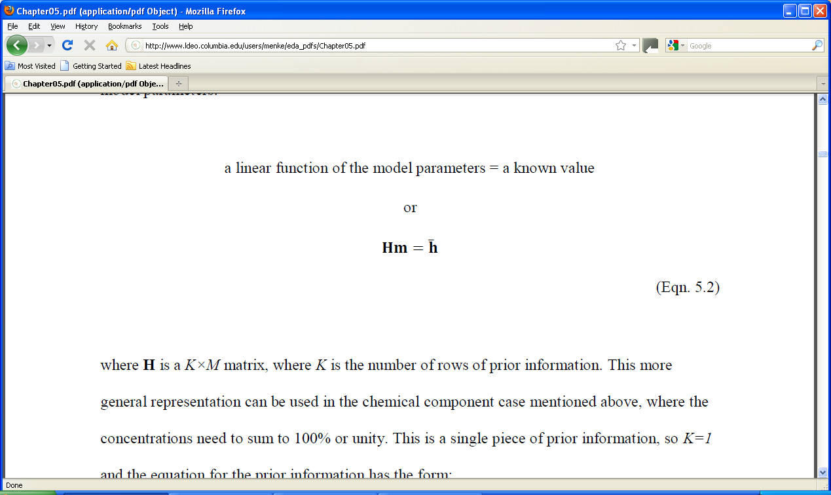
linear prior information
with covariance C_{h}
Notes:
Emphasize that the covariance matrix represents the quality of the prior information.
Is it inaccurate or accurate?

Slide 8
simplest example model parameters near known values
Hm = h with
H=I
h = [10, 20]^{T}
C_{h}=
m₁ = 10 ± 5
m₂ = 20 ± 5
m₁ and m₂ uncorrelated
5² | 0
0 | 5²
Notes:
Use a pointer to show that the known values of (10, 20) wind up in h and the confidence limits of (5,5) wind up in C_{h}.

Slide 9
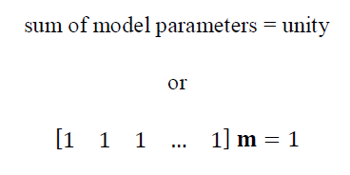
another example relevant to chemical constituents
H
h
Notes:
Mention that the matrix H has only one row. Multiplying m by it just sums the elements of m.

Slide 10
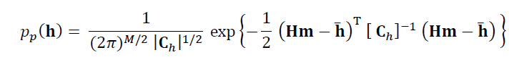
use Normal p.d.f. to represent prior information
Notes:
Mention that this is the standard form of a multivariate Normal distribution. It has mean, h-bar, and covariance, C_{h}.

Slide 11

Normal p.d.f. defines an
“error in prior information”
individual
errors weighted by their certainty
Notes:
Mention that the error is zero when the prior information equation, Hm=h-bar, is satisfied exactly.
Mention that variance is a measure of the width of the p.d.f, so that 1/variance is a measure of it narrowness, that is, its certainty.

Slide 12
now suppose that we observe some data:
d = d^{obs}
with covariance C_{d}
Notes:
Emphasize that the covariance matrix, Cd, represents the quality of the data,
that is, whether it is accurate or inaccurate.

Slide 13
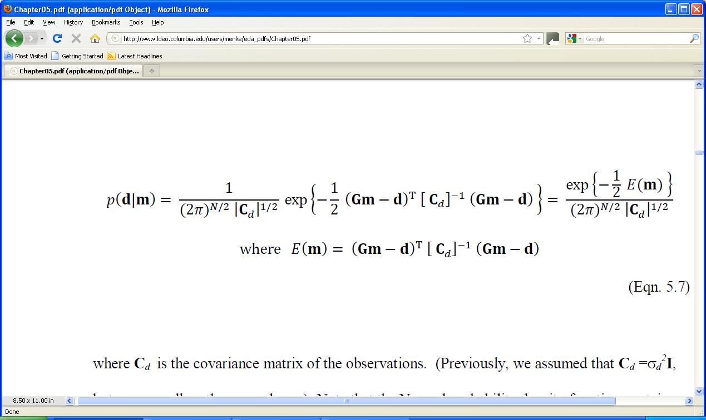
represent the observations with a
Normal p.d.f.
p(d) =
observations
mean of data predicted by the model
Notes:
This is just a standard Normal p.d.f. with the mean set to Gm and the variance to C_{d}.

Slide 14
this Normal p.d.f. defines an
“error in data”
prediction error
weighted by its certainty
Notes:
Mention that this is almost the least-squares error of Chapter 4, except that now each component error is weighted by its certainty.

Slide 15
Generalized Principle of Least Squares the best m^{est} is the one that minimizes the total error with respect to m justified by Bayes Theorem in the last lecture
Notes:
Only differences from ordinary least squares are 1) the error depends on both the prediction error and the error in the prior information. 2) all component errors are weighted by their certainty - the more certain, the more weight that they are given.

Slide 16
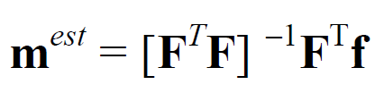
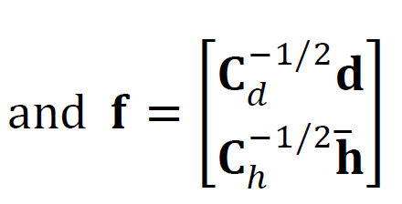
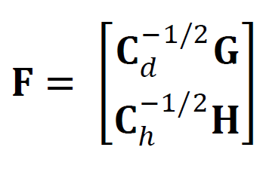
generalized least squares solution
pattern same as ordinary least squares …
… but with more complicated matrices
Notes:
The solution has been arranged to look as much like ordinary least squares as possible.
Some students may not have ever encountered the square root of a matrix, C.
In this lecture, however, we will always assume that the matrix C is diagonal, so that
its square root is just the square root of its diagonal elements.
So you might review show on the board that when you multiply a diaginal matrix by itself,
you just square its diagonal elements.

Slide 17
(new material)
How to use the
Generalized Least Squares Equations

Slide 18
Generalized least squares is equivalent to solving
F m = f by ordinary least squares
=
C_{d}^{-½}G
C_{h}^{-½}H
C_{d}^{-½}d
C_{h}^{-½}h
m
Notes:
You might need to review the notation and explain what a matrix containing sub-matrices is.

Slide 19
uncorrelated, uniform variance case
C_{d} = σ_{d}² I
C_{h} = σ_{h}² I
=
σ_{d}⁻¹G
σ_{h}⁻¹H
σ_{d}⁻¹d
σ_{h}⁻¹h
m
Notes:
You might show on the board how the general form reduces to this simpler one.

Slide 20
top part data equation weighted by its certainty
=
σ_{d}⁻¹G
σ_{h}⁻¹H
σ_{d}⁻¹d
σ_{h}⁻¹h
m
σ_{d}⁻¹ { Gm=d }
data equation
certainty of measurement
Notes:
The top part is just the data equation, weighted by its certainty.

Slide 21
bottom part prior information equation weighted by its certainty
=
σ_{d}⁻¹G
σ_{h}⁻¹H
σ_{d}⁻¹d
σ_{h}⁻¹h
m
σ_{h}⁻¹ { Hm=h }
prior information equation
certainty of prior information
Notes:
The bottom part is just the prior information equation, weighted by its certainty.

Slide 22
example no prior information but data equation weighted by its certainty
σ_{d1}⁻¹G₁₁ | σ_{d1}⁻¹G₁₂ | … | σ_{d1}⁻¹G_{1M}
σ_{d2}⁻¹G₂₁ | σ_{d2}⁻¹G₂₂ | … | σ_{d2}⁻¹G_{2M}
… | … | … | …
σ_{dN}⁻¹G_{N1} | σ_{dN}⁻¹G_{N2} | … | σ_{dN}⁻¹G_{NM}
σ_{d1}⁻¹d₁
σ_{d2}⁻¹d₂
…
σ_{dN}⁻¹d_{N}
=
m
called “weighted least squares”
Notes:
When there is no prior information, the top part (from 2 slides back) is the only part.

Slide 23
straight line fit no prior information but data equation weighted by its certainty
fit
data with low variance
data with high variance
Notes:
In this example, the left half of the data has large variance, and the right half has small variance.
The straight-line fit (green line ) more closely fits the right hand data.

Slide 24
straight line fit no prior information but data equation weighted by its certainty
fit
data with low variance
data with high variance
Notes:
In this example, the right half of the data has large variance, and the left half has small variance.
The straight-line fit (green line ) more closely fits the left hand data.

Slide 25
another example prior information that the model parameters are small m≈0
H=I h=0 assume uncorrelated with uniform variances
C_{d} = σ_{d}² I
C_{h} = σ_{h}² I
Notes:
There are many cases where a list of model parameters fluctuate around zero.
For example, suppose that the model parameters represent the amount of deposition
(when they are positive) and erosion (when they are negative) at different locations
along a river bed.
In these cases, a solution that is near zero is almost always better than a solution
that wildly fluctuating, in an Occam’s razor sense.

Slide 26
Fm=h
m =
σ_{d}⁻¹G
σ_{h}⁻¹I
σ_{d}⁻¹d
σ_{h}⁻¹0
[F^{T}F]⁻¹F^{T}m=f
m=[G^{T}G + ε²I]⁻¹G^{T}d with ε= σ_{d}/σ_{m}
Notes:
Work through the math on the board, step by step.

Slide 27
called “damped least squares”
m=[G^{T}G + ε²I]⁻¹G^{T}d with ε= σ_{d}/σ_{m}
ε=0: minimize the prediction error
ε→∞: minimize the size of the model parameters
0<ε<∞: minimize a combination of the two
Notes:
The small ε case occurs when σ_{d}<<σ_{m}, that is, the data are much more certain than is the prior information.
That case corresponds to the ordinary least squares solution.
The large ε case occurs when σ_{d}>>σ_{m}, that is, prior information is much more certain than the data.
That case simply returns the prior values of the model parameters – zero.

Slide 28
MATLAB mest = (G’*G+(e^2)*eye(M))\(G’*d);
Python
GTG = np.matmul(G.T,G);
GTd = np.matmul(G.T,d); mest = lla.solve(GTG+(e**2)*np.identity(M),GTd);
m=[G^{T}G + ε²I]⁻¹G^{T}d with ε= σ_{d}/σ_{m}
advantages:
really easy to code
always works
Notes:
Mention that the eye(M) function and the np.identity(M) metod return M×M identify matrices.

Slide 29
disadvantages:
often need to determine ε empirically
prior information that the model parameters are small not always sensible
Notes:
Reinforce the notion that prior information needs to be chosen sensibly.

Slide 30
smoothness as prior information
Notes:
We almost always have some intuitive idea about how smooth a curve should be.
Have the class think about air temperature during the course of the day.
How smooth is it?

Slide 31
model parameters represent the values of a function m(x) at equally spaced increments along the x-axis
Notes:
Mention that this process cannot capture all the nuances of m(x).
The increments much be chosen small enough so as not to miss significant features in m(x).

Slide 32
function approximated by its values at a sequence of x’s
m_{i}
m_{i+1}
m(x)
x
x_{i}
x_{i+1}
Δx
m(x) → m=[m₁, m₂, m₃, …, m_{M}]^{T}
Notes:
The column-vector, m, is called a “time series”.
This lingo makes the most sense when the independent variable, x, corresponds to time.
However, the term is often used even when x refers to position or some more abstract quantity.

Slide 33
rough function has large second derivative a smooth function is one that is not rough a smooth function has a small second derivative
Notes:
Emphasize that the intuitive quantity, “smoothness”, has been replaced
by a more precisely defined mathematical one. Whether it precisely captures
the intuitive notion of smoothness is debatable.

Slide 34
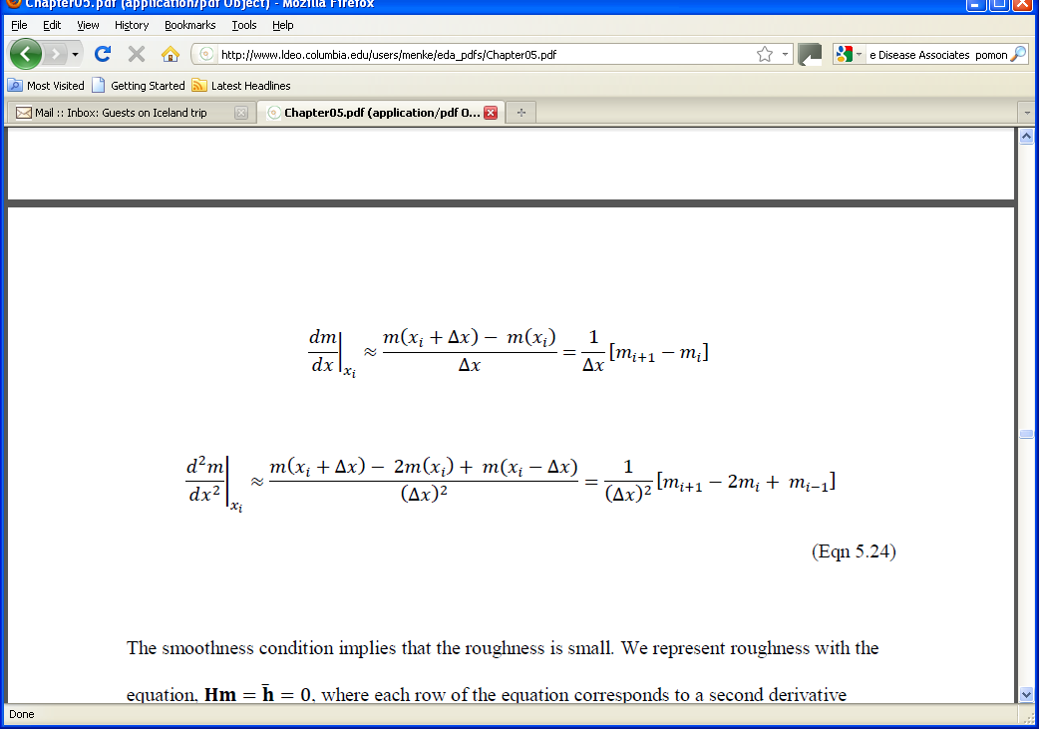
approximate expressions for second derivative
Notes:
This derivation uses the definition of the derivative (sans the limit) that one often sees in an elementary calculus course.
These formula are often referred to as ‘finite difference’ approximations to the derivative.

Slide 35
m(x)
x
x_{i}
i-th row of H: (Δx)⁻² [ 0, 0, 0, … 0, 1, -2, 1, 0, …. 0, 0, 0]
2nd derivative at x_{i}
column i
Notes:
Emphasize that it takes 3 points to calculate the 2nd derivative – the central point and one on each side.
The is going to be a problem at the ends, because there is no point to the left of the first model parameter,
and no point to the right of the last.

Slide 36
what to do about m₁ and m_{M}? not enough points for 2nd derivative two possibilities no prior information for m₁ and m_{M} or prior information about flatness
(first derivative)

Slide 37
m(x)
x
x₁
first row of H: (Δx)⁻¹ [ -1, 1, 0, … 0]
1st derivative at x₁
Notes:
First derivative requires only 2 points.

Slide 38
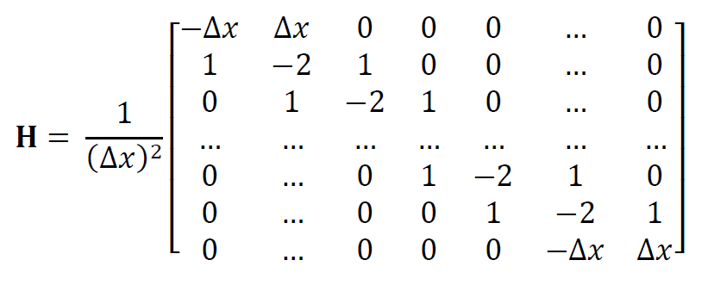
“smooth interior” / “flat ends” version of Hm=h
h=0
Notes:
This matrix is square. Given M model parameters, one can form M-2 second derivatives of the interior points and
2 first derivatives at the end points.

Slide 39
example problem:
to fill in the missing model parameters so that
the resulting curve is smooth
m = d
x
Notes:
This might be though of as a type of interpolation (although the term “interpolation” is usually reserved for the
case where the resulting curve passes exactly through the observed data, whereas in this case, it will only pass
near them).

Slide 40
the model parameters, m an ordered list of all model parameters
m₁
m₂
m₃
m₄
m₅
m₆
m₇
m=
Notes:
The model parameters is the whole time-series

Slide 41
the data, d just the model parameters that were measured
d₃
d₅
d₆
m₃
m₅
m₆
d=
=
Notes:
The data are the known values of the time-series.

Slide 42
data equation
Gm=d
m₁
m₂
m₃
m₄
m₅
m₆
m₇
0 | 0 | 1 | 0 | 0 | 0 | 0
0 | 0 | 0 | 0 | 1 | 0 | 0
 |  |  | …
0 | 0 | 0 | 0 | 0 | 1 | 0
=
d₃
d₅
d₇
data kernel “associates” a measured model parameter with an unknown model parameter
data are just model parameters that have been observed
Notes:
Multiply out the first row, to show that it yields m₃=d₃.

Slide 43
The prior information equation, Hm=h
“smooth interior” / “flat ends”
h=0
Notes:
This is the same matrix as was shown a few slides earlier. Now it is put to use.

Slide 44
put them together into the
Generalized Least Squares equation
F =
σ_{d}⁻¹G
σ_{h}⁻¹H
f =
σ_{d}⁻¹d
0
choose σ_{d}/σ_{m} to be << 1
data takes precedence over prior information
Notes:
Remind the class that the top row is the data equation weighted by its certainty, and that
the bottom row is the prior information equation weighted by its certainty. In the gap-filling
problem, we give precedence to the data, and so assume that the data are much more
certain than the prior information of smoothness.

Slide 45
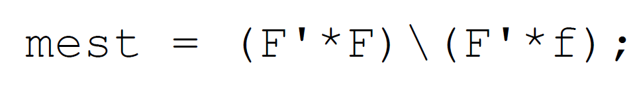
the solution using MATLAB
or Python
FTF = np.matmul(F.T,F);
FTf = np.matmul(F.T,f);
mest = la.solve(FTF,FTf);
Notes:
Remind the class of the meaning of MAtLAB’s back-slash operator. In the Pythin case, I am computing
FT F and FT f separately to avoid having a long, inscrutable line of code.

Slide 46
graph of the solution
solution passes close to data
solution is smooth
m = d
x
Notes:
The estimated model parameters form a smooth curve that satisfies the data to a high degree of approximation.
(Actually, the error is negligibly small).

Slide 47
Two MatLab issues
Issue 1: matrices like G and F can be very big, but contain mostly zeros.
Solution 1: Use “sparse matrices” which don’t store the zeros
Issue 2: matrices like G^{T}G and F^{T}F are not as sparse as G and F
Solution 2: Solve equation by a method, such as “biconjugate gradients” that doesn’t require the calculation of G^{T}G and F^{T}F
Notes:
Emphasize that this is a practical discussion that is relevant when solving large (and hence interesting)
least squares problems.

Slide 48
Using “sparse matrices” which don’t store the zeros:
N=200000;
M=100000;
F=spalloc(N,M,3*M);
creates a 200000× 100000 matrix that can hold up to 300000 non-zero elements.
“sparse allocate”
note that an ordinary matrix would have 20,000,000,000 elements
Notes:
You might flash back to the G and H for the gap-filling problem, and examine how sparse
they are. The fraction N/(NM) of the elements of G are non-zero. The fraction 3M/(M²) of
the elements of H are non-zero. Note that these fractions decrease rapidly as N and M increase.

Slide 49
Building Sparse Matrices
There are many ways to build a sparse matrix. However ...
Some work well when the matrix is small (in which case, you don’t really need a sparse matrix, at all)l, but become absurdly slow when it is large
Some work well when the matrix has a simple structure (as it often does for one-dimensional problems) but are not applicable for cases where the structure is complicated (as it often is in multidimensional problems).
The presumption in this class is that, if you’re going to need sparse matrices, it is because you need to solve a very large, multi-dimensional problem. The method used here works for such problems. However, superficially at least, it will seem more cumbersome than some other methods.
Notes:
A bit of an apology ... but here’s the reason. MATLAB allows you to define an empty sparse matrix, say A, and then to set its elements one-by-one, with statements liee A(i,j)=v. However, what is not apparent, is that every time you add an element, MATLAB is reorganizing its internal representation of the matrix, and this reorganization takes longer and longer as the number of non-zero elements grows. So, for the size matrices encountered, say, in a 100x100x100 three-dimensional grid, the process of building the matrix takes hours – far longer than the time needed to solve the matrix equation. In contrast. the method described here builds the matrix in a few seconds.

Slide 50
The sparse matrix is built in two steps:
Step 1:
Build a table of the
  row indices.
  column indices, and
  values
  of its non-zero elements
Step 2:
call a function or method
that uses the table to create
  the sparse matri

Slide 51

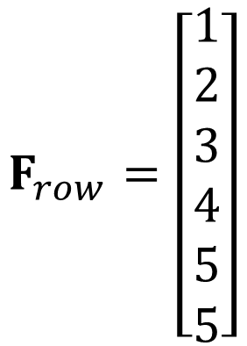
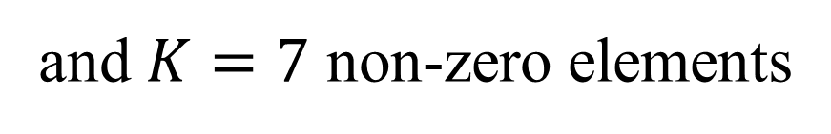
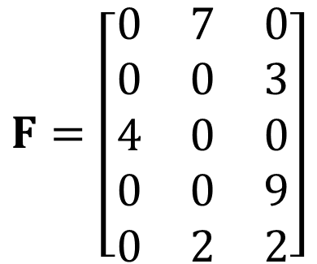
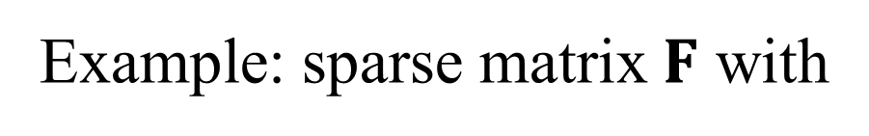
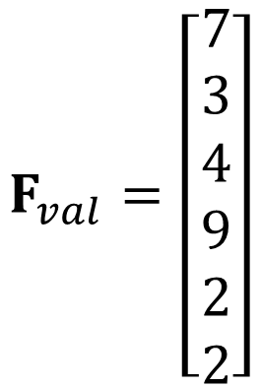
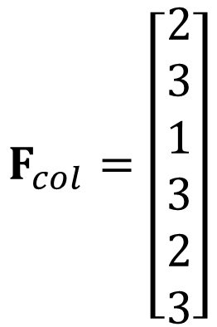
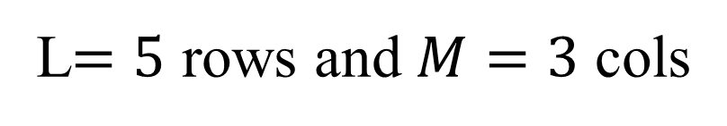
Example: sparse matrix $F$ with
L$=5$ rows and $M=3$ cols
$$F=\left[\begin{matrix}0 & 7 & 0 \\ 0 & 0 & 3 \\ 4 & 0 & 0 \\ 0 & 0 & 9 \\ 0 & 2 & 2\end{matrix}\right]$$
and $K=7$ non-zero elements
Step 1: make these three $K×1$ column-vectors
$$F_{row}=\left[\begin{matrix}1 \\ 2 \\ 3 \\ 4 \\ 5 \\ 5\end{matrix}\right]$$
$$F_{col}=\left[\begin{matrix}2 \\ 3 \\ 1 \\ 3 \\ 2 \\ 3\end{matrix}\right]$$
$$F_{val}=\left[\begin{matrix}7 \\ 3 \\ 4 \\ 9 \\ 2 \\ 2\end{matrix}\right]$$
row
col
value

Slide 52
MATLAB
% initialize table
Frow = zeros(Kmax,1);
Fcol = zeros(Kmax,1);
Fval = zeros(Kmax,1);
K=0;
% do this many times, presuming
% that i, j, and A(i,j)=a are known
K=K+1
Frow(K) = i;
Fcol(K) = j;
Fval(K) = a;
% truncate to correct number of entries
Frow = Frow(1:K);
Fcol = Fcol(1:K);
Fval = Fval(1:K);
Notes:
The table is initialized to size Kmax, which must be equal to or greater than the actual number of non-zero values in F. At the end of the code, it is trimmed to the correct length, K.

Slide 53
Python
# initialize table
Frow = np.zeros((Kmax,1),dtype=np.int32);
Fcol = np.zeros((Kmax,1),dtype=np.int32);
Fval = np.zeros((Kmax,1),dtype=np.double);
K=0;
# do this many times, presuming
# that i, j, and A(i,j)=a are known
Frow[K,0] = i;
Fcol[K,0] = j;
Fval[K,0] = a;
K=K+1
# truncate to correct number of entries
Frow = np.copy(Frow[0:K,0:1));
Fcol = np.copy(Fcol[0:K,0:1));
Fval = np.copy(Fval[0:K,0:1]);
Notes:
The table is initialized to size Kmax, which must be equal to or greater than the actual number of non-zero values in F. At the end of the code, it is trimmed to the correct length, K. Note that Frow and Fcol must be initialized to integer arrays.

Slide 54
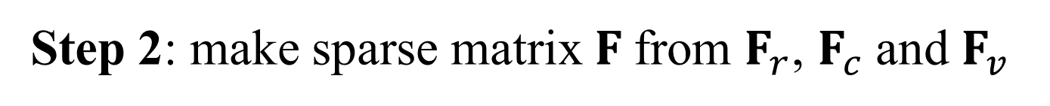
Step 2: make sparse matrix $F$from $F_{r}$, $F_{c}$ and $F_{v}$
MATLAB
F=sparse(Frow,Fcol,Fval,L,M);
clear Frow
clear Fcol
clear Fval
Python
F = sparse.coo_matrix((Fval[0:K,0], (Frow[0:KK,0], Fcol[0:KK,0])), shape=(L,M) );
del Fval;
del Frow;
del Fcol;
Notes:
In both cases, the table of rows, column and values is deleted after the sparse matrix Fsparse is created.

Slide 55
Issue 2: Use biconjugate gradient solver to avoid calculating F^{T}F
The standard way solve F^{T}F m = F^{T}f is:
mest = (FTF)\(FTf); % MATLAB
mest = la.solve(FTF,Ftf); # Python
but that requires that we compute
FTF = F’*F; % MATLAB
FTF = np.matmul(F.T,F); # Python
Notes:
This is a little complicated, but necessary if the students want to tackle large least-squares problems.

Slide 56
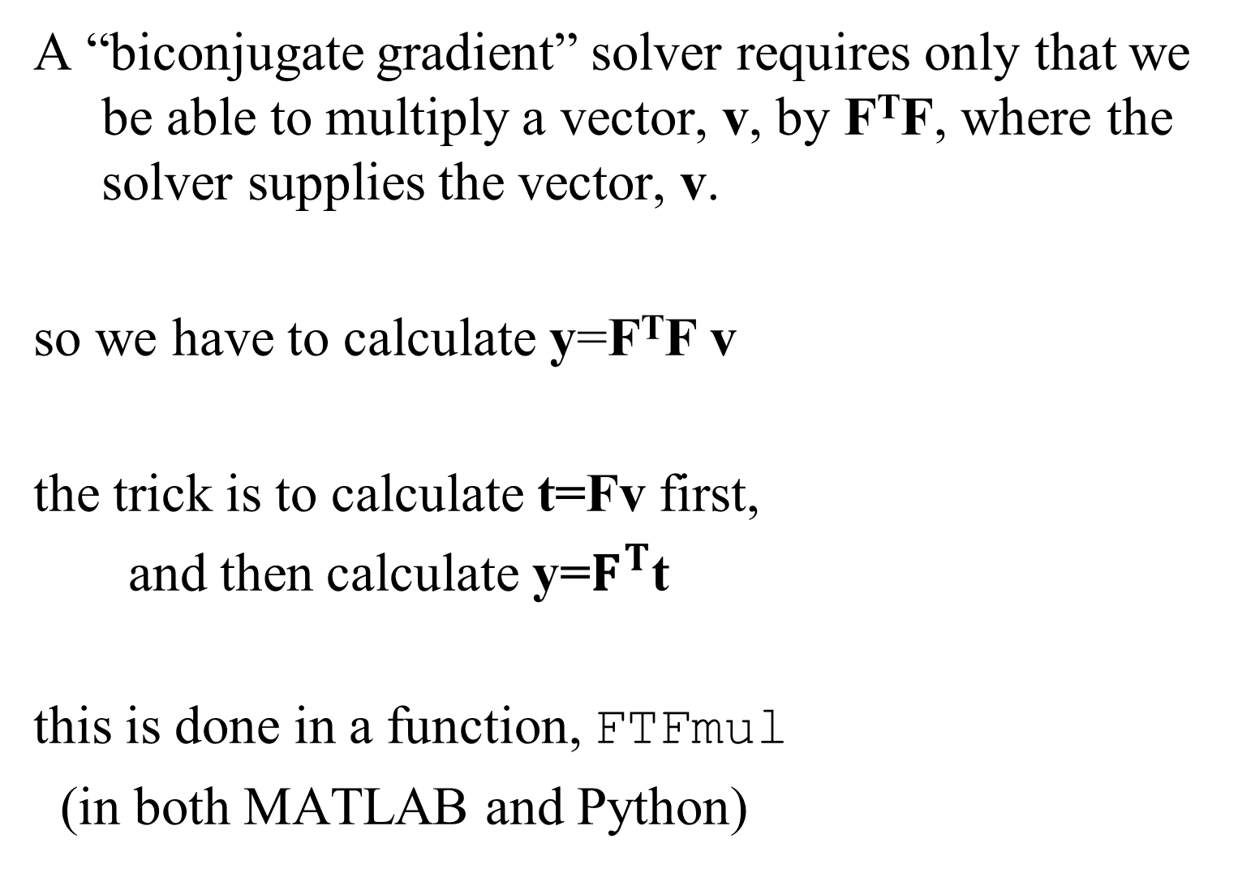
A “biconjugate gradient” solver requires only that we be able to multiply a vector, v, by F^{T}F, where the solver supplies the vector, v.
so we have to calculate y=F^{T}F v
the trick is to calculate t=Fv first,
and then calculate y=$F^{T}$t
this is done in a function, FTFmul
(in both MATLAB and Python)

Slide 57
MATLAB
function y = FTFmul(v,transp_flag)
global edaFsparse;
temp = edaFsparse*v;
y = edaFsparse'*temp;
return
ignore this variable; its never used
Notes:
MATLAB function to multiply FT F v very efficiently. Note sparse matrix F MUST be called edaFsparse, and defined as a global variable.

Slide 58
PYTHON
def FTFmul(v):
global edaFsparse;
s = np.shape(v);
if(len(s)==1):
vv = np.zeros((s[0],1));
vv[:,0] = v;
else:
vv=v;
temp = edaFsparse*vv;
return edaFsparse.transpose()*temp;
Notes:
Python function to multiply FT F v very efficiently. Note sparse matrix F MUST be called edaFsparse, and defined as a global variable. The if statement checks if v is Mx0 or Mx1, and works both ways. Note the following Pyton oddity. When multiplying by a sparse matrix, the * operator works just fine.

Slide 59
The biconjugate gradient solver is invoked in the main script as follows:

Slide 60
MATLAB
clear edaFsparse;
global edaFsparse;
. . .
FTf = edaFsparse’*f;
mest=bicg(@FTFmul,FTf,1e-12,3*(L+M))
put at the top of the LiveScript section
for
“biconjugate”
“handle” to the function
tolerance
maximum iterations
Notes:
In my experience, a tolerance of 1e-12 is almost always sufficiently accurate. However, should the solver exit early and give a warning saying the maximum number of iterations was reached but the tolerance was exceeded, the maximum number of iteration will need to be increased.

Slide 61
Python
. . .
LO=las.LinearOperator(shape=(M,M),matvec=FTFmul,rmatvec=FTFmul);
mest = np.zeros((M,1));
FTf = edaFsparse.transpose()*f;
q=las.bicg(LO, FTf, tol=1e-6,
maxiter=(3*(L+M)));
mest[:,0] = q[0];
(nothing needs to be put at the top of the LiveScript cell)
Notes:
The syntax of this method is such a mess that I suggest that you present it as a “given” and not try to explain it. As you can see, it has two parts: the LinearOperator() method encapsulated the FTFmul() function with a “linear operator” object; and then the bicg() solver uses that object.. The bicg() solver itself has arguments similar to MATLAB’s. In my experience, a tolerance of 1e-12 is almost always sufficiently accurate. However, should the solver exit early and give a warning saying the maximum number of iterations was reached but the tolerance was exceeded, the maximum number of iteration will need to be increased.

Slide 62
example of a “fairly large” problem
fill in the missing model parameters
that represents a 2D function m(x,y)
so that
the function passes through measured data points
m(x_{i},y_{i}) = d_{i}
and
the function satisfies the diffusion equation
d²m/dx² + d²m/dy² = 0

Slide 63
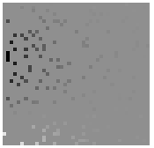

A) observed, d_{i}^{obs}=m(x_{i}, y_{i})
B) predicted, m(x,y)
y
y
x
x
(see text for details on how its done)
Notes:
The image is 41×41, so there are 1681 model parameters. The matrix, H, is M×M = 1681×1681 and has
2.8 million elements, only 5M=8405 of which are non-zero. So this “fairly large” problem benefits significantly from the use of sparse matrices.

