Slide 1
Environmental Data Analysis with MATLAB or Python
3rd Edition
Lecture 11

Slide 2
SYLLABUS
Lecture 01 Intro; Using MTLAB or Python
Lecture 02 Looking At Data
Lecture 03 Probability and Measurement Error
Lecture 04 Multivariate Distributions
Lecture 05 Linear Models
Lecture 06 The Principle of Least Squares
Lecture 07 Prior Information
Lecture 08 Solving Generalized Least Squares Problems
Lecture 09 Fourier Series
Lecture 10 Complex Fourier Series
Lecture 11 Lessons Learned from the Fourier Transform
Lecture 12 Power Spectra
Lecture 13 Filter Theory
Lecture 14 Applications of Filters
Lecture 15 Factor Analysis and Cluster Analysis
Lecture 16 Empirical Orthogonal functions and Clusters
Lecture 17 Covariance and Autocorrelation
Lecture 18 Cross-correlation
Lecture 19 Smoothing, Correlation and Spectra
Lecture 20 Coherence; Tapering and Spectral Analysis
Lecture 21 Interpolation and Gaussian Process Regression
Lecture 22 Linear Approximations and Non Linear Least Squares
Lecture 23 Adaptable Approximations with Neural Networks
Lecture 24 Hypothesis testing
Lecture 25 Hypothesis Testing continued; F-Tests
Lecture 26 Confidence Limits of Spectra, Bootstraps
Notes:
26 lectures are sufficient to survey the material in the book. However, not every topic in the book is covered, so students should be encouraged to read the book.

Slide 3
Goals of the lecture
understand some of the properties of the
Discrete Fourier Transform
Notes:
This lecture really does nothing else. Most of the properties covered here are extremely useful.
They will be applied time and time again in subsequent lectures.

Slide 4
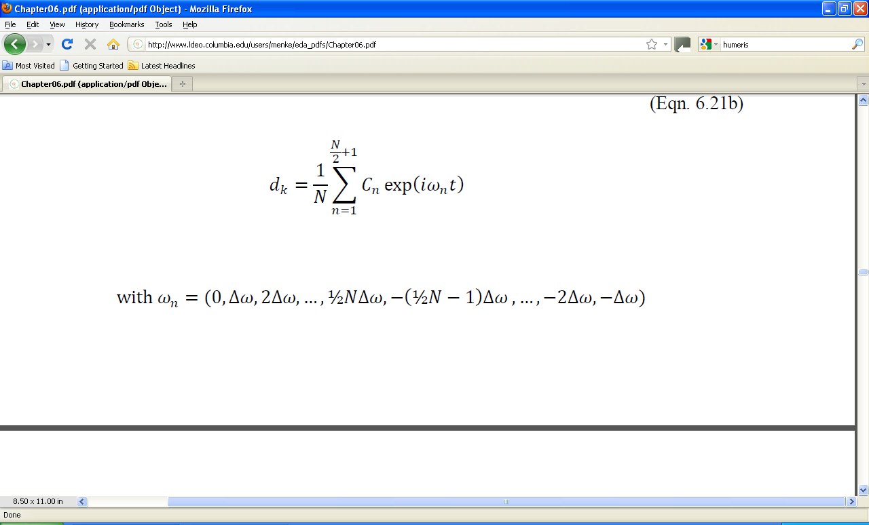
from last week …
time series = sum of sines and cosines
k
remember
exp(iωt) = cos(ωt) + i sin(ωt)
Notes:
Remind the class of the original idea, a linear model in which the time series is composed only of a sum of sines and cosines.
The coefficients C give the amplitudes of the sines and cosines.

Slide 5
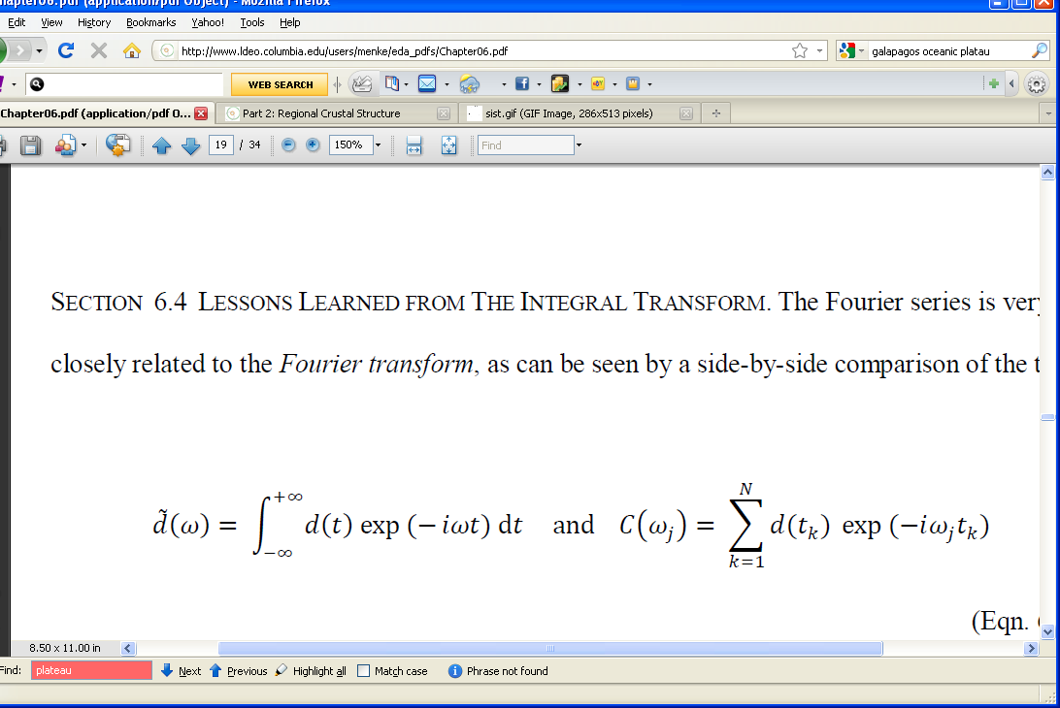
from last week …
Discrete Fourier Transform of a time series
coefficients
time series
2
power spectral density =
Notes:
Remind the class the coefficients C are computed by the above sum.
One of the uses of the C’s are to compute the power spectral density, the amplitude of the sines and cosines of a particular frequency.

Slide 6
time series
d_{i}
t_{i}
Δt
Notes:
This is a sketch of a time series. It suggests that there is an underlying smooth function that
connects the dots.

Slide 7
continuous function
d_{i}
t_{i}
Δt
a time series is a discrete representation of a continuous function
Notes:
Here’s the continuous function.

Slide 8
continuous function
d(t)
t
What happens when to the Discrete Fourier Transform when we switch from discrete to continuous?
Notes:
As continuous curve can be thought of as a time series with indefinitely fine sampling. Thus, the summation becomes an integral.

Slide 9
Discrete Fourier Transform
turns into
Fourier Transform
Notes:
Emphasize that in both cases, d is being represented by a “sum” of sines and cosines. The only difference
is that you need an infinite number of frequencies to represent a continuous function.

Slide 10
Fourier Transform
note the use of the tilde to distinguish a the Fourier Transform from the function itself. The two functions are different!
Notes:
In the discrete world, we have been using two different symbols, d_{k} and C_{j}, for the time series d_{k} and its Fourier coefficients C_{j}.
In the continuous world, the same symbol, d, is used for both, except that symbol for the Fourier transform gets a tilde.
Some authors even go so far as omitting the tilde, and rely on the argument t or ω, to distinguish the function from its Fourier Transform.

Slide 11
Fourier Transform
function of frequency
function of time
2
power spectral density =
Notes:
Emphasize that the two functions are different.
The power spectral density is computed exactly as in the discrete case, by taking the square of the absolute value of the Fourier Transform.

Slide 12
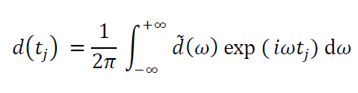
the inverse of the Fourier Transform is
function of time
function of frequency
Notes:
This says that the original function is built up by adding together an infinite number of sines and cosines, of every possible frequency.

Slide 13
recall that an integral can be approximated by a summation
f(t)
f(t_{i})
t
t_{i}
Δt
integral = area under curve =
Σ area of rectangle = Σ width × height = Δt Σ_{i} f(t_{i})
Notes:
This is called Riemann's approximation to the integral.
This will be used to show that the Fourier Transform turns into the Discrete Fourier Transform
when the integral is approximated by a summation.

Slide 14
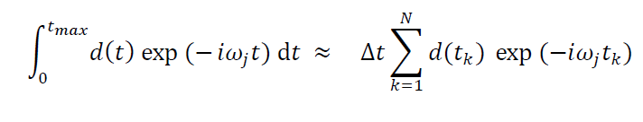
then if we use N rectangles
each of width Δt
and
each of height d(t_{k}) exp(-iωt_{k})
then the Fourier Transform becomes
provided that d(t) is “transient”
zero outside of the interval (0,t_{max})
Notes:
The point here is that the Fourier Transform turns into a Discrete Fourier Transform when the
integral is approximated by a summation. In order for the sum to have a finite number of terms,
the function d(t) must assumed to be zero outside of some finite interval, so that the time sereies
is of finite length.

Slide 15
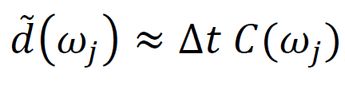
so except for a scaling factor of
Δt
the Discrete Fourier Transform is the discrete version of the Fourier Transform of a transient function, d(t)
scaling factor
Notes:
You have to remember to put in the factor of Δt when you compare the DFT, computed say with MatLab,
to the formula for a Fourier Transform, taken say from a textbook.

Slide 16

similarly the Fourier Series is an approximation of the Inverse Fourier Transform
Inverse Fourier Transform
Fourier Series
(up to an overall scaling of Δω)
Notes:
In both cases, the something that varies with time is represented as the sum of sines and cosines

Slide 17
Fourier Transform
in some ways
integrals are easier to work with than
summations
Notes:
The whole point of this part of the lecture has been to show that the continuous Fourier Transform and the
Discrete Fourier Transform are essentially the same. Now we are in the position to derive results for the FT
that carry over to the DFT. They would be much more difficult to demonstrate using the DFT, because summations
are more difficult to manipulate than are integrals.

Slide 18
Property 1
the Fourier Transform of a Normal curve with variance σ_{t}²
is a Normal curve with variance σ_{ω}² ⁼σ_{t}⁻²
Notes:
This is perhaps the most important of the seven properties in today’s lecture.

Slide 19
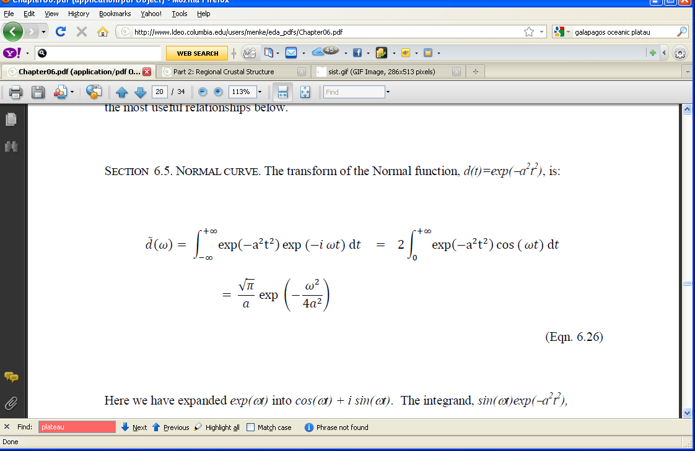
let a²= ½σ_{t}⁻²
Normal curve with variance ½a⁻² = σ_{t}²
[cos(ωt ) + i sin(ωt )] dt
cos(ωt ) dt +i
sin(ωt ) dt
symmetric about zero
antisymmetric about zero
so integral zero
Notes:
The procedure of writing the complex exponential as the sum of its real and imaginary parts,
and then integrating each, is a standard way of approaching Fourier integrals, as is the use of
symmetry. In the case of the real part, both exp() and cos() are symmetric about the origin,
so their product is symmetric and the integral is non-zero. In the case of the imaginary part
exp() is symmetric but sin() is antisymmetric, so their product is antisymmetric and the integral
is zero. In the first integral, the integral from minus infinity to zero is equal to the integral from zero
to infinity, so the complete integral can be replaced with 2 times the integral from 0 to infinity. In
the second integral, the integral from minus infinity to zero is the negative of the integral from zero
to infinity, so the two halves cancel and the total integral is zero.

Slide 20
look up in table of integrals
Normal curve with variance 2a² = σ_{t}⁻²
Notes:
This might be a good time to mention the usefulness of reference books that contains tables of integrals.

Slide 21
time series with broad features
Fourier Transform with mostly low frequencies
power spectral density with mostly low frequencies
time series with narrow features
Fourier Transform with both low and high frequencies
power spectral density with broad range of frequencies
Notes:
The general result holds even when the time series is not exactly a Normal function.

Slide 22
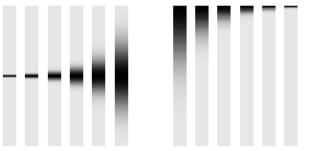
A)
B)
0
0
time, t
frequency, f
t^{max}
f^{max}
increasing variance
increasing variance
Notes:
A) A series of time series, each consisting of a single Normal curve. B) Their power spectral densities.

Slide 23
Property 2
the Fourier Transform of a spike
is constant
Notes:
One implication of this property is that a data glitch, such as the “cold spikes” in the Black Rock Forest temperature data set,
create noise in the power spectral density that affects a broad range of frequencies.

Slide 24
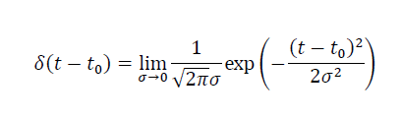
spike
“Dirac Delta Function”
Normal curve with infinitesimal variance
infinitely high
but always has unit area
Notes:
The normal curve has unit area irrespective of the value of sigma. Thus, even when sigma is indefinitely small, the area under the curve is unity.

Slide 25
depiction of spike
δ(t-t₀)
t
t₀
Notes:
The depiction only symbolic. The function is infinitely high and infinitesimally narrow.

Slide 26
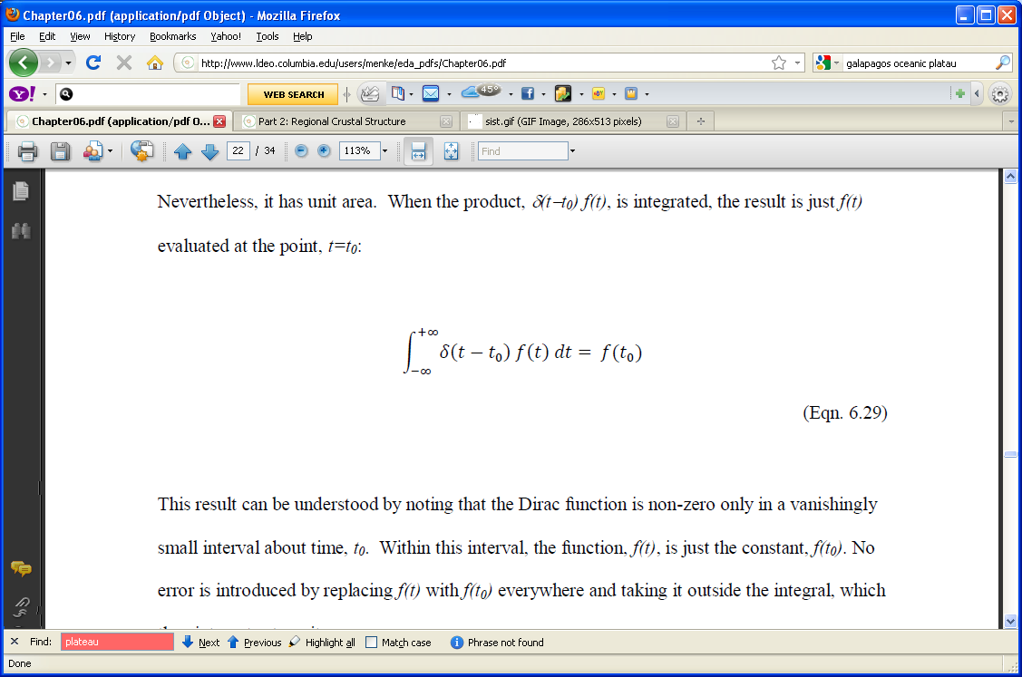
important property of spike

Slide 27
since the spike is zero everywhere except t₀
this product …
f(t₀)
t
t₀
… is equivalent to this one
f(t₀)
t
t₀

Slide 28
so
Notes:
This is just replacing f(t) with f(t₀), as justified (in a hand waving way), in the previous slide.

Slide 29
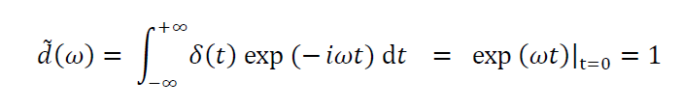
use the previous result when computing the Fourier Transform of a spike
Notes:
The fourier transform of a spike at to=0 is a constant function. That is, it has the same amplitude at all frequencies. Another way of putting this is that it is equally rich in all frequency components.

Slide 30
A spiky time series has a “flat” Fourier Transform and a “flat” power spectral density
Notes:
This result carries over to time series that a merely “rough”, in the sense of containing many sharp
features. They have a power spectral density that contains both low and high frequencies, in roughly
equal proportions.

Slide 31
A) spike function
d(t)
time, t
B) its transform
^
d(f)
frequency, f
Notes:
Example, using MatLab

Slide 32
Property 3
the Fourier Transform of cos(ω₀t )
is a pair of spikes at frequencies ±ω₀
Notes:
One tends to forget that a cosine with frequency ω₀ has not one spectral peak, but two, at -ω₀ and ω₀.

Slide 33
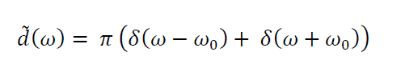



cos(ω₀t ) has Fourier Trnsform
$${−ω}_{0}$$
$$0$$
$$ω_{0}$$
Notes:
This is the result. To demonstrate it, plug it into the Inverse Fourier Transform.

Slide 34
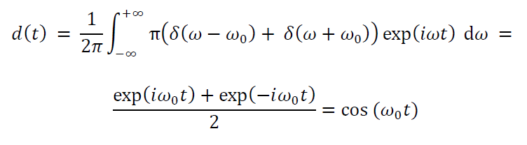
as is shown by inserting into the Inverse Fourier Transform
Notes:
Mention that you can treat +ω₀ (in the second term) as –(–ω₀).

Slide 35
An oscillatory time series has spiky Fourier Transform and a power spectral density with spectral peaks
Notes:
This is, or course, the original reason why Fourier Transforms were introduced: to discover periodicities.
A sinusoidal time series has a Fourier Transform containing spikes, and spikes are fairly easy to spot,
even in noisy data.

Slide 36
Property 4
the area under a time series
is the zero-frequency value of the Fourier Transform
Notes:
This property is not especially useful for computing area, but occasionally shows up in derivations.

Slide 37
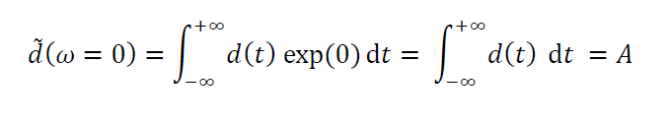
Notes:
This demonstration is the easiest of the eight. If you have a class with minimal mathematical background, you might do this one and skip over the ones that follow.

Slide 38
A time series with zero mean has a Fourier Transform that is zero at zero frequency
Notes:
In practice, one often subtracts out the mean of a time series before computing the Fourier Transform.
Otherwise, the spike at zero frequency dominates a plot.

Slide 39
MatLab
dt=fft(d);
area = real(dt(1));
Notes:
Mention that the fft() function computes the Discrete Fourier Transform of a time series,
and that the ifft() function computes the a time series given its Discrete Fourier Transform.
The command ifft(fft(d)) returns the original time series (more of less).

Slide 40
MatLab
dt=eda_cvec(np.fft.fft(d,axis=0));
area = real(dt[0,0]);
Notes:
We take the real part because, which d is real, its discrete Fourier transform at zero frequency is necessarily real.

Slide 41
Property 5
multiplying the Fourier Transform by
exp( -i ω t₀)
delays the time series by t₀
Notes:
One of the consequences of this rule is that the power spectral density of a times series
is not sensitive to a time shift, since the absolute value of exp(-iωt₀) is unity.

Slide 42
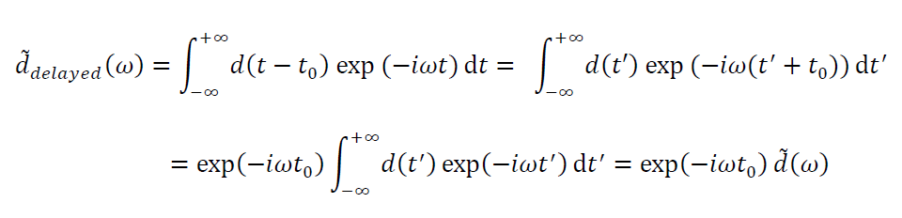
use transformation of variables
t’ = t - t₀
and note
dt’ = dt
and
t→±∞ corresponds to t’→±∞
Notes:
The demonstration is not especially important, but if you want to be sure the class understands it,
do it step-by-step on the board.

Slide 43
d(t)
time, t
d(t)
d^{shifted}(t)
time, t
Notes:
Point out that the curve is shifted to the right. The stuff that appears at the beginning of the curve is the same at the far right of the original curve, which has now been “wrapped” around. Consequently, this is often referred to as a “circular shft”

Slide 44
MATLAB
t0 = t(16);
ds=ifft(exp(complex(0,-1)*w*t0).*fft(d));
t0 = t[15,0];
dt = (np.multiply(
np.exp((complex(0,-1)*w*t0)),
np.fft.fft(d, axis=0)));
ds = eda_cvec(
np.real((np.fft.ifft(dt,axis=0))));
Python
Notes:
Advise students not to omit the axis=0 arguments..

Slide 45
Property 6
multiplying the Fourier Transform by
i ω
differentiates the time series

Slide 46
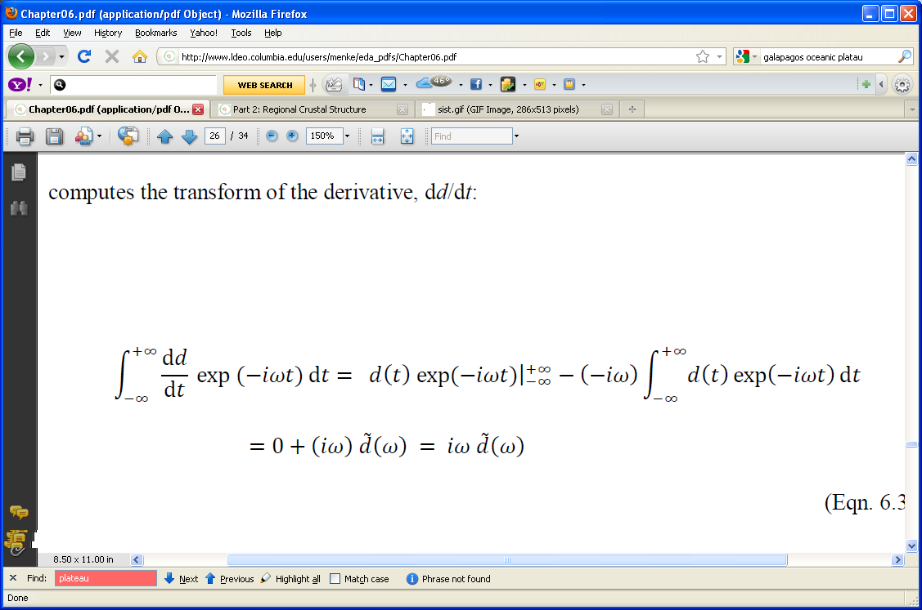
Notes:
This is integration by parts.

Slide 47
use integration by parts
and assume that the times series is zero
as t→±∞
u
dv
v
u
v
du
Notes:
You might write out the formula (integral) u dv = (u v) – (integral) v du. Note there is an assumption here that (u v) tends to zero at +/- infinity.

Slide 48
A)
d(t)
B)
dd/dt
C)
dd/dt
time, t
Notes:
(A) Original function., (B) derivative using fft, (C) derivative using first differences. Point out that (B) and (C) are identical.

Slide 49
MATLAB
dt = complex(0,1)*w.*fft(d)
dddt = real(ifft(dt));
dt = np.multiply(complex(0,1)*w,
np.fft.fft(d, axis=0));
dddt=np.real((np.fft.ifft(dt,
axis=0)));
Python
Notes:
As in previous cases, the real part is taken to delete a zero imaginary part.

Slide 50
Property 7
dividing the Fourier Transform by
i ω
integrates the time series
Notes:
This complements differentiation, which is multiplying by i omega.

Slide 51
this is another derivation by
integration by parts
but we’re skipping it here

Slide 52
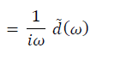
Fourier Transform of integral of d(t)
note that the zero-frequency value is undefined
(divide by zero)
this is the “integration constant”

Slide 53
A)
d(t)
B)
∫ d(t) dt
C)
∫ d(t) dt
time, t
Notes:
(A) Original function., (B) using fft, and (C) integral using Reiman summation. Point out that (B) and (C) are not quite identical, since they differ by a DC-shift,; that is, they have different integration constants.

Slide 54
MATLAB
wr=1.0./(complex(0,1)*w(2:N));
integral=ifft(fft(d).*[0,wr']');
wr=np.concatenate(
(np.zeros((1,1)),np.reciprocal(complex(0,1)*w[1:N,0:1])) );
dt = np.multiply(wr, np.fft.fft(d, axis=0));
integral1 = eda_cvec( np.real((np.fft.ifft(dt,axis=0))));
Python
Notes:
One would not ordinarily use Fourier Transforms to differentiate or integrate functions,
since they are slower than other methods (finite differences, Riemann summation).
The exception is when its necessary to take the Fourier Transform for some other reason,
in which case using this method required little overhead. For example, if we measured
the velocity of an object, but really wanted to plot the power spectral density of its acceleration,
then differenting by multiplying by (iω) would be preferred.

Slide 55
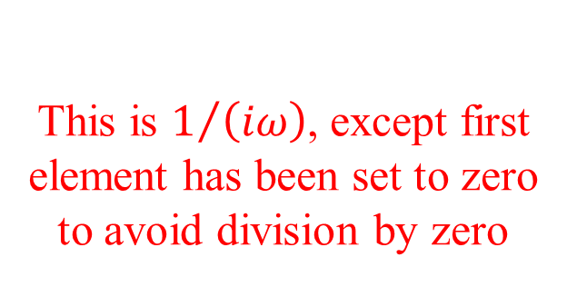
MATLAB
wr=1.0./(complex(0,1)*w(2:N));
integral=ifft(fft(d).*[0,wr']');
wr=np.concatenate(
(np.zeros((1,1)),np.reciprocal(complex(0,1)*w[1:N,0:1])) );
dt = np.multiply(wr, np.fft.fft(d, axis=0));
integral1 = eda_cvec( np.real((np.fft.ifft(dt,axis=0))));
This is $1/{\left(iω\right)}$, except first element has been set to zero to avoid division by zero
Python
Notes:
One would not ordinarily use Fourier Transforms to differentiate or integrate functions,
since they are slower than other methods (finite differences, Riemann summation).
The exception is when its necessary to take the Fourier Transform for some other reason,
in which case using this method required little overhead. For example, if we measured
the velocity of an object, but really wanted to plot the power spectral density of its acceleration,
then differentiatng by multiplying by (iω) would be preferred.

Slide 56
Property 8
Fourier Transform of the
convolution of two time series
is the product of their transforms
Notes:
This result will be very important later in the course.
You either introduce it here, where it sort of fits as one of many properties of Fourier Transforms,
or introduce it a few lectures from now, when its really needed.
If your students are finding this material difficult, you should put it off.

Slide 57
What’s a convolution ?
Notes:
Typically, few, if any, students will have heard of this operation, important though it be.

Slide 58
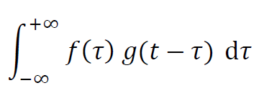
the convolution of f(t) and g(t)
is the integral
which is often abbreviated f(t) *g(t)
not multiplication
not complex conjugation
(too many uses of the asterisk!)
Notes:
Here we are treating the convolution just as a “mathematical formula” without introducing its
meaning.

Slide 59
uses of convolutions will be presented in the lecture after next
right now, just treat it as a mathematical quantity

Slide 60
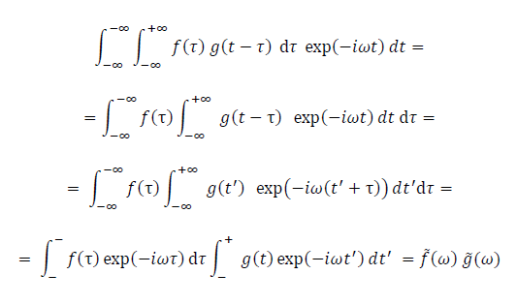
Notes:
Explained on next slide. Here, just point out the first line is the Fourier Transform of the convolution,
and the last term of the last line is the product of their transforms.

Slide 61
transformation of variables t’ = t-τ so dt’ = dt and t’→±∞ when t→±
reverse order of integration
change variables: t’ = t-τ
use exp(a+b)=exp(a)exp(b)
rearrange into the product of two separate Fourier Transforms
Notes:
Reversing the order of integration is a standard trick when manipulating multidimensional integrals. In the second step, we have g(t-tau) but want g of a single variable,, so we define t’ = t-tau. That’s also a standard trick.

Slide 62
Summary
FT of a Normal is a Normal curve
FT of a spike is constant.
FT of a cosine is a pair of spikes
Multiplying FT by exp( -i ω t₀ ) delays time series
Multiplying the FT by i ω differentiates the time series
Dividing the FT by i ω integrates the time series
FT of convolution is product of FT’s
Notes:
Students should be encouraged to memorize the properties.

