Slide 1
Environmental Data Analysis with MATLAB or Python 3rd Edition Lecture 16

Slide 2
SYLLABUS
Lecture 01 Intro; Using MTLAB or Python Lecture 02 Looking At Data Lecture 03 Probability and Measurement Error Lecture 04 Multivariate Distributions Lecture 05 Linear Models Lecture 06 The Principle of Least Squares Lecture 07 Prior Information Lecture 08 Solving Generalized Least Squares Problems Lecture 09 Fourier Series Lecture 10 Complex Fourier Series Lecture 11 Lessons Learned from the Fourier Transform
Lecture 12 Power Spectra Lecture 13 Filter Theory Lecture 14 Applications of Filters Lecture 15 Factor Analysis and Cluster Analysis Lecture 16 Empirical Orthogonal functions and Clusters Lecture 17 Covariance and Autocorrelation Lecture 18 Cross-correlation Lecture 19 Smoothing, Correlation and Spectra Lecture 20 Coherence; Tapering and Spectral Analysis Lecture 21 Interpolation and Gaussian Process Regression
Lecture 22 Linear Approximations and Non Linear Least Squares
Lecture 23 Adaptable Approximations with Neural Networks Lecture 24 Hypothesis testing Lecture 25 Hypothesis Testing continued; F-Tests Lecture 26 Confidence Limits of Spectra, Bootstraps
Notes:
26 lectures are sufficient to survey the material in the book. However, not every topic in the book is covered, so students should be encouraged to read the book.

Slide 3
Part 1: Empirical Orthogonal Functions
Notes:
This is an important extension of factor analysis.

Slide 4
row number in the sample matrix could be meaningful
example: samples collected at a succession of times
time
Notes:
Ordering by time is common, but many other types of ordering are useful.

Slide 5
column number in the sample matrix could be meaningful
example: concentration of the same chemical element at a sequence of positions
distance
Notes:
Ordering by distance is common, but many other types of ordering are useful.

Slide 6
S = CF becomes

Slide 7
S = CF becomes
distance dependence
time dependence

Slide 8
S = CF becomes
each factor:
a spatial pattern of variability of the element
each loading: a temporal pattern of variability of the corresponding factor

Slide 9
S = CF becomes
there are P patterns and they are sorted into order of importance

Slide 10
S = CF becomes
factors now called EOF’s (empirical orthogonal functions)

Slide 11
example
sea surface temperature in the Pacific Ocean

Slide 12
CAC Sea Surface Temperature
29°N
equatorial Pacific Ocean
latitude
29°S
124°E
290°E
longitude
sea surface temperature (black = warm)

Slide 13
Notes:
Sea surface temperature for each month of the year.
The complete dataset is longer than shown here, January 1970 to March 2003, or 399 months of data.

Slide 14
the image is 30 by 84 pixels in size, or 2520 pixels total
to use svd(), the image must be unwrapped into a vector of length 2520

Slide 15
2520 positions in the equatorial Pacific ocean
399 times
“element” means temperature
Notes:
Arrangement of the sample matrix

Slide 16
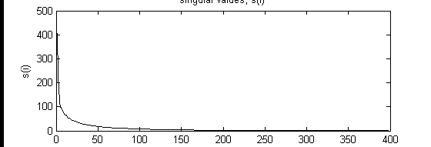
singular values
singular values, Σ_{ii}
index, i

Slide 17
singular values
singular values, Σ_{ii}
index, i
no clear cutoff for P, but the first 10 singular values are considerably larger than the rest

Slide 18
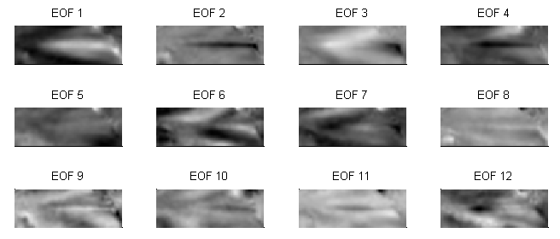
Notes:
EOF 1 is the most important pattern. It has a wide cool band running E-W across the equator.
EOF 2 it the second most important. It has a thin hot band running E-W across the equator.
The EOFs become progressively more and more complicated in spatial pattern.

Slide 19
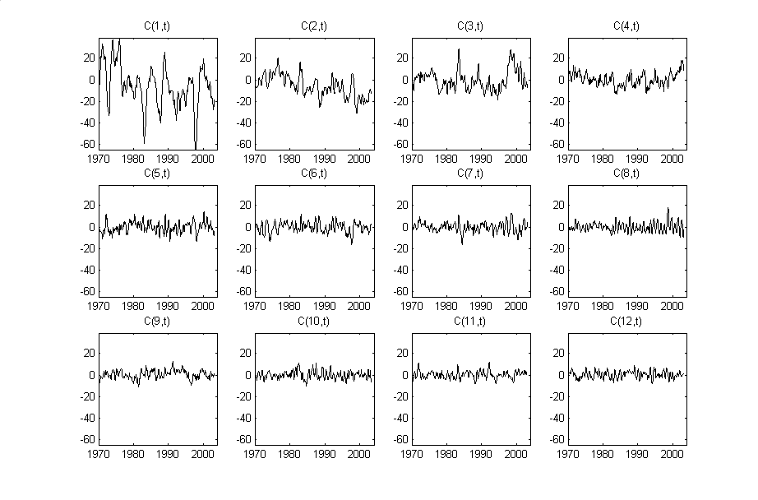
Notes:
Amplitude time series, C_{i}(t), of the First 12 EOF’s of the CAC sea surface temperature dataset for the time period January 1970 to March 2003.

Slide 20
Notes:
C₁(t), which give the time-varying amplitude of the first EOF. It varies with periods of a few years.
Flash back to the EOF plot and point out that the first EOF is a wide cool band across the equator.
This is a La Nina pattern, so C₁(t) functions like a La Nina index. large during La Nina, small during El Nino.

Slide 21
Notes:
C₁(t), which give the time-varying amplitude of the first EOF. It varies with periods of a few years.
Flash back to the EOF plot and point out that the first EOF is a wide cool band across the equator.
This is a La Nina pattern, so C₁(t) functions like a La Nina index. large during La Nina, small during El Nino.

Slide 22
Notes:
C₈(t), which give the time-varying amplitude of the 8th EOF, seems to have annual variability.
Flash back to look at EOF 8.
It is large in the northeast, small in the southwest, intermediate (near zero) elsewhere.
The pattern flips in sign every 6 months, reflecting the change from northern-summer to northern-winter.

Slide 23
Notes:
C₈(t), which give the time-varying amplitude of the 8th EOF, seems to have annual variability.
Flash back to look at EOF 8.
It is large in the northeast, small in the southwest, intermediate (near zero) elsewhere.
The pattern flips in sign every 6 months, reflecting the change from northern-summer to northern-winter.

Slide 24
Part 2: Cluster Analysis
Notes:
This is a very abridged introduction to Cluster Analysis.

Slide 25
When the data scatter about a single mean
the mean can be determined with least squares
sample mean
Notes:
This is an important extension of factor analysis.

Slide 26
This problem is easy to generalize to one in which
every column of a sample matrix $S$
scatters about its own mean
sample mean
of each column
Notes:
This is an important extension of factor analysis.

Slide 27
Now consider the further generalization:
Some rows of a sample matrix scatters about one mean,
and the rest about another
Notes:
The column-vectors of zeros and ones must be complementary. If one has a zero in a given row, the other has a one.

Slide 28
Here’s yet a further generalization
Each row of a sample matrix
scatters about one of K means
Notes:
Only one column-vectors can have a one in a given row, the others must all have zeros.

Slide 29
This equation embodies the idea of cluster analysis.
Each row “belongs” to one of $K$ clusters.
Notes:
Only one column-vectors can have a one in a given row, the others must all have zeros.

Slide 30
Putting this it in matrix form ...
association matrix
matrix of cluster means

Slide 31
The $S=AM$ of Cluster Analysis
and
the $S=CF$ of Factor Analysis look similar
but they are really quite different, because
$A$ is requires to contain only zeros and ones
whereas $C$ is not.
Notes:
For this reason, Cluter Analysis is much harder than Factor Analysis.

Slide 32
The association matrix $A$ is unnecessary.
A column-vector $k$ with elements $k_{i}$ specifying the cluster of sample $i$ is sufficient, since
$$A_{i,j}=δ_{i,k_{i}}$$

Slide 33
If we knew the cluster assignments,
then calculating the cluster means is easy:
sample mean of
data in cluster

Slide 34
If we knew the cluster means,
then calculating the cluster assignments is easy:
each sample is assigned to the nearest cluster
distance between sample i and cluster j
Notes:
The right equations says, r_ij is the Euclidian distance between sample i and cluster k.
The left equation says, sample i belongs to cluster j for which r_ij is smallest; that is the cluster nearest to the sample.

Slide 35
However, if you know neither the cluster means nor the cluster assignments, the problem becomes very hard
Notes:
In fact, no exact solution is known.

Slide 36
K-mean algorithm
Approximate solution to the problem
Starting with an initial guess of the cluster means
iterate between
assign cluster means
and
recompute new cluster means
Notes:
The algorithm usually converges to something, but not necessarily the best solution.

Slide 37
MATLAB
[mymu, myk, mydist2, mycount, myKdist2] = eda_kmeans(S, initmu);
squared cluster-sample distance
samples in each cluster
updated cluster
means
cluster assignments
inter-cluster
distances
initial cluster means
sample matrix
mymu, myk, mydist2, mycount, myKdist2 = eda_kmeans(S, initmu);
Python
Notes:
The input is the sample matrix and the matrix of initial cluster means. The main result is mymu, the matrix of updated cluster means. The other output parameters are useful in assessing the properties of the solution and its quality.

Slide 38
Example with
a few hundred samples
two elements
and
three clusters

Slide 39
Notes:
I think most people would agree that there are three clusters.

Slide 40
data
cluster
1
2
3
+
.
initial
final
Notes:
Example. The initial means (blue circles) are computed by talking random subsets of the data. The final means (grey triangles) are close to the centers of the clusters, and the data (small symbols) are assigned reasonably.

Slide 41
How do you arrive at an initial estimate of the cluster means?
Several possibilities:
set initial mean to a randomly chosen sample
set initial mean to mean of a randomly chosen
subset of samples
Notes:
The eda software package provides software for both of these possibilities.

Slide 42
How do you determine the number of clusters?
Element 2
Element 1
Notes:
I think most people would agree that there are three clusters.

Slide 43
1 clusters
Element 2
Element 1
Notes:
With only one cluster, the distances to the sample are huge.

Slide 44
2 clusters
Element 2
Element 1
Notes:
The distances are greatly reduced with two clusters.

Slide 45
3 clusters
Element 2
Element 1
Notes:
And are reduced further with three clusters.

Slide 46
4 clusters
Element 2
Element 1
Notes:
Adding more clusters results in only a very modest decrease in inter-cluster distances.

Slide 47
not much improvement beyond 3 clusters
mean distance to cluster
1
2
3
4
number of clusters
Notes:
The mean sample to cluster mean distance acts as a measure of the overall error. In this case, a point of diminishing returns is reached at about three clusters. The K-mean process had to be repeated 4 times to make this plot, each time with a different number of clusters.

Slide 48
Atlantic Rock data set
a few thousand samples
eight elements
and
unknown number of clusters
Notes:
This is the same dataset to which factor analysis was applied in the last lecture. Three factors were sufficient to account for most of the variability in the samples.

Slide 49
8
Notes:
On the basis of the plot, choose 8 clusters

Slide 50
sample
cluster mean
Notes:
Although only three elements are shown, the clustering is being performed using all eight elements. The clustering finds volumes in which the density of sample are high, but cannot capture the mixing lines very well. As a result, the these features of the dataset are not well-captured.

Slide 51
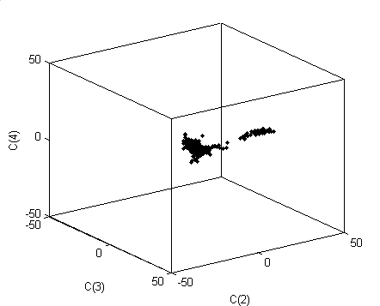
factor loadings C₂ through C₄ plotted in 3D
C₄
C₃
C₂
factors 2 through 4 capture most of the variability of the rocks
Notes:
Compare with the factor loadings, from the previous lecture.
This “L-shaped” pattern of variability accounts for a very large percentage of the overall variability
of compositions within the Atlantic Rock dataset.
You might consider running the script that generates this 3D plot, and rotate it during class time.

Slide 52
In Summary EOF’s and Clustering allow you to discover patterns in the data but they are not the “end” of the data analysis once an pattern is recognized, you need to try to develop a theory that accounts for it and then return to a more directed form of data analysis
Notes:
Discovering and describing a pattern is only the first step. The next step is developing a theory that accounts for the pattern.

