Slide 1
Environmental Data Analysis with MATLAB or Python
3rd Edition
Lecture 21

Slide 2
SYLLABUS
Lecture 01 Intro; Using MTLAB or Python
Lecture 02 Looking At Data
Lecture 03 Probability and Measurement Error
Lecture 04 Multivariate Distributions
Lecture 05 Linear Models
Lecture 06 The Principle of Least Squares
Lecture 07 Prior Information
Lecture 08 Solving Generalized Least Squares Problems
Lecture 09 Fourier Series
Lecture 10 Complex Fourier Series
Lecture 11 Lessons Learned from the Fourier Transform
Lecture 12 Power Spectra
Lecture 13 Filter Theory
Lecture 14 Applications of Filters
Lecture 15 Factor Analysis and Cluster Analysis
Lecture 16 Empirical Orthogonal functions and Clusters
Lecture 17 Covariance and Autocorrelation
Lecture 18 Cross-correlation
Lecture 19 Smoothing, Correlation and Spectra
Lecture 20 Coherence; Tapering and Spectral Analysis
Lecture 21 Interpolation and Gaussian Process Regression
Lecture 22 Linear Approximations and Non Linear Least Squares
Lecture 23 Adaptable Approximations with Neural Networks
Lecture 24 Hypothesis testing
Lecture 25 Hypothesis Testing continued; F-Tests
Lecture 26 Confidence Limits of Spectra, Bootstraps
Notes:
26 lectures are sufficient to survey the material in the book. However, not every topic in the book is covered, so students should be encouraged to read the book.

Slide 3
Goals of the lecture
to introduce
Interpolation
Gaussian Process Regression
Notes:
We have already encountered interpolation (or at least something very close to it)
in Lecture 8, as an application of generalized least squares. Today’s lecture starts
with more “traditional” forms of interpolation and then

Slide 4
Scenario 1: data are collected at irregular time intervals, but you want to compute power spectral density, which requires evenly sampled data.
A(t)
0
1
2
time
?
psd
frequency
Notes:
A common scenario where interpolation is handy is converting an irregularly
sampled data set into one with even sampling, so that the standard tools of
a spectral analysis can be applied. Note, however, that the new Δt must be
chosen sensibly, so as not to artificially increase the Nyquist frequency. If
one were to make the Δt very small, the Nyquist frequency would become
very high. But the high-frequency portion of the spectrum would then be
almost entirely unconstrained by the data. You would be just fooling yourself.

Slide 5
Scenario 2: two datasets are collected with different sampling intervals, but you want to combine them into a scatter plot
A(t)
1
2
B(t)
0
1
2
time
?
B
A
Notes:
A common scenario where interpolation is handy is changing the sampling
of two data sets to a common time base. The two data sets can then be more
easily compared, for instance, by a scatter plot. Once again, the choice of
the new Δt must be sensible or else the results are likely to be misleading.

Slide 6
in both scenarios the times that the data are collected at are inconvenient
Notes:
From this point of view, interpolation is about making the sampling of the data convenient.
A purist might point out that these sort of issues should have been thought through before
the data were collected.

Slide 7
we encountered a problem similar to this one back in Lecture 8, where we used prior information to fill in data gaps
Notes:
You can only estimate the data at a time at which you didn’t measure it by
using some kind of prior information about its general behavior – smoothness,
for example.

Slide 8
observed data with missing points
d^{obs}(t)
0
1
2
time
estimated data with missing points filled in
d^{est}(t)
0
1
2
time
Notes:
The top plot is a time series with a few missing points.
In the bottom plot, the points have been filled in using the
Generalized Least Square methodology of Lecture 8.

Slide 9
find d_{i}^{est} so that d_{i}^{est} ≈ d_{i}^{obs} at the observation points and roughness of d_{i}^{est} ≈ 0 everywhere
Notes:
Generalized least squares minimized a combination of the prediction error
(top) and error in prior information (bottom). Both were satisfied only
approximately.

Slide 10
the solution is inexact d_{i}^{est} ≠ d_{i}^{obs} everywhere and roughness of d_{i}^{est} ≠ 0 everywhere
Notes:
If its approximate, then it isn’t exact.

Slide 11
but the inexactness isn’t a problem because both observations and prior information have error
Notes:
The inexactness is not necessarily a problem, because you do not know the
data exactly anyway, but only up to measurement error. Similarly, the prior
information isn’t exact either. We only know that the data is “sort of” smooth.

Slide 12
now we examine an alternative approach traditional interpolation similar, but subtly different
Notes:
One of the characteristic of traditional interpolation is that the data will be fit
exactly. At first this seems a virtue, until you realize that you are exactly fitting
noise.

Slide 13
find d(t) so that d(t_{i}) = d_{i}^{obs} at the observation points and roughness of d(t) = 0 in between the observation points
Notes:
The data are satisfied exactly,
and the prior information is satisfied in between the data points.

Slide 14
find d(t) so that d(t_{i}) = d_{i}^{obs} at the observation points and roughness of d(t) = 0 in between the observation points
exact
exact
Notes:
Again, both exactly.

Slide 15
find d(t) so that d(t_{i}) = d_{i}^{obs} at the observation points and roughness of d(t) = 0 in between the observation points
“interpolant”
Notes:
The key concept in traditional interpolation is the interpolant, a function
that goes through the data and can be evaluated at ant time, t.

Slide 16
disadvantage the observation points are singled out as special
advantage
interpolant d(t) is an analytic function that is known everywhere
Notes:
You might see if the class can suggest some ways in which an analytic interpolant can be put to work.

Slide 17
disadvantage the observation points are singled out as special
advantage
interpolant d(t) is an analytic function that is known everywhere
can evaluate d(t) at any time, t
can differentiate d(t), integrate it, etc.
d(t) behaves differently at the observation points than between them
Notes:
In most data collection scenarios, the observation times are not special in any way. So there is
no reason that the function should behave differently at the observation times than between them.
If it does behave differently, then there is something artificial about it.

Slide 18
the interpolation problem
find an interpolant
d(t)
that goes through all the data points
and
“does something sensible”
or
“satisfies some prior information”
between them
Notes:
Again, only the availability of prior information makes this possible.

Slide 19
some obvious ideas don’t work at all
an (N-1) order polynomial can easily be constructed to that it passes through N points
so use a polynomial for d(t)
Notes:
To see how this might work, start with the polynomial
d = m₁ + m₂ t + m₃ t² + … + m_{N} t^{(N-1)}
where the m’s are unknown coefficients. Now
evaluate the polynomial at the N observation points
d_{i} = m₁ + m₂ t_{i} + m₃ t_{i}² + … + m_{N} t_{i}^{(N-1)}
and write as a matrix equation of form
d = Gm
Here G is a matrix of powers of t_{i}. In this case, G is square, so the solution is
m = G⁻¹ d

Slide 20
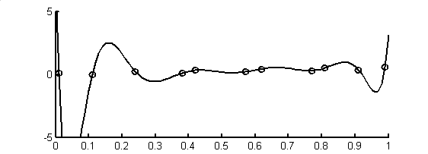
example
d(t)
time, t
Notes:
Presumably this is enough to convince everyone that interpolating data using
a high order polynomial is usually a terrible idea.

Slide 21
example
d(t)
what happened here?
and here?
time, t
Notes:
Note the overshoots.

Slide 22
solution
a low-order polynomial
has less potential for wild swings
so use many low-order polynomial
each valid in a small time interval
such a function is called a “spline”
Notes:
Spline – an interpolant constructed by pasting together many simple functions,
each valid over a small interval of time.

Slide 23
simplest case
set of linear polynomials
each valid between two data points
“connect the data points with straight lines”
Notes:
Most plotting software performs linear interpolation …

Slide 24
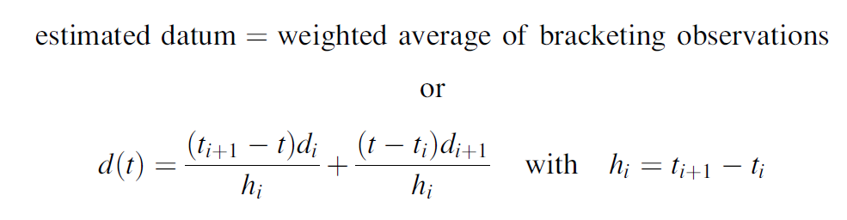
d(t)
d
t
t_{i}
t_{i+1}
Notes:
Point out that the first term is 1 when t=t_{i}, and 0 when t=t_{i}+1.
Similarly, the second term is 0 when t=t_{i}, and 1 when t=t_{i}+1.
Thus the interpolant varies linearly from d_{i} to d_{i+1}.

Slide 25
disadvantage
advantages
conceptually very simple
always get what you expect
zero roughness between observations
d(t) has kinks at observation points
Notes:
My advice: use linear interpolation for everything where the presence of a kink doesn’t matter.
However, one place that kinks are really bad is spectral analysis, because they introduce spurious
high frequencies into the data.

Slide 26
example
d(t)
time, t
Notes:
You might flash back to the polynomial interpolation for comparison. The data and plotting scales are the same.

Slide 27
example
kink
d(t)
time, t
Notes:
But is does introduce kinks …

Slide 28
MATLAB
dp=interp1(t,d,tp,'linear','extrap');
observations
times of interpolation
interpolated observations
Notes:
Pretty simple in MATLAB. However, you must use the “extrap” option if you want to fill in points to the left and right of the observed data (which usually you do).

Slide 29
Python
observations
f = ip.interp1d(t.ravel(),d.ravel(),axis=0,
kind='linear',fill_value='extrapolate');
dp = eda_cvec(f(tp));
interpolated observations
times of interpolation
Notes:
Less simple in Python. Interestingly, the ip.interp1d() method returns an “interpolant”, a function f(t) that you then call to interpolate the data. The method is in scipy.interpolate, which is abbreviated here as ip. You must use the fill_value='extrapolate’ option if you want to fill in points to the left and right of the observed data (which usually you do).

Slide 30
getting rid of the kinks
use cubic polynomials
S_{i}(t) = c₀ + c₁ t + c₂ t² + c₃ t³
each valid between two data points
Notes:
A cubic polynomail has four coefficients.

Slide 31
cubic polynomial has 4 coefficients
two constrained by need to pass through two data
two to implement prior information
no kinks in d(t) or its first derivative
Notes:
Its second derivative does have a kink.

Slide 32
the solution involves solving a matrix equation for the unknowns
(see text for details)
Notes:
I’m leaving out the details of the solution in this lecture, for lack of time.
It’s enough for the students to get the sense that standard methods can be used to solve for the coefficients.

Slide 33
MATLAB
dp=interp1(t,d,tp,'spline','extrap');
observations
times of interpolation
interpolated observations
Notes:
In MTLAB, its just as easy as linear interpolation.

Slide 34
MATLAB
observations
f = ip.interp1d(t.ravel(),d.ravel(),axis=0,
kind='cubic',fill_value='extrapolate’);
dp=eda_cvec(f(tp));
times of interpolation
interpolated observations
Notes:
In Python, its just as easy as linear interpolation, too.

Slide 35
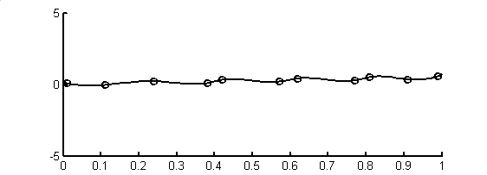
example
d(t)
time, t
Notes:
A little smoother than linear interpolation, but other than that, it looks about the same.

Slide 36
example
no kinks
d(t)
time, t
Notes:
No kinks.

Slide 37
interpolation involves prior information of smoothness
Notes:
Again, whenever we interpolate, we are making assumptions about the general behavior of the data
not constrained by the obsevations.

Slide 38
in generalized least-squares
the prior information of smoothness is quantified by a roughness matrix, H
Hm
then we minimize the overall roughness, which is to say the overall error in the prior information
(Hm)^{T} (Hm)
Notes:
In the example in Lecture 8, the matrix H contained second derivatives, and had rows
that looked like [ 0, 0, … 0, -1, 2, -1, 0, … 0]

Slide 39
note that
(Hm)^{T} (Hm) = m^{T} (H^{T}H) m
but in generalized error also has the form
m^{T} C_{m}⁻¹ m
where C_{m}⁻¹ is a covariance matrix
so in this case
C_{m} = (H^{T}H)⁻¹
Notes:
The point here is that there is a connection between the
somewhat ad hoc notion of minimizing roughness
and the more general idea of minimizing an error that is
weighted by the inverse of a covariance matrix.

Slide 40
so the prior information that the data are smooth is equivalent to the requirement that they have a specific covariance matrix which for stationary time series is equivalent to saying that they have a specific autocorrelation function
Notes:
Instead of thinking about a smooth interpolant,
think about one that has a specific autocorrelation function.

Slide 41
so an alternative, more flexible way of interpolating data is by specifying the autocorrelation function that we want the results to have
Notes:
For example, we could specify an autocorrelation functions that embodies moderately-strong inter-annual correlations; that is, some correlation between the character of the data in successive summers.

Slide 42
We did this in Chapter 5 to fill in missing data
(which is almost but not quite interpolation)
Here, we set up Generalized Least Squares to actually interpolate data in which case it is called
Gaussian Process Regression (GPR)
Notes:
In other words, Gaussian Process Regression is a special case of Generalized Least Squares.

Slide 43

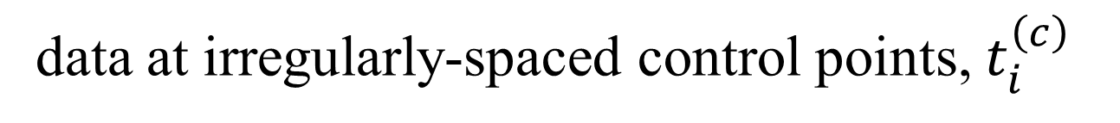

data at irregularly-spaced control points, $t_{i}^{\left(c\right)}$
$$d_{i}$$
$$t$$
Notes:
A key difference between the fill-in-the-gaps problem and general interpolation is that the data are irregularly-spaced.

Slide 44

interpolation at irregularly-spaced target points, $t_{i}^{\left(t\right)}$
?
$$m$$
?
?
?
?
?
?
$$t$$
Notes:
Another key difference is that the data are interpolated at points that are possibly unevenly-spaced, too.

Slide 45

Generalized Least Squares:
$$Gm=d^{obs} with covariance C_{d} and Hm=h^{pri} with covariance C_{h}$$
Special case:
$$m^{est}=\left[\begin{matrix}m^{\left(t,est\right)} \\ m^{\left(c,est\right)}\end{matrix}\right] and G=\left[0 I\right] and H=I and h^{pri}=m^{pri}=\left[\begin{matrix}m^{\left(t,pri\right)} \\ m^{\left(c,pri\right)}\end{matrix}\right] and C_{d}=σ_{d}^{2}I$$
$$and C_{h}=C_{m}=\left[\begin{matrix}C_{m}^{(L)} & C_{m}^{(R)}\end{matrix}\right]=\left[\begin{matrix}C_{m}^{(tt)} & C_{m}^{(tc)} \\ C_{m}^{(ct)} & C_{m}^{(cc)}\end{matrix}\right] with C_{m}^{(ct)}={\left[C_{m}^{(tc)}\right]}^{T}$$
Notes:
Gaussian Process Regression is a special case of Generalized Least Squares

Slide 46
Generalized Least Squares:
$$Gm=d^{obs} with covariance C_{d} and Hm=h^{pri} with covariance C_{h}$$
Special case:
$$m^{est}=\left[\begin{matrix}m^{\left(t,est\right)} \\ m^{\left(c,est\right)}\end{matrix}\right] and G=\left[0 I\right] and H=I and h^{pri}=m^{pri}=\left[\begin{matrix}m^{\left(t,pri\right)} \\ m^{\left(c,pri\right)}\end{matrix}\right] and C_{d}=σ_{d}^{2}I$$
$$and C_{h}=C_{m}=\left[\begin{matrix}C_{m}^{(L)} & C_{m}^{(R)}\end{matrix}\right]=\left[\begin{matrix}C_{m}^{(tt)} & C_{m}^{(tc)} \\ C_{m}^{(ct)} & C_{m}^{(cc)}\end{matrix}\right] with C_{m}^{(ct)}={\left[C_{m}^{(tc)}\right]}^{T}$$
target and control
model parameters
Notes:
Estimate BOTH the target points and the control points

Slide 47

Generalized Least Squares:
$$Gm=d^{obs} with covariance C_{d} and Hm=h^{pri} with covariance C_{h}$$
Special case:
$$m^{est}=\left[\begin{matrix}m^{\left(t,est\right)} \\ m^{\left(c,est\right)}\end{matrix}\right] and G=\left[0 I\right] and H=I and h^{pri}=m^{pri}=\left[\begin{matrix}m^{\left(t,pri\right)} \\ m^{\left(c,pri\right)}\end{matrix}\right] and C_{d}=σ_{d}^{2}I$$
$$and C_{h}=C_{m}=\left[\begin{matrix}C_{m}^{(L)} & C_{m}^{(R)}\end{matrix}\right]=\left[\begin{matrix}C_{m}^{(tt)} & C_{m}^{(tc)} \\ C_{m}^{(ct)} & C_{m}^{(cc)}\end{matrix}\right] with C_{m}^{(ct)}={\left[C_{m}^{(tc)}\right]}^{T}$$
data equation
$m^{\left(c\right)}=d$
only for
control points
Notes:
As in the gap-filling procedure, the data kernel is either 1 (to match up a control model parameter with a datum) or a zero (for target model parameters that have to corresponding data).

Slide 48
Generalized Least Squares:
$$Gm=d^{obs} with covariance C_{d} and Hm=h^{pri} with covariance C_{h}$$
Special case:
$$m^{est}=\left[\begin{matrix}m^{\left(t,est\right)} \\ m^{\left(c,est\right)}\end{matrix}\right] and G=\left[0 I\right] and H=I and h^{pri}=m^{pri}=\left[\begin{matrix}m^{\left(t,pri\right)} \\ m^{\left(c,pri\right)}\end{matrix}\right] and C_{d}=σ_{d}^{2}I$$
$$and C_{h}=C_{m}=\left[\begin{matrix}C_{m}^{(L)} & C_{m}^{(R)}\end{matrix}\right]=\left[\begin{matrix}C_{m}^{(tt)} & C_{m}^{(tc)} \\ C_{m}^{(ct)} & C_{m}^{(cc)}\end{matrix}\right] with C_{m}^{(ct)}={\left[C_{m}^{(tc)}\right]}^{T}$$
prior info
of model parameters
themselves
Notes:
The matrix H is the identity matrix, since the prior information is on the values of the model parameters, themselves.

Slide 49
Generalized Least Squares:
$$Gm=d^{obs} with covariance C_{d} and Hm=h^{pri} with covariance C_{h}$$
Special case:
$$m^{est}=\left[\begin{matrix}m^{\left(t,est\right)} \\ m^{\left(c,est\right)}\end{matrix}\right] and G=\left[0 I\right] and H=I and h^{pri}=m^{pri}=\left[\begin{matrix}m^{\left(t,pri\right)} \\ m^{\left(c,pri\right)}\end{matrix}\right] and C_{d}=σ_{d}^{2}I$$
$$and C_{h}=C_{m}=\left[\begin{matrix}C_{m}^{(L)} & C_{m}^{(R)}\end{matrix}\right]=\left[\begin{matrix}C_{m}^{(tt)} & C_{m}^{(tc)} \\ C_{m}^{(ct)} & C_{m}^{(cc)}\end{matrix}\right] with C_{m}^{(ct)}={\left[C_{m}^{(tc)}\right]}^{T}$$
prior model
parameters
Notes:
The prior model parameters are subdivided into two groups, target and control.

Slide 50
Generalized Least Squares:
$$Gm=d^{obs} with covariance C_{d} and Hm=h^{pri} with covariance C_{h}$$
Special case:
$$m^{est}=\left[\begin{matrix}m^{\left(t,est\right)} \\ m^{\left(c,est\right)}\end{matrix}\right] and G=\left[0 I\right] and H=I and h^{pri}=m^{pri}=\left[\begin{matrix}m^{\left(t,pri\right)} \\ m^{\left(c,pri\right)}\end{matrix}\right] and C_{d}=σ_{d}^{2}I$$
$$and C_{h}=C_{m}=\left[\begin{matrix}C_{m}^{(L)} & C_{m}^{(R)}\end{matrix}\right]=\left[\begin{matrix}C_{m}^{(tt)} & C_{m}^{(tc)} \\ C_{m}^{(ct)} & C_{m}^{(cc)}\end{matrix}\right] with C_{m}^{(ct)}={\left[C_{m}^{(tc)}\right]}^{T}$$
uncorrelated data
with
uniform variance
Notes:
The data are assumed to be uncorrelated and with uniform variance. (This requirement is easy to relax, but makes the form of the solution substantially more complicated).

Slide 51
Generalized Least Squares:
$$Gm=d^{obs} with covariance C_{d} and Hm=h^{pri} with covariance C_{h}$$
Special case:
$$m^{est}=\left[\begin{matrix}m^{\left(t,est\right)} \\ m^{\left(c,est\right)}\end{matrix}\right] and G=\left[0 I\right] and H=I and h^{pri}=m^{pri}=\left[\begin{matrix}m^{\left(t,pri\right)} \\ m^{\left(c,pri\right)}\end{matrix}\right] and C_{d}=σ_{d}^{2}I$$
$$and C_{h}=C_{m}=\left[\begin{matrix}C_{m}^{(L)} & C_{m}^{(R)}\end{matrix}\right]=\left[\begin{matrix}C_{m}^{(tt)} & C_{m}^{(tc)} \\ C_{m}^{(ct)} & C_{m}^{(cc)}\end{matrix}\right] with C_{m}^{(ct)}={\left[C_{m}^{(tc)}\right]}^{T}$$
specified
prior covariance
matrix
Notes:
The prior covariance of the model parameters is the key quantity, because it controls the characteristics of the solution (such as smoothness).

Slide 52
Generalized Least Squares:
$$Gm=d^{obs} with covariance C_{d} and Hm=h^{pri} with covariance C_{h}$$
Special case:
$$m^{est}=\left[\begin{matrix}m^{\left(t,est\right)} \\ m^{\left(c,est\right)}\end{matrix}\right] and G=\left[0 I\right] and H=I and h^{pri}=m^{pri}=\left[\begin{matrix}m^{\left(t,pri\right)} \\ m^{\left(c,pri\right)}\end{matrix}\right] and C_{d}=σ_{d}^{2}I$$
$$and C_{h}=C_{m}=\left[\begin{matrix}C_{m}^{(L)} & C_{m}^{(R)}\end{matrix}\right]=\left[\begin{matrix}C_{m}^{(tt)} & C_{m}^{(tc)} \\ C_{m}^{(ct)} & C_{m}^{(cc)}\end{matrix}\right] with C_{m}^{(ct)}={\left[C_{m}^{(tc)}\right]}^{T}$$
subdivided into pieces
acting on target and control
parts of model parameters
Notes:
The prior covariance matrix is subdivided into parts that involve target and control model parameters. For instance, [Ctt]_ij is the covariance of target model parameter i and target model parameter j.

Slide 53
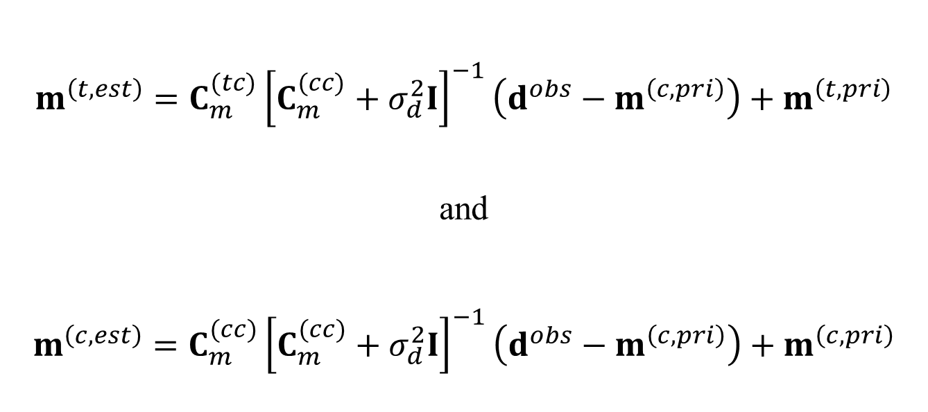
Generalized Least Squares reduces to
$$m^{\left(t,est\right)}=C_{m}^{(tc)}{\left[C_{m}^{(cc)}+σ_{d}^{2}I\right]}^{−1}\left(d^{obs}−m^{\left(c,pri\right)}\right)+m^{\left(t,pri\right)}$$
and
$$m^{\left(c,est\right)}=C_{m}^{(cc)}{\left[C_{m}^{(cc)}+σ_{d}^{2}I\right]}^{−1}\left(d^{obs}−m^{\left(c,pri\right)}\right)+m^{\left(c,pri\right)}$$
Notes:
The derivation is lengthy and is omitted both here and in the text. It’s in the Menke and Creel (Surveys in Geophysics, 2021).

Slide 54


MATLAB
% estimated target model parameters and their covariance
A = (Ccc + sigmad2*eye(N,N) );
mest = Ctc * (A\dobs);
B = Ctc/A;
Cttest = sigmad2*B*B';
(assumes $m^{\left(pri\right)}$=0)
Python
# estimated target model parameters and their covariance
A = (Ccc + sigmad2*np.identity(N) );
mest = np.matmul(Ctc,la.solve(A,dobs));
BT = la.solve(A,Ctc.T)
Cttest = sigmad2*np.matmul(BT.T,BT);
(assumes $m^{\left(pri\right)}$=0)
Notes:
Note that an equation of the form m = C inv(A) d is being solved in two steps.
First write lambda = inv(A) d, and then solve the linear equation A lambda = d for lambda.
Then compute m = C lambda.
The formula for covariance is just standard error propagation.
That is, if m = [C inv(A)] d then Cm =sigmad2 [C inv(A)] [C inv(A)]T.
In MATLAB, B=C inv(A) is written B=C/A.
There is no equivalent expression in Python,
but the equation B A = C can be transformed to AT BT = CT
and that can be solved for BT using la.solve()

Slide 55
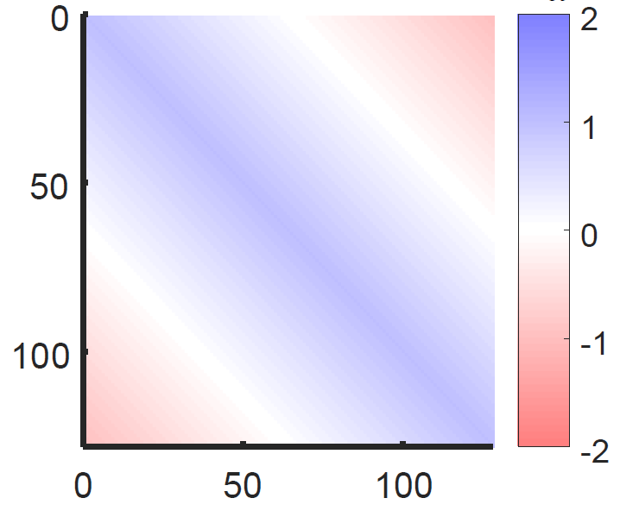



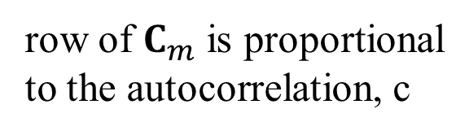


Stationary Process
prior covariance matrix depends only on lag τ=$\left|x_{i}−x_{j}\right|$
$$C_{m}$$
$$c$$
$$\text{τ}$$
$$t_{j}$$
row of $C_{m}$ is proportional
to the autocorrelation, c
$$t_{i}$$
Notes:
A hypothetical prior Cm is shown in colors. The matric is Toeplitz for a stationary process, since Cij depends only on |i-j|

Slide 56
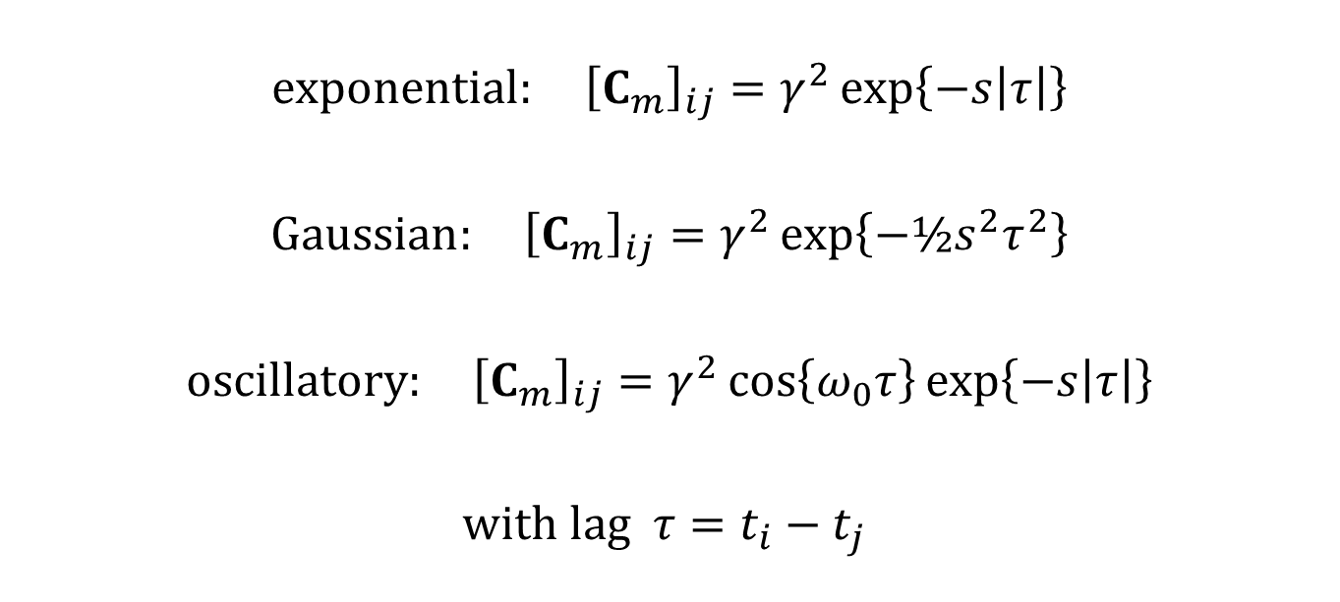
Some possible covariance matrices:
$$exponential: {\left[C_{m}\right]}_{ij}=γ^{2}\exp\left\{−s\left|τ\right|\right\}$$
$$Gaussian: {\left[C_{m}\right]}_{ij}=γ^{2}\exp\left\{−½s^{2}τ^{2}\right\}$$
$$oscillatory: {\left[C_{m}\right]}_{ij}=γ^{2}\cos\left\{ω_{0}τ\right\}\exp\left\{−s\left|τ\right|\right\}$$
$$with lag τ=t_{i}−t_{j}$$
Notes:
The overall power in the signal is given by gamma^2.
The parameter s is a scale parameter; the bigger the parameter, the narrower the central peak.
In the case of an oscillatory covariance, the parameter w0 is the angular frequency of oscillation;
for example, for annual correlation 2 pi / w0 = 1 year.

Slide 57

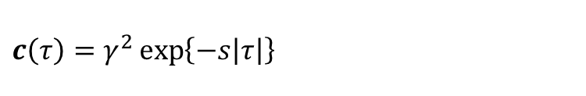

exponential
Gaussian
$$c\left(τ\right)=γ^{2}\exp\left\{−s\left|τ\right|\right\}$$
$$c\left(τ\right)=γ^{2}\exp\left\{−½s^{2}τ^{2}\right\}$$
1.5
1.5
1.0
1
$$c\left(τ\right)$$
$$c\left(τ\right)$$
0.5
0.5
0.0
0
-0.5
-0.5
-100
-50
0
50
100
-100
-50
0
50
100
time lag, τ
time lag, τ
rough time series
smooth time series
5.0
d(t)
d(t)
0.0
-5.0
0
100
200
0
100
200
time, t
time, t
Notes:
Because the exponential correlation function has a central cusp, the time series is “rough”.
The Gaussian (Normal) correlation has a flat-topped central peak, corresponding to a much smoother time series.

Slide 58
data
5.0
0.0
d(t)
-5.0
0
50
100
150
200
250
time, t
oscillatory covariance
C(τ)
-100
-50
0
50
100
time tag, τ
estimated model parameters and their confidence
5.0
d(t) and m(t)
0.0
-5.0
0
50
100
150
200
250
time, t
Notes:
Example of Gaussian Process Estimation. Top: the data; middle prior information of an oscillatory covariance, bottom, the estimated model (the interpolation) and its 95% confidence interval. The interpolation does not exactly go through the data, and does not exactly have the prior covariance, but rather is a “best compromise” between the two.

Slide 59

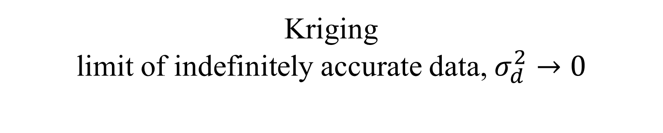
Kriging limit of indefinitely accurate data, $σ_{d}^{2}→0$
$$m^{\left(t,est\right)}=C_{m}^{(tc)}{\left[C_{m}^{(cc)}+σ_{d}^{2}I\right]}^{−1}\left(d^{obs}−m^{\left(c,pri\right)}\right)+m^{\left(t,pri\right)}$$
$$=C_{m}^{(tc)}{\left[C_{m}^{(cc)}\right]}^{−1}\left(d^{obs}−m^{\left(c,pri\right)}\right)+m^{\left(t,pri\right)}$$
and
$$m^{\left(c,est\right)}=C_{m}^{(cc)}{\left[C_{m}^{(cc)}+σ_{d}^{2}I\right]}^{−1}\left(d^{obs}−m^{\left(c,pri\right)}\right)+m^{\left(c,pri\right)}=d^{obs}$$
Notes:
Kriging was invented independently long before Gaussian Process Regression, and so has a separate name

Slide 60
Kriging limit of indefinitely accurate data, $σ_{d}^{2}→0$
$$m^{\left(t,est\right)}=C_{m}^{(tc)}{\left[C_{m}^{(cc)}+σ_{d}^{2}I\right]}^{−1}\left(d^{obs}−m^{\left(c,pri\right)}\right)+m^{\left(t,pri\right)}$$
$$=C_{m}^{(tc)}{\left[C_{m}^{(cc)}\right]}^{−1}\left(d^{obs}−m^{\left(c,pri\right)}\right)+m^{\left(t,pri\right)}$$
and
$$m^{\left(c,est\right)}=C_{m}^{(cc)}{\left[C_{m}^{(cc)}+σ_{d}^{2}I\right]}^{−1}\left(d^{obs}−m^{\left(c,pri\right)}\right)+m^{\left(c,pri\right)}=d^{obs}$$
data fit exactly
Notes:
Kriging is true interpolation, because the data are exactly fit.

Slide 61
Part 3
Interpolation in multiple dimensions

Slide 62
the fundamental idea of interpolation still holds
construct an interpolant
d(x,y)
that goes through the observations
and
does something sensible in between
Notes:
Interpolation is two (or more) dimensions is conceptually the same as in 1D. But there is a significant complication …

Slide 63
1 dimensions
notion of bracketing observations more complicated
y₀
d
y₀
t
t₀
x
x₀
2 dimensions
Notes:
In 1D, it’s easy to identify the data points that bracket a given point.
It’s not so easy in 2D …

Slide 64
1 dimensions
notion of bracketing observations more complicated
y
triangular tile
d
y₀
t
t_{i}
t_{i+1}
t₀
x
segment of t-axis
x₀
2 dimensions
Notes:
Triangles are only one possible way – the simplest - of dividing the (x,y) plane up into tiles.
Once its done, then the vertices of the enclosing triangle brackets the point.

Slide 65
Delaunay triangles
set of most-equilateral triangles connecting data points
Notes:
MatLab’s interpolation functions use Delaunay triangulations, but mostly ‘behind the scenes”.
So its sufficient for students to simply know that they exist.
Students should be aware that they have lots of uses besides interpolation, and are not
particularly difficult to manipulate using MatLab. Some of the functions are introduced
briefly in the text.

Slide 66
A) Observations
B) Delaunay triangles
x
x
y
y
Notes:
Left. Data points, positioned according to their (x_{i},y_{i}) values and with
grey level indicating the value of d_{i}.
(Right) Delaunay triangulation

Slide 67
A) Observations
B) Delaunay triangles
x
x
y
y
triangle enclosing a point of interest
Notes:
Both MATLAB and Python provide software to compute Delaunay triangulation and to manipulate the resulting triangles. See the text for details.

Slide 68
A) Linear Splines
B) Cubic Splines
x
x
y
y
Notes:
Results of 2D interpolation function.
A) Linear interpolation of the data in the previous slide. B) Cubic spline interpolation of the same data.

Slide 69
MATLAB
linear splines
B=griddata(xobs,yobs,dobs,XGRID,YGRID,'linear’);
C=griddata(xobs,yobs,dobs,XGRID,YGRID,'cubic');
cubic splines
Notes:
Other than the keywords “linear’ and ‘cubic’, the method is the same Note: griddata() is apparently being depreciated. You may wish to teach students how to use triscatteredinterp() instead, even though it is somewhat more complicated to use.

Slide 70
Python
linear splines
BB=ip.griddata(
np.concatenate((xobs,yobs),axis=1),
dobs,(XGRID,YGRID), method=‘linear’,
fill_value=0.0);
B = BB[:,:,0];
cubic splines
CC=ip.griddata(
np.concatenate((xobs,yobs),axis=1),
dobs,(XGRID,YGRID), method=‘cubic’,
fill_value=0.0);
C = CC[:,:,0];
Notes:
Other than the keywords “linear’ and ‘cubic’, the method is the same.

