Slide 1
Environmental Data Analysis with MATLAB or Python 3rd Edition Lecture 22

Slide 2
SYLLABUS
Lecture 01 Intro; Using MTLAB or Python Lecture 02 Looking At Data Lecture 03 Probability and Measurement Error Lecture 04 Multivariate Distributions Lecture 05 Linear Models Lecture 06 The Principle of Least Squares Lecture 07 Prior Information Lecture 08 Solving Generalized Least Squares Problems Lecture 09 Fourier Series Lecture 10 Complex Fourier Series Lecture 11 Lessons Learned from the Fourier Transform
Lecture 12 Power Spectra Lecture 13 Filter Theory Lecture 14 Applications of Filters Lecture 15 Factor Analysis and Cluster Analysis Lecture 16 Empirical Orthogonal functions and Clusters Lecture 17 Covariance and Autocorrelation Lecture 18 Cross-correlation Lecture 19 Smoothing, Correlation and Spectra Lecture 20 Coherence; Tapering and Spectral Analysis Lecture 21 Interpolation and Gaussian Process Regression
Lecture 22 Linear Approximations and Non Linear Least Squares
Lecture 23 Adaptable Approximations with Neural Networks Lecture 24 Hypothesis testing Lecture 25 Hypothesis Testing continued; F-Tests Lecture 26 Confidence Limits of Spectra, Bootstraps
Notes:
26 lectures are sufficient to survey the material in the book. However, not every topic in the book is covered, so students should be encouraged to read the book.

Slide 3
Goals of the lecture
learn how to make linear approximations
of non-linear functions
apply liner approximations to error estimation
apply liner approximations to least squares
Notes:
This is an generalization of the often heard “nonsense in – nonsense out’” rule”: Noisy data in,
imprecise conclusions out.

Slide 4
Taylor Series and Linear Approximations
Notes:
Many students will have encountered Taylor series in courses in elementary calculus. Our treatment here emphasizes their importance as a form of approximation.

Slide 5
polynomial approximation to a function y(t)
in the neighborhood of a point t₀
Notes:
The idea here is to design a polynomial yp(t) that is a good approximation to the arbitrary function y(t) in the neighborhood of the point t0. The formula is just a polynomial of indefinite order, with coefficients c0, c1, c2, etc. The trick is to determine these coefficients.

Slide 6
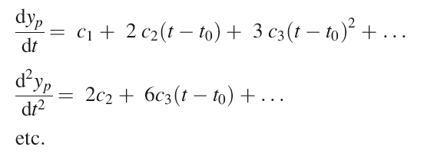
polynomial approximation to a function y(t)
in the neighborhood of a point t₀
find coefficients by taking derivatives
Notes:
Here , we compute the derivatives of the polynomial.

Slide 7
polynomial approximation to a function y(t)
in the neighborhood of a point t₀
evaluate at t₀
0
find coefficients by taking derivatives
0
0
Notes:
Note that when the functions and its derivatives are evaluated at t0, each is proportional to a single constant. yp(t0)=c0; dyp/dt evaluated at t0 is c1, etc.

Slide 8
polynomial approximation to a function y(t)
in the neighborhood of a point t₀
Notes:
Substituting these values for the c’s yields the polynomia.

Slide 9
polynomial approximation to a function y(t)
in the neighborhood of a point t₀
Taylor series
Notes:
Which is called a Taylor Series

Slide 10
Taylor Series
Linear approximation
≈
Notes:
A linear approximation to the function y(t) uses just the first two terms of the Taylor Series.

Slide 11
example
Notes:
An example of the Taylor series expansion of a simple function

Slide 12
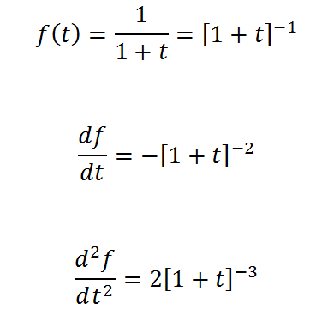
example
Notes:
Compute the derivatives. You should mention that the chain rule is being used.

Slide 13
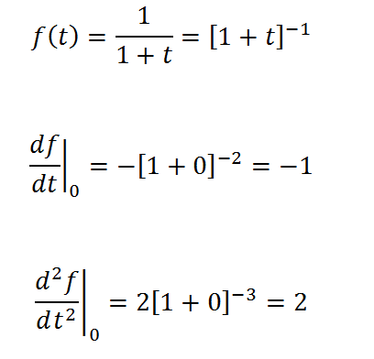
example
Notes:
Evaluate the derivatives at t0=0

Slide 14
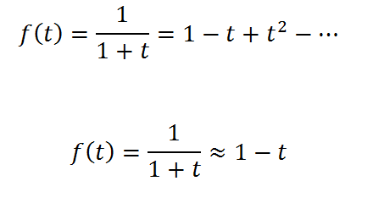
example
Linear approximation
Notes:
The Taylor series (top). The linear approximation is just the first two terms.

Slide 15
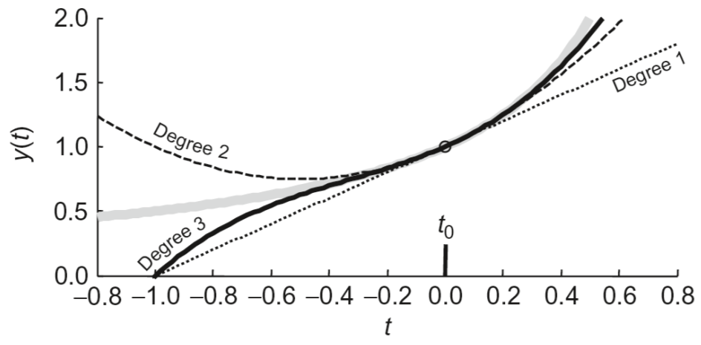
Notes:
The exact function is in grey. The point t0=0 is shown with a vertical bar. The degree 1 (linear), degree 2 and degree 3 approximations are shown in black. Note that the approximations are very good, close to the point t0.

Slide 16
example: distances on a sphere
(λ₁,L₁)
(λ₂,L₂)
r
measured in terms of central angle, r
Notes:
Another example, involving measuring distances on a sphere. Lambda and L are latitude and longitude, respectively. Note that distances are quantified by their central angle, r.

Slide 17
exact formula: 6 trig functions
approximate formula: 1 trig function and 1 square root
Notes:
The exact formula for distance r is derived using spherical tigonometry and is complicated. Involving 6 trig functions. When the distance is small (that is, in the neighborhood of lambda1=lamnbda2 and L1=L2), first order approximations can be used to represent all the trig functions. The resulting approximate formula is simpler. Furthermore, the first two terms can be identified as a ‘flat – earth’ Euclidian distamce. The third term is a correction to the Euclidian distance that accounts for the curvature of the sphere.

Slide 18
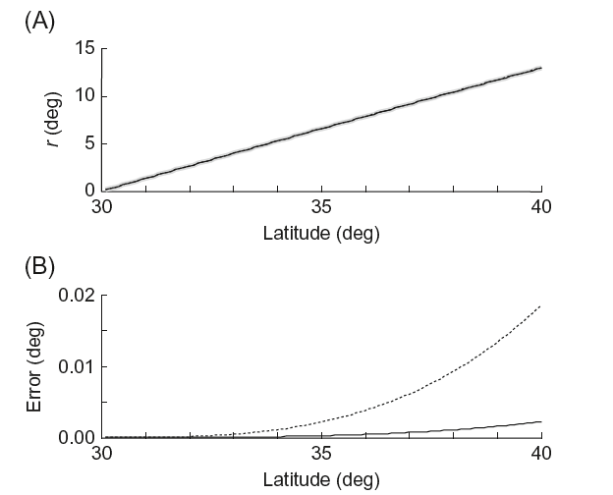
(λ₂,L₂=0)
(λ₁=0,L₁=0)
linear
quadratic
Notes:
(Top) Two points with a longitude of zero but with different latitudes. (top) The approximate distance (solid) agrees well with the exact distance (grey). (bottom) The error for the first order (linear) and second order (quadratic) approximations is small, but does grow with di

Slide 19
application to estimates of variance
Notes:
Scatter of data around its mean can analyzed using a linear approximation, as long as the scatter is only a small percentage of the mean.

Slide 20
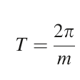
spectral analysis scenario
measure angular frequency, m
want confidence bounds on corresponding period, T
Notes:
Example: presume that we estimate the angular frequency of a process. We know its mean and variance. What is the mean and variance of the period?

Slide 21
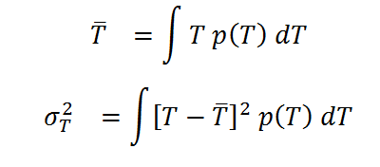
exact (but difficult) method
assume m is Normally-distributed, p(m)
work out the distribution p(T)
compute its mean and variance by integration
Notes:
We know the ‘right way’ to do this. View period T as a function of angular frequency m, and transform p(m) to p(T). Then compute the mean and variance of p(T). The only problem is that both steps are complicated.

Slide 22
approximate (and easy) method
assume m is Normally-distributed with mean m^{est}
work out a linear approximation of T in neighborhood of m^{est}
use formula for error propagation for a linear functions
Notes:
An alternative is to linearise the period of angular frequency function about the estimated angular frequency and then use the simple formula for variance propagation in a linear system.

Slide 23
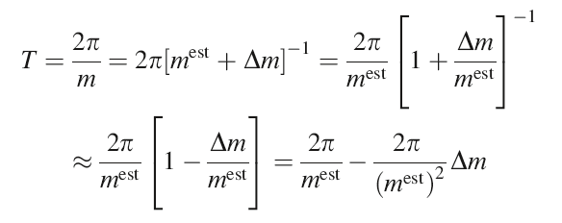
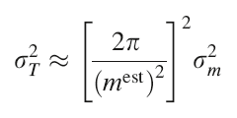
consider small fluctuations about the estimated angular frequency
T^{est}
so
Notes:
Expand the formula for period around the point m=mest. Here Delta m quantifies small deviations of m from mest.
The resulting formula gives Delta T as a constant times Delta M. The variances are then related by the constant squared.

Slide 24
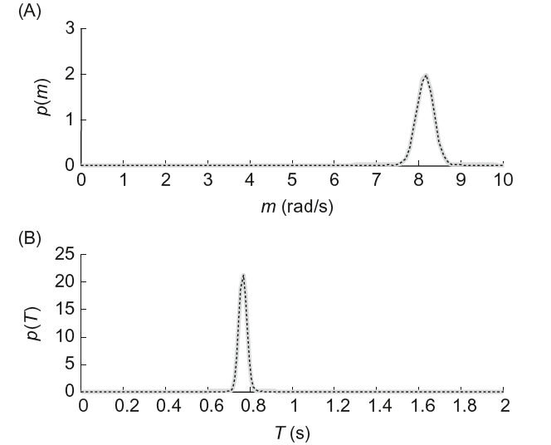
Notes:
(Top) Probability distribution p(m) (Bottom) Probability distribution p(T) computed exactly (grey) and via linear approximation (dashed) are in very good agreement.

Slide 25
application to least squares
Notes:
Applying to non-linear problems

Slide 26
Goal
Solve non-linear problems of the form
$${d_{i}^{obs}≈d_{i}^{pre}=g}_{i}\left(m\right)$$
by generalized least squares
Notes:
An extremely important application of linear approximations is solving least squares problems in which the predicted data are nonlinear functions gi of the model parameters m.

Slide 27
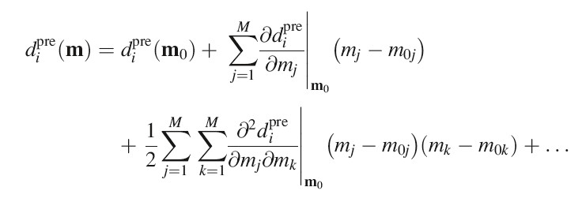
Taylor series expansion of predicted data
Notes:
Taylor series when both independent variable m and dependent variable d are vectors. Here we are expanding about a point m0. The formula is similar to the univariate case, but involves sums of derivatives.

Slide 28
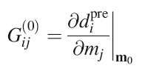
Taylor series expansion of predicted data
with $∆m=m−m^{0}$
and
Notes:
(top) The first two terms are the linear approximation. We write it in terms of the deviation Dm of the solution about the initial solution m0.

Slide 29
Now consider the data equation
$$d^{obs}=d^{pre}$$
$${with d}^{pre}=g(m)$$
$d^{obs}$ $≈$
and $∆m=m−m^{(0)}$
$$∆d=G^{(0)}∆m$$
and $∆d=d^{obs}−d_{0}^{pre}$
$$G_{ij}^{(0)}={\left.\frac{∂g_{i}}{∂m_{j}}\right|}_{m^{(0)}}$$
and
Notes:
The top equation is the non-linear data equation.
The second is its linearized form, with the derivative written as a matrix G0. This matrix is called the linearized data kernel.
The third equation moves the d0pre to the l.h.s., which becomes a deviation of the data about that predicted by m0.

Slide 30
Now consider the data equation
$$d^{obs}=d^{pre}$$
$${with d}^{pre}=g(m)$$
$d^{obs}$ $≈$
and $∆m=m−m^{(0)}$
$$∆d=G^{(0)}∆m$$
and $∆d=d^{obs}−d_{0}^{pre}$
$$G_{ij}^{(0)}={\left.\frac{∂g_{i}}{∂m_{j}}\right|}_{m^{(0)}}$$
and
looks like a standard
data equation, except:
- vectors are deviations
- data kernel involves derivative
Notes:
The equation in the red box is now in the form of a standard data equation.

Slide 31
linearized least squares
$$∆d=d^{obs}−g(m^{\left(k\right)})$$
$$G_{ij}^{(k)}={\left.\frac{∂g_{i}}{∂m_{j}}\right|}_{m^{(0)}}$$
$∆m={\left[G^{\left(k\right)T}G^{\left(k\right)T}\right]}^{−1}G^{\left(k\right)T}$ $∆d$
$m^{\left(k+1\right)}=m^{\left(k\right)}$+ $∆m$
Notes:
Putting it all together ...

Slide 32
linearized least squares
guess for the solution
$$∆d=d^{obs}−g(m^{\left(k\right)})$$
compute data deviation
$$G_{ij}^{(k)}={\left.\frac{∂g_{i}}{∂m_{j}}\right|}_{m^{(0)}}$$
compute linearized data kernel
iterate
solve by least squares
(of by GLS)
$∆m={\left[G^{\left(k\right)T}G^{\left(k\right)T}\right]}^{−1}G^{\left(k\right)T}$ $∆d$
$m^{\left(k+1\right)}=m^{\left(k\right)}$+ $∆m$
update guess
Notes:
One guess the solution mk.
The one forms the data deviation Dd.
Then one constructs the data kernel Gk, which involves differentiating g(m) and evaluating it at mk.
The resulting linearized data kernel is solved by least squares (or if prior information is availlable, by GLS.
This solution is a deviation Dm, which improves the initial guess.
mk + Dm becomes the new guess, and the process is iterated.
This algorithm is called Newton’s Method.

Slide 33
prior information
written in terms of the unknown
=
Notes:
Linear prior information is easy to add. First write it as a function of Delta m.

Slide 34
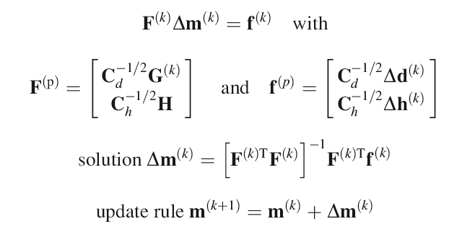
modification of generalized least squares
Notes:
Use the linearized data kernel in the standard formulation of generalized least squares, and iterate to get the solution.

Slide 35
example of generalized least squares

Slide 36
example of generalized least squares
sinusoid of unknown amplitude & frequency
superimposed on a constant background level
Notes:
Here is a formula for a sinusoidal oscillation superimposed on a background level. Suppose that we assume that both the amplitude and frequency oscillation are unknown, and solve for them. This is a little different from what we did in Fourier analysis, where we assumed that the time series was built up of many sinusoids, each with a known frequency and unknown amplitude.

Slide 37
example of generalized least squares
sinusoid of unknown amplitude & frequency
superimposed on a constant background level
normalized unknowns, so m_{i}≈1
background
level
amplitude
frequency
Notes:
Note that we have written the formula so that the model parameters multiply scale factors. As long as we get these scale factors roughly correct, then the model parameters will all be of order unity. That’s helpful, since it means that our initial guess can be m_{i}=1.

Slide 38
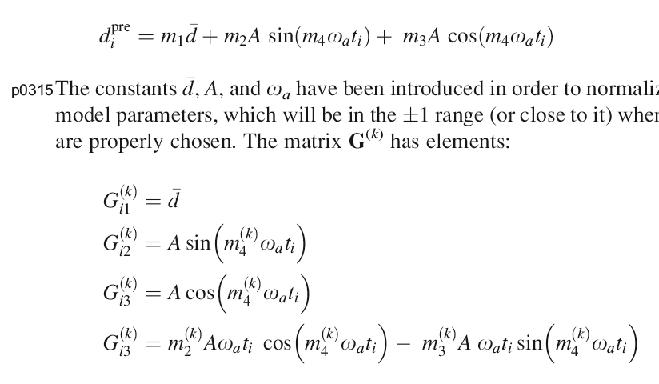
compute derivatives & evaluate in neighborhood of a guess mω_{a}
Notes:
Here are the derivatives. Gi1 is the derivative of the formula with respect to m1. G2i is the derivative of the formula with respect to m2. And so forth.

Slide 39
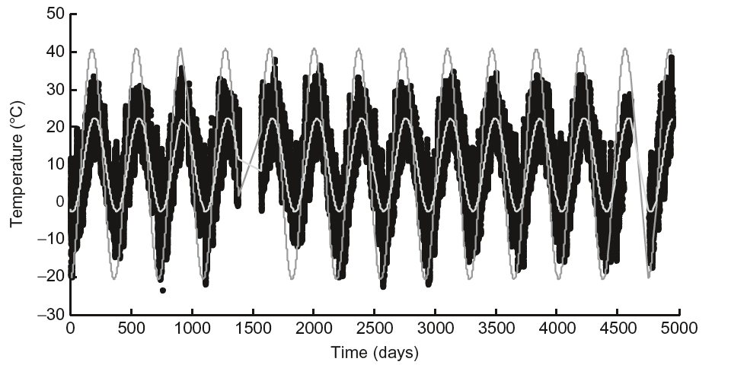
Notes:
Here the Black Rock Forest data (black), with the starting guess (dark grey) and final solution (light greay, smaller amplitude).

Slide 40
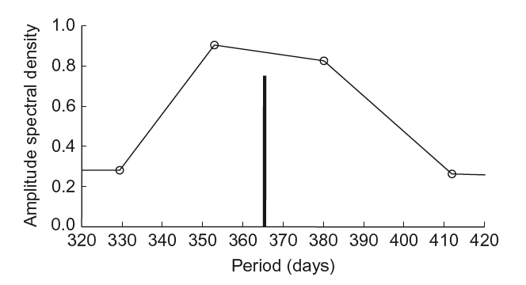
Notes:
The solution is depicted as a bar and compared to the spectrum of the data, as determined by Fourier analysis. The set of Fourier frequencies do have an oscillation at exactly at the period given by the nonlinear inversion. Instead, the two bracketing periods have high amplitude.

