Slide 1
Environmental Data Analysis with MATLAB or Python
3rd Edition
Lecture 24

Slide 2
SYLLABUS
Lecture 01 Intro; Using MTLAB or Python
Lecture 02 Looking At Data
Lecture 03 Probability and Measurement Error
Lecture 04 Multivariate Distributions
Lecture 05 Linear Models
Lecture 06 The Principle of Least Squares
Lecture 07 Prior Information
Lecture 08 Solving Generalized Least Squares Problems
Lecture 09 Fourier Series
Lecture 10 Complex Fourier Series
Lecture 11 Lessons Learned from the Fourier Transform
Lecture 12 Power Spectra
Lecture 13 Filter Theory
Lecture 14 Applications of Filters
Lecture 15 Factor Analysis and Cluster Analysis
Lecture 16 Empirical Orthogonal functions and Clusters
Lecture 17 Covariance and Autocorrelation
Lecture 18 Cross-correlation
Lecture 19 Smoothing, Correlation and Spectra
Lecture 20 Coherence; Tapering and Spectral Analysis
Lecture 21 Interpolation and Gaussian Process Regression
Lecture 22 Linear Approximations and Non Linear Least Squares
Lecture 23 Adaptable Approximations with Neural Networks
Lecture 24 Hypothesis testing
Lecture 25 Hypothesis Testing continued; F-Tests
Lecture 26 Confidence Limits of Spectra, Bootstraps
Notes:
26 lectures are sufficient to survey the material in the book. However, not every topic in the book is covered, so students should be encouraged to read the book.

Slide 3
Environmental Data Analysis with MatLab
2nd Edition
Lecture 24:
Hypothesis Testing
Notes:
Today’s lecture treats the subject of interpolation.

Slide 4
SYLLABUS
Lecture 01 Using MatLab
Lecture 02 Looking At Data
Lecture 03 Probability and Measurement Error
Lecture 04 Multivariate Distributions
Lecture 05 Linear Models
Lecture 06 The Principle of Least Squares
Lecture 07 Prior Information
Lecture 08 Solving Generalized Least Squares Problems
Lecture 09 Fourier Series
Lecture 10 Complex Fourier Series
Lecture 11 Lessons Learned from the Fourier Transform
Lecture 12 Power Spectra
Lecture 13 Filter Theory
Lecture 14 Applications of Filters
Lecture 15 Factor Analysis
Lecture 16 Orthogonal functions
Lecture 17 Covariance and Autocorrelation
Lecture 18 Cross-correlation
Lecture 19 Smoothing, Correlation and Spectra
Lecture 20 Coherence; Tapering and Spectral Analysis
Lecture 21 Interpolation
Lecture 22 Linear Approximations and Non Linear Least Squares
Lecture 23 Adaptable Approximations with Neural Networks
Lecture 24 Hypothesis testing
Lecture 25 Hypothesis Testing continued; F-Tests
Lecture 26 Confidence Limits of Spectra, Bootstraps
Notes:
24 lectures

Slide 5
purpose of the lecture
to introduce
Hypothesis Testing
the process of determining the statistical significance of results

Slide 6
Part 1
motivation
random variation as a spurious source of patterns

Slide 7
d
x
Notes:
This dataset appears to show a decreasing linear tend.

Slide 8
looks pretty linear
d
x
Notes:
The scatter about the straight line is pretty small.

Slide 9
actually, its just a bunch of random numbers!
figure(1);
for i = [1:100]
clf;
axis( [1, 8, -5, 5] );
hold on;
t = [2:7]';
d = random('normal',0,1,6,1);
plot( t, d, 'k-', 'LineWidth', 2 );
plot( t, d, 'ko', 'LineWidth', 2 );
[x,y]=ginput(1);
if( x<1 )
break;
end
end
the script makes plot after plot, and lets you stop when you see one you like
Notes:
But actually, it was made with the MATLAB script, that makes random plots, one after another, and lets you stop when you see one that you like.

Slide 10
the linearity was due to random variation!

Slide 11
4 more random plots
d
d
x
x
d
d
x
x
Notes:
the one in the lower left looks sinusoidal!

Slide 12
scenario test of a drug
Group A
Group B
given drug at start of illness
given placebo at start of illness
Notes:
Here’s a scenario with societal importance

Slide 13
Group A
Group B
average length of illness after taking drug
average length of illness after taking placebo
4.1 days
5.2 days
Notes:
The control group (who don’t take the drug) take longer to get better.

Slide 14
the logic
people’s immune systems differ
some naturally get better faster than others
perhaps the drug test just happened
by random chance -
to have naturally faster people in Group A
?
Notes:
But is the difference, 1.1 days, big enough that it is unlikely that it is caused by random variation?

Slide 15
How much confidence should you have that the difference between 4.1 and 5.2 is not due to random variation
?
Notes:
Note this is expressed probabilistically. In a world with random variation, no can never be 100% sure.

Slide 16
67%
90%
95%
99%
Notes:
What should be the right threshold for confidence.

Slide 17
67%
90%
95%
99%
1 in 20 chance that the difference was caused by random variation
minimum standard
Notes:
You might discuss with the students whether 95% confidence is the right one in the drug effectiveness scenario.

Slide 18
the goal of this lecture is to develop techniques for quantifying the probability that a result is not due to random variation
Notes:
Note the use of the negative, “not due...” to

Slide 19
Part 2
the distribution of the total error
Notes:
Now begins a long digression, in which the p.d.f. of various non-linear functions of data are discussed.

Slide 20
individual error
e_{i} = d_{i}^{obs} - d_{i}^{pre}
total error
E = Σ _{i=1}^{N} e_{i}²
Notes:
The total error is the sum of squares of random numbers.

Slide 21
individual error
e_{i} = d_{i}^{obs} - d_{i}^{pre}
Normal p.d.f.
total error
E = Σ _{i=1}^{N} e_{i}²
nonlinear
Not Normal
Notes:
The error is a nonlinear function of random variables, so its p.d.f. is not Normal

Slide 22
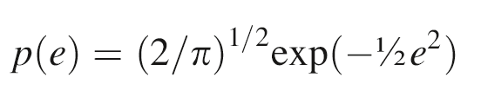
simplest case
N=1
individual error, e
Normal p.d.f.
zero mean
unit variance
assumes e>0
(since sign goes away when we square it)
Notes:
The derivation that follows in the next few slides is very similar to the one done in Lecture 3 for the function m=d^2 and p(d)=uniform. Here E=e^2 and p(e)=normal.

Slide 23
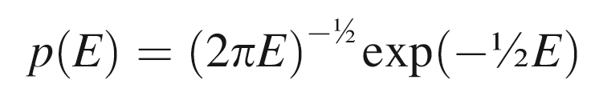
total error, E=e²
p(E)= p[e(E)] |de/dE|
e=E ^{½} so de/dE = ½E ^{-½}
Notes:
This is a standard transformation of a probability density, following the algorithm in Lecture 3.

Slide 24
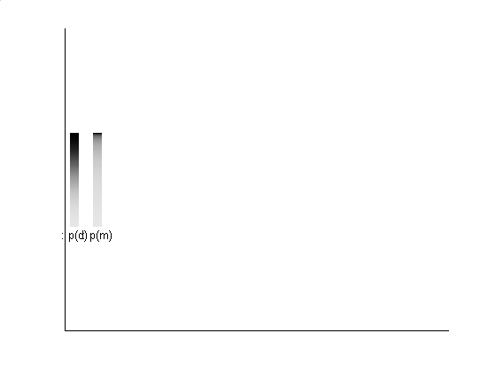
0
0
probability squeezed towards zero
increasing e
increasing E
p(e)
p(E)
Notes:
probaity is squeezed toward the origin.

Slide 25
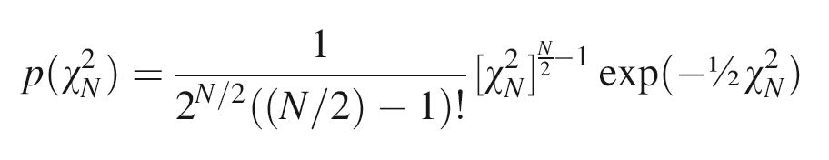
general case of N>1 tedious to compute, but not mysterious
total error
E = χ_{N}² = Σ _{i=1}^{N} e_{i}²
Notes:
Note that instead of writing p(E), one writes p(chi squared). This is just nomenclature.
The p.d.f. is a different function for each value of N.

Slide 26
general case of N>1 tedious to compute, but not mysterious
total error
E = χ_{N}² = Σ _{i=1}^{N} e_{i}²
E called chi-squared when e_{i} is Normally-distributed with zero mean and unit variance
called chi-squared p.d.f
Notes:
chi-squared-sub-N is the sum of squares of N random numbers, each Normally-distributed with zero mean and unit variance.

Slide 27
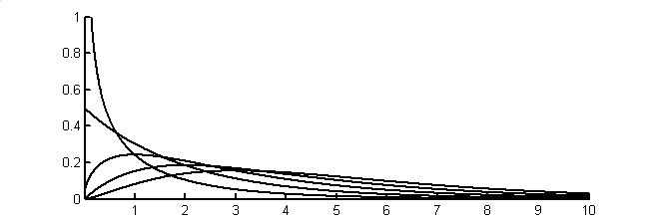
N=1
p(χ_{N}²)
2
3
4
5
χ²
Notes:
Chi-squared probability density function for N=1, 2, 3, 4, and 5.

Slide 28
N=1
case we just worked out
p(χ_{N}²)
2
3
4
5
χ²
Notes:
Chi-squared probability density function for N=1, 2, 3, 4, and 5.

Slide 29
Chi-Squared p.d.f.
N called “the degrees of freedom”
mean N
variance 2N
Notes:
The formulas for mean and variance are both simple and very important. Encourage students to memorize them.

Slide 30
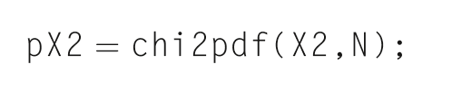
MATLAB
Python
pX2 = eda_cvec(
stats.chi2.pdf(X2,N));
Notes:
These functions compute the p.d.f.

Slide 31
Four Important Distributions used in hypothesis testing
Notes:
Hundreds of p.d.f.’s have been developed for modeling specific scenarios. Only four are shown here. But one gets a lot of mileage from these four.

Slide 32
#1 p(Z) with Z=e
Normal distribution for a quantity Z with zero mean and unit variance
Normally-distributed with zero mean and unit variance

Slide 33
if d is Normally-distributed with mean d and variance σ²_{d}
then Z = (d-d)/ σ_{d} is Normally-distributed with zero mean and unit variance
Notes:
Students are asked to show this formally as a homework problem.

Slide 34
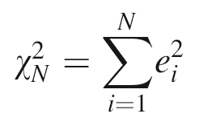
#2
p(χ_{N}²) with
the chi-squared distribution, which we just worked out
N is called the number of degrees of freedom
Notes:
Each random variable in the sum is “free to vary”. So N is called the degrees of freedom.

Slide 35
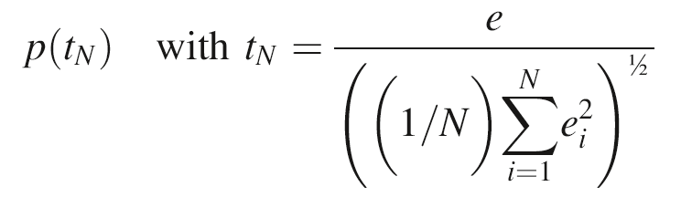
#3
a new distribution, called the
“t-distribution’
Notes:
Note that tN is the ratio of a normally-distributed variable and a chi-squared distributed variable.

Slide 36
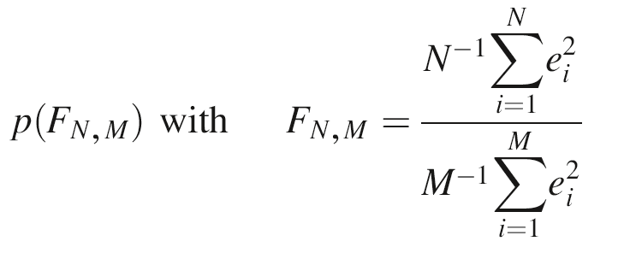
#4
another new distribution, called the
“F-distribution’
Notes:
Note that FN,M is the ratio of a two chi-squared distributed variables, each with a different number of degrees of freedom.

Slide 37
t-distribution
N=5
p(t_{N})
N=1
t_{N}
Notes:
Student’s t-probability density function for N=1, 2, 3, 4, and 5. It looks a lot like the Normal p.d.f., except is has much longer tails.

Slide 38
t-distribution
N=5
wider tailed than a Normal p.d.f.
p(t_{N})
N=1
t_{N}
Notes:
Student’s t-probability density function for N=1, 2, 3, 4, and 5.

Slide 39
F-distribution
p(F_{N,2})
N=2
50
F
N=2
50
p(F_{N,5})
F
p(F_{N,25})
N=2
50
F
p(F_{N,50})
N=2
50
F
Notes:
F-probability density function, p(F_{N,M}), for selected values of M and N.

Slide 40
F-distribution
skewed at low N and M
p(F_{N,2})
N=2
50
F
N=2
50
p(F_{N,5})
F
p(F_{N,25})
N=2
50
F
p(F_{N,50})
N=2
50
F
starts to look Normal at high N and M
Notes:
F-probability density function, p(F_{N,M}), for selected values of M and N.

Slide 41
Part 4
Hypothesis Testing

Slide 42
Step 1. State a Null Hypothesis some variation of the result is due to random variation

Slide 43
Step 1. State a Null Hypothesis some variation of the result is due to random variation
e.g.
the means of the Group A and Group B are different only because of random variation
Notes:
Emphasize that confidence is relative to a particular Null Hypothesis. A poorly thought0trough Null Hypothesis can produce a very misleading estimate of confidence.

Slide 44
Step 2. Focus on a quantity that is unlikely to be large when the Null Hypothesis is true

Slide 45
Step 2. Focus on a quantity that is unlikely to be large when the Null Hypothesis is true
called a “statistic”
Notes:
A “statistic” is justa “summary number” derived from data.

Slide 46
Step 2. Focus on a quantity that is unlikely to be large when the Null Hypothesis is true
e.g.
the difference in the means Δm=(mean_{A} – mean_{B}) is unlikely to be large if the Null Hypothesis is true
Notes:
This connects the Null Hypothesis to values of the statistic.

Slide 47
Step 3.
Determine the value of statistic for your problem
Notes:
That is, perform the data analysis and compute some function of the error.

Slide 48
Step 3.
Determine the value of statistic for your problem
e.g.
|Δm| = |mean_{A} – mean_{B}| = 5.2 – 4.1 = 1.1
Notes:
The absolute value sign is important, since it will be used to implement the notion that Dm is “not so far from zero”.

Slide 49
Step 4.
Calculate that the probability that a the observed value or greater would occur if the Null Hypothesis were true

Slide 50
Step 4.
Calculate that the probability that a the observed value or greater would occur if the Null Hypothesis were true
P( |Δm| ≥ 1.1 ) = ?
Notes:
Note the use of the capital P. We are talking about a probability here, not a probability density.

Slide 51
Step 4.
Reject the Null Hypothesis if such large values occur less than 5% of the time
Notes:
Again, the 5% is the minimum level of confidence accepted in science.

Slide 52
Step 4.
Reject the Null Hypothesis if such large values occur less than 5% of the time
rejecting the Null Hypothesis means that your result is unlikely to be due to random variation
Notes:
Emphasize the phrase, “unlikely to be due to random variation”. You can bever be certain.

Slide 53
Part 5
An example
test of a particle size measuring device
Notes:
This example is from the text.

Slide 54
manufacturer's specs
machine is perfectly calibrated
particle diameters scatter about true value
measurement error is
σ_{d}² = 1 nm²
Notes:
This is a prior error, since it is not based on any measurements, but rather on general knowledge about the machine.

Slide 55
your test of the machine
purchase batch of 25 test particles
each exactly 100 nm in diameter
measure and tabulate their diameters
repeat with another batch a few weeks later
Notes:
That is, perform the experiment and do the data analysis.

Slide 56
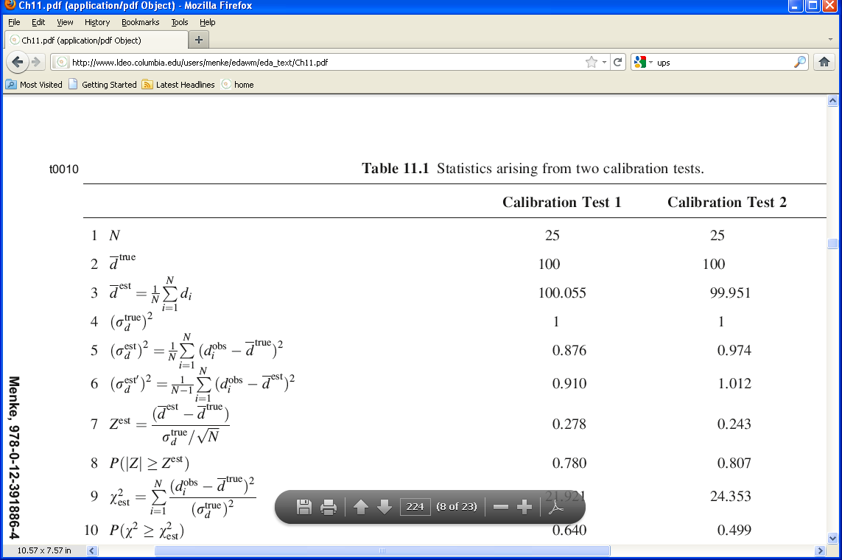
Results of Test 1

Slide 57
Results of Test 2

Slide 58
Question 1
Is the Calibration Correct?
Null Hypothesis
The observed deviation of the average particle size from its true value is due to random variation (as contrasted to a bias in the calibration).

Slide 59
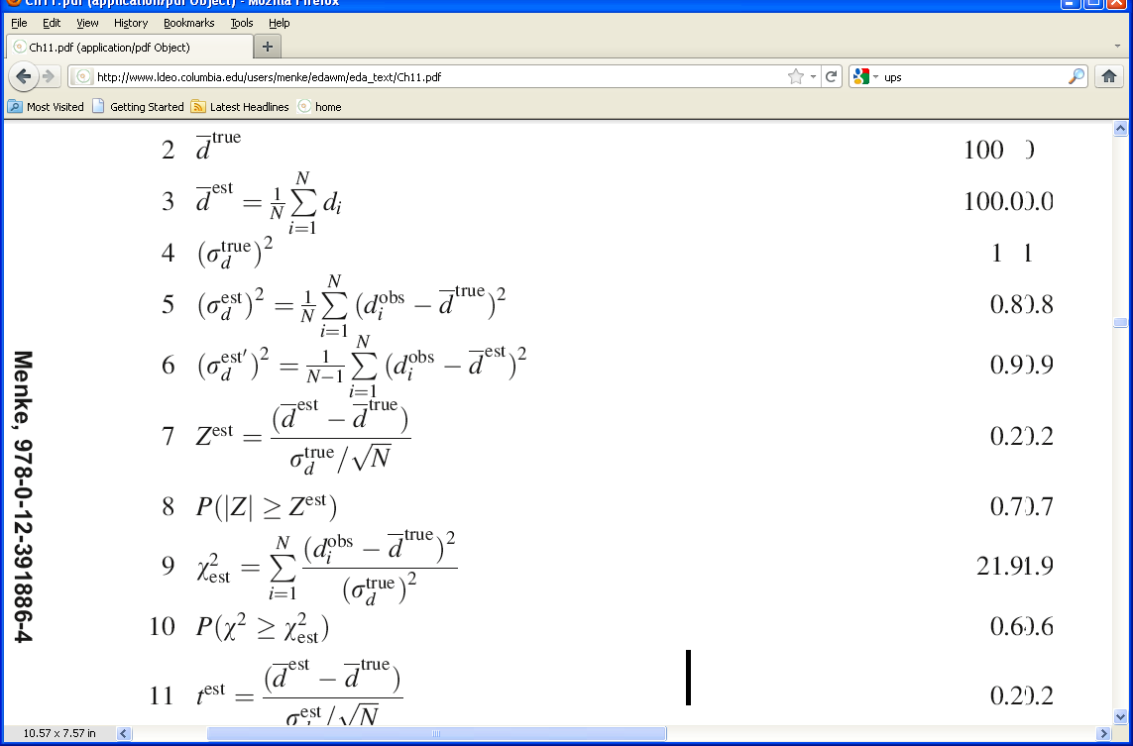
assume that the measurement error is Normally-distributed with zero mean and variance 1 nm²
the mean of 25 measurements has variance
1 nm² / √25
the quantity
is Normal with zero mean and unit variance

Slide 60
in our case
0.278 (test 1)
=
0.243 (test 2)
the key question is
Are these unusually large values for Z ?

Slide 61
in our case
0.278 (test 1)
=
0.243 (test 2)
the key question is
Are these unusually large values for Z ?
actually, its immaterial whether d^{est} is bigger or smaller than d^{true} =100, but only whether they’re different
so we should really ask whether |Z^{est}|
is unusually large
Notes:
Note that the standard error in the mean is sigma_d_true/sqrt(N). The reduction in error from an individual measurement to the mean was derived in Lecture 6.

Slide 62
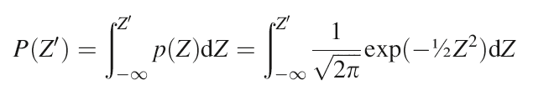
P(Z’) is the cumulative probability from -∞ to Z’
p(Z)
Z
0
Z’
Notes:
This is the standard definition of the cumulative probability function P(Z’). Note that Z is a Normally-distributed variable, so that its p.d.f., p(z), is a bell-shaped curve.

Slide 63
The quantity we want is
P( |Z| > Z^{est} )
p(Z)
Z
0
-Z^{est}
Z^{est}
which is
1 – [P(Z^{est}) - P(-Z^{est})]
Notes:
This is a “two-sized test”, in the sense that we are looking at both ends of the p.d.f.

Slide 64
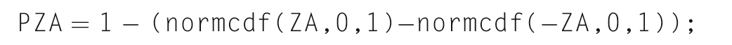
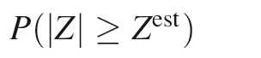
MATLAB
= 0.780 and 0.807
Python
PZA = 1 - (stats.norm.cdf((ZA),0.0,1.0)-
stats.norm.cdf(-(ZA),0.0,1.0));
0.780 (test 1)
=
0.807 (test 2)
So values of |Z| greater than Z^{est} are very common
Notes:
The P’s are much larger than 0.05 ...

Slide 65
MATLAB
= 0.780 and 0.807
Python
PZA = 1 - (stats.norm.cdf((ZA),0.0,1.0)-
stats.norm.cdf(-(ZA),0.0,1.0));
The Null Hypotheses cannot be rejected
0.780 (test 1)
=
0.807 (test 2)
So values of |Z| greater than Z^{est} are very common
Notes:
... so the Null Hypothesis cannot be rejected.

Slide 66
Question 2
Is the variance in spec?
Null Hypothesis
The observed deviation of the variance from its true value of 1 nm² is due to random variation (as contrasted to the machine being noisier than the specs).
Notes:
In other words, are the machines noisier than the manufacturer says.

Slide 67
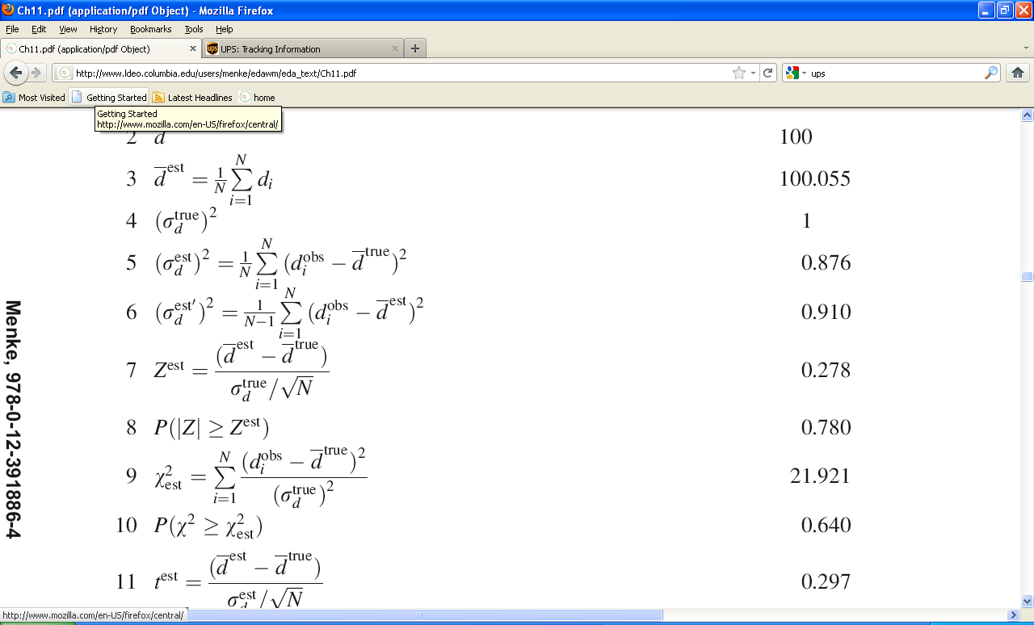
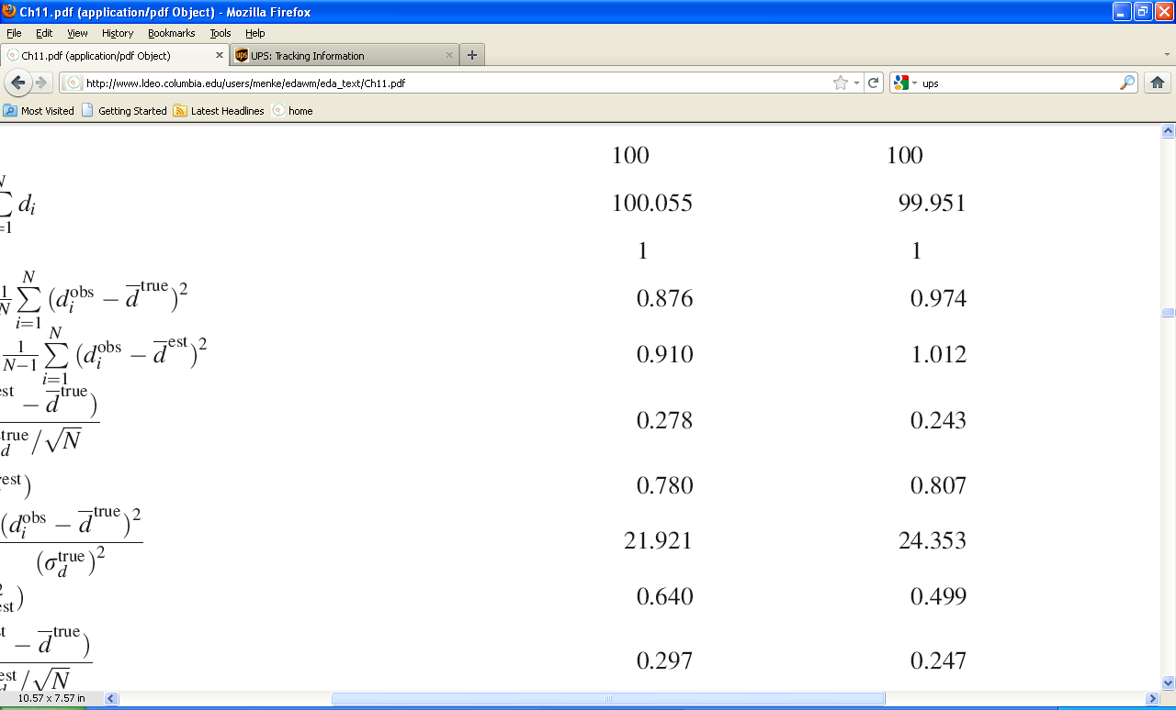
Results of the two tests
test 1
test 2
Notes:
Here, we have just evaluated the three formula using the data from the tests.

Slide 68
Results of the two tests
test 1
test 2
zero mean
unit variance
Notes:
Note that the circled quantity is Normally –distributed with zero mean and unit variance. Also, we have used the true variance, as specified by the manufacturer.

Slide 69
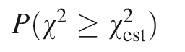
in our case
21.921 (test 1)
=
24.353 (test 2)
the key question is
Are these unusually large values for χ² ?
? (test 1)
=
? (test 2)

Slide 70
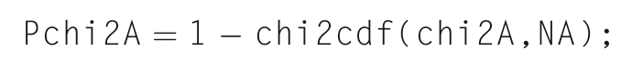
MATLAB
Python
Pchi2A = 1 - stats.chi2.cdf(chi2A,NA);
0.640 (test 1)
=
0.499 (test 2)
Notes:
These Probabilities are much larger than 0.05, soo ...

Slide 71
MATLAB
Python
Pchi2A = 1 - stats.chi2.cdf(chi2A,NA);
0.640 (test 1)
=
0.499 (test 2)
The Null Hypotheses cannot be rejected
Notes:
... the Null Hypothesis cannot be rejected.

Slide 72
we will continue this scenario in the next lecture
Notes:
Maybe too much material here. If you have the class time, you might split this lecture in two.

