Slide 1
Lecture 1
Describing Inverse Problems
Notes:
This lecture outlines the general scope of inverse theory.

Slide 2
Syllabus
Lecture 01 Describing Inverse Problems
Lecture 02 Probability and Measurement Error, Part 1
Lecture 03 Probability and Measurement Error, Part 2
Lecture 04 The L₂ Norm and Simple Least Squares
Lecture 05 A Priori Information and Weighted Least Squared
Lecture 06 Resolution and Generalized Inverses
Lecture 07 Backus-Gilbert Inverse and the Trade Off of Resolution and Variance
Lecture 08 The Principle of Maximum Likelihood
Lecture 09 Inexact Theories
Lecture 10 Prior Covariance and Gaussian Process Regression
Lecture 11 Non-uniqueness and Localized Averages
Lecture 12 Vector Spaces and Singular Value Decomposition
Lecture 13 Equality and Inequality Constraints
Lecture 14 L₁ , L∞ Norm Problems and Linear Programming
Lecture 15 Nonlinear Problems: Grid and Monte Carlo Searches
Lecture 16 Nonlinear Problems: Newton’s Method
Lecture 17 Nonlinear Problems: MCMC and Bootstrap Confidence Intervals
Lecture 18 Factor Analysis
Lecture 19 Varimax Factors, Empirical Orthogonal Functions
Lecture 20 Backus-Gilbert Theory for Continuous Problems; Radon’s Problem
Lecture 21 Linear Operators and Their Adjoints
Lecture 22 Fréchet Derivatives
Lecture 23 Estimating a Parameter in a Differential Equation
Lecture 24 Exemplary Inverse Problems, incl. Filter Design
Lecture 25 Exemplary Inverse Problems, incl. Earthquake Location
Lecture 26 Exemplary Inverse Problems, incl. Vibrational Problems

Slide 3
Purpose of the Lecture
Distinguishing forward and inverse problems
Categorizing inverse problems
Examining a few examples
Enumerate different kinds of solutions to inverse problems
Notes:
This lecture introduces some important lingo, first of the names of important quantities such as data and model parameters,
and the classification of problems by their structure. It then examines a few examples. Finally, it deals with the question of
what we are looking for when we solve an inverse problem; just what constitutes a solution?

Slide 4
Part 1
Distinguishing forward and inverse problems
Notes:
Observations (data) are not knowledge. The purpose of data analysis in general, and inverse theory in particular,
is to use data to derive knowledge. While knowledge can take many forms, we assume here we are primarily after
knowledge that is numerical in nature.

Slide 5
three important definitions
Notes:
An important goal of the course if for people to be able to distinguish between inverse theory quantities.

Slide 6
data, d = [d₁, d₂, … d_{N}]^{T}
things that are measured in an experiment or observed in nature…
model parameters, m = [m₁, m₂, … m_{M}]^{T}
things you want to know about the world …
quantitative model (or theory)
relationship between data and model parameters
Notes:
data = what you measure; model parameters = numbers that constitute knowledge, something distilled from data; the quantitative model (or theory) is the link between the two.

Slide 7
data, d = [d₁, d₂, … d_{N}]^{T}
gravitational accelerations
travel time of seismic waves
model parameters, m = [m₁, m₂, … m_{M}]^{T}
density
seismic velocity
quantitative model (or theory)
Newton’s law of gravity
seismic wave equation
Notes:
Examples: You measure gravitational acceleration of, say a satellite in orbit about the planet; that’s the data. You want to know the density of the planet; that the knowledge, summarize by a parameter such as density; the two are linked by the physics of gravitation; that’s th equantitative model or theory.

Slide 8
Forward Theory
m^{est}
Quantitative Model
d^{pre}
estimates
predictions
Inverse Theory
m^{est}
d^{obs}
Quantitative Model
estimates
observations
Notes:
Lingo: Forward theory starts with estimates of the model parameters and predicts the observations.
Inverse Theory starts with observations and make estimates of the model parameters.

Slide 9
m^{true}
Quantitative Model
d^{pre}
due to observational error
≠
m^{est}
Quantitative Model
d^{obs}
Notes:
Suppose you knew the true values of the model parameters. The data predicted by them is never equal to the observed data, due to observational error.

Slide 10
m^{true}
Quantitative Model
d^{pre}
≠
due to error propagation
m^{est}
Quantitative Model
d^{obs}
Notes:
Consequently, the estimates of the model parameters are never equal to their true values. Error has propagated through the solution process.

Slide 11
Understanding the effects of
observational error
is central to Inverse Theory
Notes:
Data analysis must be prepared to deal with “noise”, that is, observational error..

Slide 12
Part 2
Categorizing inverse problems
Notes:
This is a classification exercise.

Slide 13
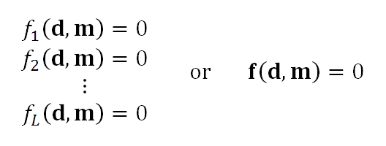
A. Implicit Theory
L relationships between the data and the model are known
Notes:
An implicit theory is the most general case. You know relationship between the data and model parameters.

Slide 14
Example
mass = density ⨉ length ⨉ width ⨉ height
M = ρ ⨉ L ⨉ W ⨉ H
L
ρ
H
M
Notes:
Here you know a relationship between mass, density and volume.
Of these, density is the most fundamental – the knowledge – because it provides compositional information.
That’s the model parameter.
The other quantities are measured; they’re the data.

Slide 15
mass = density ⨉ volume
measure
mass, d₁=M
size, d₂=L, d₃,=H, d₄=W
want to know
density, m₁= ρ
d=[d₁, d₂, d₃, d₄]^{T}
N=4
m=[m₁]^{T}
M=1
d₁ = m₁ d₂ d₃ d₄
or
d₁ - m₁ d₂ d₃ d₄ = 0
Notes:
observed; data = mass, height, width, depth
knowledge; model parameters, density
we know one relationship between them

Slide 16
mass = density ⨉ volume
measure
mass, d₁=M
size, d₂=L, d₃,=H, d₄=W
want to know
density, m₁= ρ
d=[d₁, d₂, d₃, d₄]^{T}
N=4
m=[m₁]^{T}
M=1
d₁ = m₁ d₂ d₃ d₄
or
d₁ - m₁ d₂ d₃ d₄ = 0
in the form
f₁(d,m)=0
with L=1
Notes:
observed; data = mass, height, width, depth
knowledge; model parameters, density
we know one relationship between them

Slide 17
note
No guarantee that
f(d,m)=0
contains enough information
for unique estimate m
determining whether or not there is enough
is part of the inverse problem
Notes:
L=1. Is one relationship enough? Its all we have, so we will learn from it as much as we can.

Slide 18
B. Explicit Theory
the equation can be arranged so that d is a function of m
d = g(m) or d - g(m) = 0
L = N one equation per datum
Notes:
Explicit theory. Manipulate so that the data is on the left hand side of the equation.
Makes predicting the data easy: d-predicted = g(m-estimated).

Slide 19
Example
rectangle
H
L
Circumference = 2 ⨉ length + 2 ⨉ height
Area = length ⨉ height
Notes:
Observed: length, height
Want to know: model parameters, Circumference, area

Slide 20
Circumference = 2 ⨉ length + 2 ⨉ height
C = 2L+2H
Area = length ⨉ height
A=LH
measure
C=d₁
A=d₂
want to know
L=m₁
H=m₂
d=[d₁, d₂]^{T} and N=2
m=[m₁, m₂]^{T} and M=2
d₁ = 2m₁ + 2m₂
d₂ m₁m₂
d=g(m)
Notes:
Arrange so that dara are on l.h.s. of equation, model parameters are on r.h.s.

Slide 21
C. Linear Explicit Theory
the function g(m) is a matrix G times m
d = Gm
G has N rows and M columns
Notes:
This is the special case where the data are linear related to the model parameters.
Note rectangle example was nonlinear, owing to combination m1*m2.
Linear is simple; just a matrix G.
Linear: double m, double d;
if m broken into two parts m=(mA+mB) then d=G*mA+G*mb.

Slide 22
C. Linear Explicit Theory
the function g(m) is a matrix G times m
d = Gm
“data kernel”
G has N rows and M columns
Notes:
G called the “data kernel”

Slide 23
Example
quartz
gold
total volume = volume of gold + volume of quartz
V = V _{g}+ V _{q}
total mass = density of gold ⨉ volume of gold
+ density of quartz ⨉ volume of quartz
M = ρ_{g} ⨉ V _{g}+ ρ_{q} ⨉ V _{q}
Notes:
You want to know how much gold is in the rock.
You measure mass and volume.
You want to infer the volume of the gold.

Slide 24
V = V _{g}+ V _{q}
M = ρ_{g} ⨉ V_{g}+ ρ_{q} ⨉ V _{q}
measure
V = d₁
M = d₂
want to know
V_{g} =m₁
V_{q} =m₂
assume
ρ_{g}
ρ_{g}
d=[d₁, d₂]^{T} and N=2
m=[m₁, m₂]^{T} and M=2
known
d =
1
1
m
ρ_{g}
ρ_{q}
Notes:
Note that, in this problem, the densities are assumed to be known. They are auxiliary information
that accompanies the problem.

Slide 25
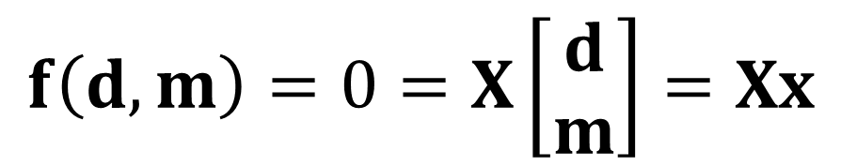
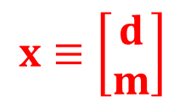
D. Linear Implicit Theory
The L relationships between the data are linear
$$f\left(d,m\right)=0=X\left[\begin{matrix}d \\ m\end{matrix}\right]=Xx$$
$$x≡\left[\begin{matrix}d \\ m\end{matrix}\right]$$
L rows
N+M columns
Notes:
Implicit theories also have a linear special case. Note that the data and model parameters are
(for convenience) combined into a single vector x. Then the problem involves a single matrix X.

Slide 26
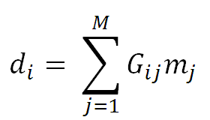
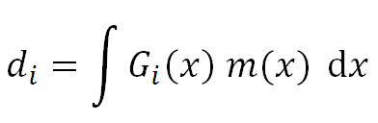
in all these examples m is discrete
discrete inverse theory
one could have a continuous m(x) instead
continuous inverse theory
Notes:
I this first part of this book, we consider only “discrete” model parameters.
That is, model parameters that are numbers arranged into a vector.
However, many geophysically-interesting model parameters are functions, not vectors.
We will study them later in the book.
A discrete problem involves summation.
The analogous continuous problem involves integration.

Slide 27
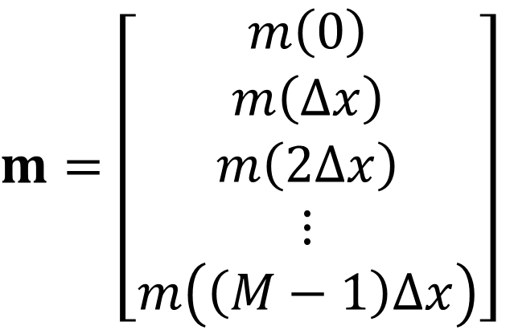
as a discrete vector
in this course we will usually approximate a continuous m(x)
$$m=\left[\begin{matrix}m\left(0\right) \\ m\left(∆x\right) \\ m\left(2∆x\right) \\ ⋮ \\ m\left(\left(M−1\right)∆x\right)\end{matrix}\right]$$
but we will spend some time later in the course dealing with the continuous problem directly
Notes:
Discrete variable: list of individual numbers; e.g. a vector m. Continuous: Infinite detail; e.g. a function m(x).
Data are always discrete: you can measure only a finite number of things.
Model parameters can be discrete or continuous, but in this course we will mostly consider discrete model parameters.
A continuous function can be approximated as a discrete vector by sampling it at regular intervals.

Slide 28
Part 3
Some Examples

Slide 29
A. Fitting a straight line to data
T = a + bt
temperature anomaly, T_{i} (deg) C)
time, t (calendar years)
Notes:
The straight line has only two model parameters, intercept and slope.
But they often constitute really important knowledge. Especially slope,
which makes a prediction about how fast a quantity is increasing or decreasing.
Go through the graph, point out the axes: horizontal axis is time in years, vertical is temperature anomaly
(temperature minus a reference temperature) in degrees C. Red dots are the data. Blue line is the
theory. Note that the data do not exactly fit the theory. That’s OK. It means either that 1) the red dots
contain observational error; or 2) the straight line is an approximate theory that does not capture all lthe
nuiances of the data.
is only an approximate theory
Fig. 1.1. (Red) Average global temperature for the time period, 1965-2010. The inverse problem is to determine the rate of increase of temperature and its confidence interval. (Blue) Straight line fit to data. The slope of the line is 0.015±0.002 (2σ) ºC/year. Data from Hansen et al. 2006. MatLab script gda01_??.

Slide 30
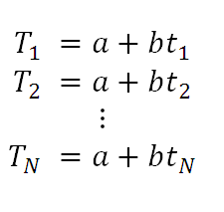
each data point
is predicted by a straight line
Notes:
Write out the straight line equation for every observation.

Slide 31
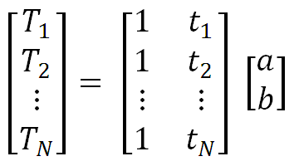
matrix formulation
d = G m
M=2
Notes:
Arrange into a matrix equation.

Slide 32
B. Fitting a parabola
T = a + bt+ ct²
Notes:
Parabola is similar in form to a straight line; just one additional model parameter, c.

Slide 33
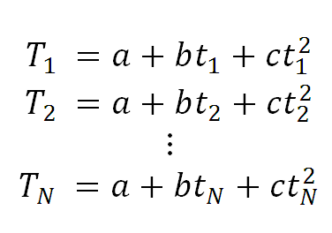
each data point
is predicted by a quadratic curve
Notes:
Write out equation for each observation.

Slide 34
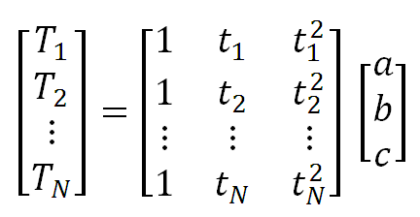
matrix formulation
d = G m
M=3
Notes:
Group into a matrix equation.

Slide 35
straight line
parabola
note similarity
Notes:
Note similarity in structure to the straight line problem.
Shows power of using matricies.

Slide 36
in MATLAB®
G=[ones(N,1), t, t.^2];
Notes:
The data kernel can be created with one command in MATLAB®.

Slide 37
in Python
G=np.concatenate( (
np.ones((N,1)),
t,
np.power(t,2) ), axis=1);
kind of messy …
Notes:
It can also be ceated with one command in Python.
However, the command has an awful lot of nested parentheses.

Slide 38
Python Alternative
G=np.zeros((N,M));
G(0:N,0:1) = np.zeros((N,1));
G(0:N,1:2) = t;
G(0:N,2:3) = np.power(t,2);
less elegant but less prone to error
Notes:
I feel that creating it in multiple steps is less prone to error.
Here, the data kernel G is created with all-zero eleements
and then each of its columns are individually set.

Slide 39
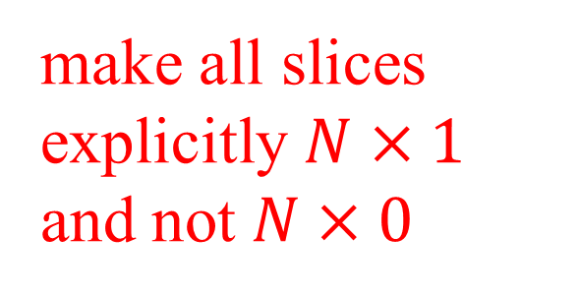
Python Alternative
G=np.zeros((N,1));
G(0:N,0:1) = np.zeros((N,1));
G(0:N,1:2) = t;
G(0:N,2:3) = np.power(t,2);
make all slices explicitly $N×1$ and not $N×0$
Notes:
Insofar as is possible, I always specify rectangular slices of arrays,
and equations where the rectangular object on the left of the equal sign
exactly matches the shape of the rectangular object on the right.
I try to avoid Nx0 slices.
The purpose is to avoid errors.

Slide 40
C. Acoustic Tomography
h
1
2
3
4
h
5
6
7
8
source, S
receiver, R
13
14
15
16
travel time = length ⨉ slowness
Notes:
Tomography: Making an image using observations made along rays.
Theory: travel time of sound = distance / velocity. But rather than to have a division, define slowness = 1/velocity and then travel time = distance * slowness.
Model parameters: The way seismic slowness varies from place to place. It’s a continuous function s(x,y). But we discretize it here into set of 16 “pixels” (constant slowness regions). Think of each pixel as a uniform brick.
Data: Travel time of sound wave to travel from a source S to a receiver R. In this hypothetical problem,
just measure along rows and columns.
Fig. 1.2. The travel time of acoustic waves (blue line) thorough the rows and columns of a square array of bricks is measured with with acoustic source, S, and receiver, R, placed on the edges of the square. The inverse problem is to infer the acoustic properties of the bricks, here depicted by the colors. Although the overall pattern is spatially-variable, individual bricks are assumed to be homogeneous.

Slide 41
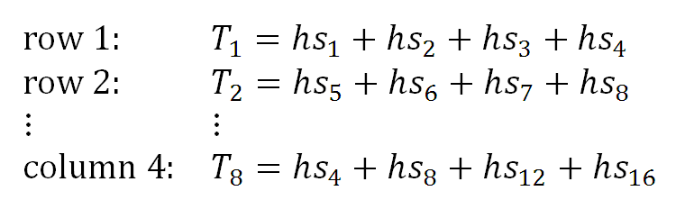
collect data along rows and columns
Notes:
Data collected along 4 rows and 4 columns, so a total of N=8 data.
16 bricks, so 16 model parameters. Arrange them in a vector m rowwise,
m = [ s1, s2, s3, s4, s5, s6, s7, … s16]^{T}.

Slide 42
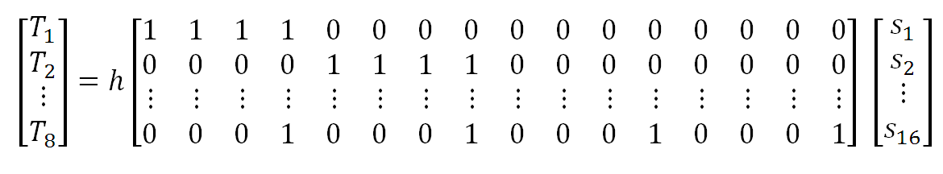
matrix formulation
d = G m
N=8
M=16
Notes:
Matrix version. Lots of zeros in that matrix!

Slide 43
in MATLAB®
G=zeros(N,M);
for i = [1:4]
for j = [1:4]
% measurements over rows
k = (i-1)*4 + j;
G(i,k)=1;
% measurements over columns
k = (j-1)*4 + i;
G(i+4,k)=1;
end
end
Notes:
A bit brute force. Perhaps a student could think of a better way. Note that the 4x4 array
of pixels is being “unfolded” into a vector using the formula k = (i-1)*4 + j.

Slide 44
In Python
G=np.zeros((N,M));
for i in range(4):
for j in range(4):
% measurements over rows
k = i*4 + j;
G[i,k]=1.0;
% measurements over columns
k = j*4 + i;
G[i+4,k]=1.0;
Notes:
A bit brute force. Perhaps a student could think of a better way. Note that the 4x4 array
of pixels is being “unfolded” into a vector using the formula k = i*4 + j.
This is a good time to mention to students that MATLAB® uses a convention where the first element of an array is indexed 1, whereas Python, 0. In the book, I usually write formulas using the 1 convention (because that is how its done in most elementary algebra textbooks).

Slide 45
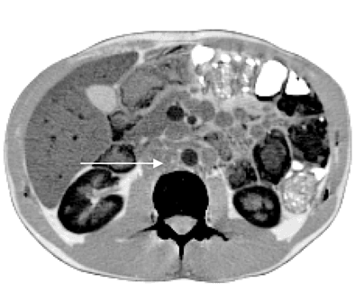
D. X-ray Imaging
(A)
(B)
S
R₁
R₂
R₃
R₄
R₅
enlarged lymph node
Notes:
X-ray tomography. Similar to acoustic tomography, but now use X-rays. Also collect data at every angle (by rotating source & receivers).
Fig. 1.3. (A) An idealized Computed Tomography (CT) medical scanner measures the x-ray absorption along lines (blue) passing through the body of the patient (orange). After a set of measurements are made, the source, S, and receivers, R_{i}, are rotated, and the measurements are repeated, so that data along many crisscrossing lines are collected. The inverse problem is to determine the x-ray opacity as a function of position in the body. (B) Actual CT image of a patient infected with Mycobacterium genavense (from de Lastours et al., 2008).

Slide 46
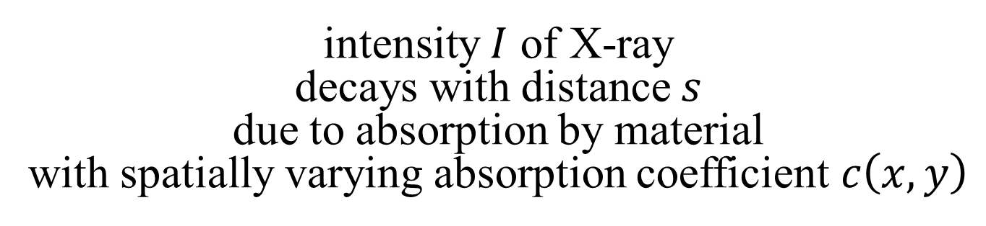
theory
intensity $I$ of X-ray
decays with distance $s$
due to absorption by material
with spatially varying absorption coefficient $c\left(x,y\right)$
I = Intensity of x-rays (data)
s = distance
c = absorption coefficient (model parameters)
Notes:
X-rays are absorbed at a rate that depends on the absorption coefficient c(x,y) in the body.
The absorption coefficient is the model parameter, different organs have different coefficients.
Note that it is a continuous variable; we’ll have to discretize it.

Slide 47
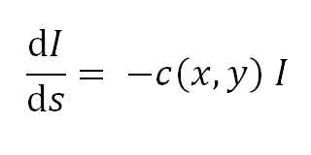
theory
I = Intensity of x-rays (data)
s = distance
c = absorption coefficient (model parameters)
Notes:
X-rays are absorbed at a rate that depends on the absorption coefficient c(x,y) in the body.
The absorption coefficient is the model parameter, different organs have different coefficients.
Note that it is a continuous variable; we’ll have to discretize it.

Slide 48

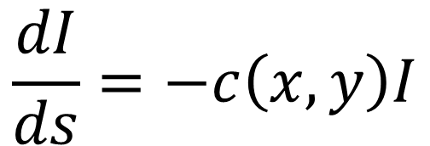

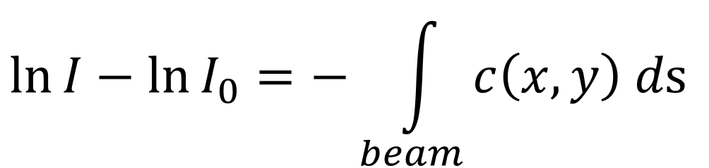
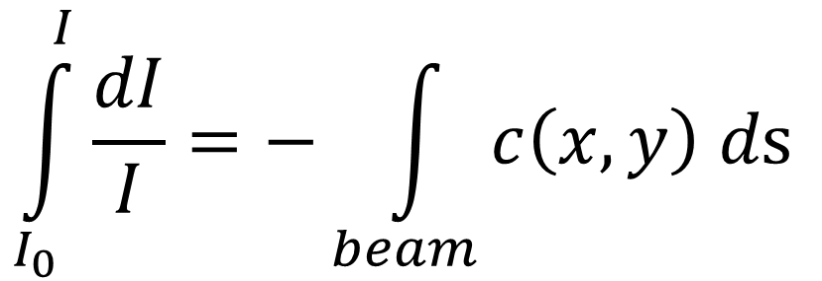
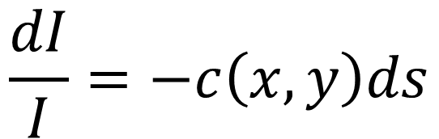

solution
$$\frac{dI}{ds}=−c\left(x,y\right)I$$
$$I$$
$$I_{0}$$
$$\frac{dI}{I}=−c\left(x,y\right)ds$$
$$s$$
$$\int_{I_{0}}^{I}{\frac{dI}{I}}=−\int_{beam}{c\left(x,y\right) d\text{s} }$$
$$\ln{I}−\ln{I_{0}}=−\int_{beam}{c\left(x,y\right) d\text{s} }$$
Notes:
I’m using here the Method of Separation of Variables.
Feel free to skip the solution if you think it’s above the level of training of the typical student.

Slide 49
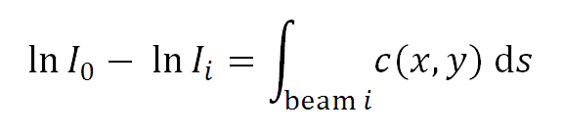
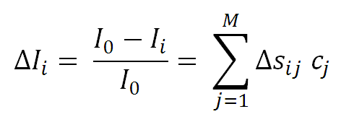
Taylor
Series
approximation
Notes:
Linearize the l.h.s. by assuming that the amount of absorption is small.

Slide 50
Taylor
Series
approximation
discrete pixel
approximation
Notes:
Approximate the integral using Riemann summation..

Slide 51
Taylor
Series
approximation
discrete pixel
approximation
d = G m
standard form
Notes:
The result is the standard linear for d=Gm, where the data G are the intensity deviations, and the model parameters are the absorption coefficents.

Slide 52
Taylor
Series
approximation
discrete pixel
approximation
length of beam i in pixel j
d = G m
standard form
Notes:
Note that Delta-s-i-j is the length of ray in pixel j.

Slide 53
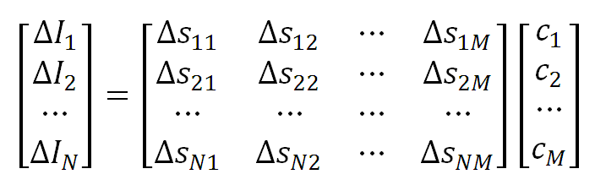
matrix formulation
d = G m
N≈10⁶
M≈10⁶
Notes:
Typically, d and m are very long vectors.

Slide 54
note that G is huge
10⁶⨉10⁶ but it is sparse
(mostly zero) since a beam passes through only a tiny fraction of the total number of pixels
Notes:
Sparse matrix: contains mosty zeros. In this case, beam passes through roughly sqrt(M) pixels, so if
M=1,000,000 then matrix is 999/1000 sparse.

Slide 55
in MATLAB®
G = sparse( ... );
in Python
G = sparse.coo_matrix ( ... );
Notes:
We will routinely use sparse matrices when appropriate. They must be explicitly defined, but they save on memory hugely.

Slide 56
E. Spectral Curve Fitting
Notes:
Mossbauer spectrum: sum on absorption peaks.
Area of each peak diagnostic of amount of Fe in a particular atomic arrangement in the rock.
Fig 2.4. Example of a Mossbauer spectroscopy experiment performed by the Spirit rover on Martian soil. (Red) Absorption peaks reflect the concentration of different iron-bearing minerals in the soil. The inverse problem is to determine the position and area of each peak, which can be used to determine the concentration of the minerals. (Blue) The sum of ten Lorentzian curves fit to the data. Data courtesy of NASA and the University of Mainz. MatLab script gda01_??.

Slide 57
single spectral peak
area, A
p(z)
width, c
z
position, f
Notes:
One peak. Note is upside down with respect to actual spectrum.
M=3 model parameters per peak, area, width, position.

Slide 58
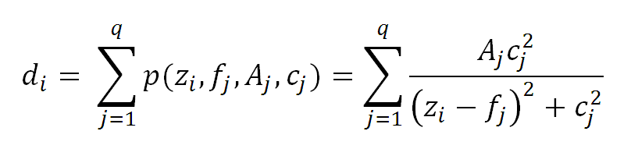
q spectral peaks
“Lorentzian”
d = g(m)
Notes:
Theory: spectrum is a sum of q peaks.
M = 3*q.

Slide 59
F. Factor Analysis
s₁
s₂
e₁
e₁
e₂
e₂
e₃
e₃
e₄
e₄
e₅
e₅
ocean
sediment
Notes:
Theory:
Sediments from different sources, S1, S2 flow into oceans, where they mix.
Sediments contain elements e1, e2, … so sediments on ocean floor are a mix of these elements.
Fig 1.5. Sediment on the floor of this idealized ocean is a mixture of rocks eroded from several sources, s_{i}. The sources are characterized by chemical elements, e₁ through e₅, depicted here with color bars. The chemical composition of the sediments is a simple mixture of the composition of the sources. The inverse problem is to determine the number and composition of sources from observations of the composition of the sediments. MatLab script gda01_??.

Slide 60
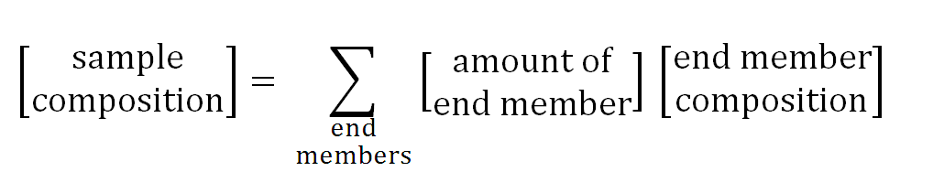
d = g(m)
Notes:
Sample is a mixture of end-members.
Data: elemental composition of samples.
Model parameters: elemental composition of end members and their amounts.
A nonlinear explicit problem

Slide 61
Part 4
What kind of solution are we looking for ?
Notes:
Ask the class to contribute ideas. Try to at least get them to realize that numeric values of model parameters is
insufficient. Need confidence intervals as well.

Slide 62
A: Estimate of model parameters meaning numerical values m₁ = 10.5 m₂ = 7.2
Notes:
Numeric values.

Slide 63
But we really need confidence limits, too
m₁ = 10.5 ± 0.2
m₂ = 7.2 ± 0.1
m₁ = 10.5 ± 22.3
m₂ = 7.2 ± 9.1
or
completely different implications!
Notes:
Numeric values with confidence intervals much more meaningful.

Slide 64
B: probability density functions
if p(m₁) simple
not so different than confidence intervals
Notes:
Could go with entire probabiity density function.

Slide 65
m is either
about 3
plus of minus 1
or about 8
plus or minus 1
but that’s less likely
m is about 5
plus or minus 1.5
we don’t really know anything useful about m
Notes:
But in simple cases it has similar info to a value and a confidence interval.
An in complicated cases means little.
Only in intermediate cases does it add information.

Slide 66
C: localized averages
A = 0.2m₉ + 0.6m₁₀ + 0.2m₁₁
might be better determined than either
m₉ or m₁₀ or m₁₁ individually
Notes:
Sometimes a localized average has a much smaller confidence interval than any of the individual parameters.

Slide 67
Is this useful?
Do we care about
A = 0.2m₉ + 0.6m₁₀ + 0.2m₁₁
?
Maybe …
Notes:
Ask class to think of cases where an average might be useful.

Slide 68
Suppose if m is a discrete approximation of m(x)
m₁₀
m₁₁
m₉
m(x)
x
Notes:
A continuous variable m(x) has an “infinite number of points”. We can’t determine each of them.

Slide 69
A= 0.2m₉ + 0.6m₁₀ + 0.2m₁₁
weighted average of m(x)
in the vicinity of x₁₀
m₁₀
m₁₁
m₉
m(x)
x₁₀
x
Notes:
But we can determine the average value of m(x) centered about a given point, such as x=10.

Slide 70
average “localized’
in the vicinity of x₁₀
m₁₀
m₁₁
m₉
m(x)
x₁₀
x
weights
of weighted average
Notes:
The weights, (…, 0.0, 0.2, 0.6, 0.2, 0.0, …), might be considered a discrete approximation of a triangular weighting function.

Slide 71
Localized average mean can’t determine m(x) at x=10 but can determine average value of m(x) near x=10
Such a localized average might very well be useful
Notes:
Localized averages are essential for dealing with continuous functions,
because knowing the value of a function at a single point,
tells you very little,
as its value at a closely-adjacent point may be completely different.

