Slide 1
Lecture 13
Equality and Inequality Constraints
Notes:
One of the primary results of today’s is a general technique to determine the
null vectors of a linear inverse problem, something that we recognized was
important (and missing) in the last lecture.

Slide 2
Syllabus
Lecture 01 Describing Inverse Problems
Lecture 02 Probability and Measurement Error, Part 1
Lecture 03 Probability and Measurement Error, Part 2
Lecture 04 The L₂ Norm and Simple Least Squares
Lecture 05 A Priori Information and Weighted Least Squared
Lecture 06 Resolution and Generalized Inverses
Lecture 07 Backus-Gilbert Inverse and the Trade Off of Resolution and Variance
Lecture 08 The Principle of Maximum Likelihood
Lecture 09 Inexact Theories
Lecture 10 Prior Covariance and Gaussian Process Regression
Lecture 11 Non-uniqueness and Localized Averages
Lecture 12 Vector Spaces and Singular Value Decomposition
Lecture 13 Equality and Inequality Constraints
Lecture 14 L₁ , L∞ Norm Problems and Linear Programming
Lecture 15 Nonlinear Problems: Grid and Monte Carlo Searches
Lecture 16 Nonlinear Problems: Newton’s Method
Lecture 17 Nonlinear Problems: MCMC and Bootstrap Confidence Intervals
Lecture 18 Factor Analysis
Lecture 19 Varimax Factors, Empirical Orthogonal Functions
Lecture 20 Backus-Gilbert Theory for Continuous Problems; Radon’s Problem
Lecture 21 Linear Operators and Their Adjoints
Lecture 22 Fréchet Derivatives
Lecture 23 Estimating a Parameter in a Differential Equation
Lecture 24 Exemplary Inverse Problems, incl. Filter Design
Lecture 25 Exemplary Inverse Problems, incl. Earthquake Location
Lecture 26 Exemplary Inverse Problems, incl. Vibrational Problems

Slide 3
Purpose of the Lecture
Review the Natural Solution and SVD
Apply SVD to other types of prior information
and to
equality constraints
Introduce Inequality Constraints and the
Notion of Feasibility
Develop Solution Methods
Solve Exemplary Problems
Notes:
Like the last lecture, this one oneupon ideas from vector spaces.
The first half deals with SVD. The second half deals with inequality constraints.

Slide 4
Part 1
Review the Natural Solution and
SVD
Notes:
Review of last lecture

Slide 5
subspaces model parameters m_{p} can affect data m₀ cannot affect data data d_{p} can be fit by a model d₀ cannot be fit by any model
Notes:
Natural solution. Smallest error, just ||d0||^2. Smallest model parameter length, just ||m0||2.

Slide 6
natural solution determine m_{p} by solving d_{p}-Gm_{p}=0 set m₀=0
Notes:
Natural solution. Smallest error, just ||d0||^2. Smallest model parameter length, just ||m0||2.

Slide 7
natural solution determine m_{p} by solving d_{p}-Gm_{p}=0 set m₀=0
error reduced to its minimum E=e₀^{T}e₀
Notes:
This is the requirement that that solution minimize the error.

Slide 8
natural solution determine m_{p} by solving d_{p}-Gm_{p}=0 set m₀=0
solution length reduced to its minimum L=m_{p}^{T}m_{p}
Notes:
This is the requirement that the solution is – of all the solutions that minimize the
error – the one with the smallest solution length.

Slide 9






Singular Value Decomposition (SVD)
Notes:
SVD decomposes the solution into a left and right eigenvalue matrix and a diaginal matrix

Slide 10
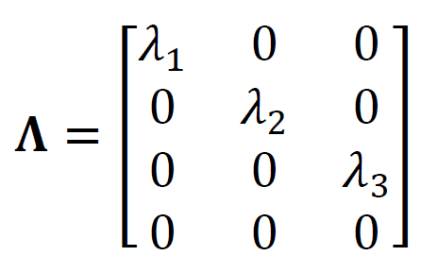
singular value decomposition
U^{T}U=I and V^{T}V=I
Notes:
Note the two eigenvalue matrices are orthonormal.
The lambdas are called singular values.

Slide 11
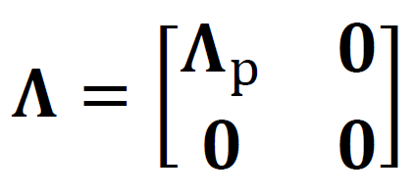
suppose only p λ’s are non-zero
Notes:
Note that if some lambdas are zero, then the matric LAMBDA looks like this. It has a block of zeros at the bottom.

Slide 12

suppose only p λ’s are non-zero
only first p columns of U
only first p columns of V
Notes:
When the three matrices are multiplied, the block of zeros cancels out some of the eigenvectors.
The remaining eigenvectors form smaller matrices Up and Vp.

Slide 13
U_{p}^{T}U_{p}=I and V_{p}^{T}V_{p}=I since vectors mutually pependicular and of unit length
U_{p}U_{p}^{T}≠I and V_{p}V_{p}^{T}≠I
since vectors do not span entire space
Notes:
The vectors making up the submatrices Up and Vp are orthonormal
(the top equations), but they don’t span the complete space (bottom equations).

Slide 14
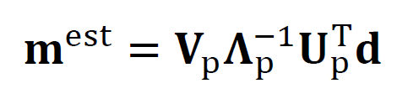
The Natural Solution
Notes:
Here’s the way to calculate the natural solution.

Slide 15
The Natural Solution
natural generalized inverse G^{-g}
Notes:
Sometimes it’s called THE generalized inverse, though of course its only one of many.

Slide 16




resolution and covariance
Notes:
Simple formulas of R and N.
Note covariance depends on size of largest singular value.

Slide 17
Part 2
Application of SVD to other types of prior information and to equality constraints
Notes:
Put SVD to further use.

Slide 18
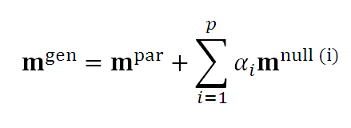

general solution to linear inverse problem

Slide 19
general minimum-error solution
2 lectures ago

Slide 20
general minimum-error solution
plus amount α of null vectors
natural solution
Notes:
Note that no matter what the value of alpha, the
solution still minimizes the error. Thus alpha can be
chosen in accord with a priori information.

Slide 21
you can adjust α to match whatever a priori information you want
for example
m=<m>
by minimizing L=||m-<m>||₂ w.r.t. α
Notes:
choose alpha to minimize the distance of m from an a priori value <m>,
that is, solution is close to an a priori value

Slide 22
you can adjust α to match whatever a priori information you want
for example
m=<m>
by minimizing L=||m-<m>||₂ w.r.t. α
get α =V₀^{T}<m> so m = V_{p}Λ_{p}⁻¹U_{p}^{T}d + V₀V₀^{T}<m>
Notes:
The solution is understood as follows.
Part of <m> lies in the Sp space, part in the S0 space.
The Sp part is VpT<m>, the S0 is V0T<m>.
You are not allowed to change mp to try to match <m>, because that would increase the error.
So you can only minimize the distance between m0 and <m>0.
So rotate <m> into the (p,0) subspaces, throw the p part away, and rotate back.
That gives m0=VVT<m>.
Which is m0=(I-R)<m>, a result that we have encountered before.

Slide 23
equality constraints minimize E with constraint Hm=h
Notes:
We solved this previously with Lagrange Multipliers.

Slide 24
Step 1
find part of solution constrained by Hm=h
SVD of H (not G)
H = V_{p}Λ_{p}U_{p}^{T}
so
m=V_{p}Λ_{p}⁻¹U_{p}^{T}h + V₀α
Notes:
Emphasize that we’re taking the SCD of H not G.
The general solution is one that minimizes the error of Hm=h.
If Hm=h is consistent, then it will have zero error and be satisfied exactly.
So the general solution at the bottom satisfies the constrints for any value of alpha.

Slide 25
Step 2
convert Gm=d
into and equation for α
GV_{p}Λ_{p}⁻¹U_{p}^{T}h + GV₀α = d
and rearrange
[GV₀]α = [d - GV_{p}Λ_{p}⁻¹U_{p}^{T}h]
G’α= d’
Notes:
Only vary alpha to minimize e=d-Gm.

Slide 26
Step 3
solve G’α= d’
for α
using least squares
Notes:
Equation can now be solved with simple least sqared.

Slide 27
Step 4
reconstruct m from α
m=V_{p}Λ_{p}⁻¹U_{p}^{T}h + V₀α
Notes:
Then you must transform back from alpha to m.

Slide 28
Part 3
Inequality Constraints and the
Notion of Feasibility
Notes:
Examples of linear inequality constraints:
model parameters are positive;
one model parameter is bigger than another;
etc.

Slide 29
Not all inequality constraints provide new information
x > 3
x > 2
Notes:
In this example, the second condition is implied by the first.

Slide 30
Not all inequality constraints provide new information
x > 3
x > 2
follows from first constraint
Notes:
and so is redundant.

Slide 31
Some inequality constraints are incompatible
x > 3
x < 2
Notes:
In the example,
the constraints are incompatible

Slide 32
Some inequality constraints are incompatible
x > 3
x < 2
nothing can be both bigger than 3 and smaller than 2
Notes:
This no solution exists that can satisfy them.

Slide 33
every row of the inequality constraint
Hm ≥ h
divides the space of m
into two parts
one where a solution is feasible
one where it is infeasible
the boundary is a planar surface
Notes:
Feasible means that the solution satisfies the constraint;
infeasible means that it doesn’t.

Slide 34
when all the constraints are considered together
they either create a feasible volume
or they don’t
if they do, then the solution must be in that volume
if they don’t, then no solution exists
Notes:
Feasible volume: any point in the volume satisfies all the constraints simultaneously.
Infesible: No feasible volume

Slide 35
feasible region
(A)
(B)
m₂
m₂
m₁
m₁
Notes:
Each line represents an inequality constraint.
The infeasible side of each constraint is shaded.
A solution can exist only on the unshaded (feasible) side.
In the left plot, the planes are arranged to form a polygonal feasible area.
In the right plot, no feasible volume exists.
In general, linear constraints form a feasible volume that is a convex polyhedron.
Fig. 7.5. (A) Each linear inequality constraint divides S(m) into two half-spaces, one infeasible (shaded) and the other feasible (white). Consistent constraints combine to form a convex, polygonal region within S(m) (white) of feasible m. (B) Inconsistent constraints do not form a feasible region.

Slide 36
now consider the problem of minimizing the error E
subject to inequality constraints Hm ≥ h
Notes:
This is least squares with inequality constraints.

Slide 37
if the global minimum is
inside the feasible region
then
the inequality constraints
have no effect on the solution
Notes:
If the global minimum is feasible, then the solution is at the global minimum
and the constraints are irrelevant.

Slide 38
but
if the global minimum is
outside the feasible region
then
the solution is on the surface
of the feasible volume
Notes:
If the global minimum is infeasible, you could
ask, how close can I get to it and still be feasible?

Slide 39
but
if the global minimum is
outside the feasible region
then
the solution is on the surface
of the feasible volume
the point on the surface where E is the smallest
Notes:
Solution will be on the surface of the feasible volume, here the error is smallest.

Slide 40
Hm≥h
m₂
feasible
m^{est}
-∇E
E_{min}
infeasible
m₁
Notes:
The error surface is shown in color.
Blue is low error. Red is high error.
The inequality constraint is the line, with the feasible side to the upper right.
The global solution (yellow triangle) is infeasible,
The best you can do is on the line close to the triangle.

Slide 41
furthermore
the feasible-pointing normal to the surface
must be parallel to ∇E
else
you could slide the point along the surface
to reduce the error E
Notes:
We encountered this kind of thinking before when discussing Lagrange Multipliers.
This is just the condition that the solution be at the minimum of E on the surface.

Slide 42
Hm≥h
m₂
m^{est}
-∇E
E_{min}
m₁
Notes:
Fig. 7.6. The error, E(m), (colors) has a single minimum (yellow triangle). The linear equality constraint, Hm≥h, divides S(m) into two half-spaces (black line, with grey arrows pointing into the feasible half-space). Solution (circle) lies on the boundary between the two half-spaces and therefore satisfies the constraint in the equality sense. At this point, the normal of the constraint hyperplane (grey arrow) is anti-parallel to -∇E. MatLab script gda07_05.

Slide 43
Kuhn – Tucker theorem
Notes:
Basis for solving problems with inequality constraints.

Slide 44

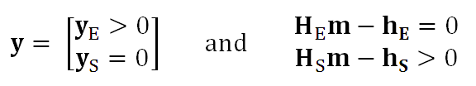
it’s possible to find a vector y with y_{i}≥0 such that
Notes:
We’ll go through this step by step.
Concerning the bottom, we’ve divided the components of the variable y into to groups,
one indexed with E (for equality)
one indexed with S (for slack)

Slide 45
it’s possible to find a vector y with y≥0 such that
feasible-pointing normals to surface
Notes:
each column of grad Hm is a normal to a constraint plane.
the sign chosen so that the normal points into the fesible volume

Slide 46
it’s possible to find a vector y with y≥0 such that
feasible-pointing normals to surface
the gradient of the error
Notes:
The gradient of the error must not have a component anti=parallel to any of the normals.

Slide 47
it’s possible to find a vector y with y≥0 such that
feasible-pointing normals to surface
is a non-negative combination of feasible normals
the gradient of the error
Notes:
Thus you must be able to construct it by adding together a positive amount of all the normals.

Slide 48
it’s possible to find a vector y with y≥0 such that
feasible-pointing normals to surface
y specifies the combination
is a non-negative combination of feasible normals
the gradient of the error
Notes:
Here the vector y specifies the amout of each normal that you need to construct the gradient of the error.
None of the elements of y can be negative.

Slide 49

it’s possible to find a vector y with y≥0 such that
for linear case with Gm=d
Notes:
The right equation is just the left equation with d=Gm substituted in,
and with the gradient performed.

Slide 50
it’s possible to find a vector y with y≥0 such that
some coefficients y_{i} are positive
Notes:
The y’s cannot be negative.
Some can be zero, others are positive.
We divide them into the positive group yE
and a zero group yS

Slide 51
it’s possible to find a vector y with y≥0 such that
the solution is on the corresponding constraint surface
some coefficients y_{i} are positive
Notes:
If y>0, then it has a non-zero contribution to the gradient of the error.
This happens when the solution is on the constraint surface.
So the solution satisfies those constraints in the equality sense.

Slide 52
it’s possible to find a vector y with y≥0 such that
some coefficients y_{i} are zero
Notes:
Some coefficients are zero.

Slide 53
it’s possible to find a vector y with y≥0 such that
the solution is on the feasible side of the corresponding constraint surface
some coefficients y_{i} are zero
Notes:
If y=0, then it has a zero contribution to the gradient of the error.
This happens when the solution is off the constraint surface, within the feasible volume.
So the solution satisfies those constraints in the inequality sense.

Slide 54
Part 4
Solution Methods
Notes:
Here we use the theorem we just derived.

Slide 55
simplest case minimize E subject to m_{i}>0
(H=I and h=0) iterative algorithm with two nested loops
Notes:
This is least squares with positivity constraints.
Note there is one constraint per model parameter, since each model parameter must be positive.

Slide 56
Step 1
  Start with an initial guess for m
  The particular initial guess m=0 is feasible
  It has all its elements in m_{E}
  constraints satisfied in the equality sense
Notes:
The thing about this problem that allows for easy solution is that you already know
The shape of the feasible volume. Its easy to pick a point – for example, m=0 - that is guaranteed to be feasible.
Note that the solution will have some zero model parameters and some positive model parameters.
Suppose that we know which were which. Then we could merely throw the zero ones out of Gm=d
leaving GS mS = DS and we could solve this reduced problem by simple least squares.
Thus the hard part is merely figuring out which model parameters are zero.

Slide 57
Step 2
  Any model parameter m_{i} in m_{E} that has associated with it a negative gradient [∇E]_{i} can be changed both to decrease the error and to remain feasible.
  If there is no such model parameter in m_{E}, the Kuhn – Tucker theorem indicates that this m is the solution to the problem.
Notes:
Its also easy to check whether a trial solution satisfies the KT theorem.
If any component of the gradient of the error is negative, the solution
can be moved to decrease the error.
So if so component of the gradient is negative, we’re done.

Slide 58
Step 3
  If some model parameter m_{i} in m_{E} has a corresponding negative gradient, then the solution can be changed to decrease the prediction error.
  To change the solution, we select the model parameter corresponding to the most negative gradient and move it to the set m_{S}.
  All the model parameters in m_{S} are now recomputed by solving the system G_{S}m’_{S}=d_{S} in the least squares sense. The subscript S on the matrix indicates that only the columns multiplying the model parameters in m_{S} have been included in the calculation.
  All the m_{E}’s are still zero. If the new model parameters are all feasible, then we set m = m′ and return to Step 2.
Notes:
But if there is a negative gradient, we can move the solution to reduce the error.
So we move one model parameter to the group with positive solution (the S group)
Recompute the solution and see if its feasible. If it is feasible, we go back to step 2.

Slide 59
Step 4
  If some of the elements of m’_{S} are infeasible, however, we cannot use this vector as a new guess for the solution.
  So, we compute the change in the solution and add as much of this vector as possible to the solution m_{S} without causing the solution to become infeasible.
  We therefore replace m_{S} with the new guess m_{S} + α δm, where is the largest choice that can be made without some m_{S} becoming infeasible. At least one of the m_{Si}’s has its constraint satisfied in the equality sense and must be moved back to m_{E}. The process then returns to Step 3.
Notes:
But if its not feasible, we modify it by moving it back towards the old solution until no model parameters are negative.
Any model parameters that are zero are moved back to the equality group.

Slide 60
In MATLAB®
mest = lsqnonneg(G,dobs);
In Python
vest, E = opt.nnls(G,dobs.ravel());
mest = gda_cvec(vest);
Notes:
This algorithm is implemented in MATLAB® and Python and is very easy to use.
It’s not clear to me how Python defines the error E, and I never use it.

Slide 61
example
gravitational field depends upon density
via the inverse square law
Notes:
Density – inherently positive.

Slide 62
example
gravitational force depends upon density
observations
model parameters
via the inverse square law
theory
Notes:
Observe field to estimate density.

Slide 63
(C)
(B)
gravity force, d_{i}
(D)
distance, y_{i}
(x_{i},y_{i})
(E)
(A)
R_{ij}
θ_{ij}
(F)
(x_{j},y_{j})
Notes:
In this example, the true model is a variable-density cube (bottom center).
The inverse-square law gives the force (bell-shaped curve)
The differnent solutions are wildly different.
But all satisfy the data (black) up to the noise.
The non-negative solution (green) satisfies the data very well/
Fig. 7.7. (A) The vertical force of gravity is measured on a horizontal line above a massive. This cube contains a grid of 20×20 model parameters representing spatially-varying density, m (colors). The equation Gm=d embodies Newton’s inverse-square law of gravity. (B) The N=600 gravitational force observations d^{obs} (black curve) and the gravitational force predicted by the natural solution (red curve, p=15) and non-negative least squares (green curve). (C) True model. (D) Natural estimate of model, with p=4. (E) Natural estimate of model, with p=15. (F) Non-negative estimate of model. MatLab script gda07_06.

Slide 64
(C)
(B)
gravity force, d_{i}
(D)
distance, y_{i}
(x_{i},y_{i})
(E)
(A)
R_{ij}
θ_{ij}
(F)
True solution
(x_{j},y_{j})
Notes:
In this example, the true model is a variable-density cube (bottom center).
The inverse-square law gives the force (bell-shaped curve)
The different solutions are wildly different.
But all satisfy the data (black) up to the noise.
The non-negative solution (green) satisfies the data very well/
Fig. 7.7. (A) The vertical force of gravity is measured on a horizontal line above a massive. This cube contains a grid of 20×20 model parameters representing spatially-varying density, m (colors). The equation Gm=d embodies Newton’s inverse-square law of gravity. (B) The N=600 gravitational force observations d^{obs} (black curve) and the gravitational force predicted by the natural solution (red curve, p=15) and non-negative least squares (green curve). (C) True model. (D) Natural estimate of model, with p=4. (E) Natural estimate of model, with p=15. (F) Non-negative estimate of model. MatLab script gda07_06.

Slide 65
True solution
(C)
(B)
Natural solution p=4
gravity force, d_{i}
(D)
distance, y_{i}
(x_{i},y_{i})
(E)
(A)
R_{ij}
θ_{ij}
Natural solution p=15
(F)
(x_{j},y_{j})
non-negative solution
Notes:
In this example, the true model is a variable-density cube (bottom center).
The inverse-square law gives the force (bell-shaped curve)
The different solutions are wildly different.
But all satisfy the data (black) up to the noise.
The non-negative solution (green) satisfies the data very well/
(A) The vertical force of gravity is measured on a horizontal line above a massive. This cube contains a grid of 20×20 model parameters representing spatially-varying density, m (colors). The equation Gm=d embodies Newton’s inverse-square law of gravity. (B) The N=600 gravitational force observations d^{obs} (black curve) and the gravitational force predicted by the natural solution (red curve, p=15) and non-negative least squares (green curve). (C) True model. (D) Natural estimate of model, with p=4. (E) Natural estimate of model, with p=15. (F) Non-negative estimate of model.

Slide 66
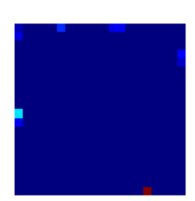
non-negative solution
Notes:
The non-negative solution is zero, except at a few points on the surface of the massive object.

Slide 67
All solutions fit the data well
(C)
(B)
gravity force, d_{i}
(D)
distance, y_{i}
(x_{i},y_{i})
(E)
(A)
R_{ij}
θ_{ij}
(F)
(x_{j},y_{j})

Slide 68
more complicated case minimize ||m||₂ subject to Hm≥h
Notes:
We describe the transformation of this problem into the previous problem.

Slide 69
this problem is solved by transformation to the previous problem
Notes:
We wont do the derivation here, just state the result.

Slide 70


solve by non-negative least squares
then compute m_{i} as
with e’=d’-G’m’
Notes:
You set up a new matrix equation
solve it by nonnegative least squares
and then the error of the transformed problem is the solution to the original problem

Slide 71
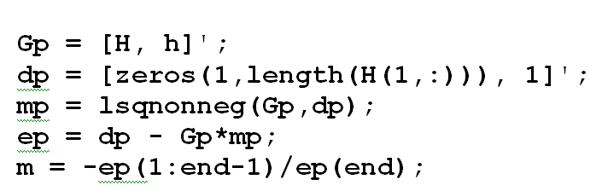
In MATLAB®
Notes:
Easy to set up.

Slide 72
In Python
Gp = np.concatenate((H,h),axis=1).T;
dp = gda_cvec( np.zeros((MH,1)), 1.0);
t1, t2 = opt.nnls(Gp,dp.ravel());
mp = gda_cvec(t1);
ep = dp - np.matmul(Gp,mp);
Ne,i = np.shape(ep);
m = -ep[0:Ne-1,0:1]/ep[Ne-1,0];
Notes:
Easy to set up.

Slide 73
(A) m₁-m₂≥0
m₂
(B) ½m₁-m₂≥1
m₂
(C) m₁≥0.2
m₂
(D) Intersection
m₂
infeasible
infeasible
infeasible
infeasible
m^{est}
feasible
feasible
feasible
feasible
m₁
m₁
m₁
m₁
Notes:
We illustrate the method.
There are 3 constraints, shown in the first three figures.
The union of the feasible areas is shown in the last figure.
The method gives the point (green circle) on the boundary of the
feasible area that is as close as possible to the origin,
that is, the point where ||m|| (the distance to the origin)
is minimized.
Example with three constraints.
Each constraint is shown separately.
Their union is shown at right.
The solution is the point in the feasible volume as close as possible to the origin.
Fig. 7.8. Exemplary solution of the problem of minimizing m^{T}m with N=3 inequality constraints Hm≥h. (A-c) Each constraint divides the (m₁,m₂. ) plane into two half-places, one feasible and the other infeasible. (D) The intersection of the three feasible half-planes is polygonal in shape. The solution m^{est} (green circle) is the point in feasible area that is closest to the origin. Note that two of the three constrains are satisfied in the equality sense. MatLab script gda07_07

Slide 74
yet more complicated case minimize ||d-Gm||₂ subject to Hm≥h
Notes:
This is a constrained least squares problem,
minimize the prediction error W
with a set of linear equality constraints.

Slide 75
this problem is solved by transformation to the previous problem
Notes:
We won’t do the derivation here, just state the result.

Slide 76
minimize ||m’|| subject to H’m’≥h’
where
and
Notes:
We will not derive the transformation here. Note that it requires the SVD of the data kernel G

Slide 77
In MATLAB®
[Up, Lp, Vp] = svd(G,0);
lambda = diag(Lp);
rlambda = 1./lambda;
Lpi = diag(rlambda);
% transformation 1
Hp = -H*Vp*Lpi;
hp = h + Hp*Up'*dobs;
% transformation 2
Gp = [Hp, hp]';
dp = [zeros(1,length(Hp(1,:))), 1]';
mpp = lsqnonneg(Gp,dp);
ep = dp - Gp*mpp;
mp = -ep(1:end-1)/ep(end);
% take mp back to m
mest = Vp*Lpi*(Up'*dobs-mp);
dpre = G*mest;
Notes:
Easy to do in MATLAB®.

Slide 78
In Python
Up, lam, VpT = la.svd(G,full_matrices=False);
lam = gda_cvec(lam);
Vp = VpT.T;
rlambda = np.reciprocal(lam);
Lpi = np.diag(rlambda.ravel());
# transformation 1
Hp = -np.matmul(H,np.matmul(Vp,Lpi));
NHp, MHp = np.shape(Hp);
hp = h + np.matmul(Hp,np.matmul(Up.T,dobs));
Notes:
As usual, Python is more verbose.

Slide 79
In Python, con’t
# transformation 2
Gp = np.concatenate( (Hp,hp), axis=1).T
dp = gda_cvec( np.zeros((MHp,1)), 1.0 );
t1, t2 = opt.nnls(Gp,dp.ravel());
mpp = gda_cvec(t1);
ep = dp - np.matmul(Gp,mpp);
Ne,i = np.shape(ep);
mp = -ep[0:Ne-1,0:1]/ep[Ne-1,0];
# take mp back to m
mest = np.matmul( Vp, np.matmul(Lpi, (np.matmul(Up.T,dobs)-mp)));
dpre = np.matmul(G,mest);
dpre = G*mest;
Notes:
As usual, Python is more verbose … but the steps are the same

Slide 80
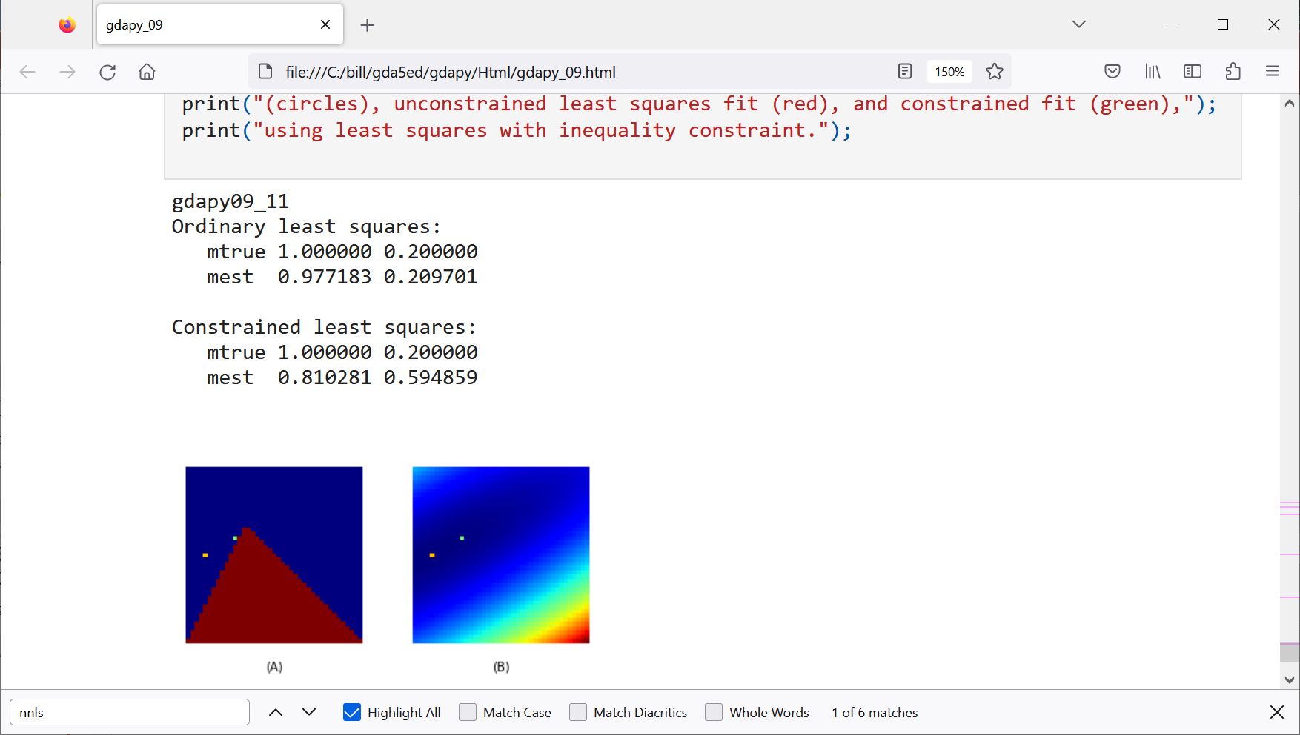
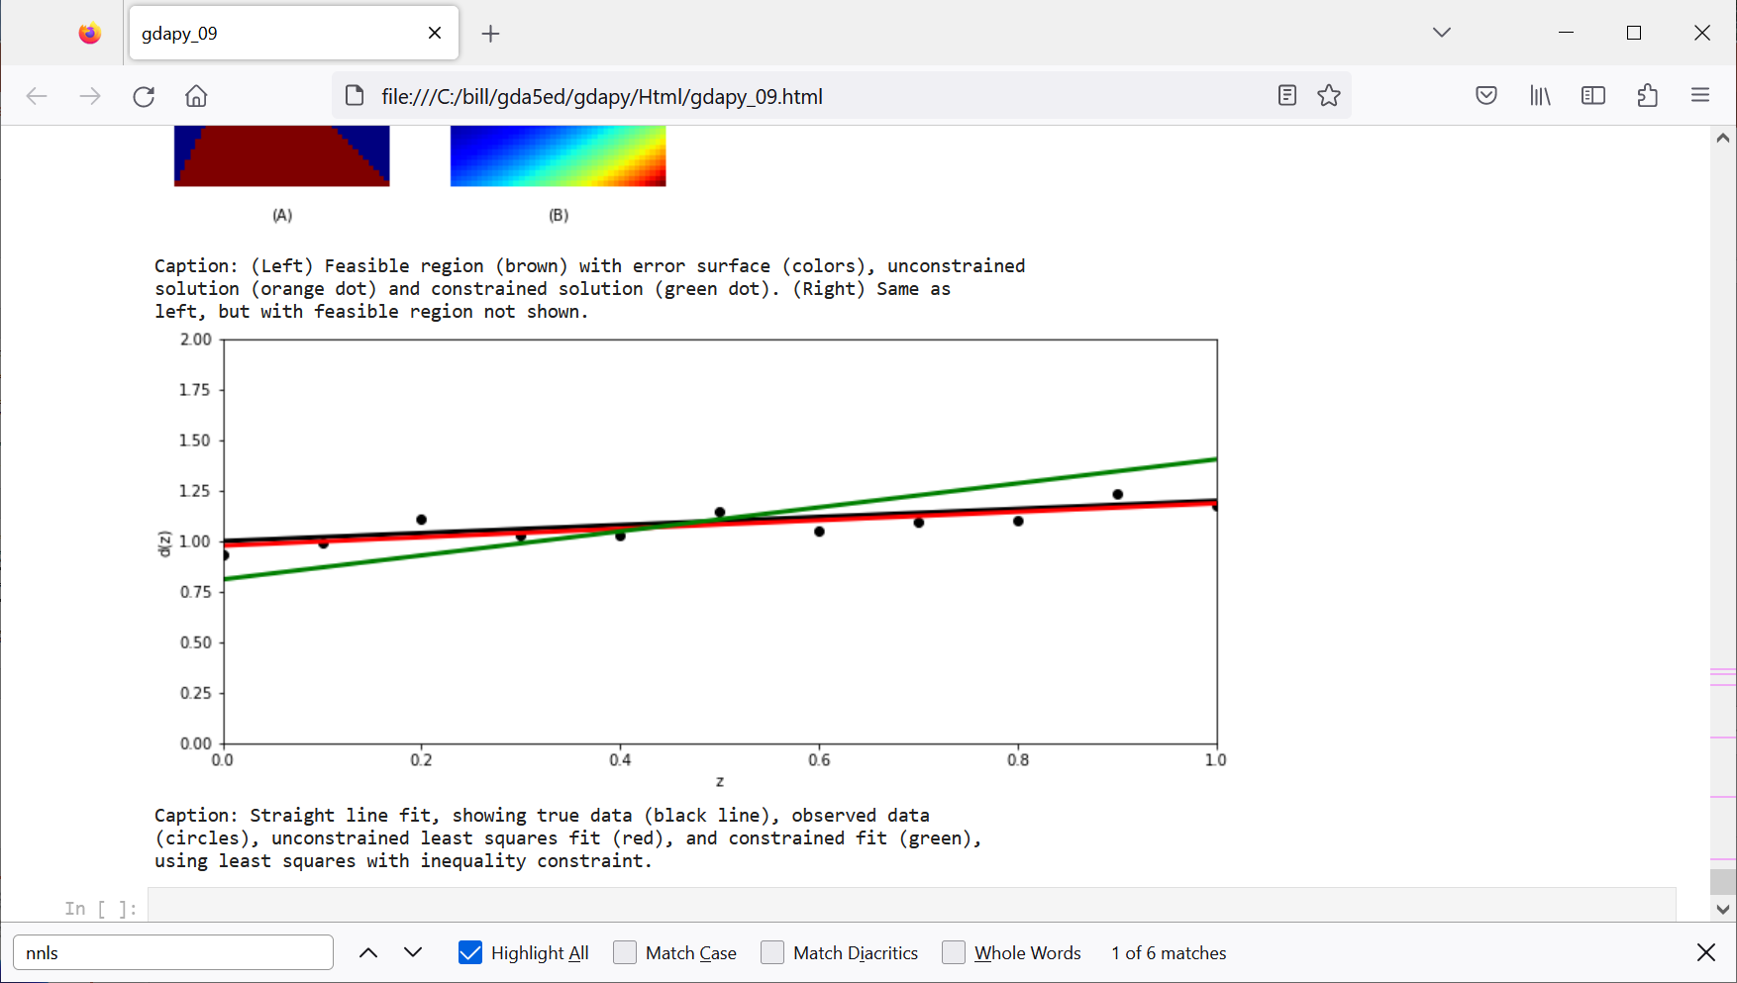


Straight line fit to data,
solution must be in feasible area
of (m₁,m₂) plane (brown)
$$m_{1}$$
$$m_{2}$$
unconstrained
constrained
true
Notes:
An example of a straight ;ine fit to data, where the solution is constrained to be in the feasible area (brown) of the (m1,m2) plane.

Slide 81




$$m_{1}$$
$$m_{1}$$
$$m_{2}$$
$$m_{2}$$
Notes:
Comparison of solutions, with error surface in colors and feasible are in brown.

