Slide 1
Lecture 17
Nonlinear Problems:
Markov Chain – Monte Carlo (MCMC)
Methods and Bootstrap Confidence Intervals
Notes:
MCMC methods are a way of solving an inverse problem.
Bootstraps are a general way of calculating confidence intervals that can be applied to many solution methods.

Slide 2
Syllabus
Lecture 01 Describing Inverse Problems
Lecture 02 Probability and Measurement Error, Part 1
Lecture 03 Probability and Measurement Error, Part 2
Lecture 04 The L₂ Norm and Simple Least Squares
Lecture 05 A Priori Information and Weighted Least Squared
Lecture 06 Resolution and Generalized Inverses
Lecture 07 Backus-Gilbert Inverse and the Trade Off of Resolution and Variance
Lecture 08 The Principle of Maximum Likelihood
Lecture 09 Inexact Theories
Lecture 10 Prior Covariance and Gaussian Process Regression
Lecture 11 Non-uniqueness and Localized Averages
Lecture 12 Vector Spaces and Singular Value Decomposition
Lecture 13 Equality and Inequality Constraints
Lecture 14 L₁ , L∞ Norm Problems and Linear Programming
Lecture 15 Nonlinear Problems: Grid and Monte Carlo Searches
Lecture 16 Nonlinear Problems: Newton’s Method
Lecture 17 Nonlinear Problems: MCMC and Bootstrap Confidence Intervals
Lecture 18 Factor Analysis
Lecture 19 Varimax Factors, Empirical Orthogonal Functions
Lecture 20 Backus-Gilbert Theory for Continuous Problems; Radon’s Problem
Lecture 21 Linear Operators and Their Adjoints
Lecture 22 Fréchet Derivatives
Lecture 23 Estimating a Parameter in a Differential Equation
Lecture 24 Exemplary Inverse Problems, incl. Filter Design
Lecture 25 Exemplary Inverse Problems, incl. Earthquake Location
Lecture 26 Exemplary Inverse Problems, incl. Vibrational Problems

Slide 3
Purpose of the Lecture
Introduce
Markov Chain – Monte Carlo Methods
and the
Bootstrap Method for
Computing Confidence Intervals
Notes:
These two topics share the common theme of exploiting randomness to learn something about the solution of an inverse problem.

Slide 4
Part 1
Markov Chain – Monte Carlo Methods
Notes:
A Markov chain is a sequence of quantities x1, x2, x3, ... that are calculated in sequence,
and where the process of calculating xi depends only on the value of the immediate prdiceor, xi-1.
The idea will be to create a chain of solutions m1, m2, m3 … that sample the pdf p(m).

Slide 5
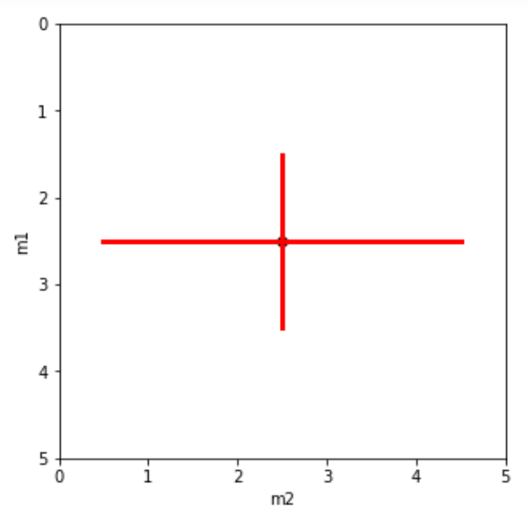
Estimate and 95% confidence
as the solution of an inverse problem
Notes:
Many different quantities can be viewed as the solution to an inverse problem.
The simplest is an estimate and its 95% confidence intervals

Slide 6
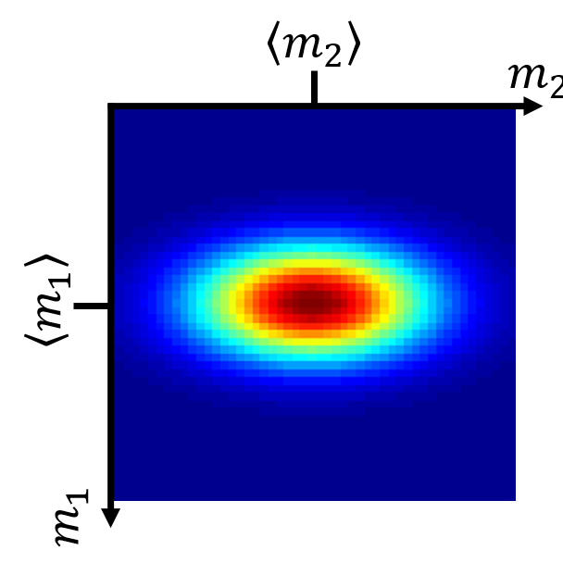
Pdf as the solution of
an inverse problem
Notes:
The pdf for the model parameters p(m) can be viewed as solution.
In some sense, it provides all possible information about the solution.

Slide 7
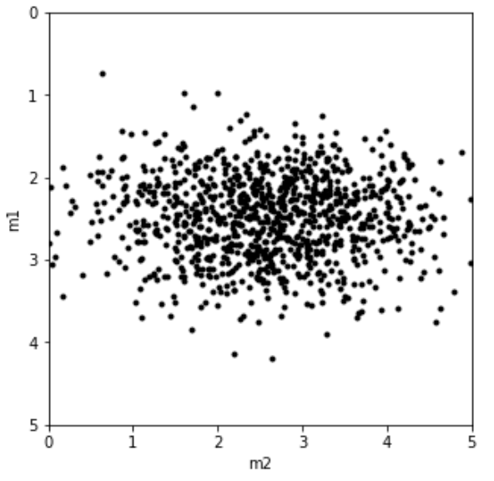
Ensemble sampled from the pdf
as the solution of an inverse problem
1000 members
Notes:
The eneble of exemplary solutions drawn from the pdf also can be viewed as the solution.
If there are enough members, one could create an empirical histogram that reconstructs p(m).
The MCMC method creates such an ensemble solution.

Slide 8
Ensemble Solution
Advantages
Disadvantages
queries like
“What percent of ensemble
has a given property?”
easy to answer
might need to very large
any others?
any others?
Notes:
Might be useful for class discussion.

Slide 9
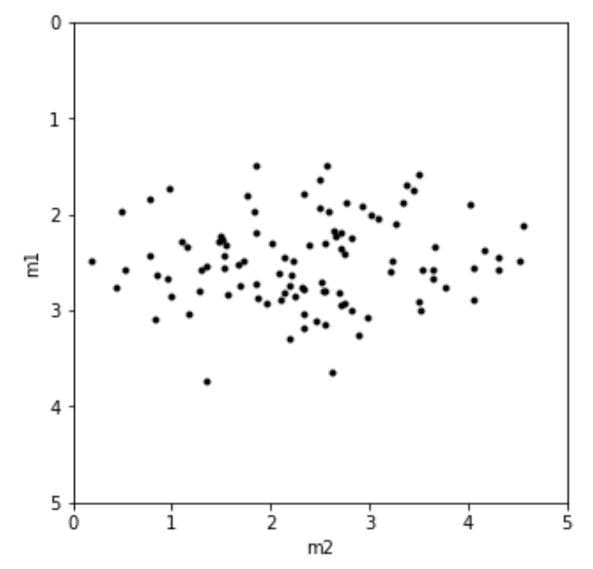
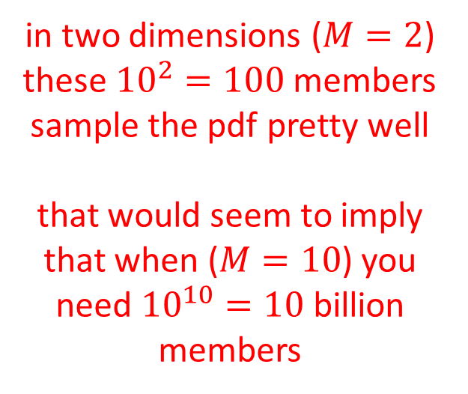
Ensemble Solution
Advantages
Disadvantages
queries like
“What percent of ensemble
has a given property?”
easy to answer
might need to very large
in two dimensions ($M=2$) these ${10}^{2}=100$ members sample the pdf pretty well
that would seem to imply that when ($M=10$) you need ${10}^{10}=10$ billion members
Notes:
Irrespective of the details, it is clear that an inverse problem of any complexity is going to require (at least) millions of members.
I the book, I routinely calculate a million.

Slide 10
The Markov Chain
Monte Carlo method samples a pdf to produce a ensemble
Notes:
Here begins a description of the method.
I don’t develop the theory behind the method here, but its in the book.

Slide 11

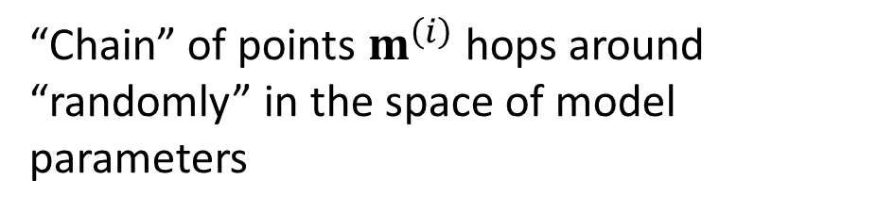
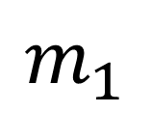






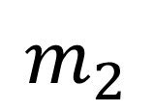

“Chain” of points $m^{\left(i\right)}$ hops around “randomly” in the space of model parameters
$$m^{\left(8\right)}$$
$$m^{\left(5\right)}$$
$$m^{\left(6\right)}$$
$$m^{\left(2\right)}$$
$$m^{\left(7\right)}$$
$$m_{2}$$
$$m^{\left(3\right)}$$
$$m^{\left(1\right)}$$
$$m^{\left(4\right)}$$
$$m_{1}$$
Notes:
Here a chain of “solutions” randomly sampling the space of model parameters.

Slide 12








The trick is designing the hopping algorithm so the chain stays mostly
in regions of high probability
$$m^{\left(6\right)}$$
$$m^{\left(8\right)}$$
$$m^{\left(7\right)}$$
$$m^{\left(5\right)}$$
$$m^{\left(3\right)}$$
$$m^{\left(2\right)}$$
$$m^{\left(4\right)}$$
$$m_{2}$$
$$m^{\left(1\right)}$$
$$m_{1}$$
Notes:
The MCMC method is a way of creating the chain so that it mostly hops around in the parts of the space
of model parameters in which a specific pdf, p(m) has high probability.

Slide 13
Metropolis-Hastings Algorithm hopping algorithm that samples a pdf
Issues
What pdf should be sampled
to produce a “solution” to an inverse problem?
What pdf best represents small
random moves in the space of model parameters?
Notes:
There are two important pdf’s in the MCMC method. The pdf p(m) that represents the solution to the inverse problem,
and a pdf q(m) that defines the hopping process.

Slide 14
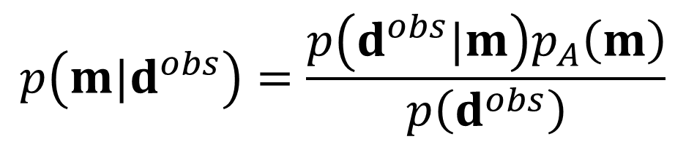
What pdf should be sampled
to produce a “solution” to an inverse problem?
The same one as in Chapter 6. According to Bayes theorem:
$$p\left(m|d^{obs}\right)=\frac{p\left(d^{obs}|m\right)p_{A}\left(m\right)}{p\left(d^{obs}\right)}$$
Notes:
The pdf that defines the inverse problem is the same one investigated in Chapter 6.

Slide 15
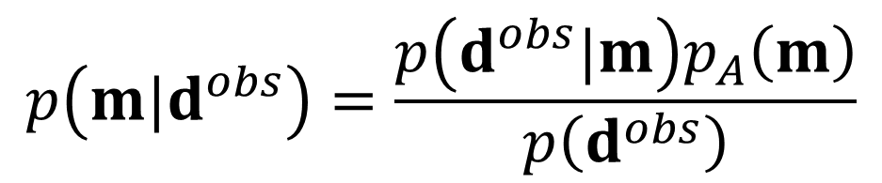
What pdf should be sampled
to produce a “solution” to an inverse problem
Bayes theorem:
likelihood
prior
posterior
$$p\left(m|d^{obs}\right)=\frac{p\left(d^{obs}|m\right)p_{A}\left(m\right)}{p\left(d^{obs}\right)}$$
will turn out this one not needed
Notes:
It’s usually called the “posterior”.
It is built up by the “likelihood” (which defines the relationship between data and model parameters),
and the “prior: (which defines the prior information).
The term in the denominator cancel in MCMC problems, and is not discussed here.

Slide 16
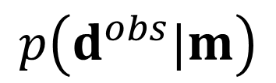
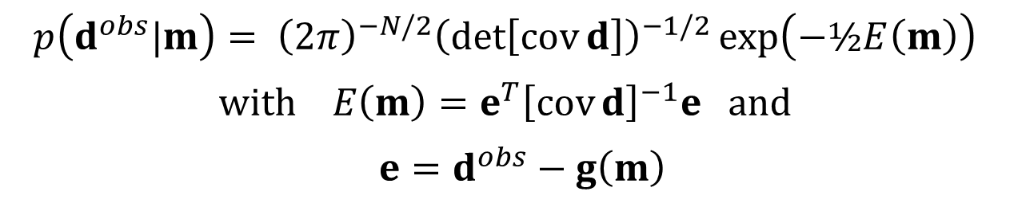
Likelihood pdf
$$p\left(d^{obs}|m\right)$$
example: Normal pdf with a non-linear theory
$$p\left(d^{obs}|m\right)= {\left(2π\right)}^{−N/2}{\left(\det\left[\operatorname{cov}{d}\right]\right)}^{−1/2}\exp\left(−½E\left(m\right)\right)$$
$$with E\left(m\right)=e^{T}{\left[\operatorname{cov}{d}\right]}^{−1}e and$$
$$e=d^{obs}−g\left(m\right)$$
Notes:
The likelihood needs to be based on the prediction error, here shown as e=dobs-g(m), where g(m) is a nonlinear theory.
The Normal pdf is used here, but other pdf’s could be used to represent measurement error that behaves differently.

Slide 17

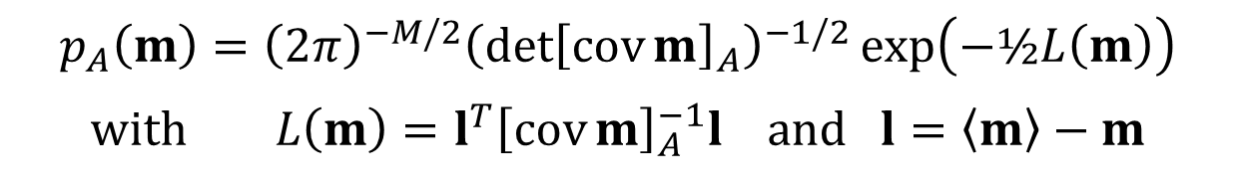
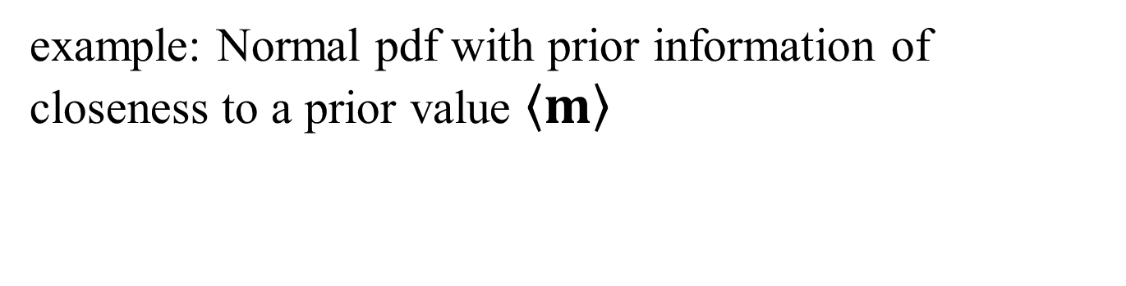
Prior pdf
$$p_{A}\left(m\right)$$
example: Normal pdf with prior information of closeness to a prior value $〈m〉$
$$p_{A}\left(m\right)={\left(2π\right)}^{−M/2}{\left(\det{{\left[\operatorname{cov}{m}\right]}_{A}}\right)}^{−1/2}\exp\left(−½L\left(m\right)\right)$$
$$with L\left(m\right)=l^{T}{\left[\operatorname{cov}{m}\right]}_{A}^{−1}l and l=〈m〉−m$$
Notes:
The likelihood needs to be based on some measure of how the solution m meets the prior information.
In this case, we use the simple case of distance from some prior vaue <m>.
Once again, we use a Normal pdf, but we could have used some other pdf if we thought it better represented the prior information.
T

Slide 18
What pdf best represents small
random moves in the space of model parameters?
q(m*|m^{(i)})
Probability of jumping to m* when current position is m^{(i)}
Notes:
The neighborhood pdf represents the probability of jumping to a proposed new position m*, given the current position m.

Slide 19
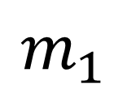
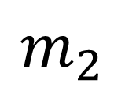
Jump from m^{(i)} to m*
m*
$$m_{2}$$
m^{(i)}
q(m*|m^{(i)})
$$m_{1}$$
Notes:
A new proposed solution is created that is in the neighborhood of m^{(p)},
where the sense of neighborhood is defined by a conditional p.d.f.
p(m*|m^{(p)}). In practice, we will use a Gaussian distribution centered
on the current solution. The variance of the p.d.f. defines the size of
the neighborhood.

Slide 20
symmetrical jump helpful
(but not required)
m*
$$m_{2}$$
m^{(i)}
q(m^{(i)} |m*)=q(m*|m^{(i)})
$$m_{1}$$
Notes:
The mathematics of the MCMC method are simplified if the neighborhood pdf Is symmetric,
meaning that the probability of jumping from mi to m* is the same as the probability of jumping from m* to mi.

Slide 21
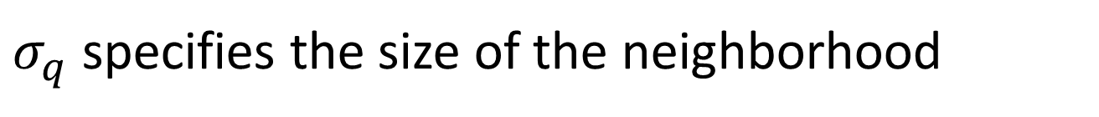
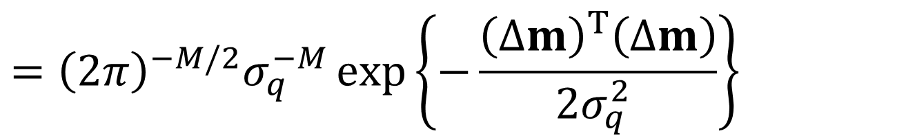
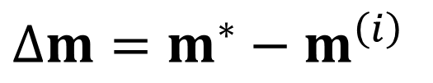
A Normal pdf is a reasonable choice
$$q\left(m^{∗}|m^{\left(i\right)}\right)=q\left(m^{\left(i\right)}|m^{∗}\right)$$
$$={\left(2π\right)}^{−M/2}σ_{q}^{−M}\exp\left\{−\frac{{\left(∆m\right)}^{T}\left(∆m\right)}{2σ_{q}^{2} }\right\}$$
$$∆m=m^{∗}−m^{\left(i\right)}$$
$σ_{q}$ specifies the size of the neighborhood
Notes:
This Normal pdf is symmetric in this sense.
Its variance specifies the size of the neighborhood.
In theory, MCMC will work for any (reasonable) choice of q,
meaning that an infinitely long chain will correctly sample p(m).
However, the choice of the pdf, and especially its variance, are of practical importance,
as the chains that we are working with are not infinite in length.
Too small a variance, and the chain will explore only a tiny part of the space of model parameters.
Too big, and it will jump away from a region of high probability with fully exploring it.

Slide 22
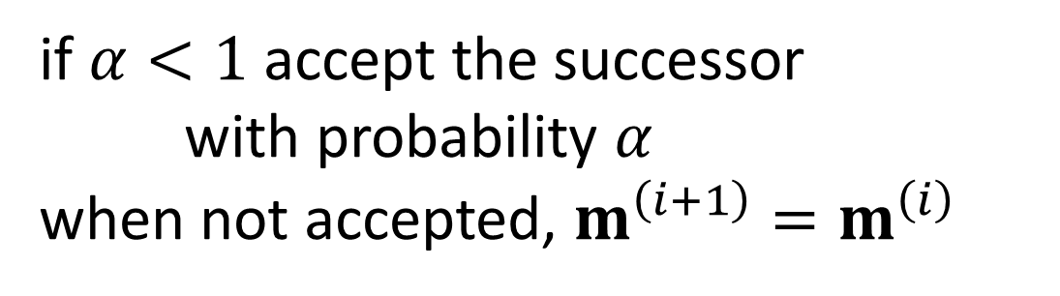

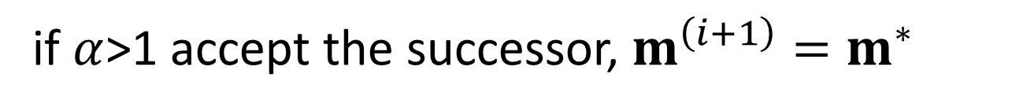
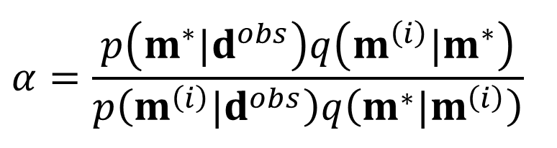


The Metropolis-Hastings algorithm
given $m^{\left(i\right)}$
create a proposed successor $m^{∗}$
by sampling $q\left(m^{∗}|m^{\left(i\right)}\right)$
compute the test parameter
$$α=\frac{p\left(m^{∗}|d^{obs}\right)q\left(m^{\left(i\right)}|m^{∗}\right)}{p\left(m^{\left(i\right)}|d^{obs}\right)q\left(m^{∗}|m^{\left(i\right)}\right)}$$
if $α$>1 accept the successor, $m^{\left(i+1\right)}=m^{∗}$
if $α<1$ accept the successor
with probability $α$
when not accepted, $m^{\left(i+1\right)}=m^{\left(i\right)}$
Notes:
Here’s and outline of the algorithm.

Slide 23
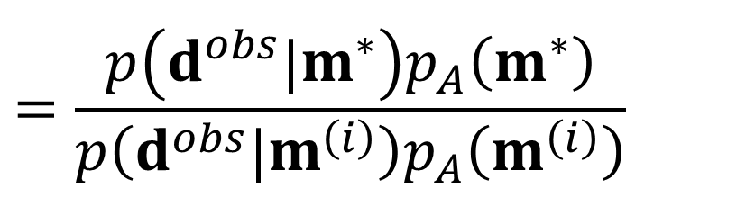
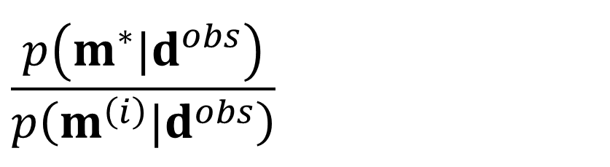
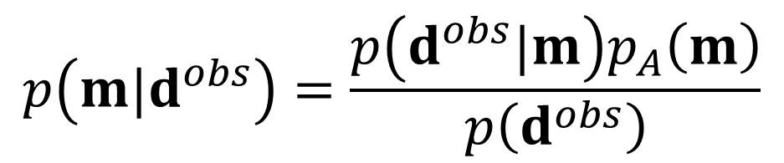
Note 1
Because
$$p\left(m|d^{obs}\right)=\frac{p\left(d^{obs}|m\right)p_{A}\left(m\right)}{p\left(d^{obs}\right)}$$
This simplification occurs
$$\frac{p\left(m^{∗}|d^{obs}\right)}{p\left(m^{\left(i\right)}|d^{obs}\right)}$$
This term cancels
$$=\frac{p\left(d^{obs}|m^{∗}\right)p_{A}\left(m^{∗}\right)}{p\left(d^{obs}|m^{\left(i\right)}\right)p_{A}\left(m^{\left(i\right)}\right)}$$
Notes:
Here’s why $p\left(d^{obs}\right)$ is not important. It cancels out of the test parameter alpha.

Slide 24
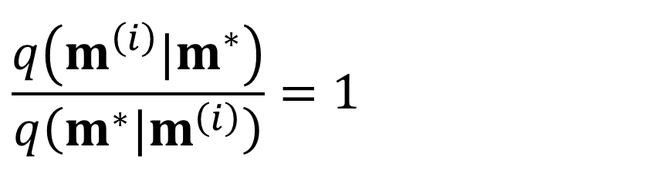
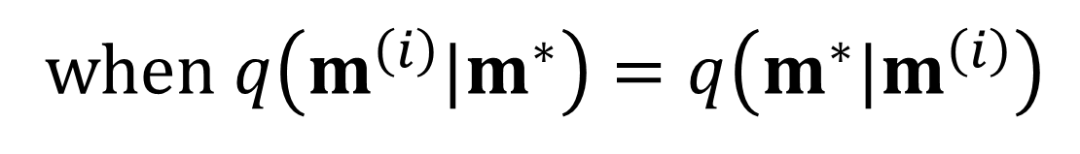
Note 2
when $q\left(m^{\left(i\right)}|m^{∗}\right)=q\left(m^{∗}|m^{\left(i\right)}\right)$
This simplification occurs
$$\frac{q\left(m^{\left(i\right)}|m^{∗}\right)}{q\left(m^{∗}|m^{\left(i\right)}\right)}=1$$
Notes:
Here’s why a symmetric q is useful. The ratio that appears in the test parameter alpha is unity.

Slide 25
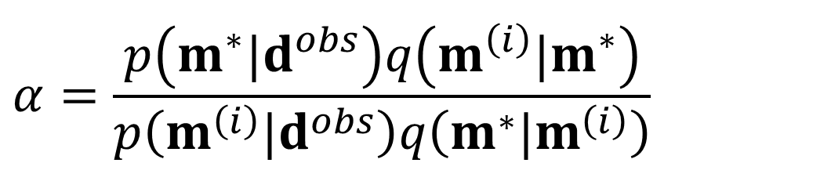
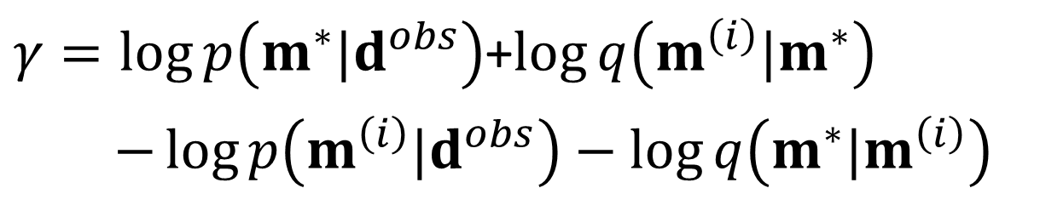

Note 3
In practice, it easier to work with $γ≡\log{α}$
$$α=\frac{p\left(m^{∗}|d^{obs}\right)q\left(m^{\left(i\right)}|m^{∗}\right)}{p\left(m^{\left(i\right)}|d^{obs}\right)q\left(m^{∗}|m^{\left(i\right)}\right)}$$
$γ=\log{p\left(m^{∗}|d^{obs}\right)}$+$\log{q\left(m^{\left(i\right)}|m^{∗}\right)}$
$$−\log{p\left(m^{\left(i\right)}|d^{obs}\right)}−\log{q\left(m^{∗}|m^{\left(i\right)}\right)}$$
Notes:
In practice, it’s better to do all the calculation with logarithms.
That’s expecially true ofNormal pqf’, because the log undoes the exponentiation,
that is log exp x = x.

Slide 26
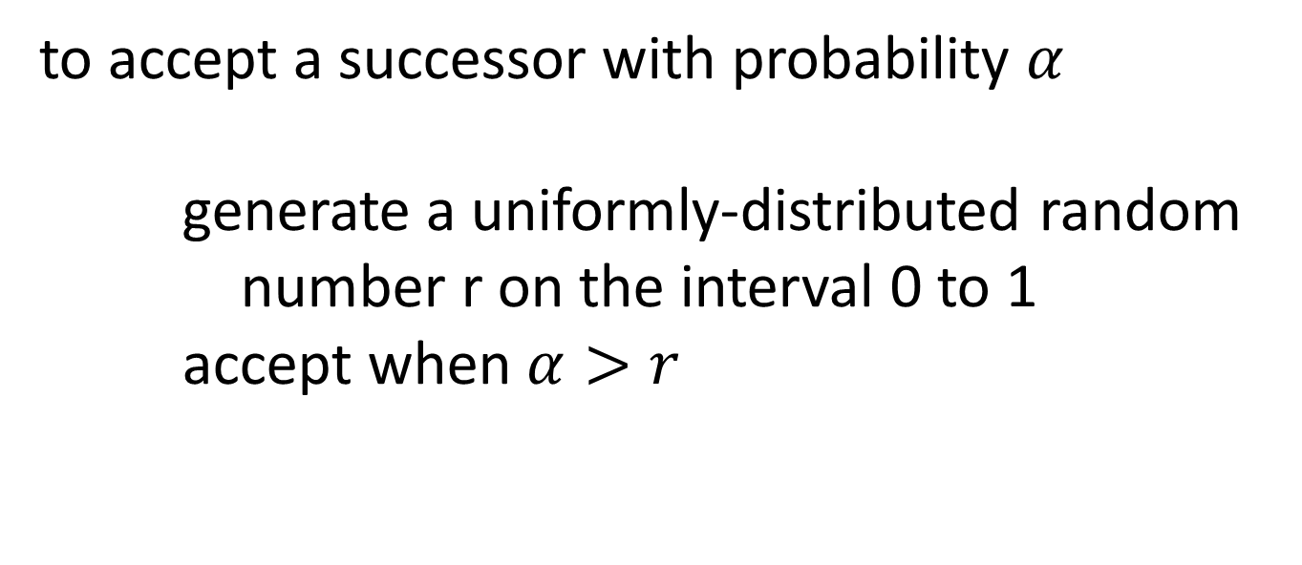
Note 4
to accept a successor with probability $α$
generate a uniformly-distributed random
number r on the interval 0 to 1
accept when $α>r$
Notes:
Accepting a proposed solution with probability alpha is easy to do,
by using a random number generator to generate a uniformly-distributed
number r in the interval 0-1.

Slide 27
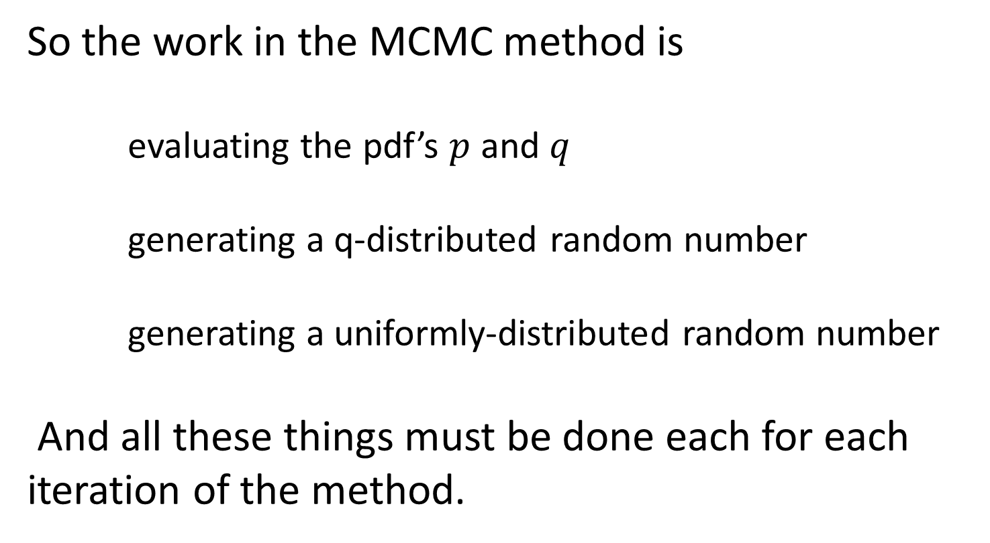
So the work in the MCMC method is
evaluating the pdf’s $p$ and $q$
generating a q-distributed random number
generating a uniformly-distributed random number
And all these things must be done each for each iteration of the method.
Notes:
Most of the work is usually in evaluating the likelihood $p\left(d^{obs}|m\right)$, because it depends on
the predicted data $d^{obs}=g\left(m\right)$, implying that one must solve the forward problem once per iteration.

Slide 28
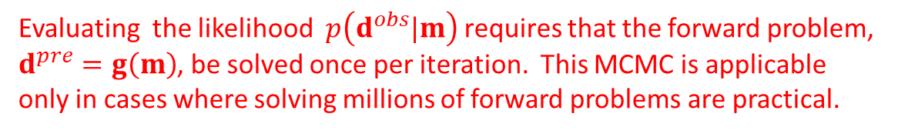
So the work in the MCMC method is
evaluating the pdf’s $p$ and $q$
generating a q-distributed random number
generating a uniformly-distributed random number
And all these things must be done each for each iteration of the method.
Evaluating the likelihood $p\left(d^{obs}|m\right)$ requires that the forward problem, $d^{pre}=g\left(m\right)$, be solved once per iteration. This MCMC is applicable only in cases where solving millions of forward problems are practical.
Notes:
Most of the work is usually in evaluating the likelihood $p\left(d^{obs}|m\right)$, because it depends on
the predicted data $d^{pre}=g\left(m\right)$, implying that one must solve the forward problem once per iteration.

Slide 29

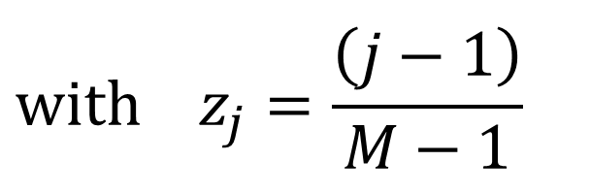
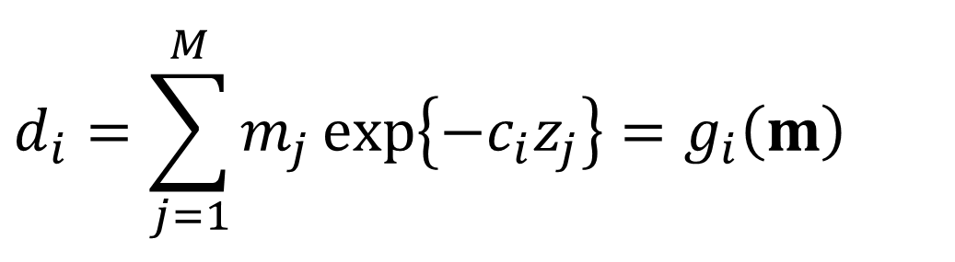
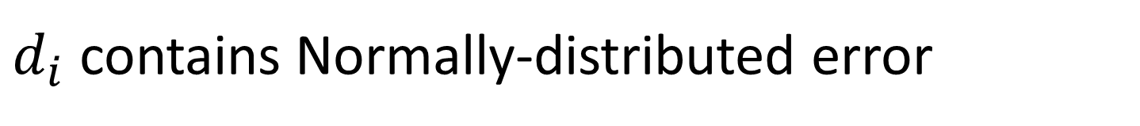
Example with a Laplace-transform-like theory
$$d_{i}=\sum_{j=1}^{M}{m_{j}}\exp\left\{−c_{i}z_{j}\right\}=g_{i}\left(m\right)$$
$$with z_{j}=\frac{\left(j−1\right)}{M−1}$$
True $m_{j}\left(z_{j}\right)$ a sine wave of amplitude 2
$$M=10$$
$d_{i}$ contains Normally-distributed error
Notes:
Here’s an example of MCMC applied to Laplace-transform-like problem.
This is a linear problem, and so an estimated solution could be obtained using least squares.
But as we will show, MCMC is still useful.

Slide 30
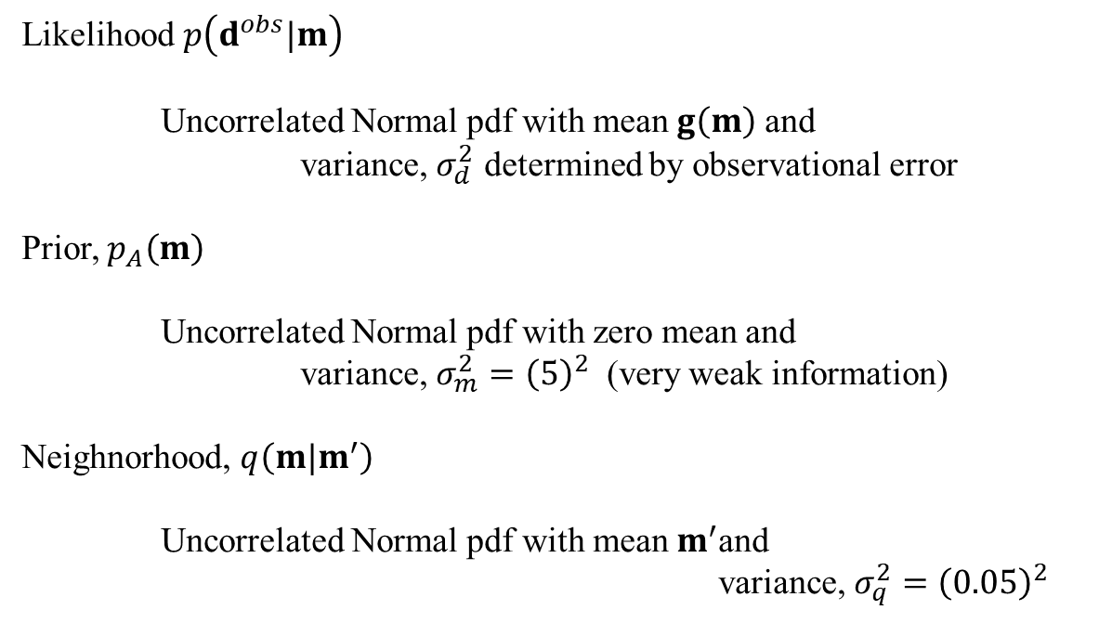
Example with a Laplace-transform-like theory
Likelihood $p\left(d^{obs}|m\right)$
Uncorrelated Normal pdf with mean $g\left(m\right)$ and
variance, $σ_{d}^{2}$ determined by observational error
Prior, $p_{A}\left(m\right)$
Uncorrelated Normal pdf with zero mean and
variance, $σ_{m}^{2}={\left(5\right)}^{2}$ (very weak information)
Neighnorhood, $q\left(m|m^{′}\right)$
Uncorrelated Normal pdf with mean $m^{′}$and
variance, $σ_{q}^{2}={\left(0.05\right)}^{2}$
Notes:
We need to defied upon three pdf’s.

Slide 31
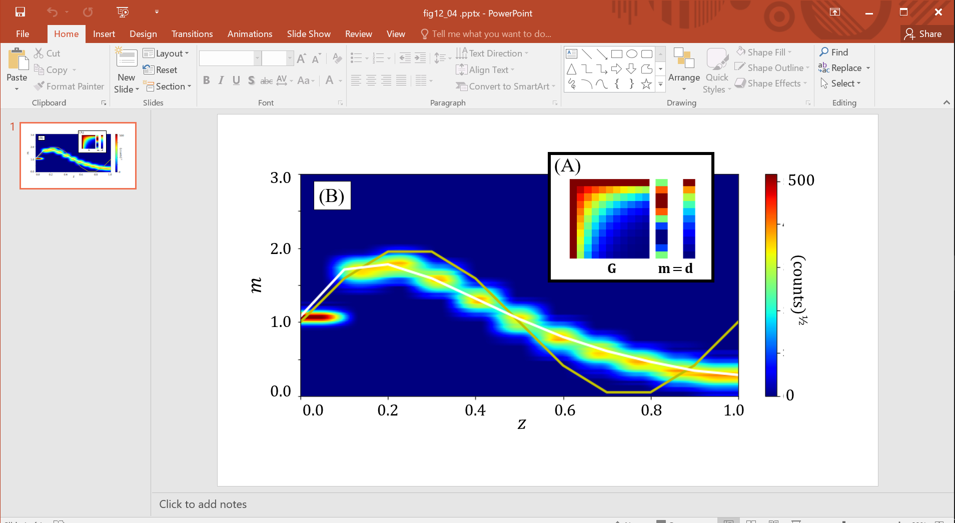

$$m_{3}$$
Notes:
The inset is the problem being solved, which has the form Gm=d.
The colors are a histogram of one million MCMC solutions.
The grey line is the true solution.
Note that at large z the histogram does not match the true solution.
That’s because the data are insensitive to the solution at large z,
and so the solutions are being controlled by the prior information,
which says that the solution is zero.

Slide 32

In what percentage of the ensemble is
have a peak at $m_{3}$ ?
$$m_{3}$$
Notes:
One use of the MCMC method is to answer questions by “scanning” the members of the ensemble.
Here, we look at each member and ask whether it has a peak at model parameter 3.

Slide 33
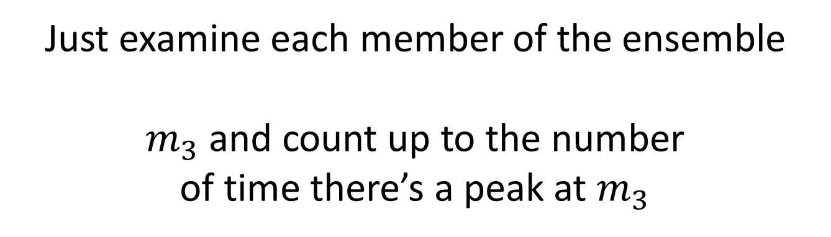
In what percentage of the ensemble is
have a peak at $m_{3}$ ?
Just examine each member of the ensemble
$m_{3}$ and count up to the number
of time there’s a peak at $m_{3}$
Notes:
We count up the ones that do, and compute percentage of solutions that have such a peak.

Slide 34
In what percentage of the ensemble is
have a peak at $m_{3}$ ?
63%
Notes:
Only 63% of solutions have such peak.
This calculation is very easy to perform from an ensemble.
Computing it from the posterior pdf (even though we have a formula for it)
is possible, but requires some nasty integration over the volume of
solution space for which m2<m3>m4.
.

Slide 35
Part 2
Bootstrap Method
Notes:
In this section we return to the matter of computing confidence intervals.

Slide 36
theory of confidence intervals
error is the data
result in
errors in the estimated model parameters
m(d)
p(d)
p(m)
d
m
d^{obs}
m^{est}
Notes:
The basic idea from probability theory is that
noise in the data propagates to uncertainty in the estimate of the model parameters.
Since an estimate of the model parameters is a function of the data,
and functions of random variables are themselves random variables.

Slide 37
theory of confidence intervals
error is the data
result in
errors in the estimated model parameters
m(d)
p(d)
2½%
2½%
p(m)
2½%
2½%
d
m
95% confidence
95% confidence
Notes:
If we could calculate the p.d.f. of the model parameters,
we could easily work out confidence intervals,
by defining the 2.5% tails of the p.d.f.

Slide 38
Gaussian linear theory d = Gm m = G^{-g}d standard error propagation
[cov m]=G^{-g} [cov d] G^{-gT} univariate Gaussian distribution has
95% of error within two σ of its mean
Notes:
We know how to do this for a linear Gaussian theory.
Because a linear function of a Gaussian-distributed random variable is another Gaussian-distributed random variable,
with covariance that can be calculated via a simple rule.
And we know that plus-minus two sigma encloses 95% of the probability,
for a Gaussian-distributed variable.

Slide 39
What to do with
Gaussian nonlinear theory?
One possibility linearize theory and use standard error propagation d = g(m) m-m^{(p)} ≈ G_{(p)} ^{–g} [d- g(m^{(p)}) ]
[cov m]≈G_{(p)}^{-g} [cov d] G_{(p)}^{-g}
Notes:
In the non-linear case,
we could make an estimate based on the linearized data kernel.

Slide 40
disadvantages unknown accuracy and need to compute gradient of theory G_{(p)}
G_{(p)} not computed when using some solution methods
Notes:
However, the linearization is not valid far from the peak of the distribution,
and its just that part – the tails – that are important to get right when dealing with confidence intervals.
Furthermore, we need the linearized data kernel. Thus may be tough to calculate, and would
not be available if we solved the problem by, say, a grid search.

Slide 41
alternative confidence intervals with repeat datasets
do the whole experiment many times
use results of each experiment to make compute m^{est}
create histograms from many m^{est}’s
derive empirical 95% confidence intervals
from histograms
Notes:
Hence an alternative method is needed.
If we had a big set of “repeat datasets”
we could approach the problem empirically.
Of course, usually we don’t have repeat experiments, but rather only one.

Slide 42
Bootstrap Method
create approximate repeat datasets
by randomly resampling (with duplications)
the one existing data set
Notes:
The bootstrap method creates approximate repeat datasets.
The key is “random resampling with duplications”
as described in the next few slides.

Slide 43
example of resampling
original data set
random integers in range 1-6
resampled data set
1 2 3 4 5 6
1.4 2.1 3.8 3.1 1.5 1.7
3 1 3 2 5 1
1 2 3 4 5 6
3.8 1.4 3.8 2.1 1.5 1.4
Notes:
Point out that this data set consists of a single column of data with 6 rows.
The resampled data set also has 6 rows.
Each row of the resampled data set matches an entry somewhere in the original dataset.
But the order is scrambled and there are repeats.

Slide 44
example of resampling
original data set
random integers in range 1-6
new data set
1 2 3 4 5 6
1.4 2.1 3.8 3.1 1.5 1.7
3 1 3 2 5 1
1 2 3 4 5 6
3.8 1.4 3.8 2.1 1.5 1.4
Notes:
(red) randomly choose a row of the original dataset
(blue) copy to the next available row of the resampled dataset

Slide 45
example of resampling
original data set
random integers in range 1-6
resampled data set
1 2 3 4 5 6
1.4 2.1 3.8 3.1 1.5 1.7
3 1 3 2 5 1
1 2 3 4 5 6
3.8 1.4 3.8 2.1 1.5 1.4
note repeats
Notes:
Point out the repeats.

Slide 46
MATLAB®
rowindex = unidrnd(N,N,1);
xresampled = x( rowindex );
dresampled = dobs( rowindex );
Python
rowindex = np.ransom.randint(low=0,
high=N,size=(N,) );
xresampled = x[rowindex,0:1];
dresampled = dobs[rowindex,0:1];
Notes:
Here’s the MatLab & Pythin code for resampling.
Pretty trivial.

Slide 47
interpretation of resampling
mixing
sampling
duplication
p(d)
p’(d)
Notes:
A graphical (and hand-waving) interpretation of resampling.
A probability density function, p(d), is represented by the large urn at the left and a few of realizations of this function are represented by the small goblet. The contents of the goblet are duplicated indefinitely many times, mixed together and poured into the large urn at the right, creating a new probability density function, p’(d). Under some circumstances, p’(d)≈p(d).

Slide 48
(A)
(B)
p(m₁)
m₁
(C)
m₁
p(m₂)
m₂
m₂
Notes:
An example, using the same nonlinear inverse problem we’ve used in previous problems.
each white dot is a solution of the inverse problem using a different repeat dataset
Note that they scatter about the region of low error of the original dataset.
Note also that there are a lot of white dots. The inverse problem has been solved numerous
times for numerous repeat datasets.
(B) and (C) Histograms for m1 and m2.
Note the empirical mean and 95% bounds (red ticks) calculated for each.
Fig. 9.15. Bootstrap confidence intervals for model parameters estimated using Newton’s Method for the same problem as in Figure 9.5. (A) Error surface (colors), showing true solution (green circle), estimated solution (green circle) and bootstrap solutions (white dots). (B) Empirically-derived probability density fnction p(m₁), with m₁^{est} (large red tick) and 95% confidence limits (small red ticks). (C) Same as (B), but for p(m₂). MatLab script gda09_17.

Slide 49
Process for computing empirical pdf
and confidence intervals
decide upon range and number of bins
compute histogram
empirical pdf is histogram normalized to unit area
empirical distribution is integral of pdf
left confidence is where distribution increases above 0.025
right confidence is where distribution increases above 0.975

Slide 50
compute histogram
h = hist( … )
h,e = np.histogram( … )
Notes:
MATLAB® and Pythinhistogram commands (not showing arguments)

Slide 51
Process for computing empirical pdf
and confidence intervals
empirical pdf is histogram normalized to unit area
p = h / (Dm*sum(h));
p = h / (Dm*np.sum(h));
Notes:
Definite intergal is approximated using sum()

Slide 52
Process for computing empirical pdf
and confidence intervals
empirical distribution is integral of pdf
p = Dm * cumsum(p);
p = Dm * np.cumsum(p);
Notes:
Indefinite intergal is approximated using cumsum()

