Slide 1
Lecture 18
Factor Analysis
Notes:
This lecture is teaches the basics of Factor Analysis.

Slide 2
Syllabus
Lecture 01 Describing Inverse Problems
Lecture 02 Probability and Measurement Error, Part 1
Lecture 03 Probability and Measurement Error, Part 2
Lecture 04 The L₂ Norm and Simple Least Squares
Lecture 05 A Priori Information and Weighted Least Squared
Lecture 06 Resolution and Generalized Inverses
Lecture 07 Backus-Gilbert Inverse and the Trade Off of Resolution and Variance
Lecture 08 The Principle of Maximum Likelihood
Lecture 09 Inexact Theories
Lecture 10 Prior Covariance and Gaussian Process Regression
Lecture 11 Non-uniqueness and Localized Averages
Lecture 12 Vector Spaces and Singular Value Decomposition
Lecture 13 Equality and Inequality Constraints
Lecture 14 L₁ , L∞ Norm Problems and Linear Programming
Lecture 15 Nonlinear Problems: Grid and Monte Carlo Searches
Lecture 16 Nonlinear Problems: Newton’s Method
Lecture 17 Nonlinear Problems: MCMC and Bootstrap Confidence Intervals
Lecture 18 Factor Analysis
Lecture 19 Varimax Factors, Empirical Orthogonal Functions
Lecture 20 Backus-Gilbert Theory for Continuous Problems; Radon’s Problem
Lecture 21 Linear Operators and Their Adjoints
Lecture 22 Fréchet Derivatives
Lecture 23 Estimating a Parameter in a Differential Equation
Lecture 24 Exemplary Inverse Problems, incl. Filter Design
Lecture 25 Exemplary Inverse Problems, incl. Earthquake Location
Lecture 26 Exemplary Inverse Problems, incl. Vibrational Problems

Slide 3
Purpose of the Lecture
Introduce Factor Analysis
Work through an example
Notes:
The first section introduces a new method for solving nonlinear problems is developed and applied.
The second introduces a new way to compute confidence intervals.

Slide 4
Part 1
Factor Analysis
Notes:
Factor analysis is very closely related to the idea of mixing of endmembers

Slide 5
source A
source B
ocean
sediment
s₁
s₂
s₃
s₄
Notes:
Material from sources A and B is eroded into the ocean and fix to form sediment. Samples, s_{i}, of the sediment are collected and their chemical composition is determined. The data are used to infer the composition of the sources.

Slide 6

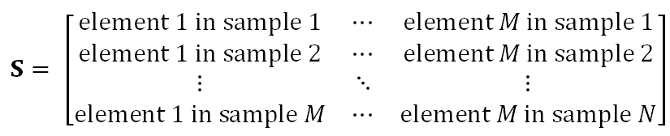
sample matrix S
S arranged row-wise
but we’ll use a column vector s^{(i)} for individual samples)
Notes:
In factor analysis, the data is organized as a “sample matrix”, with rows being “samples” or “observations”
and columns being the “elements” or “parameters” measured for each sample.

Slide 7
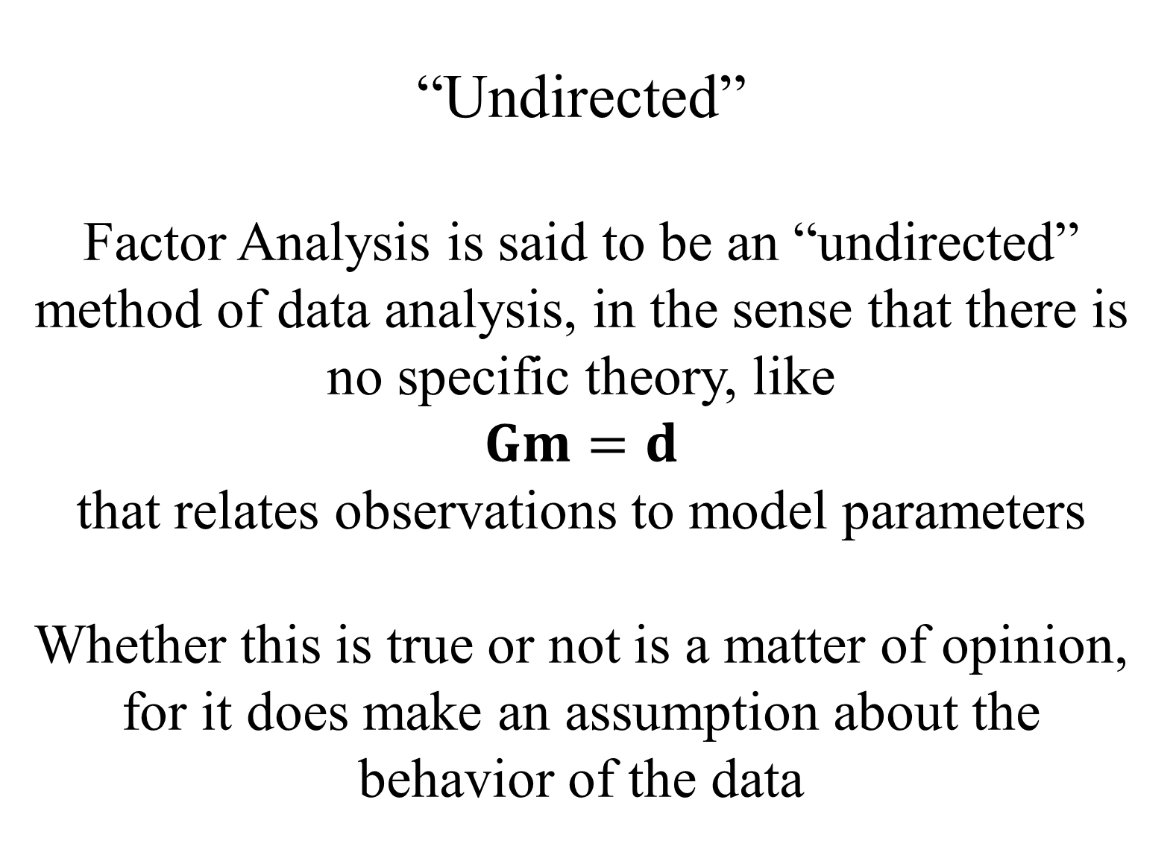
“Undirected”
Factor Analysis is said to be an “undirected” method of data analysis, in the sense that there is no specific theory, like
$$Gm=d$$ that relates observations to model parameters
Whether this is true or not is a matter of opinion, for it does make an assumption about the behavior of the data
Notes:
Some data analysis methods, including factor analysis, is said to be “undirected”,
meaning that they are not tied to a specific theory.

Slide 8
theory
samples are a linear mixture of sources
S = C F
Notes:
However, Factor Analysis does make a specific assumption about the structure of the data,
namely that the data are a mixture of endmembers, F, with the coefficients of the mixture
(called the “loadings”). It is undirected in the sense that there is no specific notion of what
the endmembers look like. The data themselves define them. Well, sort of.

Slide 9
theory
samples are a linear mixture of sources
S = C F
samples contain “elements”

Slide 10
theory
samples are a linear mixture of sources
S = C F
sources called “factors” factors contain “elements”

Slide 11
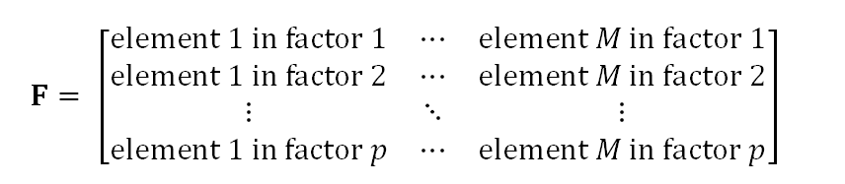
factor matrix F
F arranged row-wise
but we’ll use a column vector f^{(i)} for individual factors
Notes:
The factor matrix, F, has a structure similar to the sample matrix, with the columns being the elements.
Note that there are p factors, where the number p is initially unknown.
There is a bit of awkwardness associated with the way in which individual factors are indicated.
They are rows, of the sample matrix, but when dealing with just one of them, it makes more sense
to consider it a column-vector.
Hence the need to take a lot of transforms.

Slide 12
theory
samples are a linear mixture of sources
S = C F
coefficients
called “loadings”
Notes:
The loadings are the coefficients; how much of each factor is in a given sample.

Slide 13

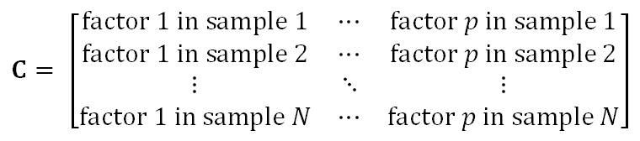
loading matrix C
Notes:
The loadings matrix is pxN.

Slide 14
inverse problem
given S
find C and F
so that S=CF
Notes:
Here is the factor analysis problem.

Slide 15
very non-unique
given T with inverse T⁻¹
if S=CF
then S=[C T⁻¹][TF] =C’F’
Notes:
However, it’s easy to show that the inverse problem is very non-unique.
Given a solution (C,F) that yields an S
any invertible matrix T can be used to create a different solution (C’,F’) that yields the same S.

Slide 16
very non-unique
so a priori information needed to select a solution
Notes:
That’s not a problem, but it does mean that prior information will be important.

Slide 17
simplicity
what is the minimum number of factors needed
call that number p
Notes:
Part of the factor analysis problem is determining the minimum number of endmembers (or factors) needed to
satisfy the data.

Slide 18
does S span the full space of M elements?
or just a p –dimensional subspace?
Notes:
The problem can be thought of in terms of spaces and sub-spaces.

Slide 19
A
s₁
s₁
s₃
s₄
E₃
B
E₂
E₁
Notes:
The composition of the samples, s_{i}, (black arrows) lies on a triangular sector of a plate bounded by the composition of the sources A and B (red arrows).

Slide 20

we know how to answer this question
p is the number of non-zero singular values

Slide 21
A
s₁
E₃
s₂
v₁
s₃
s₄
B
E₂
v₃
E₁
v₂
Notes:
Eigenvectors, v₁ and v₂ , lie in the plane of the samples (v₁ is closest to the mean sample). Eigenvector, v₃ , is normal to the plane.

Slide 22
SVD identifies a subspace
but the SVD factors
f^{(i)} = v^{(i)} i=1, p
not unique
usually not the “best”
Notes:
The word “best” here is in the sense of not embodying prior information.
They are as good as any other set of factors in the sense of reproducing the sample matrix.

Slide 23


factor f⁽¹⁾ v with the largest singular value
usually near the mean sample
sample mean <s>
minimize
eigenvector <v>
minimize
Notes:
As long as the sample vectors are reasonably close to one another (say in the same quadrant), the
first factor is close to the sample mean.

Slide 24
factor f⁽¹⁾ v with the largest singular value
usually near the mean sample
sample mean <s>
minimize
eigenvector <v>
minimize
about the same if samples are clustered

Slide 25
(A)
(B)
f⁽¹⁾
f⁽¹⁾
s₁
s₁
s₂
s₂
E₃
s₃
E₃
s₃
s₄
s₄
f⁽²⁾
f⁽²⁾
E₂
E₂
E₁
E₁
Notes:
Any two factors f⁽¹⁾ and f⁽¹⁾ (red arrows) that lie in the plane of the samples and that bound the range of sample compositions (black arrows) are acceptable, such as those shown in (A) and (B).

Slide 26
in MATLAB®
[U, LAMBDA, V] = svd(S,0);
lambda = diag(LAMBDA);
F = V';
C = U*LAMBDA;
in Python
U,lam,VT=la.svd(S,full_matrices=False);
F = VT;
C = np.matmul(U,np.diag(lam));
Notes:
Here’s the code for calculating the loading and factor matrices.
Note that we’re using the “economy” versions of svd();

Slide 27
since samples have measurement noise
probably no exactly singular values
just very small ones
so pick p
for which
S≈CF
is an adequate approximation

Slide 28
Reducing the number of factors
in MATLAB®
FP = F(1:P,:);
CP = C(:,1:P);
in Python
P=5;
FP = np.copy(F[0:P,0:M]);
CP = np.copy(C[0:N,0:P]);
Notes:
Here we create reduced versions of the loadings and the factors.
The matrix SP=CP*FP is now an approximation for S.

Slide 29
Atlantic Rock Dataset
SiO₂ TiO₂ Al₂O₃ FeO_{t} MgO CaO Na₂O K₂O
51.97 1.25 14.28 11.57 7.02 11.67 2.12 0.07
50.21 1.46 16.41 10.39 7.46 11.27 2.94 0.07
50.08 1.93 15.6 11.62 7.66 10.69 2.92 0.34
51.04 1.35 16.4 9.69 7.29 10.82 2.65 0.13
52.29 0.74 15.06 8.97 8.14 13.19 1.81 0.04
49.18 1.69 13.95 12.11 7.26 12.33 2 0.15
50.82 1.59 14.21 12.85 6.61 11.25 2.16 0.16
49.85 1.54 14.07 12.24 6.95 11.31 2.17 0.15
50.87 1.52 14.38 12.38 6.69 11.28 2.11 0.17
(several thousand more rows)
Notes:
Note that the overall size and the range variation of the elements vary significantly.

Slide 30
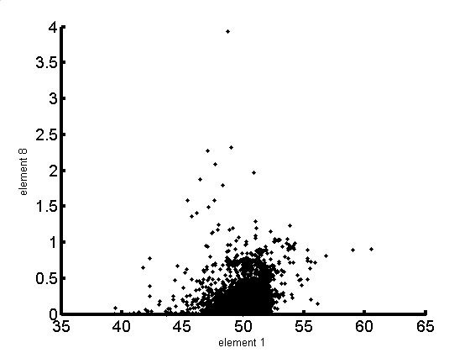
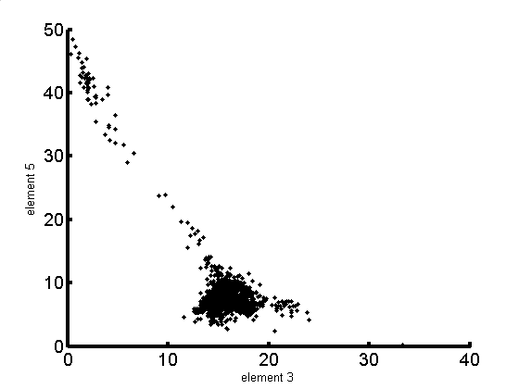
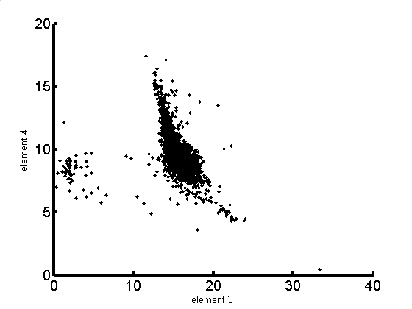
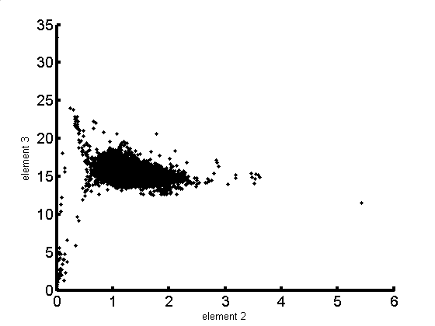
A)
B)
K₂0
Mg0
Si0₂
Al₂0₃
C)
D)
Fe0
Al₂0₃
Al₂0₃
Ti0₂
Notes:
Scatter plot of four combinations of chemical components of the Atlantic Ocean rock sample dataset.
They show some systematics, but look pretty different, too.

Slide 31
singular values, λ_{i}
index, i
Notes:
Fig. 10.5.. Singular values λ_{i} of the Atlantic Ocean rock dataset. Where would you pick p?

Slide 32
SiO₂
TiO₂
Al₂O₃
FeO_{total}
MgO
CaO
Na₂O
K₂O
f⁽²⁾
f⁽³⁾
f⁽⁴⁾
f⁽⁵⁾
Notes:
Factors, f⁽²⁾ through f⁽⁵⁾ , of the Atlantic Rock data set, as calculated by singular value decomposition.
We ignore f⁽¹, as it is just the mean.

Slide 33
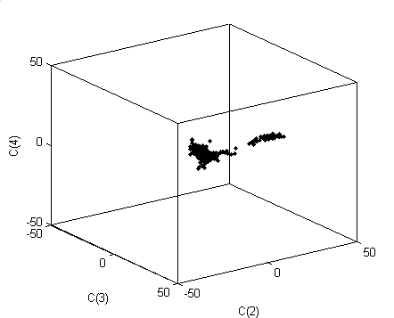
C₄
C₃
C₂
Notes:
Three dimensional perspective view of the coefficients, C_{i}, of factors 2, 3 and 4 in each of the rock samples (dots) of the Atlantic Ocean Rock dataset.
It is a fairly simple “L” shaped pattern.
Returning to the “undirected” issue, we have used factor analysis to identify a pattern in the data,
but the factor analysis does not explain the pattern. The next step (which requires detailed geochemical knowledge)
is to develop a theory than can explain it.

